Slide 1
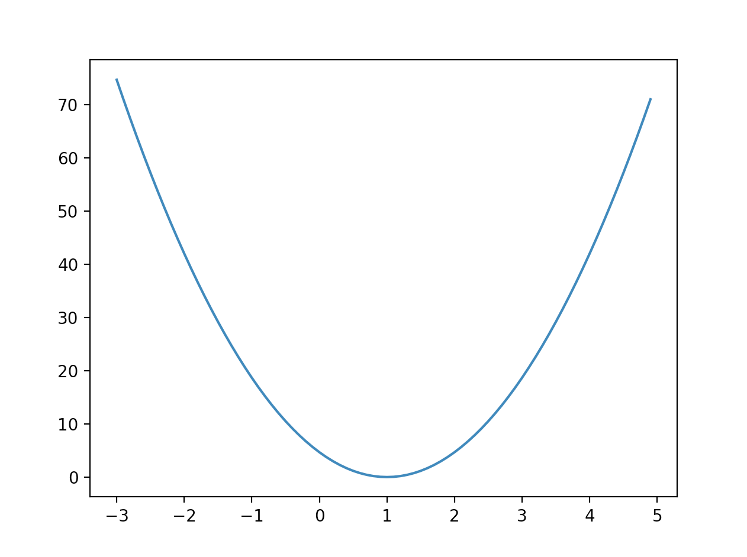



3 | 경사 하강법
cost (W)
# Minimize: Gradient Descent using derivative: W -= learning_rate * derivative
learning_rate = 0.1
gradient = tf.reduce_mean((W * X - Y) * X)
descent = W - learning_rate * gradient
update = W.assign(descent)
W

