Slide 1
Lin Zhou
MA615 Final Project:
Investment Portfolio analysis

Slide 2




Introduction:
In this project, I am going to introduce three portfolios about their monthly return, daily return plot, final return value. A shiny app adjusted buy the percentage of stocks amount which will show the return rate, value, and perform analysis.

Slide 3
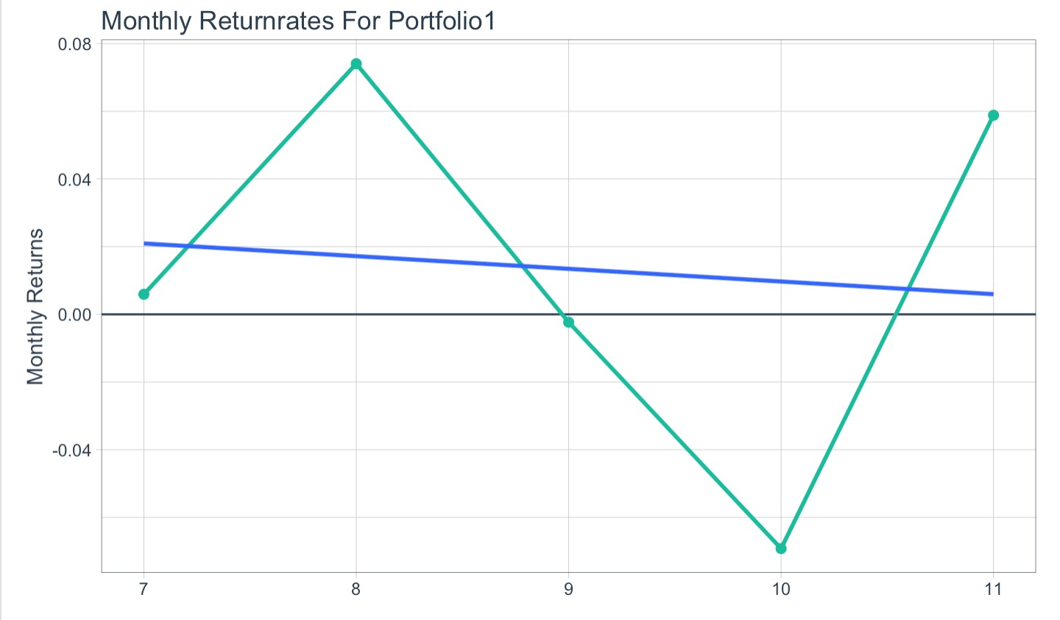
Portfolio one
Five stocks: "FB", "ATVI", "SHOP", "BYND", "NFLX” (20% each)
Calculate monthly return rate
Final value if have 250000 dollars in july1: 265575.278
Suggestion from: https://investorplace.com/2020/06/the-top-15-stocks-to-buy-in-2020/

Slide 4
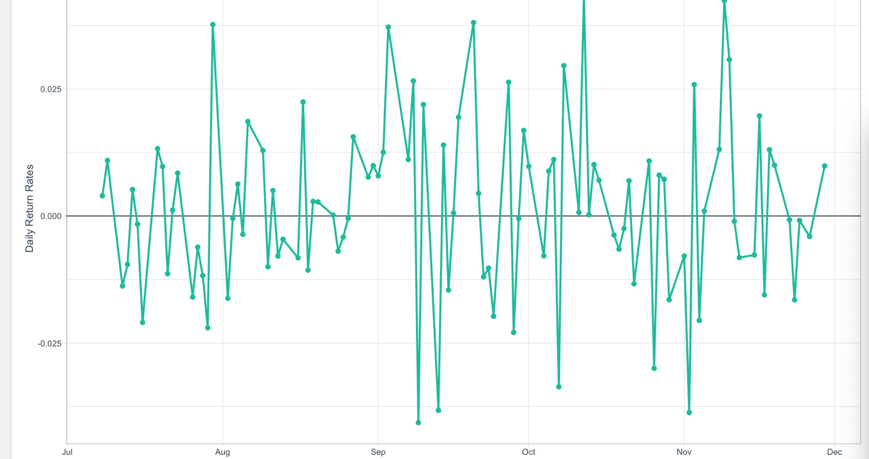
Portfolio Two
Plot of return rates for holding 50% Broadcom stocks
Two stocks: Broadcom, Alexion Pharmaceuticals
Final value if have 250000 dollars in july1: 296324.424
Making a shinyapp which shows the returns and return rates for different percentage
Suggestion from: https://www.fool.com/investing/2020/06/02/3-top-stocks-that-will-make-you-richer-in-june-and.aspx

Slide 5
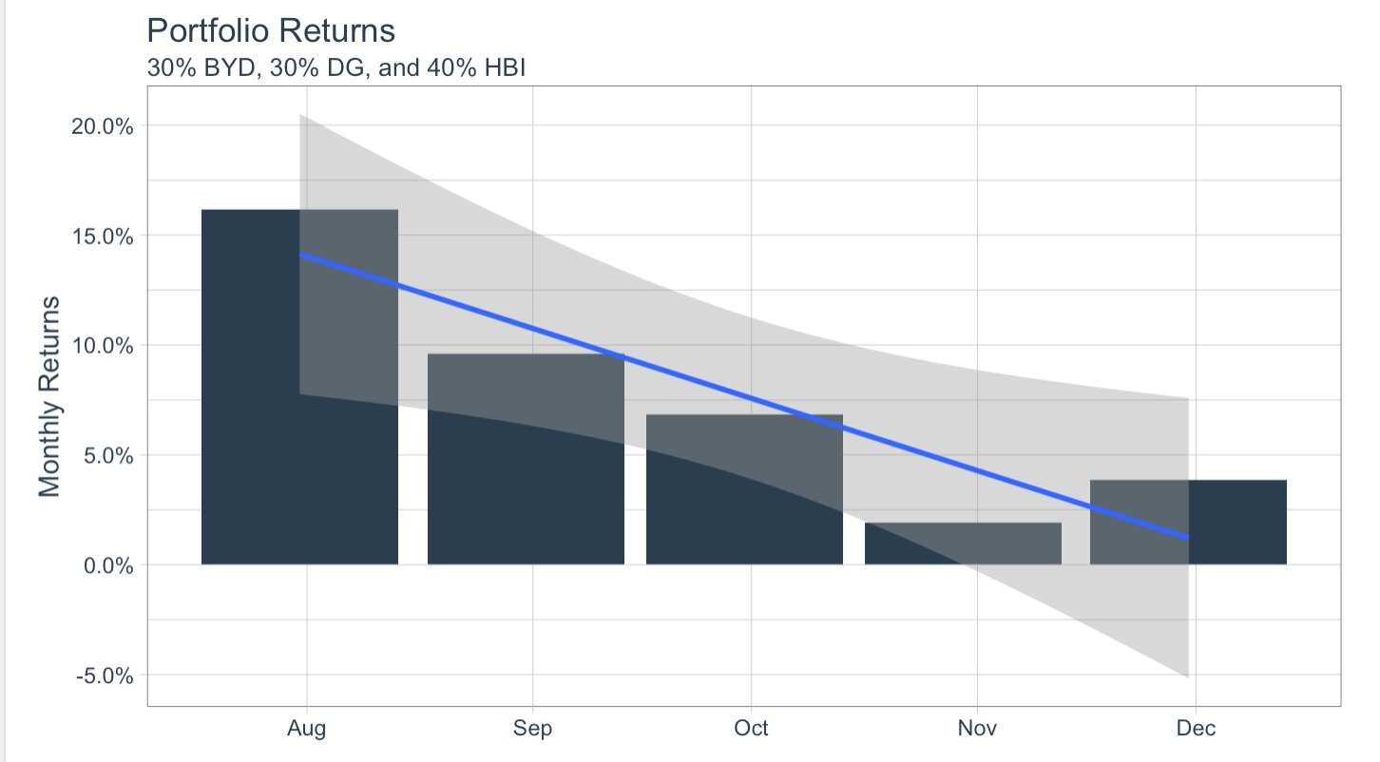
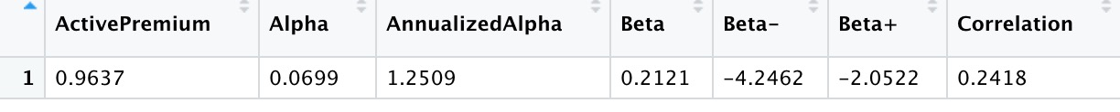
Portfolio Three
Portfolio monthly return plot
Three Stocks: Boyd Gaming, Dollar General, Hanesbrands (weight 30%, 30%, 40%)
Period: 2020/7/1 – 2020/12/1
Method: CAPM (Capital Asset Pricing Model)
Final value if have 250000 dollars in july1: 359956.2108
Perform analysis: Choose S&P 500 as baseline
Suggestions from: https://www.fool.com/investing/2020/06/10/3-top-us-stocks-to-buy-in-june.aspx
CAPM output table

