Slide 1






“Berries”EDA
Lin zhou

Slide 2
These data were collected from the USDA database selector: https://quickstats.nass.usda.gov
The data were stored online and then downloaded as a CSV file.
Data selected from the NASS database often has columns without any data or with a single repeated Values. The berries data had only 8 out of 21 columns containing meaningful data.
- Introduction of dataset

Slide 3
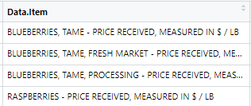
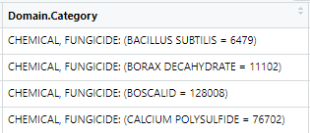
- EDA – Data cleaning
Firstly, we look through the data and check the distinct values of each column, filter those columns which only have unique value or have insignificant meanings.
Then we look through the columns which have distinct values to check whether the values are well split and in right places.
For example, the two columns above display the several values together, we need to separate them into multiple columns

Slide 4
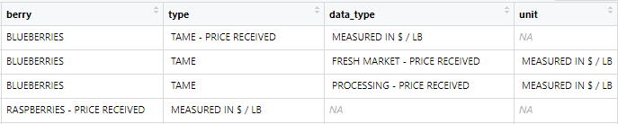
- EDA – Data cleaning
Using separate function to split the columns into several ones
For example, we separate “Data.Item” column into 4 independent columns “berry”, “type”, “data_type”, “unit” like following graph.
Same process would be done for other columns.

Slide 5
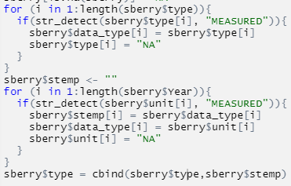
- EDA – Data cleaning
Then we want to look into the dataset of specific type berry.
For example, strawberries dataset.
We check the values under each column and find there are some values not in the right places. We use two for loops to adjust the values.

Slide 6
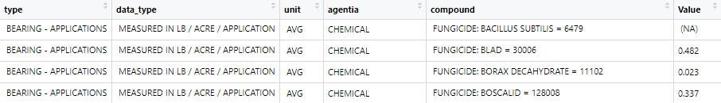
- EDA – Data cleaning
Finally, we look over the strawberry dataset again, select the meaning columns after splitting and adjusting columns.
Now the strawberry dataset used for analysis becomes tidy and easy-understand with 9 columns selected.

Slide 7
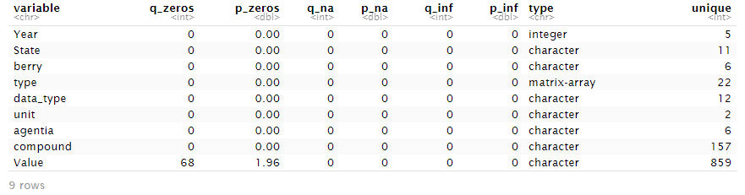
- EDA – Data visualization
Above all, we check the unique and type of data again.
We use the function df_status() to acquire the information about data type, zero-value, unlimit-value, and NA.

Slide 8
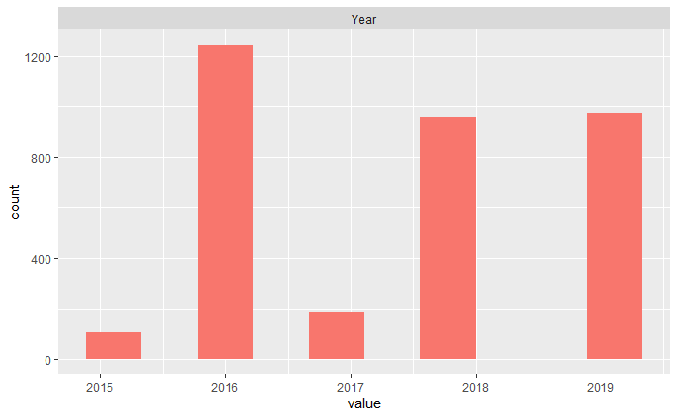
- EDA – Data visualization
Since most of the variables are categorical variables, we might want to calculate the counts of each value of variable under specific column. For example, the following graph shows the frequency of the years when the strawberry data was collected.

Slide 9
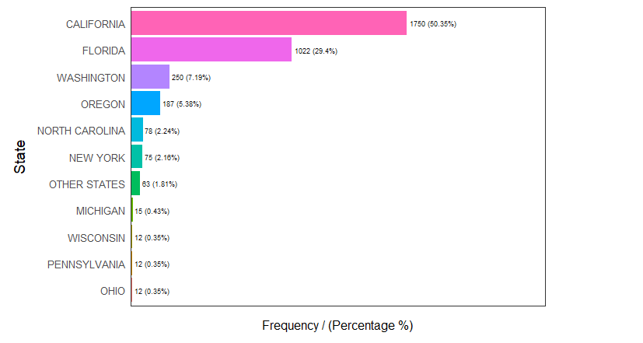
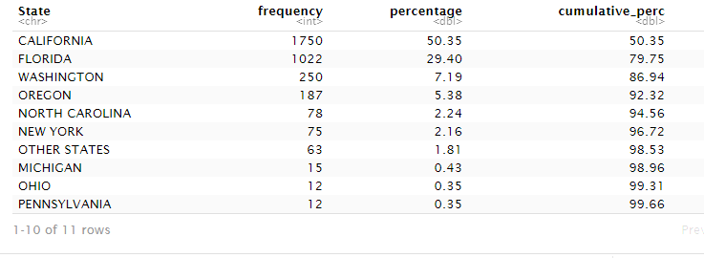
- EDA – Data visualization
To give a general description of the locations about strawberries, we use the freq() function which calculates each location by percentage and shows as following graph.

Slide 10
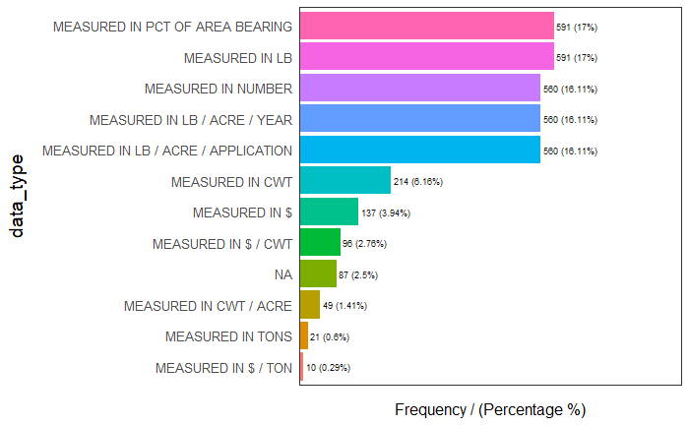
- EDA – Data visualization
Another important factor is the way of measurements. We use the same function above to get the general proportions of each measurement.

Slide 11

- EDA – Principal components analysis
Then I would like to move to principal components analysis part. This would lower the dimensions of model and change the mutilple index into comprehensive index, which makes the model easy to handle.

Slide 12
Reference
https://www.tidyverse.org/packages/
https://www.rdocumentation.org/packages/dplyr/versions/0.7.8
https://cran.r-project.org/web/packages/magrittr/vignettes/magrittr.html
https://cran.r-project.org/web/packages/funModeling/index.html
https://cran.r-project.org/web/packages/Hmisc/index.html

