Slide 1

Transferring ESL Data Across Platforms: Accurately Completing ILPs
Nabrittney Douglas
Notes:
Hello, I will be reviewing materials created to help learners transfer ESL date from the data management platform to a new platform known as TN-Pulse. The title of this training is Transferring ESL Data Across Platforms. It was designed to help teachers accurately complete ILPs for EL students.

Slide 2





Statement of Instructional Opportunity
Current Performance | Desired Performance
Missing or duplicated student records | Filter and identify all students
Exporting incomplete data | Export all student data
Incomplete ILPs | Complete all tiles of student ILPs
Failure to check accuracy after transfer | Verify the transfer of students and ILP completion using tracking spreadsheet
The Problem
ESL teachers are not consistently completing ILPs or transferring important data from an old data management platform to a new one.
Instructional opportunity: Create a training that properly explains how to identify EL students, transfer data, and complete ILPs accurately.
Notes:
State problem
Current performance
desired performance

Slide 3
Training Format & Logistics as Aligned with Learner Need
Learner Profile
9 ESL Teachers (all have ESL experience)
Prior experience using data management systems ELLevation and TN-Pulse
Prior Knowledge of ESL program requirements
Prefers self-paced training, job aid/handout, and other visual aids
Problems sorting and identifying students in ELLevation and navigating TN-Pulse to create ILPs.
Need Response
Asynchronous scenario-based training
3 self-paced modules
A step-by-step guide/handout
Video, transferring student data from one platform to another.
Notes:
Based on the information gained from my interview and survey, I learned...

Slide 4
Objectives
01 | 1a Given access to ELLevation, ESL teachers will learn how to filter and identify EL students on their caseload with 100% accuracy. 1b Teachers will demonstrate understanding of why accuracy is important.
02 | Given access to TN-Pulse, ESL teachers will add identified EL students from ELLevation to their caseload with 100% accuracy.
03 | ESL teachers will complete ILPs for all students on their caseload with 100% accuracy.
Notes:
There are three main objectives for this training.

Slide 5
Activities and Assessments
Objectives | Activity | Assessment
1a: Given access to ELLevation, ESL teachers will learn how to filter and identify EL students on their caseload with 100% accuracy 1b: Demonstrate understanding of why accuracy is important. | Scenario 1: A new ESL teacher doesn’t know how to find her students in the ELLevation platform to add them to her spreadsheet. How should she sort and identify her students? | Quiz Questions on filtering and identifying students Questions on the importance of accuracy
Given access to TN-Pulse, ESL teachers will add identified EL students from ELLevation to their caseload with 100% accuracy. | Scenario 2: An ESL teacher just received a new student. It has been months since she has used the TN-Pulse platform and she can’t remember how to add students to her caseload. Could you put the steps in the correct order for her? | Quiz: Learners will put the transfer steps in order
ESL teachers will complete ILPs for all students on their caseload with 100% accuracy. | The learner will engage in a drag and drop activity. They will have to put the steps to complete an ILP in order. | Learners will complete a quiz at the end of the training on how to complete various parts of an ILP. Sample questions: In which tile must student demographic information be placed? How do I create an initial parent notification letter? Which tiles must be completed for T1/T2 students?
Notes:
These are the activities that will help the learner reach the objectives stated, and the assessments to determine if the activities were successful in helping them gain information and meet the objectives.

Slide 6
Deep Dive: Objective 1
Notes:
We will take a closer look at objective 1

Slide 7
Objective 1
1a: Given access to ELLevation, ESL teachers will learn how to filter and identify EL students on their caseload with 100% accuracy
1b: Demonstrate understanding of why accuracy is important.
Notes:
These are the objectives for module one.

Slide 8
Instructional Strategy
Asynchronous scenario-based training
Video explaining the steps to identify students
Sequence activity
Training quiz
Job aid/handout
Notes:
For this objective I developed a few instructional strategies to help the learners reach the objective

Slide 9

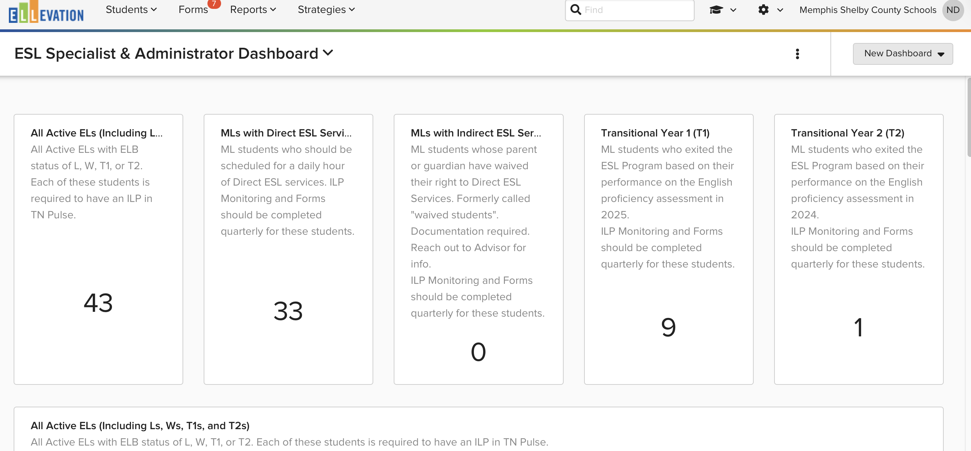
Training video
The learner will watch a video explaining how to identify students in ELLevation.
Notes:
Learners will engage in a video that will review the steps of how to sort and identify students in the ELLevation platform.

Slide 10
Module 1:Activity
The learner will engage in a scenario-based activity.
Scenario:
A new ESL teacher doesn’t know how to find her students in the ELLevation platform. How should she sort and identify her students?
Sorting activity- Put the steps in order.
Apply filter to narrow results
Log in to Ellevation
Go to the “students” tab
Verify student assignment
Notes:
This is an example of an activity that the learner will engage in related to the objective.

Slide 11
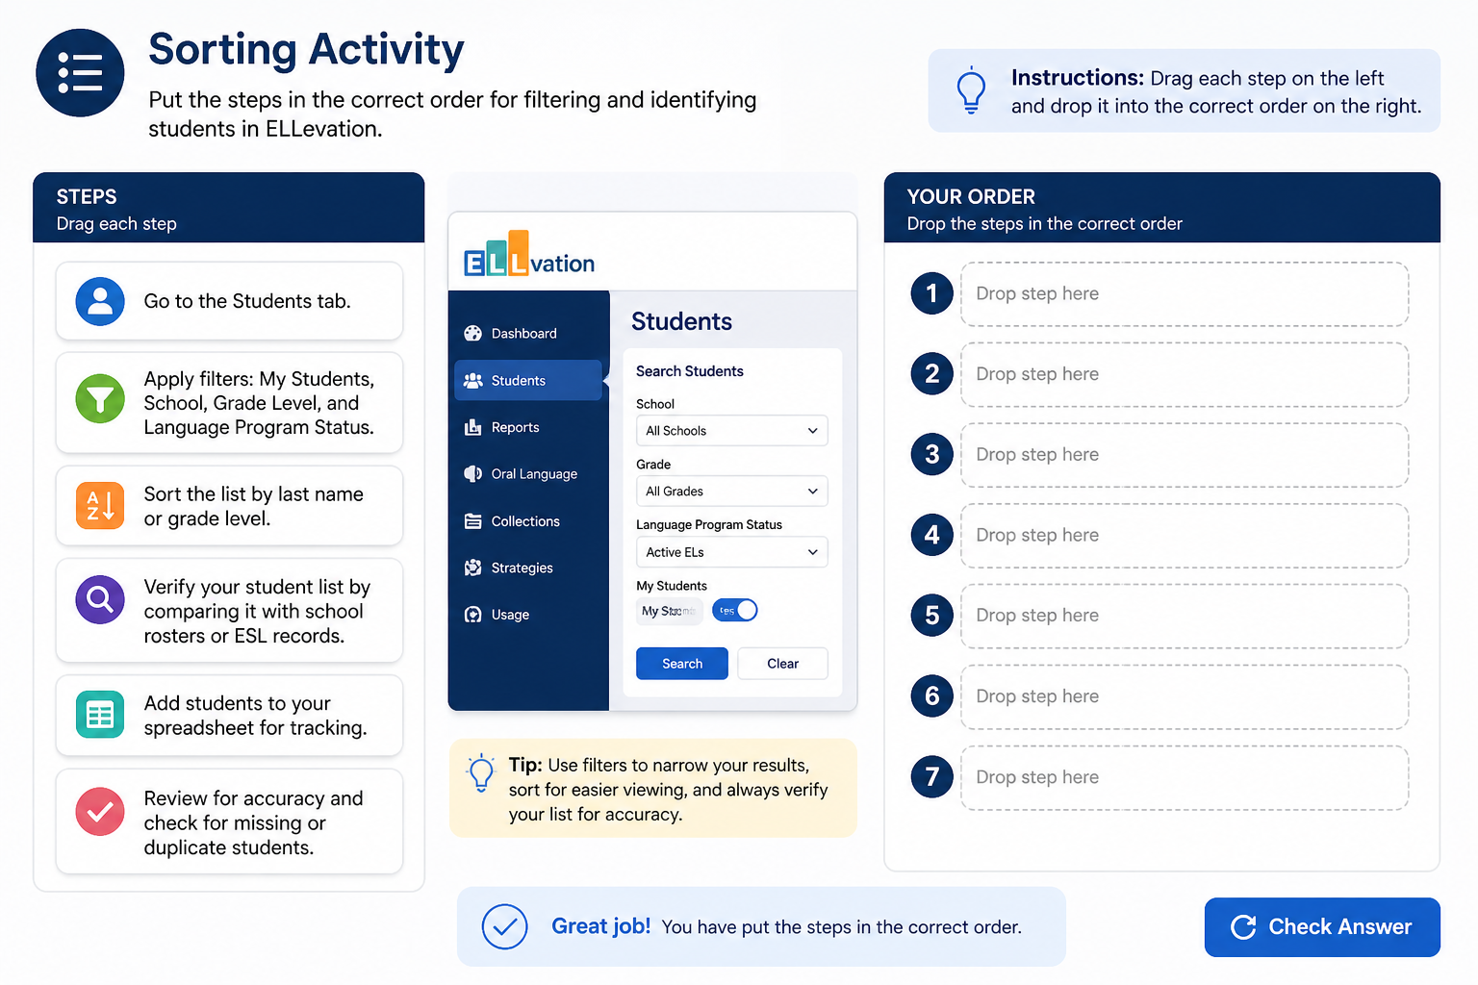
Activity Example
Module 1
*Visuals created with AI assistance
Notes:
This is an example of what the training could potentially look like

Slide 12
Assessment: Training Quiz
Section 1: Filtering and identifying students
Which filter should you apply when identifying students?
Monitoring status & EL Status
School & teacher
Grade level and teacher
Section 2: Importance and Accuracy
Why is accuracy important when completing ILPs?
a. Accuracy affects school funding
b. Teacher scores are affected
c. Students may be dropped from school rosters
Notes:
Here I have sample questions for the assessment portion of the training. The questions will cover both parts of objective 1.

Slide 13
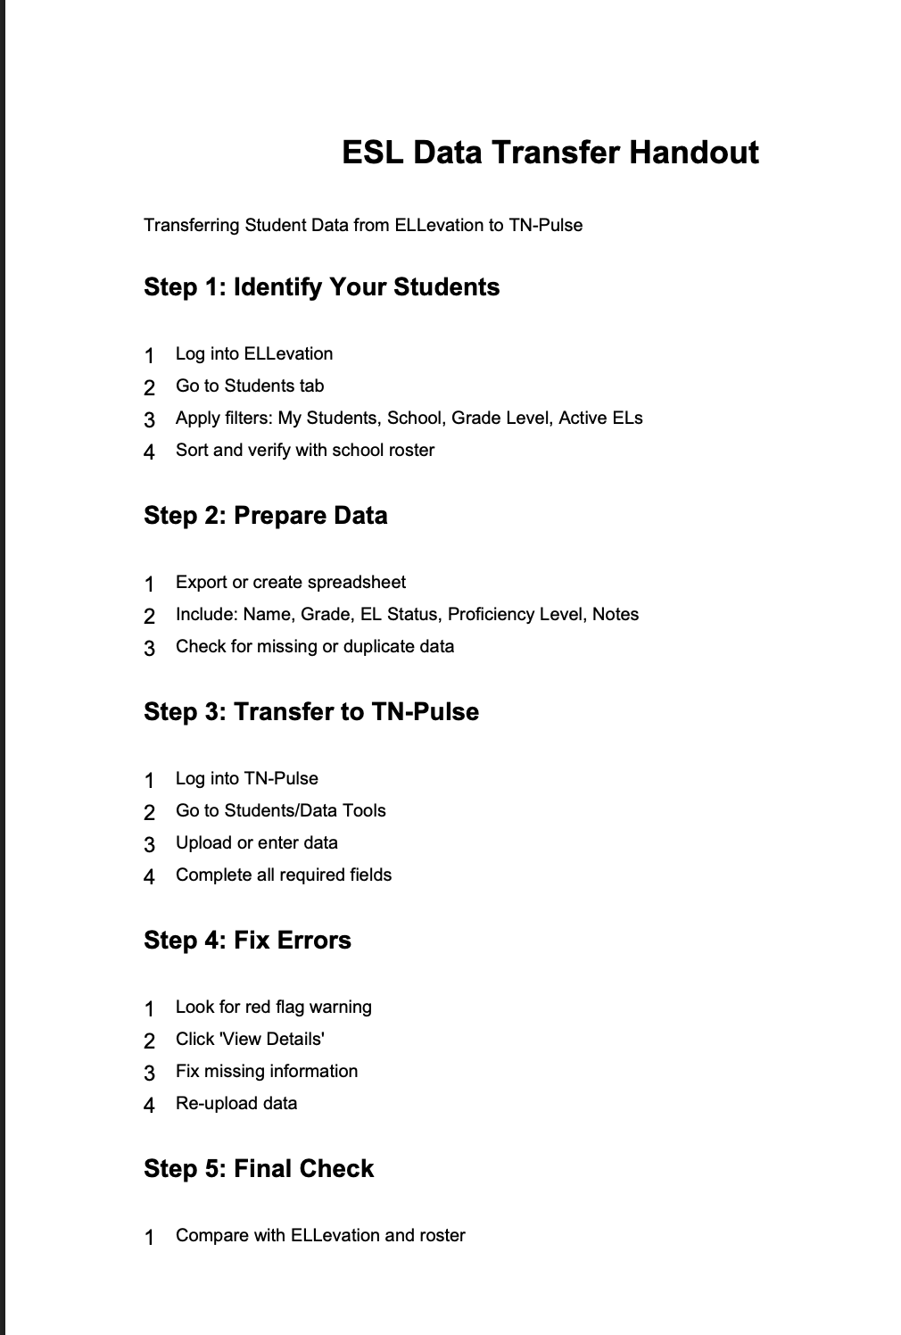
Job Aid/Handout
Module 1
Notes:
A job aid will also be created to help guide the learners as they work to identify students and complete ILPs.

