Slide 1



Slide 2

I. PROJECT DESCRIPTION

Slide 3
A game based on COVID-19 QUARANTINE.
Government uses quarantine to stop the spread of this contagious virus. They also quarantine those people who are exposed to an infected person. They are ask to stay at home and to be observed if they are affected

Slide 4
CONCEPT
The objective of this game is to kill / remove the virus spider in the room to avoid being infected by the virus
The algorithm of this game is based on where the virus spider respawn where in the player must remove the virus spiders for them to live

Slide 5
II. GAME DESCRIPTION

Slide 6
Coronaviruses are a family of viruses that can cause illnesses such as the common cold, severe acute respiratory syndrome (SARS) and Middle East respiratory syndrome (MERS). In 2019, a new coronavirus was identified as the cause of a disease outbreak that originated in China. The goal of this game is for the user to control the boy and remove all the viruses within 30 days. To achieve the goal the player needs to earn money by killing viruses and buy an armor for the player to live.

Slide 7
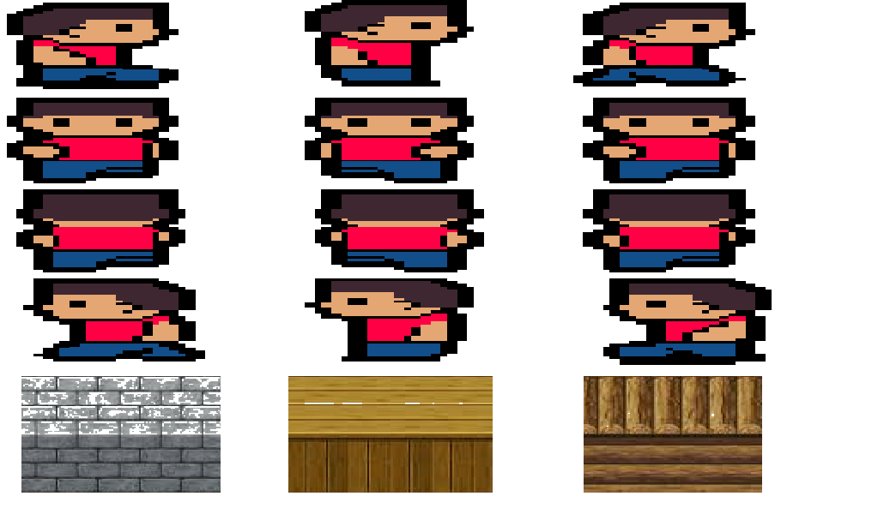

THE HERO, CONTROL THIS CHARACTER AND REMOVE AND VIRUS IN ORDER FOR HIM TO SURVIVE
THE VIRUS, KILL ALL THE VIRUS RESPAWNING EVERY DAY AND WIN THE GAME

Slide 8





Slide 9

III

Slide 10



Slide 11



Slide 13

BED, USED TO HEAL YOURSELF AFTER BEING DAMAGED

Slide 14

If the numbers of days is equal to 30 then the virus will now vanish forever and the is now open for you to go out.

Slide 15


Slide 16
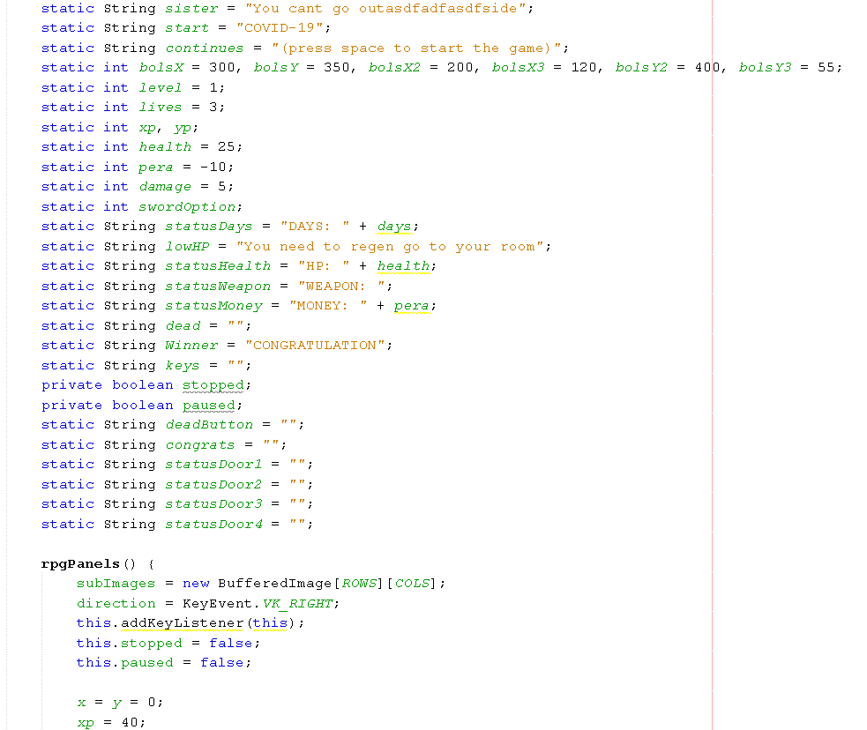
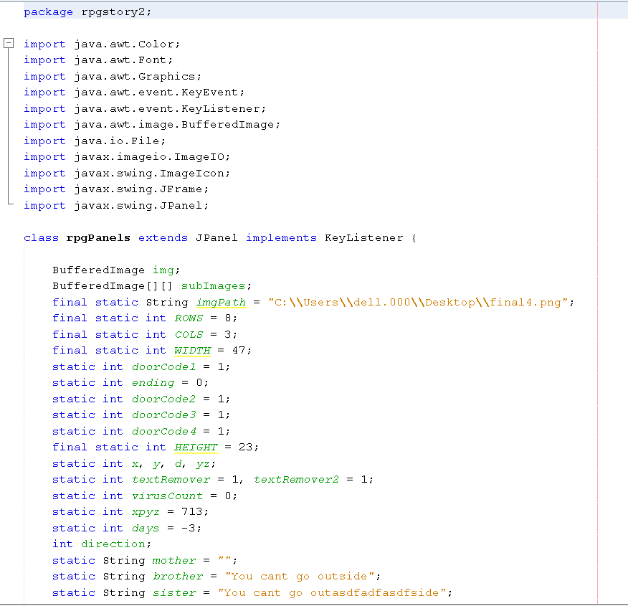
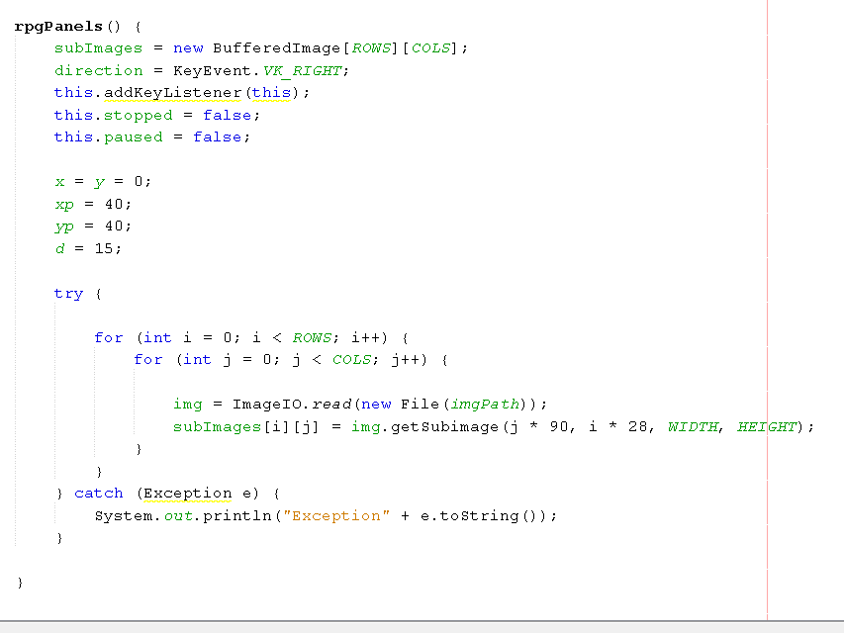
GAME PANEL

Slide 17
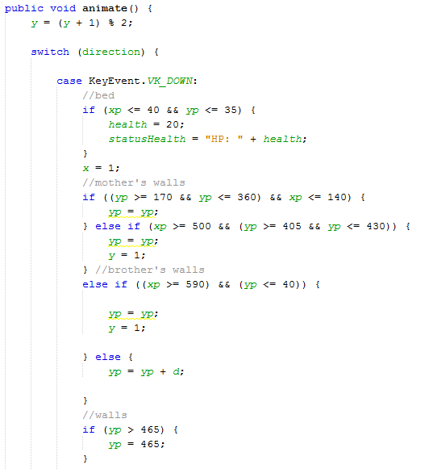
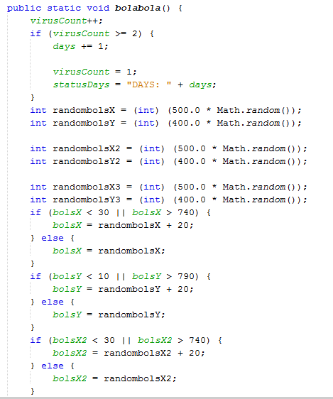
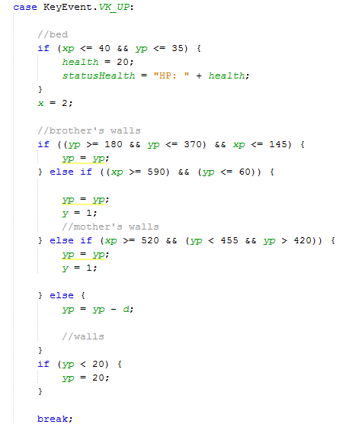
ENTITY / ANIMATION

Slide 18
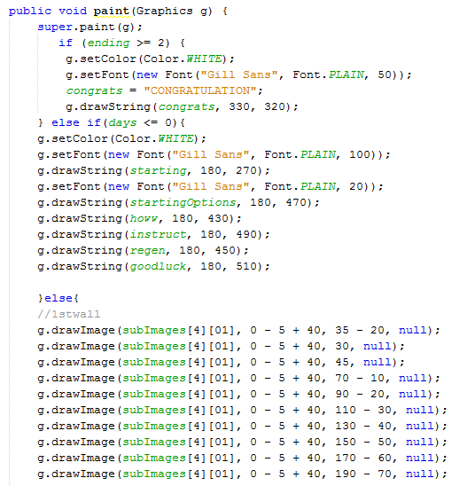
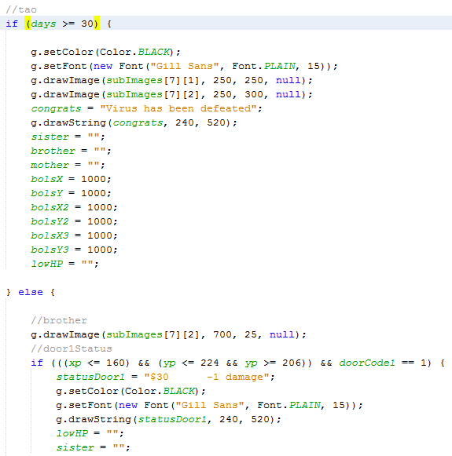
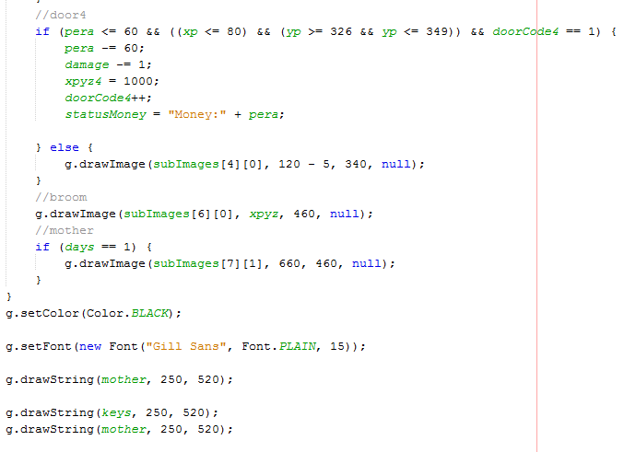
CONTENT

