Slide 1
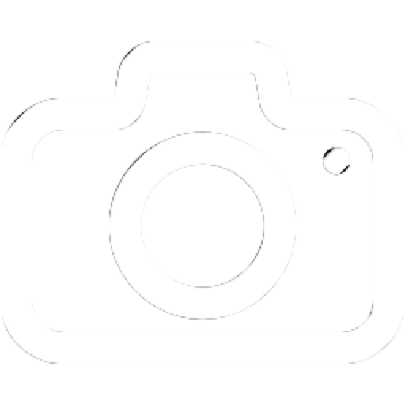
Halal?

Slide 2

Halal?

