Slide 1

Welcome to my presentation By Name: Zunaid Miah ID: 171-35-1841

Slide 2
Project Name : Property Management
Submitted By
Name: Zunaid Miah
ID: 171-35-1841
Sec: D
Submitted To
Name: Mushfiqur Rahman
Lecturer at
Daffodil International University
Software Engineering Department

Slide 3
About Project
This is property management based project
Named OurProperty.com
In my project I’m trying to maintain three actors which are Registered users, Unregistered users and admin
Now I just completed Unregistered part and just start about admin part.

Slide 4
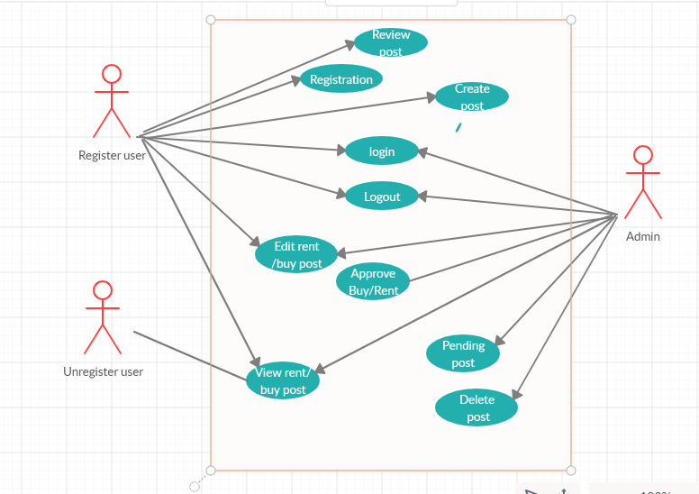
Use case

Slide 5
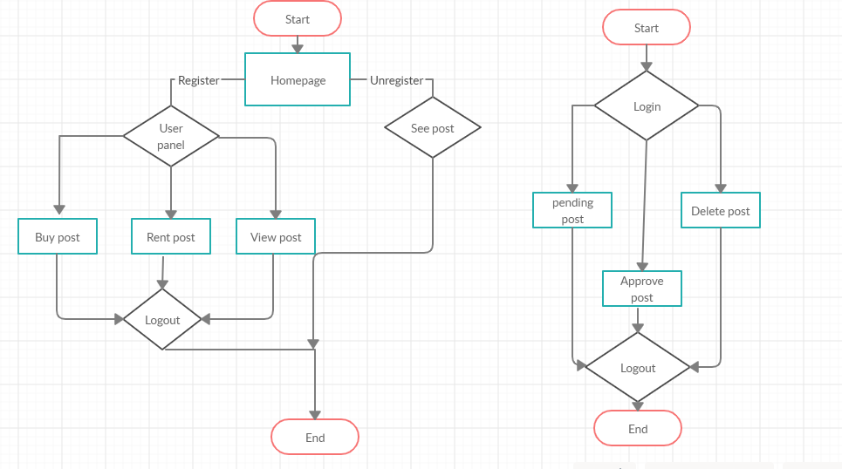
Activity Diagram

Slide 6
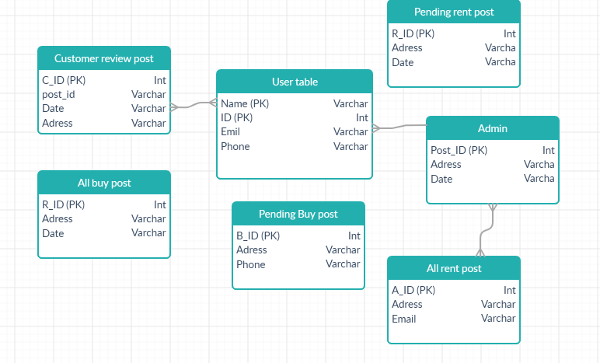
Database Diagram

Slide 7
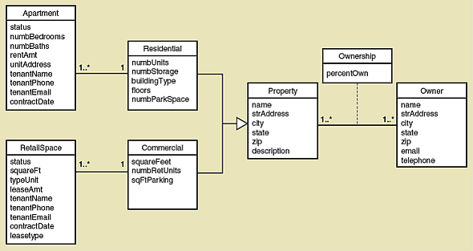
Class Diagram

Slide 8

User interface
Homepage 1st half pic

Slide 9
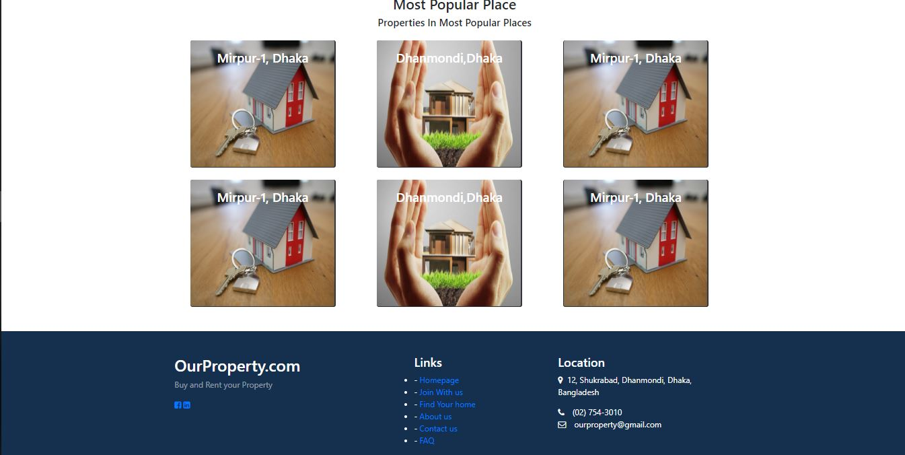
Second half part

Slide 10
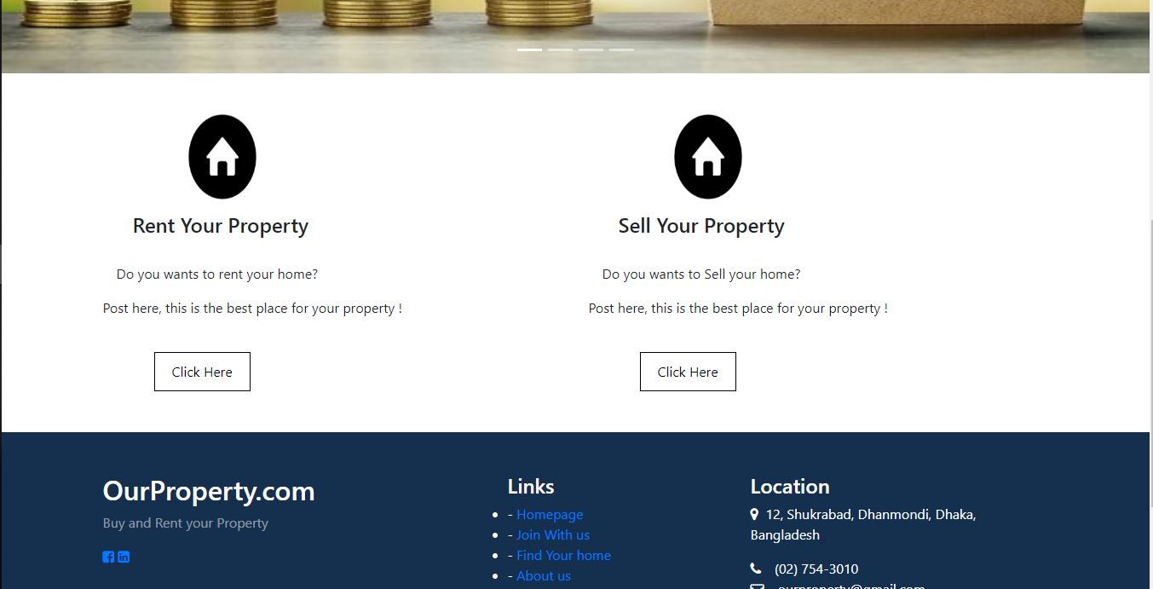
Create post page

Slide 11
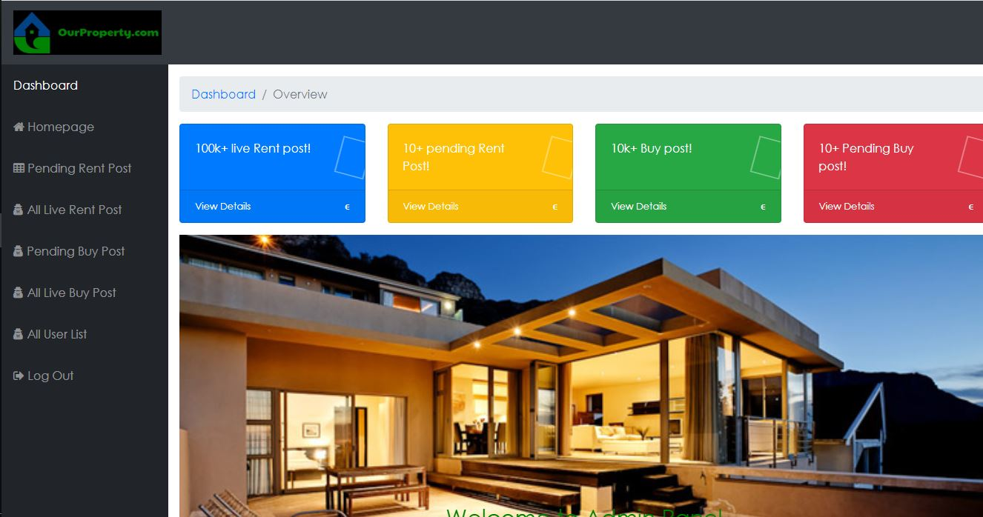
Admin dashboard

Slide 12
Technology
Client Side
HTML
CSS
JavaScript
jQuery
Bootstrap
Server Side
PHP(laravel framework)
MYSQL(Apache)

Slide 13
Outcome
Unregistered users
They can View buy/rent post
They can search any post
Registered users
They can also View buy/rent post
They can also search any post
They can create a sell/rent post
They can edit/delete their post

Slide 14
Outcome(cont..)
Registered users (cont..)
They can see their pending post
They can see their live post
They can given suggestion us
Admin
Admin can approve or delete any post
Can delete any live jobs
Admin have overall access

Slide 15
Future Plan
After mid term I will try to complete full admin and registered users part
Already I got many error and I was learn many things from this error
I just try to think real life project and trying to implemented in my project

Slide 16
Thank You Everyone

