Slide 1
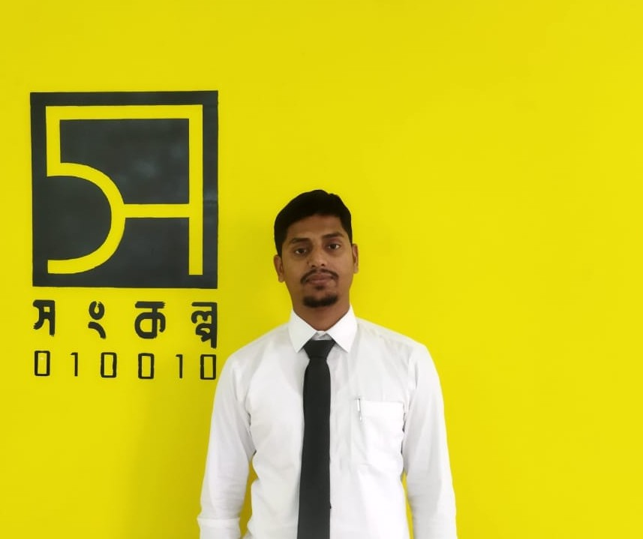
Hello Everyone
This is
MD. NAEEM-AL-IMRAN
MD. NAEEM-AL-IMRAN
BSc in CSE, DUET (Final Year)
Diploma in CMT. Th.P.I
+8801537076092
naeemceg@gmail.com
https://www.linkedin.com/naeem4265

Slide 2
Achievement
ICPC Asia West Continent Finalist-2021.
ICPC Dhaka Regionalist 2019,2020 and 2021.
Expert at Codeforces.
Three star at Codechef.
Problem setter – IDPC-2021,2022 and 2023.
2500+ Problems solved, 500+ contests completed.
President, DUET Computer Society.

Slide 3


Slide 4
What is Programming?
Solve the problems in optimal way.
What is Competitive Programming?
Also known as sports programming.
Competition between programmers.

Slide 5
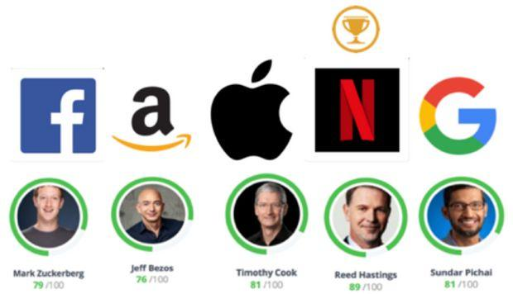
Importance of Competitive Programming
Top Tech Companies In the World
Hire software Engineer based on their programming skill.

Slide 6
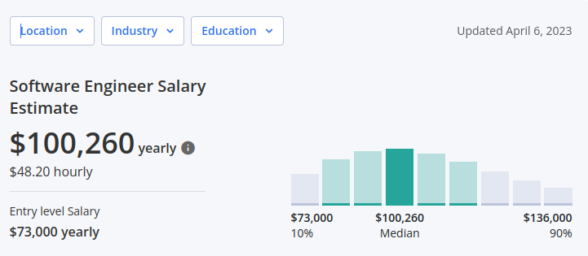
Software Engineer Average Salary

Slide 7
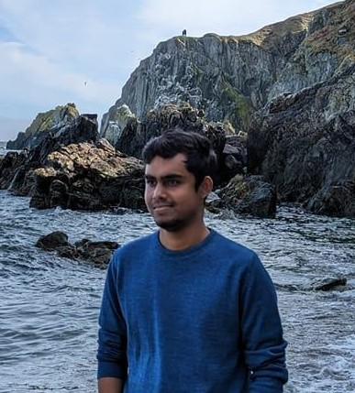
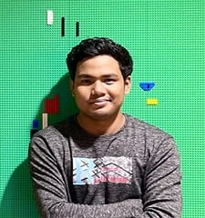
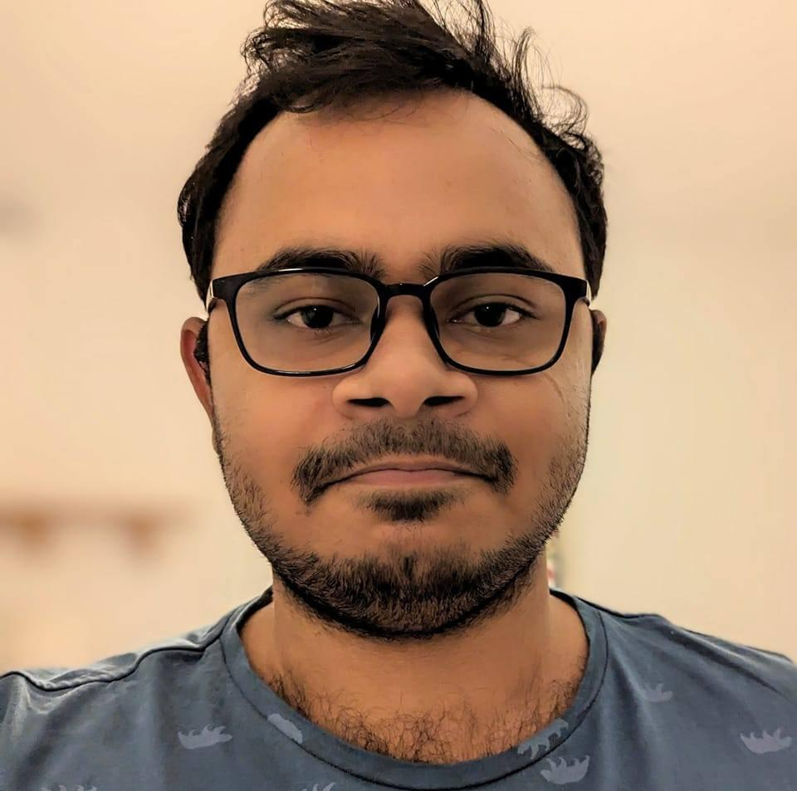
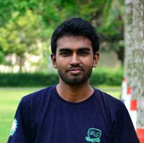
Let’s meet with some successful recent graduate
Hasibul Haque Himel
BSc in CSE, IUT
Software Engineer, Google
Chayan Kumar Roy
BSc in CSE, JU
Software Engineer, Google
Safayet Hossain Masum
BSc in CSE, IUT
Software Engineer, Amazon
Md. Shihab
BSc in CSE, DUET
Software Engineer,
Brand Cloud, Japan

Slide 8
How to prepare for Competitive Programming?
Learn one programming language(C, C++, Python).
Learn basic math.
Start Problem solving.
Start online programming contest.
Learn Data Structure and Algorithm.
Prepare for ICPC, IUPC.

Slide 9
What is ICPC and IUPC ?
International Collegiate Programming Contest.
Inter University Programming Contest.
Now Watch
The Best Moments for Bangladesh ever

Slide 10
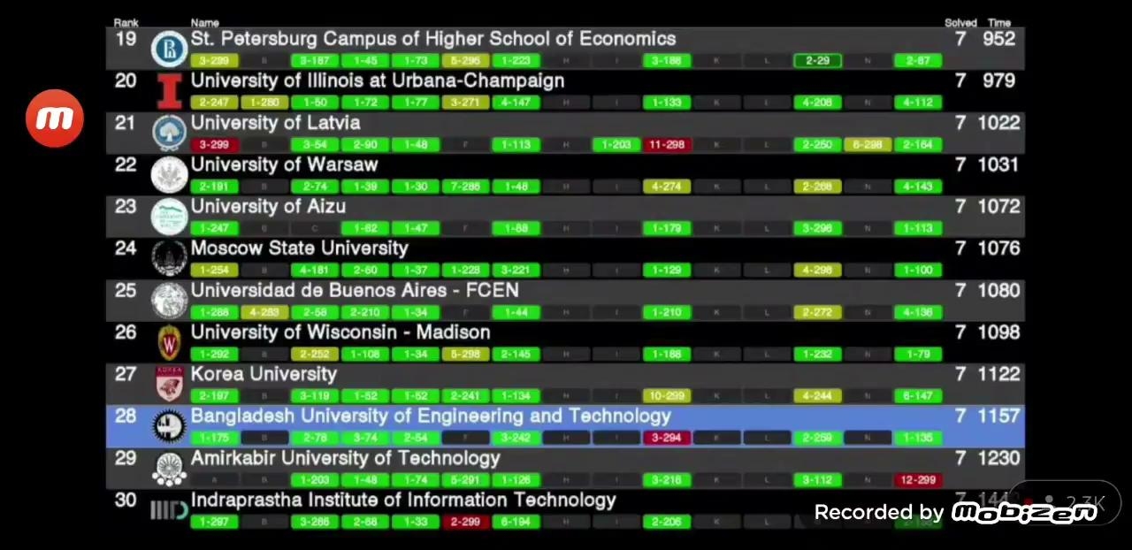

Slide 11
Data Structure and Algorithm
Basic math(GCD, LCM, Combinatorics, Probability)
Number Theory(Prime factorization, NOD, SOD, Bigmod, Modular Inverse).
STL(Stack, Queue, Vector, Map, Link list).
Graph Algorithm(BFS, DFS, DSU, MST, Djkstra).
Basic Geometry.
And Now you know what you should learn.

Slide 12
What are the most important things for programming?
Persistence and patience.
Hard-working.
Determination.
Self-motivation.
Ability to manage stress.

Slide 13
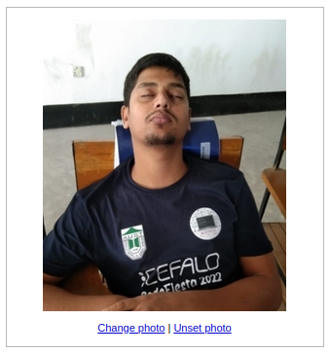
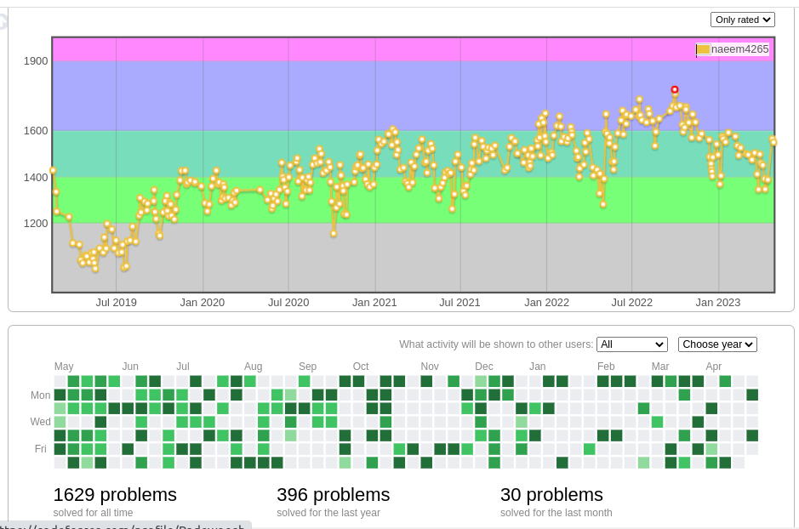
Let’s Meet with Some Passionate Programmers
Guess the Person ?
Naeem’s Codeforces Profile

Slide 14
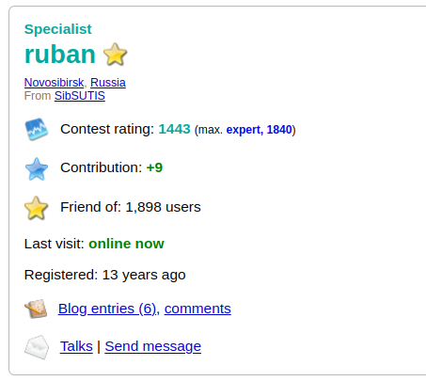
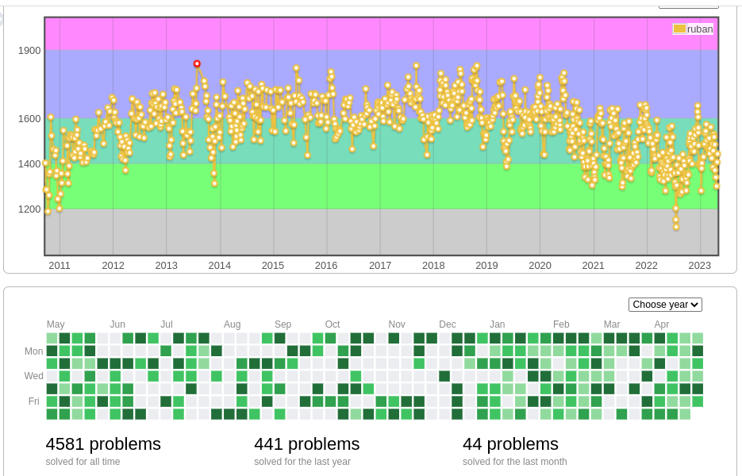
Let’s Meet with Some Passionate Programmers

Slide 15
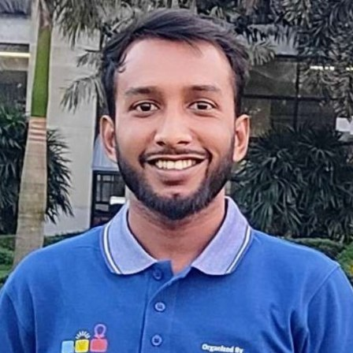
They are successful recent diploma graduates
Faysal Ahmed
Jr. Software Engineer - iOS at Reserveit BD
Diploma in Eng: Brahmanbaria Polytechnic Institute

Slide 16
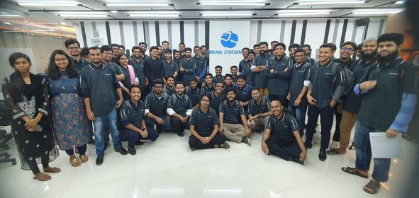
Recently, Brain Station 23 hired 55 new graduates for multiple positions, and the exciting news is that one of them is a diploma graduate.
Zahid Hasan
Software Engineer Trainee at Brain Station 23
Diploma In Eng: Chapainawabganj Polytechnic institute

Slide 17
Online Platform for the Beginners
Beecrowd: https://www.beecrowd.com.br/
CSES: https://cses.fi/
Atcoder: https://atcoder.jp/
Codeforces: https://codeforces.com/
Codechef: https://www.codechef.com/
Lightoj: https://lightoj.com/
Codemarshal: https://algo.codemarshal.org/

Slide 18
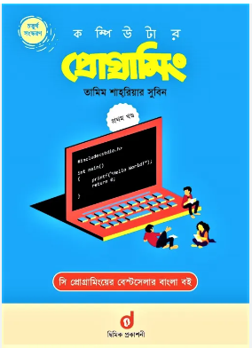
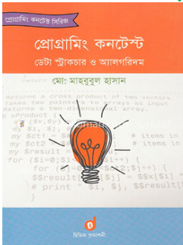
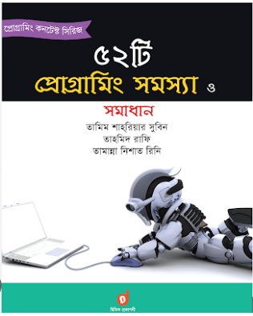
Books and Online Resource
Anisul Islam Tutorials: https://youtu.be/6nOavbvFvbY
Shafaet’s blog: http://www.shafaetsplanet.com/?p=1437

Slide 19
And Finally Secret Suggestion for You:
Practice
Practice
And Practice.

Slide 20
