Slide 1
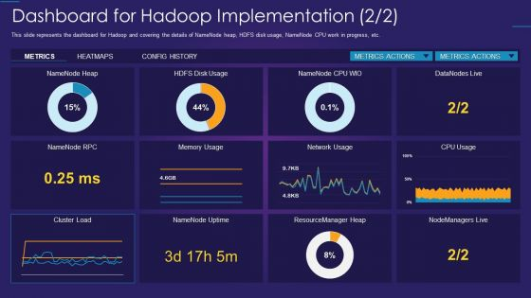
Duration: 60 min
Grade: 11
CCSS, NGSS
Introduction:
Big Data & Hadoop Ecosystem
Lesson 1

Slide 2
Overview
Big Data refers to extremely large and complex datasets that are difficult to process using traditional data tools due to their volume, velocity, and variety.
The Hadoop Ecosystem is an open-source framework that enables the distributed storage and processing of Big Data across clusters of commodity hardware.
Learning objectives
Understand the core characteristics of Big Data and why traditional systems struggle to handle.
Explain the architecture and key components of the Hadoop ecosystem, including HDFS and MapReduce.
Describe how Hadoop enables scalable and distributed processing of large datasets across multiple machines.
Keywords
Volume, Velocity, Variety, Veracity, Unstructured Data

Slide 3
What is Big Data
Big data refers to extremely large and diverse collections of structured, unstructured, and semi-structured data that continues to grow exponentially over time.
These datasets are so huge and complex in volume, velocity, and variety, that traditional data management systems cannot store, process, and analyze them.
The amount and availability of data is growing rapidly, spurred on by digital technology advancements, such as connectivity, mobility, the Internet of Things (IoT), and artificial intelligence (AI).

Slide 4
Big Data Examples
Tracking consumer behavior and shopping habits to deliver Hyper-personalized retail product recommendations tailored to individual customers.
Using image data from cameras and sensors, as well as GPS data, to detect potholes and improve road maintenance in cities.
Using AI-powered technologies like natural language processing to analyze unstructured medical data.

Slide 5
The Vs of Big Data
Volume: This describes the enormous amount of data that is available for collection and produced from a variety of sources and devices on a continuous basis.
Velocity: Big data velocity refers to the speed at which data is generated. Today, data is often produced in real time or near real time, and therefore, it must also be processed, accessed, and analyzed at the same rate to have any meaningful impact.
Variety: Data is heterogeneous, meaning it can come from many different sources and can be structured, unstructured, or semi-structured.
In addition to these three original Vs, three others that are often mentioned in relation to harnessing the power of big data: veracity, variability, and value.
Veracity: Big data can be messy, noisy, and error-prone, which makes it difficult to control the quality and accuracy of the data.
Variability: The meaning of collected data is constantly changing, which can lead to inconsistency over time.
Value: It’s essential to determine the business value of the data you collect.

Slide 6
How does Big Data Works
The central concept of big data is that the more visibility you have into anything, the more effectively you can gain insights to make better decisions, uncover growth opportunities, and improve your business model.
Making big data work requires three main actions:
Integration: Big data collects terabytes, and sometimes even petabytes, of raw data from many sources that must be received, processed, and transformed into the format that business users and analysts need to start analyzing it.
Management: Big data needs big storage, whether in the cloud, on-premises, or both. Data must also be stored in whatever form required.
Analysis: The final step is analyzing and acting on big data—otherwise, the investment won’t be worth it.

Slide 7
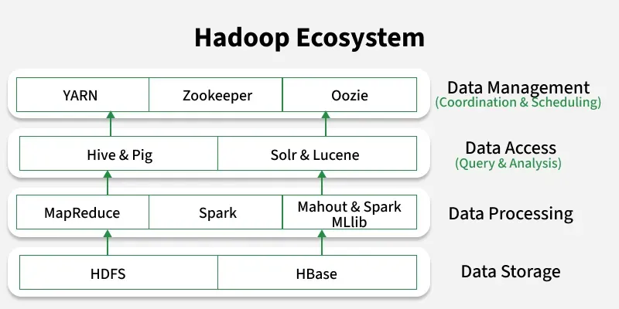
Duration: 60 min
Grade: 11
CCSS, NGSS
Introduction:
Hadoop Ecosystem

Slide 8
Hadoop Ecosystem
Hadoop is an open-source framework for storing and processing large-scale data across distributed clusters using commodity hardware. The Hadoop Ecosystem is a suite of tools and technologies built around Hadoop's core components (HDFS, YARN, MapReduce and Hadoop Common) to enhance its capabilities in data storage, processing, analysis and management.
Components of Hadoop Ecosystem:
HDFS (Hadoop Distributed File System): Stores large datasets across distributed nodes.
YARN (Yet Another Resource Negotiator): Manages cluster resources and job scheduling.
MapReduce: A programming model for batch data processing.
Spark: Provides fast, in-memory data processing.
Hive & Pig: High-level tools for querying and analyzing large datasets.
Hbase: A NoSQL database for real-time read/write access.
Mahout & Spark MLlib: Libraries for scalable machine learning.
Solr & Lucene: Tools for full-text search and indexing.
Zookeeper: Manages coordination and configuration across the cluster.
Oozie: A workflow scheduler for managing Hadoop jobs.

Slide 9
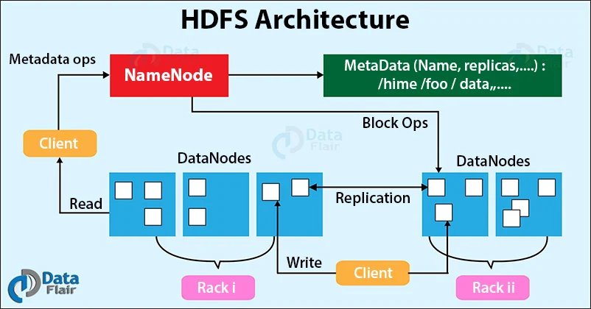
HDFS Architecture

