Slide 1

Harvard University Extension School
"Principles of Big Data Processing"
CSCI E-88, Fall 2022
Final Project
by Asma Naeem

Slide 2
Project Goal and Problem Statement
Set up a data processing pipeline for ingesting Twitter streaming data filtered by some criteria and move it into Elasticsearch for visualization and insights

Slide 3
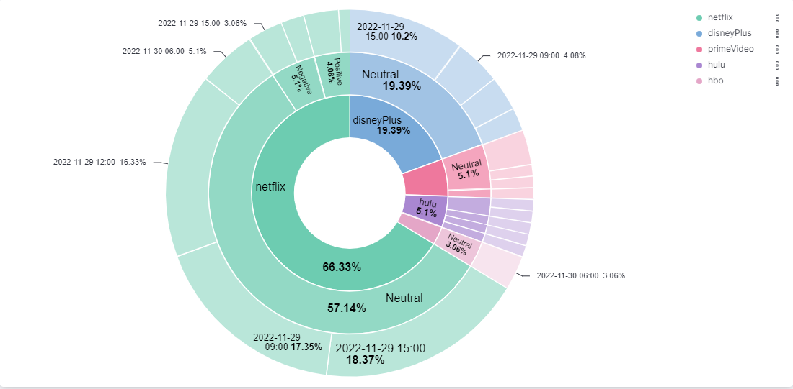
Expected Results
Demonstrate graphs and maps for visualizing tweets data to compare the most popular video-on-demand over-the-top streaming services like Netflix, Amazon Prime Video, Disney Plus, and Hulu

Slide 4
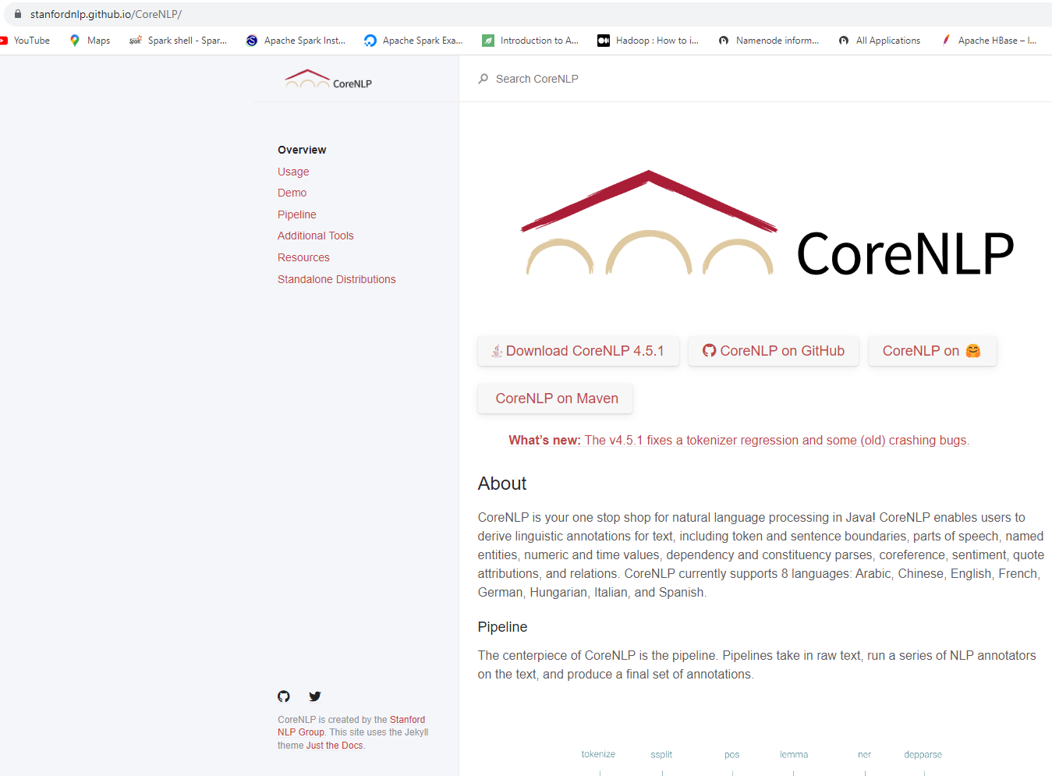

Slide 5
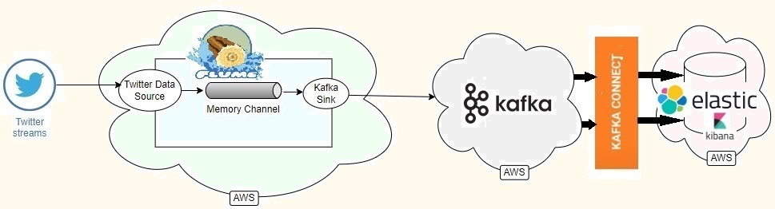
Processing Pipeline
Collection Tier: Apache Flume
Messaging Tier: Apache Kafka
Stream Processing Tier: Kafka Elasticsearch Sink Connector
Visualization Tier: Kibana data visualization dashboard software for Elasticsearch

Slide 6
Thank You

