Slide 1



Finding, Monitoring, and Checking Claims Computationally Based on Structured Data
Brett Walenz, You (Will) Wu, Seokhyun (Alex) Song, Emre Sonmez, Eric Wu, Kevin Wu, Pankaj K. Agarwal, Jun Yang | Duke University
Naeemul Hassan, Afroza Sultana, Gensheng Zhang, Chengkai Li | University of Texas, Arlington
Cong Yu | Google, Inc.

Slide 2
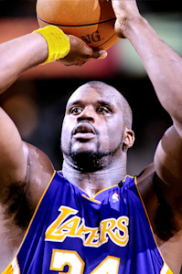
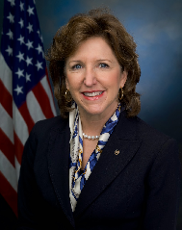


Claims based on data …
“Shaquille O’Neal had 40 points and 19 rebounds in the game against the Detroit Pistons on April 5, 1995. No one had a better performance in season 1994-95.”
“During her six years in the Senate, Hagan has rubber-stamped the Obama agenda 95% of the time.”
Jim Marshall, a Democratic incumbent from Georgia, voted with Nancy Pelosi “almost 90 percent of the time”
Jim Marshall “is a long way from Nancy Pelosi,” as he “voted the same as Republican leaders 65 percent of the time”
Last three claims from factcheck.org; images from
http://actionpcsports.yuku.com/
http://en.wikipedia.org/wiki/File:Rudy_Giuliani.jpg http://en.wikipedia.org/wiki/Kay_Hagan
http://en.wikipedia.org/wiki/File:Jim_Marshall.jpg http://en.wikipedia.org/wiki/File:Nancy_Pelosi_2013.jpg

Slide 3
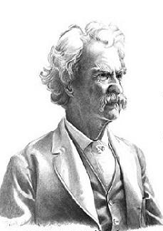
There are lies, damned lies, and statistics.
– Mark Twain
How do we check these claims?
Image: http://www.quotespedia.info/

Slide 4
Challenge: vagueness
“During her six years in the Senate, Hagan has rubber-stamped the Obama agenda 95% of the time.”
Huh? “Obama agenda”? “95%”?
A lot of “hidden” information in here.
“Obama agenda” : official statements made by President Obama
about a bill OR nomination
“six years, 95% of the time”: That sounds… bad? Is it? Does this mean
all six years, or just lately?

Slide 5
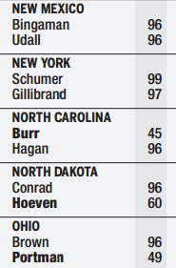
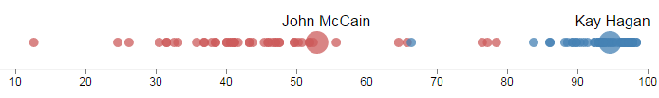
Challenge: beyond correctness
Correct…
… but a little misleading?
Source: Congressional Quarterly

Slide 6
Challenge: examine counter arguments
“During her six years in the Senate, Hagan has rubber-stamped the Obama agenda 95% of the time.”
Counter-argument
“During the years 2012-2013, Democrats on average voted 94% of the time in line with Obama’s public position. Kay Hagan votes within 1% of the average Democrat on Obama’s position.”

Slide 7
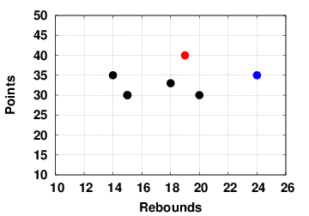
Challenge: generating claims
“Shaquille O’Neal had 40 points and 19 rebounds in the game against the Detroit Pistons on April 5, 1995. No one had a better performance in season 1994-95.”

Slide 8
Goal
Fact-checking is growing by leaps and bounds, can be aided by analytic process
How much can we automate this process?
Can we quantify quality beyond correctness?
Can we formulate
reverse-engineering of vague claims
finding counterarguments
generating/monitoring claims
as computational problems?
Can we do so in a general way, for many claims in many domains?

Slide 9
To check a claim, tweak the way it manipulates data and see if we get different conclusions.
Obama agenda
Bills
Nominations
General Votes
“During her six years in the Senate, Hagan has rubber-stamped the Obama agenda 95% of the time.”
2009-2014
Hagan
Date Ranges: 2009-2010,
2010-2011,
2012-2014, …
Democrats
Republicans
Individuals

Slide 10

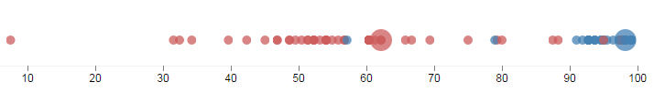


Original
Bills
Only
Nominations
Only
Bills + 2012
Bills + 2013
Vote agreement with a public Obama position

Slide 11
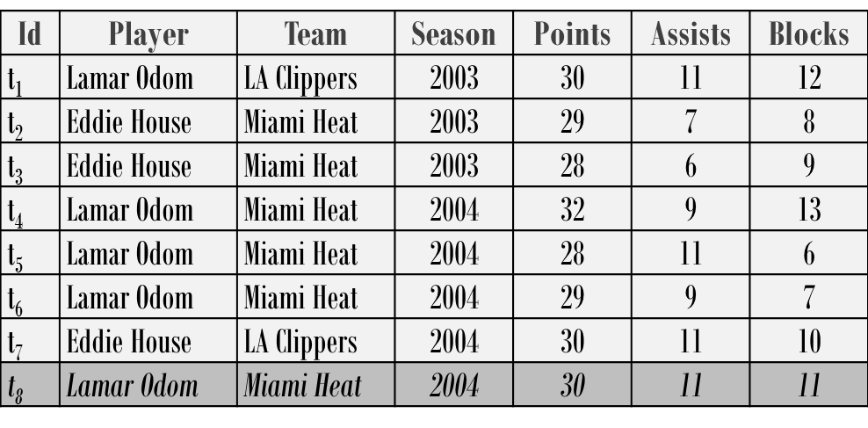
To generate a claim, tweak the way it manipulates data and see how it compares to others
D
M
Conditions | Combinations
Season = 2004 | Assists, Blocks
Player = Lamar Odom Season = 2004 | Points, Assists
… | …
Lamar Odom scored 11 assists and 11 blocks. No one made a better performance in season 2004
Lamar Odom had at least 28 points and 9 or more assists for 4 consecutive games; his the longest such streak in 2004
Find conditions over D and combinations of M such that
t₈ is in the skyline
t₈ generates a prominent streak

Slide 12
Parameterized Queries
A claim, such as the Kay Hagan example, is a template with a set of existing parameters (ex. Obama agenda, six years, Kay Hagan)
iCheck/uClaim works on query templates, which tell us how to get the data and perturb the parameters
In addition, we need to understand how to compare and contrast results and parameters

Slide 13
Parameterized Queries II
Relative claim strength – a function to determine how to compare results (ex. lower is better in the Kay Hagan example)
Not all parameter perturbations are sensible (ex. dates before Obama took office). Need a parameter sensibility function

Slide 14
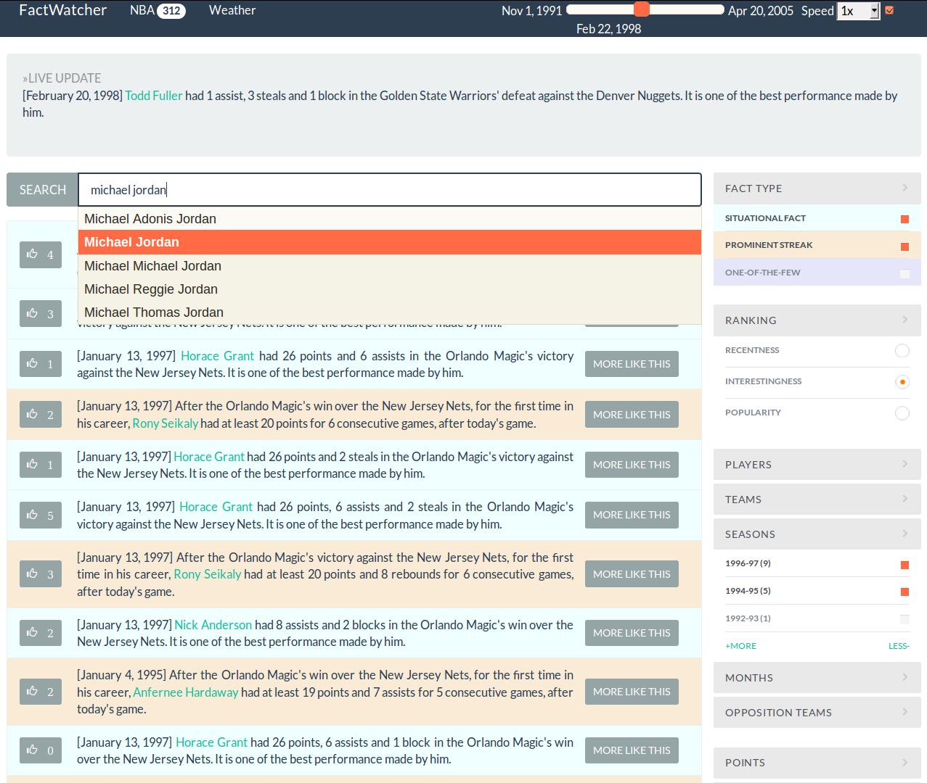
uClaim

Slide 15
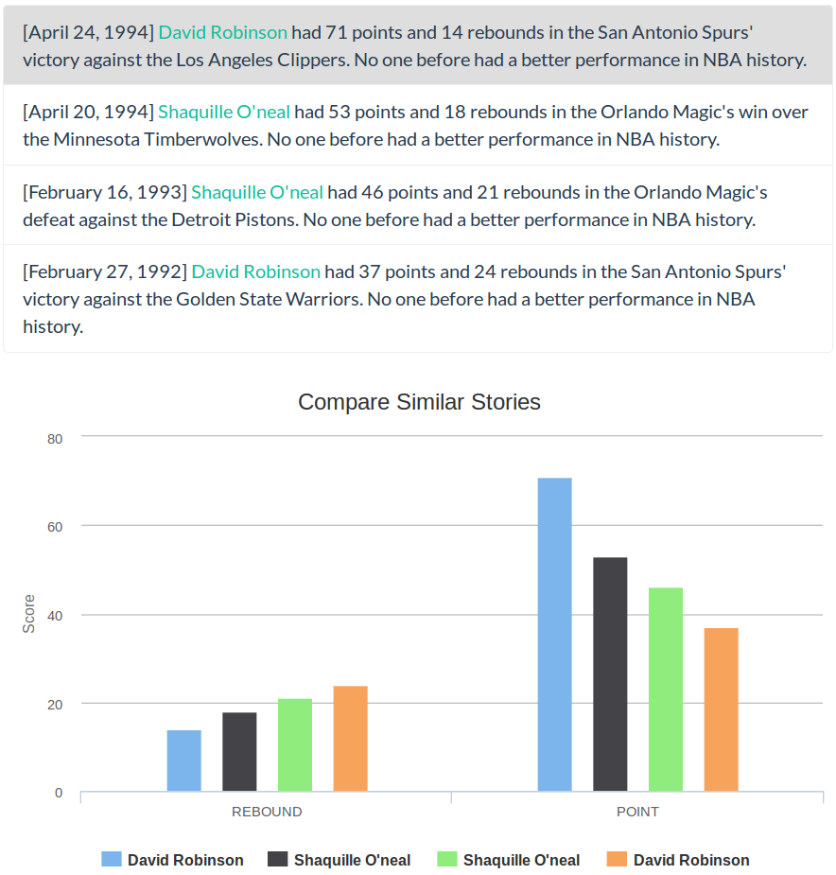
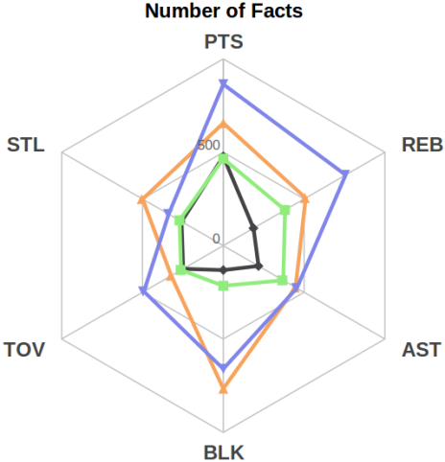
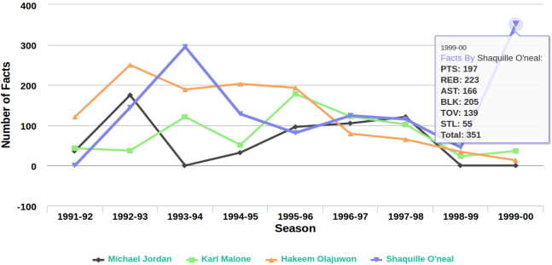
uClaim
Similar Stories
Comparison of Players

Slide 16
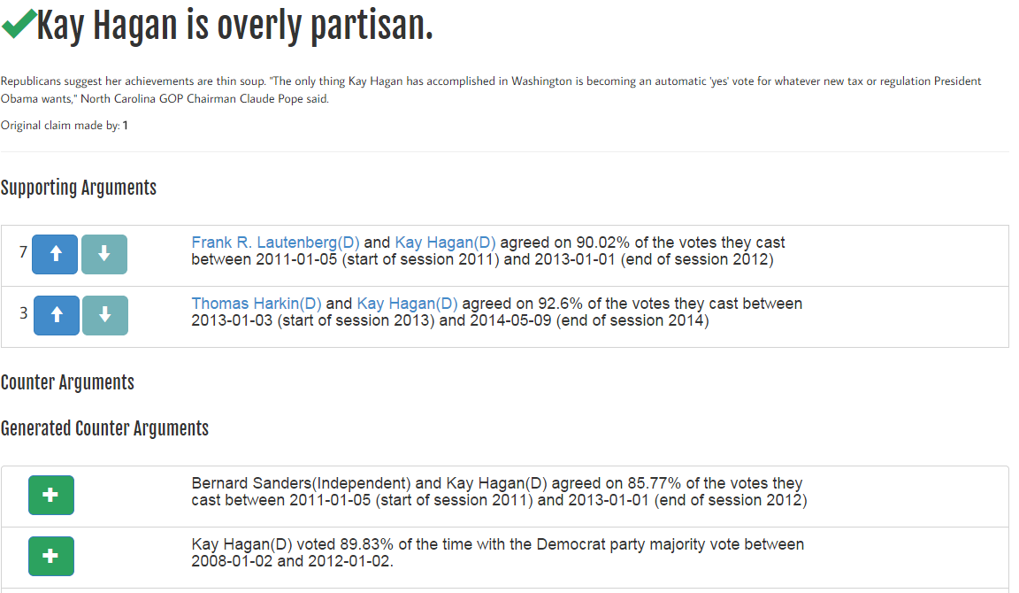
iCheck

Slide 17
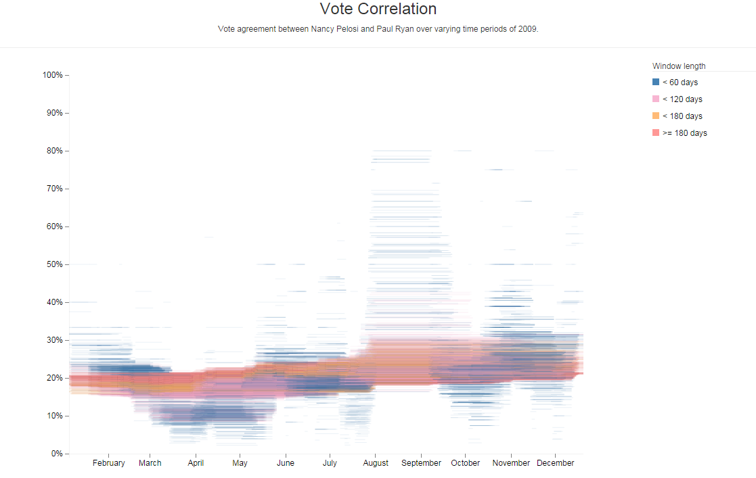
Finding counter arguments

Slide 18
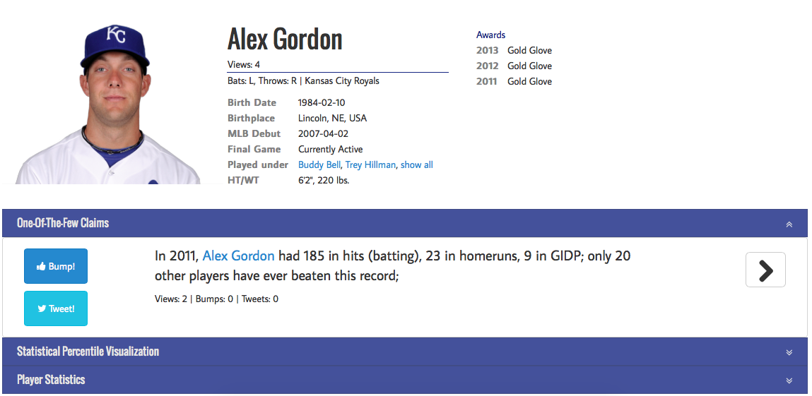
iCheck

Slide 19
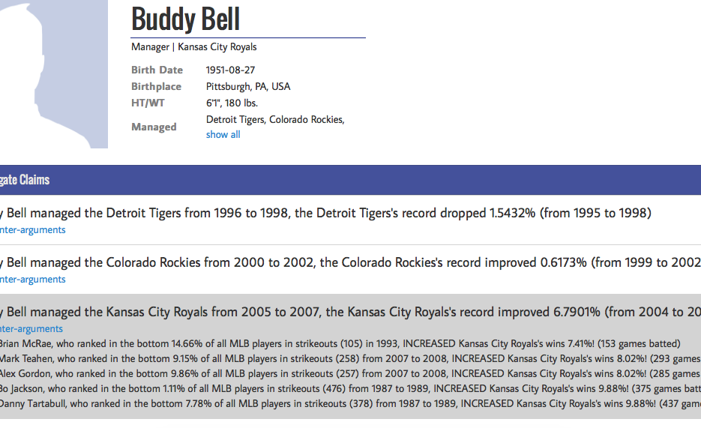
iCheck

Slide 20
Thank you!
Questions?
Brett Walenz, You (Will) Wu, Seokhyun (Alex) Song, Emre Sonmez, Eric Wu, Kevin Wu, Pankaj K. Agarwal, Jun Yang | Duke University
Naeemul Hassan, Afroza Sultana, Gensheng Zhang, Chengkai Li | University of Texas, Arlington
Cong Yu | Google, Inc.

