Slide 1
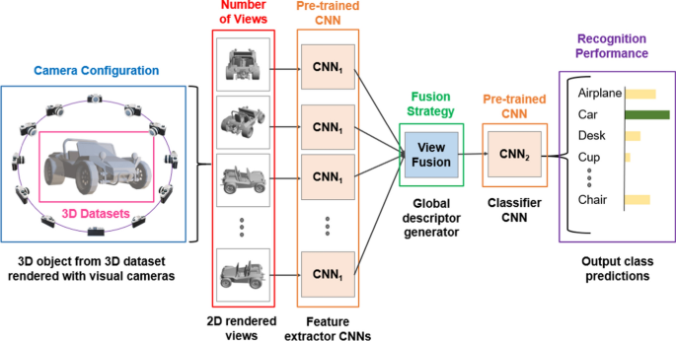
Multi-view objects Detection Using Deep Neural Networks

Slide 2
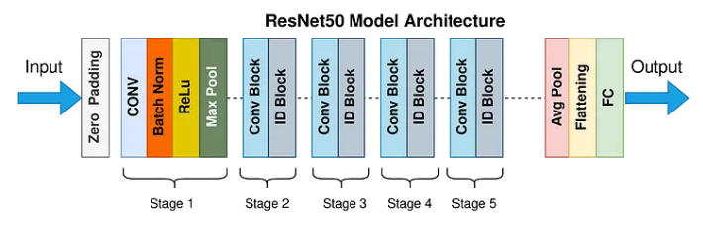
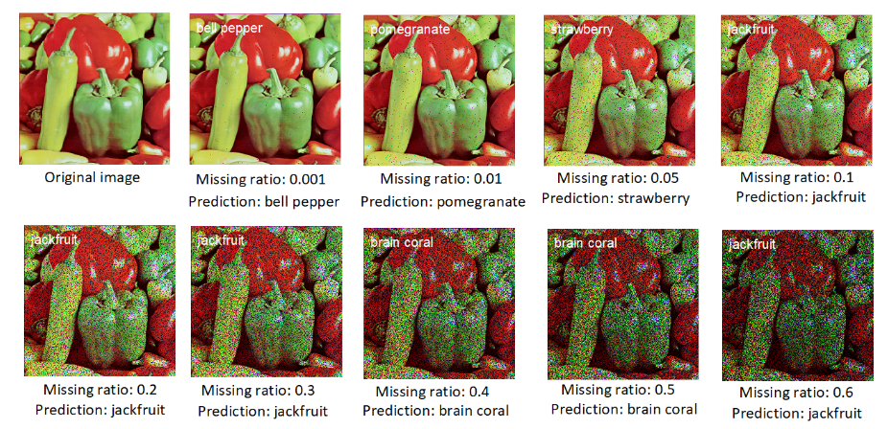
Deep neural network are sensitive to pixel removal and noise

Slide 3
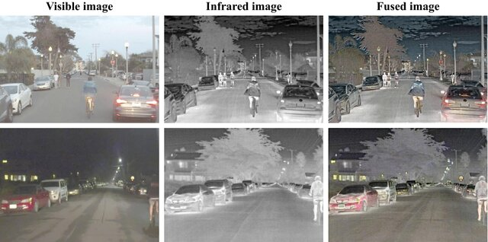
Multimodal image fusion for object detection

