Slide 1
Bodega Bash
Marina Johnson, James, Jake, Dalton, isaac

Slide 2
Bodega? Bash?
Yes, welcome to Calamity Cay. Where everyday is a disaster!
Yes, that’s our slogan. Calamity Cay is an island somewhere off the Atlantic but not specifically in the Pacific. Here in Calamity Cay everyday there is a new and exciting natural disaster!!
So as you can imagine our grocery stores are jack full of supplies ranging from earthquakes to zombie invasions.

Slide 3
How to play
Play
Rules
With your shopping cart, navigate around the grocery store
Pick up items you need to survive
Knock into other carts to grab their items.
Try and pick up as many items as needed before the time runs out.
There are only so many items in supply so try and grab the most important one’s first.
At the end of the time limit it will take into account all items grabbed and tell you if you actually survived the disaster.

Slide 4
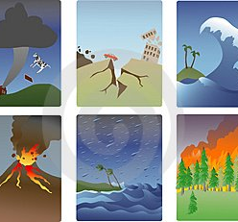
Target Market and Similar Games
This game is a mix between Mario kart and super smash bros.
Targeted towards children and young adults.
It is a multiplayer game designed to teach people what they would need in certain natural and unnatural disasters.
The crazy flow of the game will really teach players what they need and how to prioritize finding these items.

Slide 5
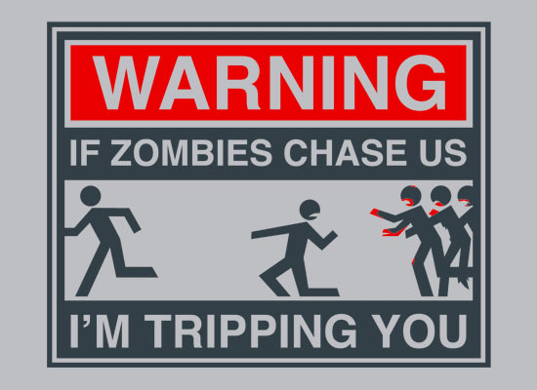
Well… Good luck I guess.

