Slide 1
Secure Data Hiding in Image Using Steganography
CAPSTONE PROJECT
Presented By Student Name : Naema Mohamed Rafiq College Name & Department : VKCET, Parippally; Computer Science

Slide 2
CONTENTS
Problem Statement
Technology used
Wow factor
End users
Result
Conclusion
Git-hub Link
Future scope

Slide 3
Problem Statement
In today's digital era, secure communication is crucial to protect sensitive information from unauthorized access. Traditional encryption methods can attract attention, making hidden data transmission a challenge. Steganography addresses this by concealing data within digital images, ensuring secrecy without raising suspicion. However, challenges such as maintaining image quality, resisting attacks, and increasing data capacity must be overcome. This project aims to develop a robust image steganography technique that ensures high security, imperceptibility, and efficient data embedding while minimizing the risk of detection.

Slide 4
Technology used
GitHub
GitHub is a web-based platform for version control and collaboration, primarily used for software development. It allows developers to store, manage, and track changes in their code using Git. GitHub supports open-source and private repositories, enabling teams to work together efficiently.
Python IDLE
Python IDLE (Integrated Development and Learning Environment) is a simple, beginner-friendly environment that comes with Python. It includes a Python shell for interactive execution, a code editor with syntax highlighting, and basic debugging tools.
Google images

Slide 5
Wow factors
Enhanced Security – Unlike basic steganographic methods, this project integrates advanced encryption (e.g., AES or RSA) before embedding data, ensuring double-layer protection.
Adaptive Techniques – It utilizes hybrid approaches like LSB with DCT/DWT, making detection and extraction harder for unauthorized users.
AI-Powered Steganalysis Resistance – Machine learning models can be incorporated to analyze and improve the robustness of hidden data against steganalysis attacks.
High Capacity with Minimal Distortion – The project optimizes data embedding to ensure the host image maintains its quality while allowing a higher data payload.
Cross-Platform and Cloud Integration – It supports secure transmission and retrieval over networks with cloud-based encryption for remote access and protection.

Slide 6
End users
Cybersecurity Professionals – They use steganography for secure communication and data protection.
Government & Military Agencies – For covert communication and secure intelligence transmission.
Journalists & Whistleblowers – To safely share sensitive information while avoiding surveillance.
Corporate & Financial Institutions – To protect confidential business data from cyber threats.
General Users & Privacy Enthusiasts – Individuals who need secure personal data storage and communication.

Slide 7
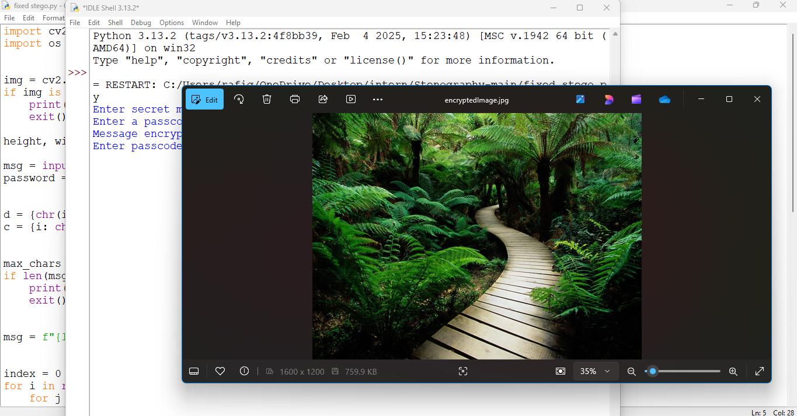
Results (OUTPUT)

Slide 8
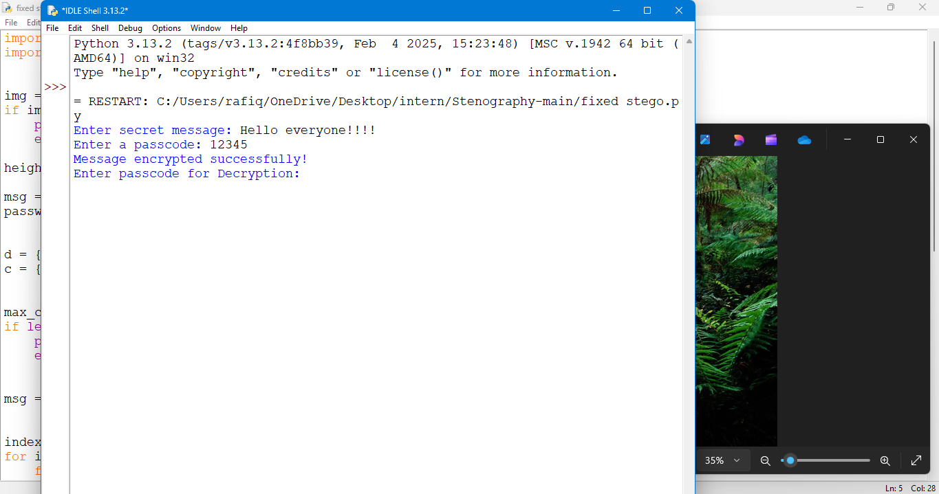

Slide 9
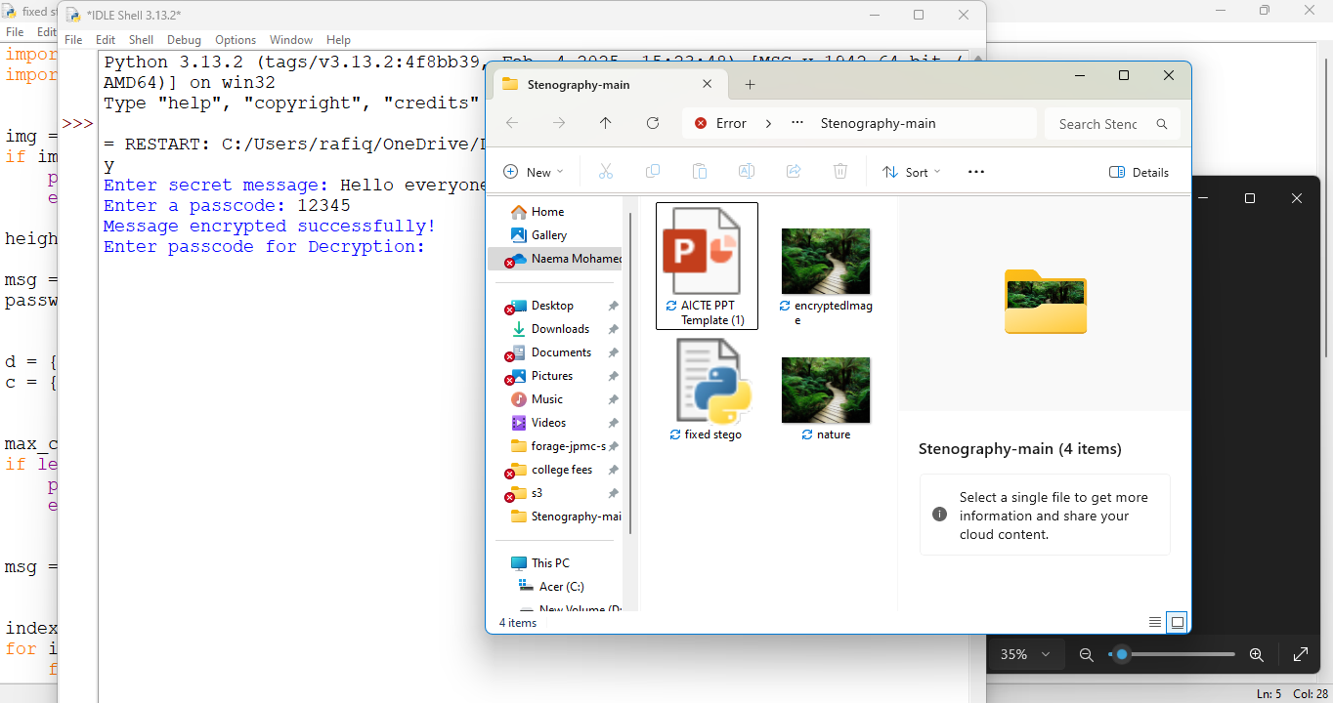

Slide 10
Conclusion
To conclude, our project on Secure Data Hiding in Image Using Steganography effectively addresses the problem of secure communication and data protection by embedding confidential information within digital images. By implementing advanced steganographic techniques such as LSB substitution, DCT, and DWT, along with encryption methods, we enhance the security and resilience of hidden data against unauthorized access and attacks. The results demonstrate that our approach maintains image quality while ensuring high security and undetectability. As steganographic threats and detection methods continue to evolve, further improvements can be made using AI-driven techniques and enhanced encryption models.

Slide 11
GitHub Link
https://github.com/naemar1/edunet-project.git

Slide 12
Future scope
The future of steganography in secure data hiding holds immense potential with advancements in artificial intelligence, cryptography, and digital security. Integrating advanced encryption techniques like quantum cryptography or blockchain-based encryption can further enhance data security before embedding it into images. Additionally, real-time steganography systems could be developed for secure messaging applications, enabling hidden communication over platforms like WhatsApp and Signal. The project can also be extended to cross-media steganography, allowing data to be embedded in videos, audio, and 3D models for diverse applications. Implementing cloud-based encrypted storage for steganographic images would ensure secure data transmission and retrieval. Moreover, the development of mobile and web applications would make steganography accessible to a broader audience, enabling secure communication with ease. Overall, the future of this project lies in enhancing security, improving efficiency, and expanding its application in real-world cybersecurity.

Slide 13
THANK YOU

