Slide 1




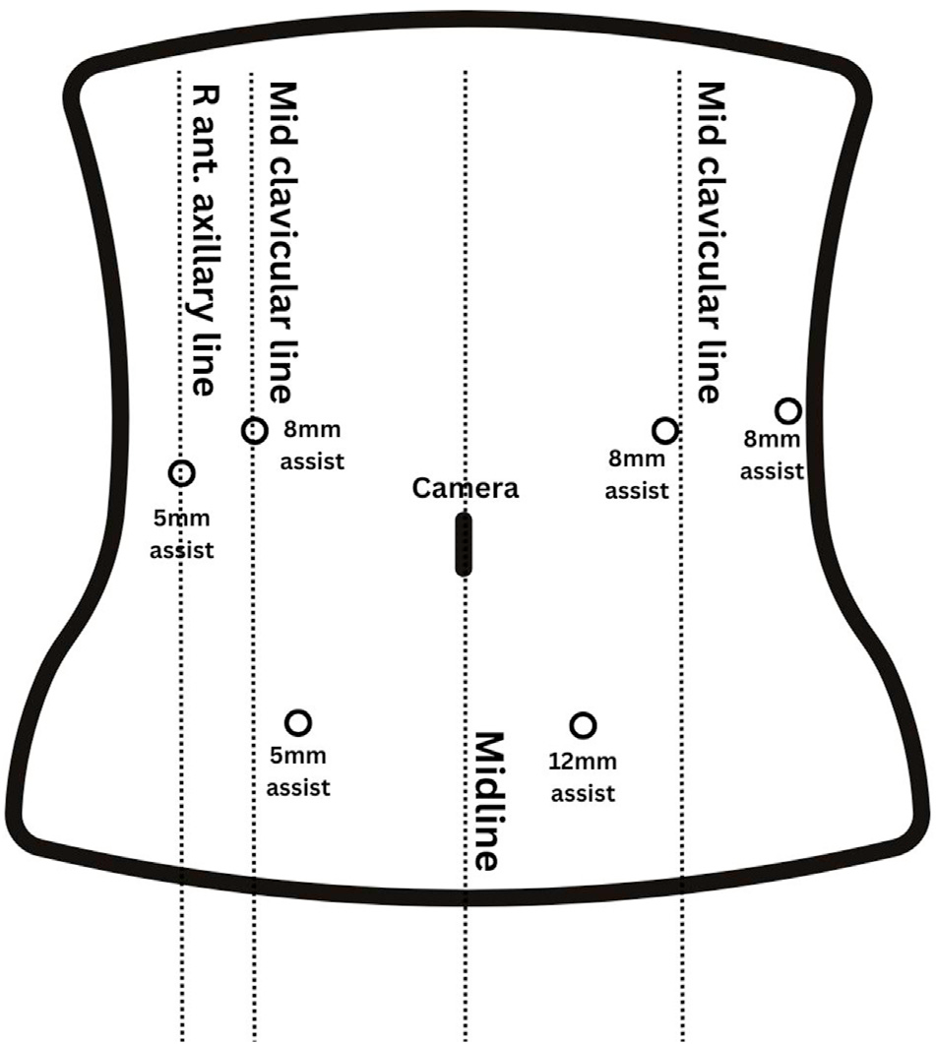




Clinical review of robotic distal pancreatectomy
Naeun Hwang¹, Sam Reddish¹, Jonathan Koea^{1,2}, Sanket Srinivasa^{1,2}
¹Upper GI Unit, Department of Surgery, Te Whatu Ora Waitematā, Auckland, New Zealand
²Department of Surgery, University of Auckland, Auckland, New Zealand
≈1 day
shorter hospital stay than laparoscopic
0%
positive margins (laparoscopic 2%)
≤ LDP
overall cost; well below open surgery
+30 min
operating time vs laparoscopic, mostly docking
01
Background & aim
02
Why robotic?
Distal pancreatectomy has moved from open (ODP) to laparoscopic (LDP) and robotic (RDP) surgery.
LDP is limited by dexterity and visualisation.
Whether RDP's technical gains improve outcomes is still debated.
Aim Compare RDP with ODP and LDP: technique, outcomes, cost and challenges.
3D magnified
vision
Tremor
filtration
Motion
scaling
Wristed
instruments
Platforms: almost all evidence is from da Vinci; Versius and hinotori™ have only early case reports.
03
Operative technique
1
Position
Supine or split legs; steep reverse Trendelenburg; dock
4
Divide
Pancreas with a macroscopic margin
2
Expose
Enter the lesser sac
5
Resect
En bloc retroperitoneal dissection ± spleen
3
Control
Splenic artery and splenic vein
Spleen preserving: splenic vessel preservation or Warshaw technique
Fig. 1 Port placement
04
Clinical outcomes of RDP
Outcome | RDP vs open | RDP vs laparoscopic
Blood loss | ▼ Lower | ▼ Lower (planned spleen preservation)
Complications | ▼ Fewer (fistula, respiratory, wound) | = Similar overall, major and fistula
Hospital stay | ▼ Shorter | ▼ ≈1 day shorter
Conversion to open | Not applicable | ▼ Fewer
Spleen preservation | ▲ Higher | ▲ Higher; fewer conversions to splenectomy
Oncological | = Non-inferior R0 and lymph node yield | ▲ 0% vs 2% R1; more lymph nodes
Operative time | = Conflicting | ▲ ≈30 min longer (docking)
■ favours RDP ■ no clear difference ■ favours comparator
05
Cost-effectiveness
06
Challenges
Operative cost
RDP higher
Overall cost
RDP ≤ LDP < ODP
Quality of life
RDP > LDP
Operative time
Docking adds time; falls with the learning curve
Theatre costs offset by shorter stay, fewer conversions and lower morbidity; costs fall with volume.
More QALYs than LDP at similar cost (ROBOCOSTES).
Team & training
Dedicated robotic team; few training centres
Access
High upfront cost; robots mostly in advanced economies
CONCLUSION
RDP offers greater precision, better clinical outcomes and more spleen preservation than open and laparoscopic surgery, and is cost-effective. Wider adoption depends on training and equitable access.

