Slide 1





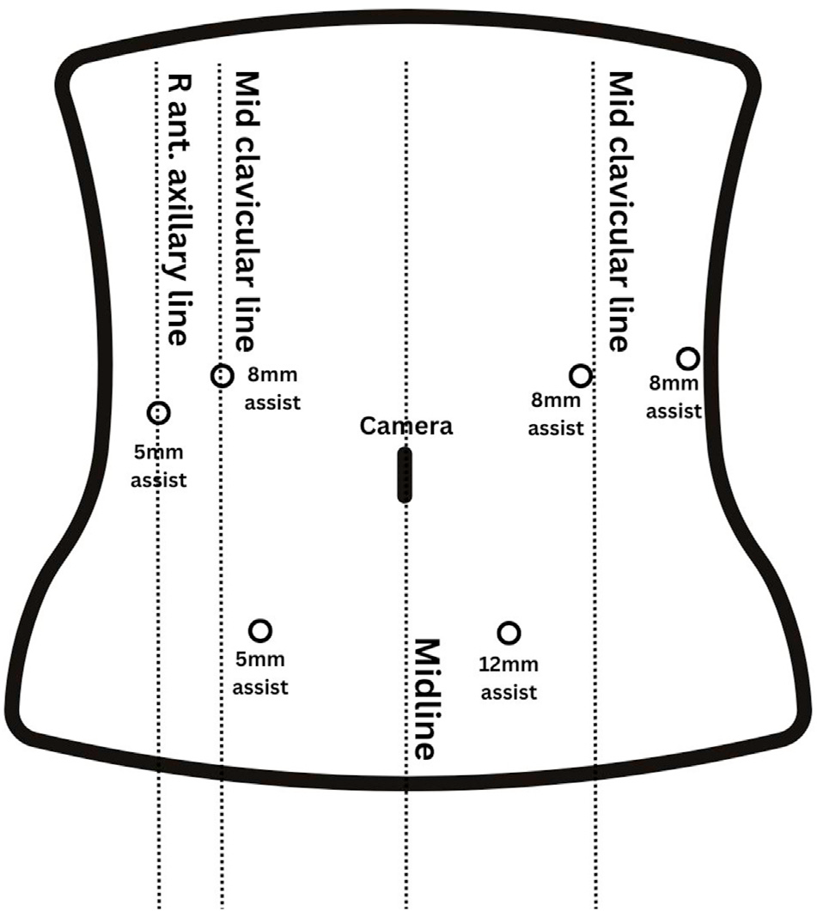




Clinical review of robotic distal pancreatectomy
Naeun Hwang¹, Sam Reddish¹, Jonathan Koea^{1,2}, Sanket Srinivasa^{1,2}
¹Upper GI Unit, Department of Surgery, Te Whatu Ora Waitematā, Auckland, New Zealand
²Department of Surgery, University of Auckland, Auckland, New Zealand
Robotic distal pancreatectomy (RDP) matches or improves on laparoscopic surgery and outperforms open surgery, at a similar overall cost to laparoscopy.
≈1 day
0%
≤ LDP
+30 min
shorter hospital stay than laparoscopic
positive margins (laparoscopic 2%)
overall cost; well below open surgery
operating time vs laparoscopic, mostly docking
01
Background & aim
04
Clinical outcomes of RDP
Distal pancreatectomy has moved from open (ODP) to minimally invasive surgery: laparoscopic (LDP) and robotic (RDP).
LDP is established but limited by dexterity and visualisation.
Whether RDP's technical gains translate into better outcomes is still debated.
Outcome | RDP vs open | RDP vs laparoscopic
Blood loss | ▼ Lower | ▼ Lower (planned SP)
Complications | ▼ Fewer (fistula, wound) | = Similar overall and fistula
Hospital stay | ▼ Shorter | ▼ ≈1 day shorter
Conversion | Not applicable | ▼ Fewer to open
Spleen preservation | ▲ Higher | ▲ Higher
Oncological | = Non-inferior R0 and nodes | ▲ 0% vs 2% R1; more nodes
Operative time | = Conflicting | ▲ ≈30 min longer
Aim Compare RDP with ODP and LDP: technique, outcomes, cost-effectiveness and challenges.
02
Why robotic?
■ favours RDP ■ no clear difference ■ favours comparator SP, spleen preservation
3D magnified
visualisation
Tremor
filtration
Motion
scaling
Wristed
instruments
05
Cost-effectiveness
Platforms: almost all evidence is from da Vinci; Versius and hinotori™ have only early case reports.
Operative cost
RDP higher
Overall cost
RDP ≤ LDP < ODP
Quality of life
RDP > LDP
03
Operative technique
Theatre costs are offset by shorter stay, fewer conversions and lower morbidity.
Costs fall as case volume grows.
More QALYs than LDP at similar cost (ROBOCOSTES and others).
1
Position
Supine; reverse Trendelenburg; dock
2
Expose
Enter the lesser sac
3
Control
Splenic artery and vein
06
Challenges
4
Divide
Pancreas, clear margin
Operative time
Docking adds time; falls along the learning curve
Fig. 1 Port placement
5
Resect
En bloc ± spleen
Team & training
Dedicated robotic team; few training centres
Spleen preserving: splenic vessel preservation or Warshaw technique
Access
High upfront cost; robots concentrated in advanced economies
CONCLUSION
RDP offers greater precision, better clinical outcomes and more spleen preservation than open and laparoscopic surgery, and is cost-effective. Wider adoption depends on training and equitable access.
Full paper: Lap Endosc Robot Surg 2025;8:80–83

