Slide 1
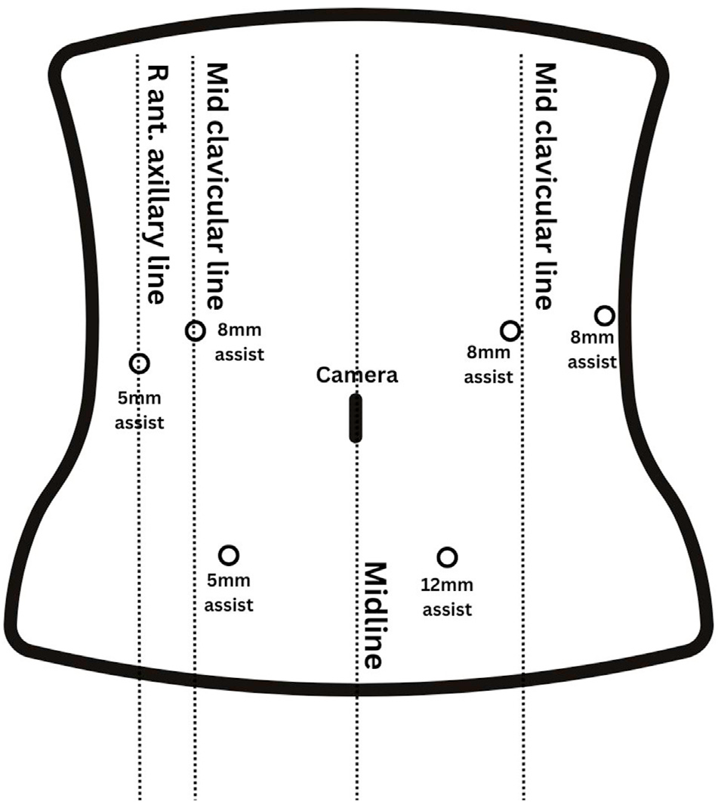
Clinical review of robotic distal pancreatectomy
Naeun Hwang¹, Sam Reddish¹, Jonathan Koea^{1,2}, Sanket Srinivasa^{1,2}
¹Upper GI Unit, Department of Surgery, Te Whatu Ora Waitematā, Auckland, New Zealand
²Department of Surgery, University of Auckland, Auckland, New Zealand
BACKGROUND
CLINICAL OUTCOMES OF RDP
Distal pancreatectomy has shifted from open (ODP) to minimally invasive surgery: laparoscopic (LDP, since 1994) and robotic (RDP).
LDP is established but limited by dexterity and visualisation.
RDP addresses these limits, yet whether it improves outcomes over LDP remains unsettled.
Outcome | RDP vs ODP | RDP vs LDP
Blood loss | ▼ Lower | ▼ Lower (planned SP)
Complications | ▼ Fewer (fistula, respiratory, wound) | = Similar overall, major & fistula
Hospital stay | ▼ Shorter | ▼ ≈1 day shorter
Conversion to open | n/a | ▼ Lower
Spleen preservation | ▲ Higher | ▲ Higher; fewer conversions to splenectomy
Oncological | = Non-inferior R0 and LN yield (MIDP) | ▲ 0% vs 2% R1; more lymph nodes
Operative time | = Conflicting | ▲ ≈30 min longer (docking)
AIM A clinical review comparing RDP with ODP and LDP: technique, clinical outcomes, cost-effectiveness and challenges.
WHY ROBOTIC?
3D
magnified
visualisation
Tremor
filtration
Motion
scaling
Wristed
articulating
instruments
Green favours RDP Grey no clear difference Amber favours comparator. SP, spleen preservation; MIDP, minimally invasive DP
1 day
shorter stay
vs LDP
0%
positive margins
(LDP 2%)
+30 min
operative time
vs LDP
Platforms: almost all evidence is from da Vinci; Versius and hinotori™ have only early case reports, and none yet for Hugo.
OPERATIVE TECHNIQUE
COST-EFFECTIVENESS
1 Position Supine or split legs; steep reverse Trendelenburg, then dock
2 Expose Enter the lesser sac to expose the pancreas
3 Control Splenic artery and splenic vein
4 Divide Pancreas with a macroscopic margin
5 Resect En bloc retroperitoneal dissection ± spleen
Operative cost
RDP > LDP, ODP
Overall cost
RDP ≤ LDP < ODP
QALYs
RDP > LDP
Higher instrument and platform costs are offset by shorter stay, fewer conversions and lower morbidity.
Costs fall with case volume (learning curve, robot-specific instruments).
Higher QALYs than LDP at similar cost, within the European acceptability threshold; supported by the multicentre ROBOCOSTES trial.
Fig. 1 Port placement: 8 mm robotic arms, 12 mm camera, 5 and 12 mm assistant ports
Spleen-preserving options: splenic vessel preservation or Warshaw technique
CHALLENGES
CONCLUSION
!
Operative time
≈30 min longer than LDP in meta-analysis, largely robot docking; shortens along the learning curve.
RDP is a safe, cost-effective advance in distal pancreatectomy, offering greater precision, better clinical outcomes and higher spleen preservation than open and laparoscopic approaches.
Wider adoption depends on expanding training, dedicated robotic teams and equitable access.
!
Team & training
Needs a console surgeon, skilled bedside assistant and robot-trained scrub nurse; few training centres.
!
Cost & access
High upfront cost; robots concentrated in advanced economies, creating inequity of access.
Hwang N, Reddish S, Koea J, Srinivasa S. Clinical review of robotic distal pancreatectomy. Laparoscopic, Endoscopic and Robotic Surgery 2025;8:80–83. doi:10.1016/j.lers.2025.02.001

