Slide 1
NAME: NAFEES AHAMED A COLLEGE NAME: SARANATHAN COLLEGE OF ENGINEERING BRANCH:ARTIFICIAL INTELLIGENCE AND DATA SCIENCE YEAR: THIRD YEAR NM ID: au813821243037 REGISTER NUMBER:813821243037 EMAIL ID: nafeesahamed006@gmail.com
Final Project
Sentiment Analysis
3/21/2024 Annual Review

Slide 2
PROJECT TITLE
Sentiment Analysis: A Journey Through Text Classification
3/21/2024 Annual Review

Slide 3


AGENDA
Project Overview
Problem Statement
End Users Solution
Value Proposition
Modelling
Results and Evaluation
3/21/2024 Annual Review

Slide 4

PROBLEM STATEMENT
Manual sentiment analysis of large volumes of text data is inefficient and time-consuming, hindering decision-making processes for companies receiving numerous customer reviews
3/21/2024 Annual Review

Slide 5

PROJECT OVERVIEW
Sentiment Analysis: leveraging natural language processing (NLP) and machine learning to automate the classification of emotions in text data.
Implementation of text cleaning techniques, word embeddings, and various neural network architectures to build effective sentiment analysis models.
3/21/2024 Annual Review

Slide 6

WHO ARE THE END USERS?
Companies with substantial text data streams, such as e-commerce platforms, social media platforms, and customer service departments.
Data scientists and machine learning engineers tasked with automating sentiment analysis processes.
3/21/2024 Annual Review

Slide 7

YOUR SOLUTION AND ITS VALUE PROPOSITION
Develop a robust sentiment analysis pipeline utilizing NLP and machine learning techniques.
Automate the classification of text data into positive, negative, or neutral sentiments, enabling efficient analysis of large datasets.
Enhance decision-making processes for businesses by providing insights from customer feedback and reviews.
3/21/2024 Annual Review

Slide 8

THE WOW IN YOUR SOLUTION
Efficiently process large volumes of text data without manual intervention.
Improve accuracy and consistency in sentiment analysis compared to manual methods.
Scalable solution adaptable to diverse industries and applications.
3/21/2024 Annual Review

Slide 9
MODELLING
Text cleaning: URL and email removal, punctuation removal, lowercase conversion, stop-word removal, and tokenization.
Word embeddings: Transforming text data into numeric tensors using word vectors.
Modelling techniques: LSTM, Bidirectional LSTM, Convolutional Neural Networks (CNN) for sentiment analysis.
3/21/2024 Annual Review

Slide 10
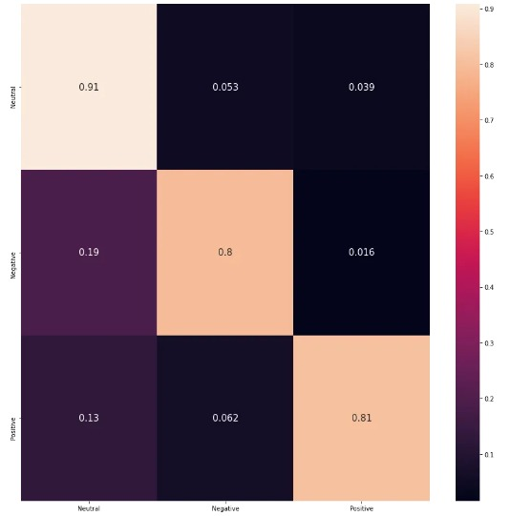
RESULTS
Evaluation of model performance based on accuracy, precision, recall, and F1-score metrics.
Comparison of different neural network architectures for sentiment analysis .
Visualization of confusion matrices to assess model performance across sentiment classes.
Demo Link
3/21/2024 Annual Review

