Slide 1
Implementation and development of a web-based application Curriculum Vitae analysis and evaluation system, An approach to CV modeling
A PRESENTATION ON
INSTITUTE OF INFORMATION TECHNOLOGY
JAHANGIRNAGAR UNIVERSITY

Slide 2
PROPOSED BY :
IIT_ JU_ Aristocrats
Nafeo Alam (Roll: 186)
Md.Mohibur Rahman khan (Roll:181 )
Md.Julkar Nayeen Mahi (Roll: 162)
Md.Anwar Hossain (Roll: )
Ashik Sarker Lifat (Roll: )
IIT_ JU_ Aristocrats

Slide 3
Rationale
Goal 1 : ensuring talents for any organization throughout the whole country via interactive web based system
Goal 2: An innovative work under software web based module for any country
IIT_ JU_ Aristocrats

Slide 4
Transition headline
1
Let’s start with the first set of slides

Slide 5
Quotations are commonly printed as a means of inspiration and to invoke philosophical thoughts from the reader.

Slide 6
Project Relavance:
A new CV monitoring system for the HR section of any company or organizations
In addition to traditional parameters such as the academic results, experience, interests, skills of the candidates, the software will additionally provide some level of intelligent reasoning
Candidates will not only select with HR’s own instints and judgements but also some technical help in order to support their selection process.
This software will provide the necessary analytical methods which will help the HR section to identify the more qualified and desired candidates
IIT_ JU_ Aristocrats

Slide 7
Bring the attention of your audience over a key concept using icons or illustrations

Slide 8
Problems with traditional CV modelling
HR’s choosable person may get the job , degnified person may suffer from his/her own identity,quality and ability reviewing an HR’s decesion .
The HR section has to go through a loads of CVs within a short span of time and have to select only a handful of them to call for interview. As a result, a lot of CV can get overlooked or the details may not be analysed with required amount of time.
while one can overlook some details in one CV, the same details may seem important to others
Also the hesitation and quick judgements of HR team may affect the overall process and also the perspective of “ideal” candidate may vary from person to person.
IIT_ JU_ Aristocrats

Slide 9

Project Scopes
The software is meant to help HR in their selection, analysis and processing of CV through providing technological support with their own reasoning and judgements.
The software analyses CVs and instantly identifies their strengths and weaknesses. It also compares CVs to the requirements of a job specification.
The commercial usage versions of the software include the ability to batch-analyse an unlimited number of CVs and order them by best overall CV, best match to a job specification and individual identified human qualities and skills.

Slide 10
Project Scopes
Graphical printable views are presented that provide an instant overview of the quality of CVs and the suitability of an applicant to a job vacancy
The software features a keyword search and compare facility. However, CV and Job Specification Analyser is unique in that it also features a human qualities analysis engine
This part of the software identifies an applicant’s character, nature and disposition, adaptability, career aspirations, creativity, quality awareness, diligence, teamwork and interpersonal skills. It also identifies an applicant’s level of educational attainment, IT skills, management skills, organisational skills and expertise
The software also identifies lazy or informal grammar, potentially negative words and phrases and other content that is generally considered to be inappropriate for a CV.
IIT_ JU_ Aristocrats

Slide 11
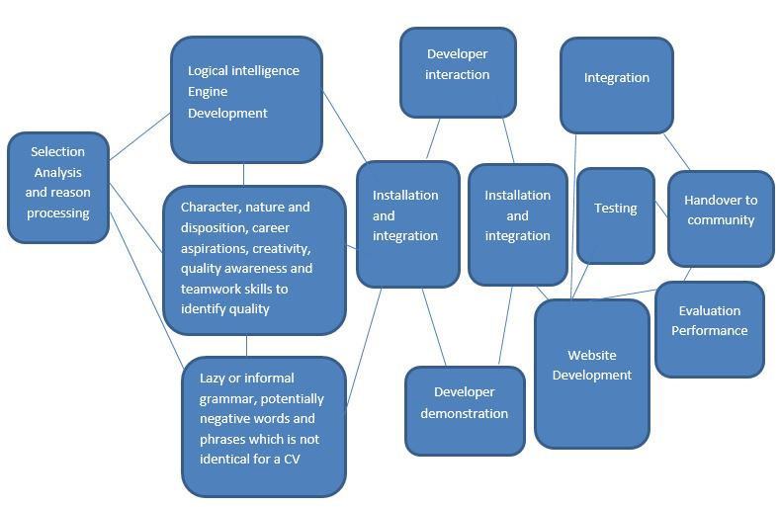
Task Network
IIT_ JU_ Aristocrats

Slide 12
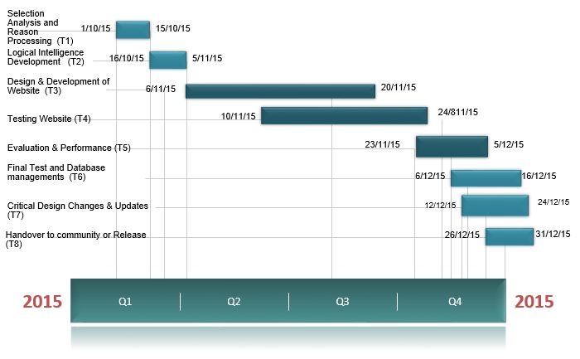
Project Milestone
IIT_ JU_ Aristocrats

Slide 13
Questionnaires ?
Thank you
IIT_ JU_ Aristocrats

Slide 14
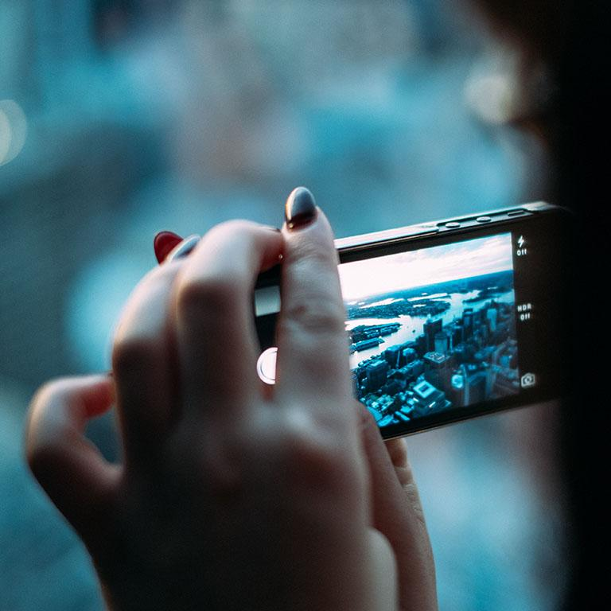
Project Milestone
A complex idea can be conveyed with just a single still image.
Namely making it possible to absorb large amounts of data quickly.

Slide 15
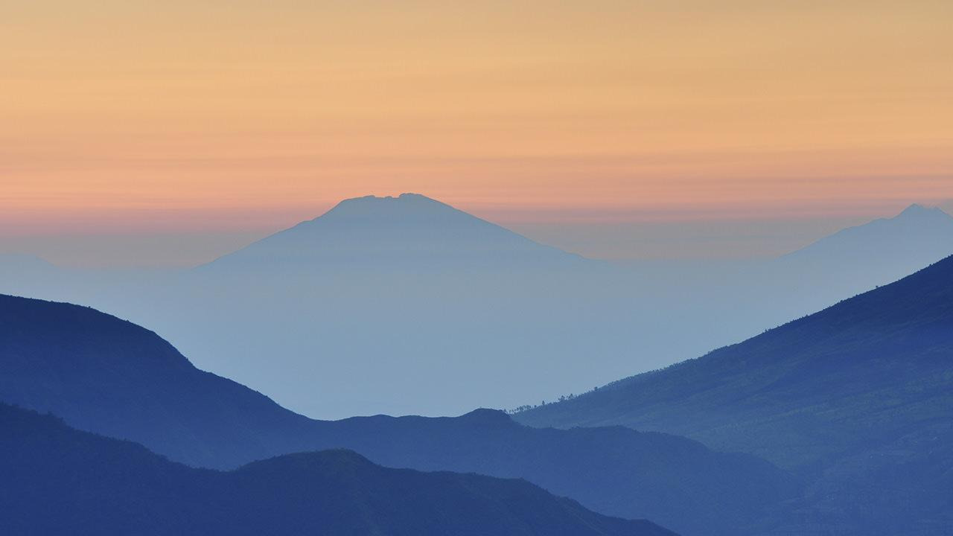
WANT BIG IMPACT?
USE BIG IMAGE.

Slide 16
USE CHARTS TO EXPLAIN YOUR IDEAS

Slide 17
AND TABLES TO COMPARE DATA
 | A | B | C
Yellow | 10 | 20 | 7
Blue | 30 | 15 | 10
Orange | 5 | 24 | 16

Slide 18
MAPS
our office

Slide 19
89,526,124
Whoa! That’s a big number, aren’t you proud?

Slide 20
89,526,124$
185,244 users
100%
That’s a lot of money
And a lot of users
Total success!

Slide 21
OUR PROCESS IS EASY
first
second
last

Slide 22
LET’S REVIEW SOME CONCEPTS
Yellow
Is the color of gold, butter and ripe lemons. In the spectrum of visible light, yellow is found between green and orange.
Blue
Is the colour of the clear sky and the deep sea. It is located between violet and green on the optical spectrum.
Red
Is the color of blood, and because of this it has historically been associated with sacrifice, danger and courage.
Yellow
Is the color of gold, butter and ripe lemons. In the spectrum of visible light, yellow is found between green and orange.
Blue
Is the colour of the clear sky and the deep sea. It is located between violet and green on the optical spectrum.
Red
Is the color of blood, and because of this it has historically been associated with sacrifice, danger and courage.

Slide 23
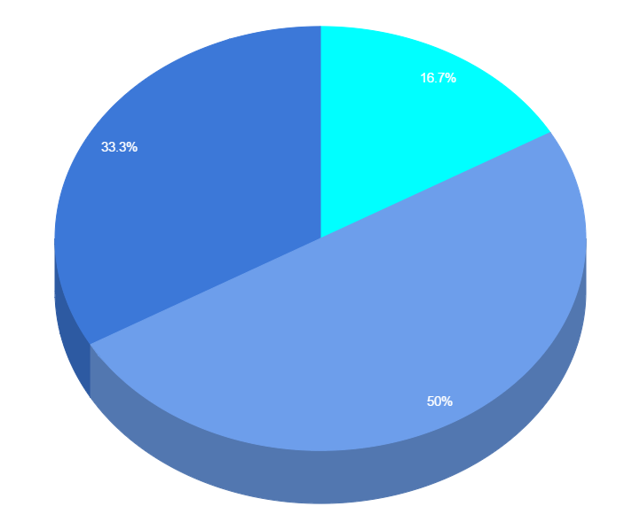
You can copy&paste graphs from Google Sheets

Slide 24
Place your screenshot here
ANDROID PROJECT
Show and explain your web, app or software projects using these gadget templates.

Slide 25
Place your screenshot here
iPHONE PROJECT
Show and explain your web, app or software projects using these gadget templates.

Slide 26
Place your screenshot here
TABLET PROJECT
Show and explain your web, app or software projects using these gadget templates.

Slide 27
Place your screenshot here
DESKTOP PROJECT
Show and explain your web, app or software projects using these gadget templates.

Slide 28
THANKS!
Any questions?
You can find me at
@username / user@mail.me

Slide 29
CREDITS
Special thanks to all the people who made and released these awesome resources for free:
Presentation template by SlidesCarnival
Photographs by Unsplash

Slide 30

PRESENTATION DESIGN
This presentation uses the following typographies and colors:
Titles: Oswald
Body copy: Source Sans Pro
You can download the fonts on this page:
https://www.google.com/fonts#UsePlace:use/Collection:Source+Sans+Pro:400,700|Oswald:400,700
Click on the “arrow button” that appears on the top right
Sky blue #00cef6 / Bright green #aff000 / Blue #3c78d8 / Dark blue #28324a
You don’t need to keep this slide in your presentation. It’s only here to serve you as a design guide if you need to create new slides or download the fonts to edit the presentation in PowerPoint®

Slide 31
SlidesCarnival icons are editable shapes.
This means that you can:
Resize them without losing quality.
Change fill color and opacity.
Change line color, width and style.
Isn’t that nice? :)
Examples:

