Slide 1
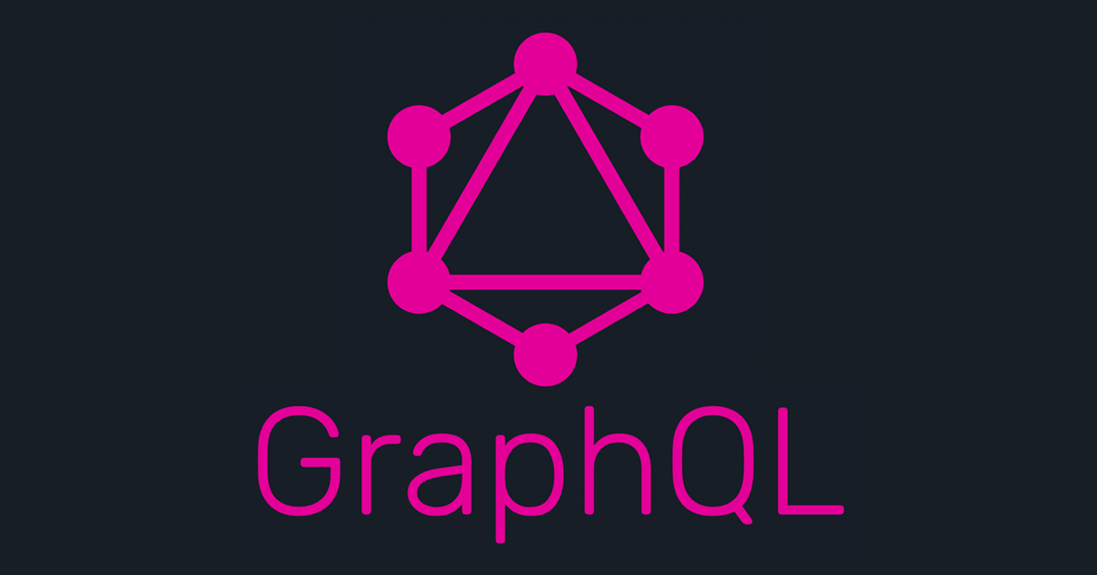
Lunch & Learn
Nafeu Nasir – Full Stack Developer (Console Team)
March 22nd, 2019

Slide 2
What is your experience with GraphQL:
a – never heard of it
b – heard of it but have never used it
c – used it in a sandbox or pet project
d – used it in production

Slide 3
What is GraphQL?

Slide 4
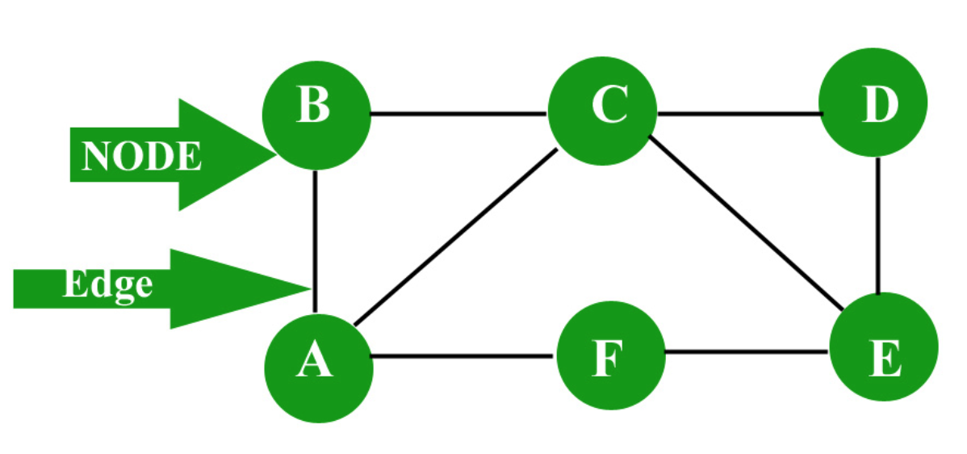
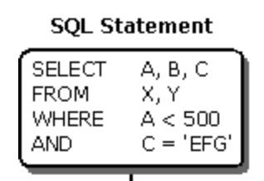
First lets get some context:
Graph => thinking of a problem in terms of nodes and edges
QL => query language (a way of asking for data)
GraphQL => a way of asking for data in terms of nodes and edges
Imagine querying an API in terms of nodes and edges instead of endpoints.

Slide 5
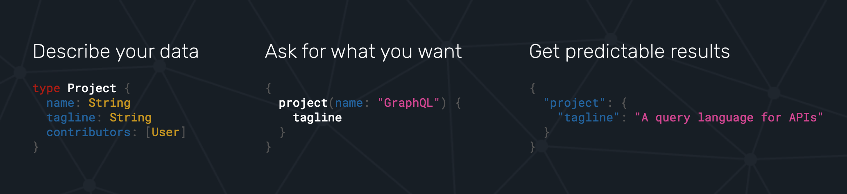

Slide 6
It can be your API, or a wrapper around your existing API, or an API gateway to manage communications to all your microservices.
It is a process that sits between your application logic and your database resources, but at its core its just a paradigm for designing your API(s).

Slide 7
Why should you care?

Slide 8
Maintaining and evolving REST APIs in the long run is:
a - Trivial
b - Meh
c - Reasonably difficult
d - Very difficult

Slide 9
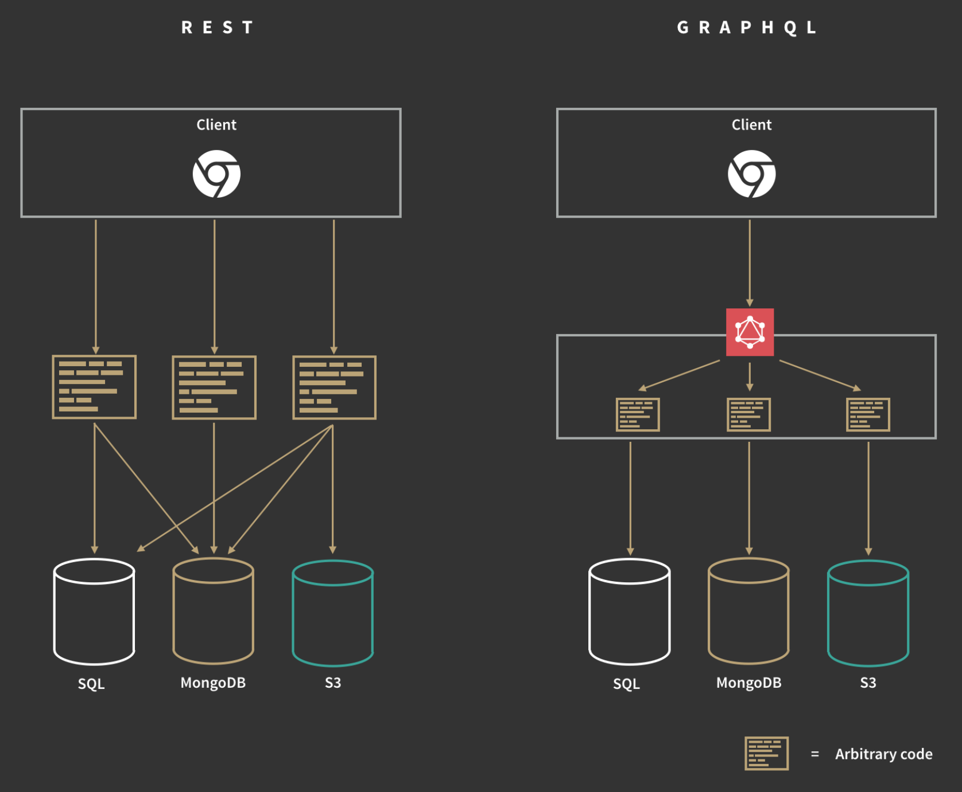
It replaces REST APIs! (or can be used to manage multiple separate REST APIs)
it can be used in conjunction with existing technology
it is shown to be highly performant, more maintainable, more scalable and more efficient in place of REST

Slide 10
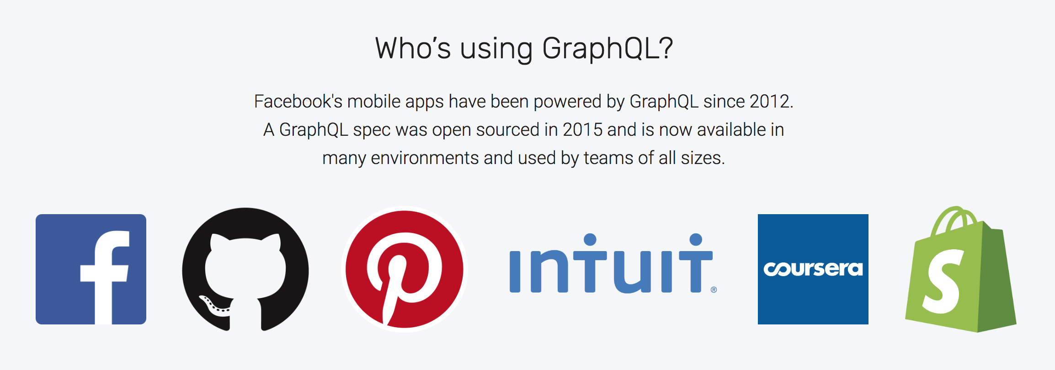

Slide 11
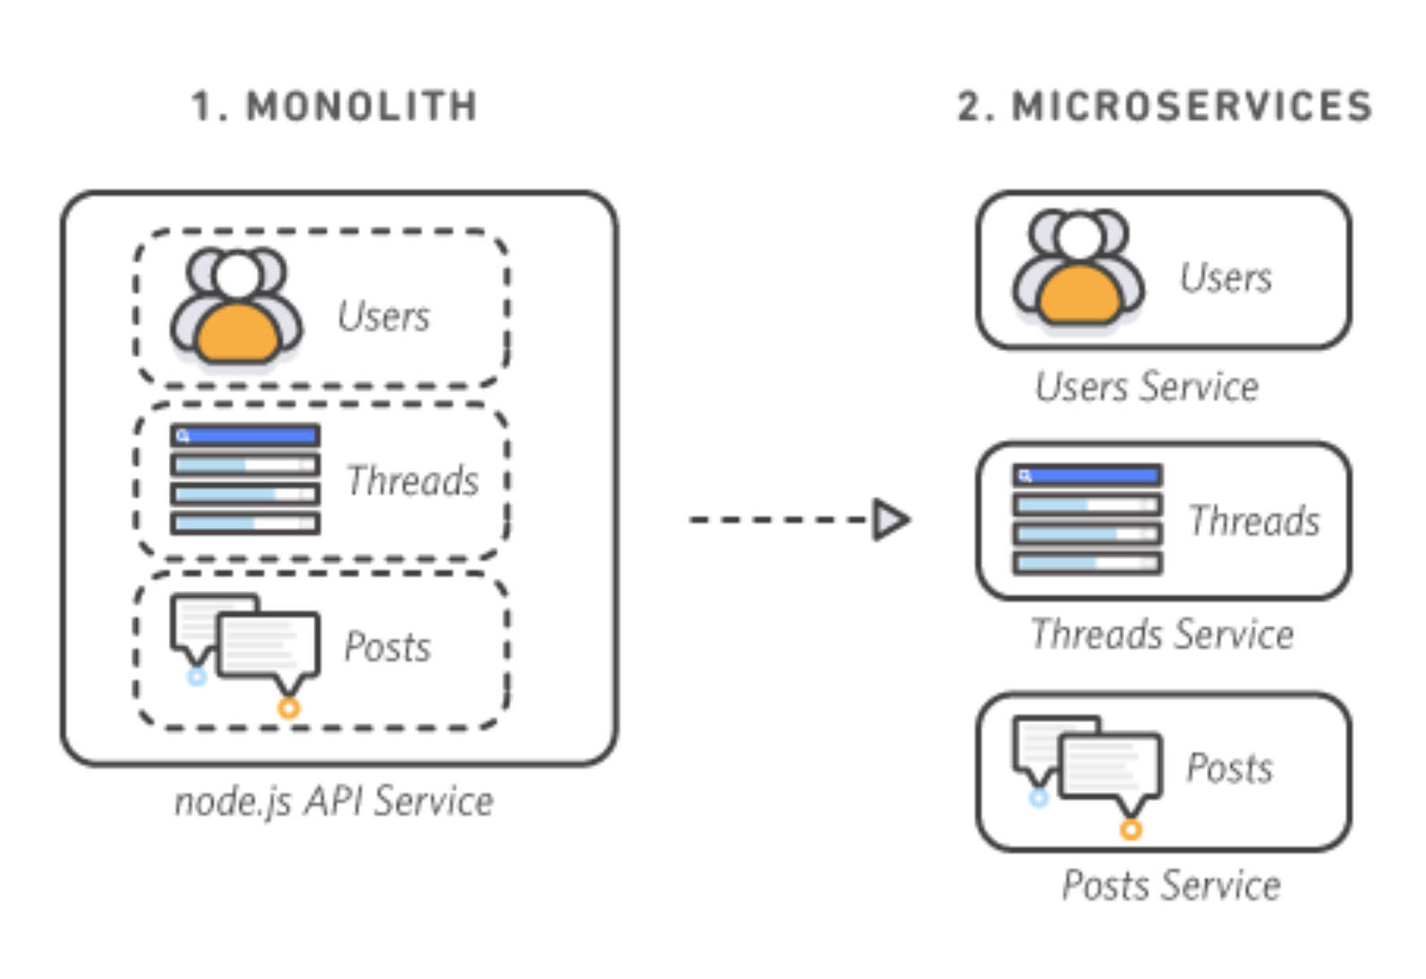
Goodbye Monolith
the industry is moving towards microservice and hexagonal architecture over monolithic architecture (and for good reason)
we have a huge variation in experiences now (mobile, tablet, IOT device, desktop, voice assistant) all querying the same resources
we have Third Party APIs that do certain challenging things really well so that we don't have to anymore
Twilio: handles texting & automated voice calls
Braintree: handles monetary transactions
Auth0: handles authentication and user account management
Goole/Amazon/IBM/Microsoft Cloud: various AI related APIs

Slide 12
Our problems, in layman's:
Our apps are talking to a lot of things, and then those things are talking to other things. Some of those things are inside a database that we own and some aren’t. Some of those things get searched through multiple times even when its not necessary. Some of those lookups hog more resources than they need to. Sometimes we need to change the types of things we are looking for while simultaneously NOT breaking how we are already looking for things.
Sometimes we do not get all of the things and we don’t know why.

Slide 13
Facebook’s Solution:
Instead of having multiple “dumb” endpoints, have a single “smart” endpoint that can take in complex queries, and then massage the data output into whatever shape the client requires.

Slide 14
“I want a list of all the users but sometimes I just need a list of their emails, or just their phone numbers”
With REST:
Multiple endpoints? or additional query params?
`api/users/getAll`
`api/users/getAllEmails`
`api/users/getAll?filter=email`
…
With GraphQL:
One endpoint: /graphql?query=‘…’
`{
User {
emails
}
}`

Slide 15
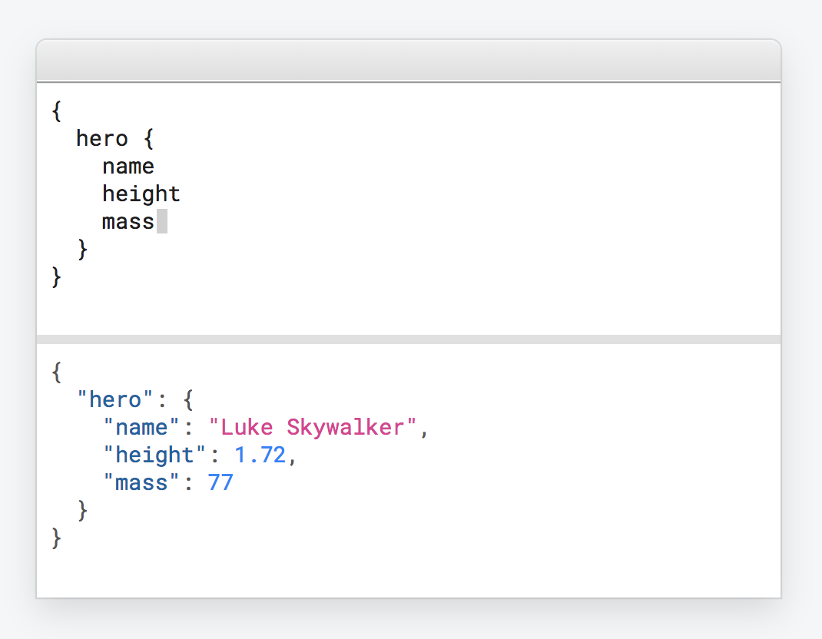
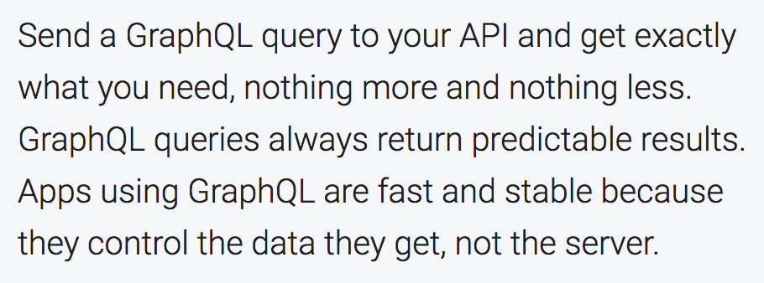

Slide 16
You worked on a production level API that you felt was making more requests and serving more data than it needed to:
a - Disagree
b – Mildly Disagree
c - Agree
d – Strongly Agree

Slide 17
GraphQL makes it easy to stich together results from various combined external resources.
An example of this will be shown during the demo.

Slide 18
How about maintainability?

Slide 19
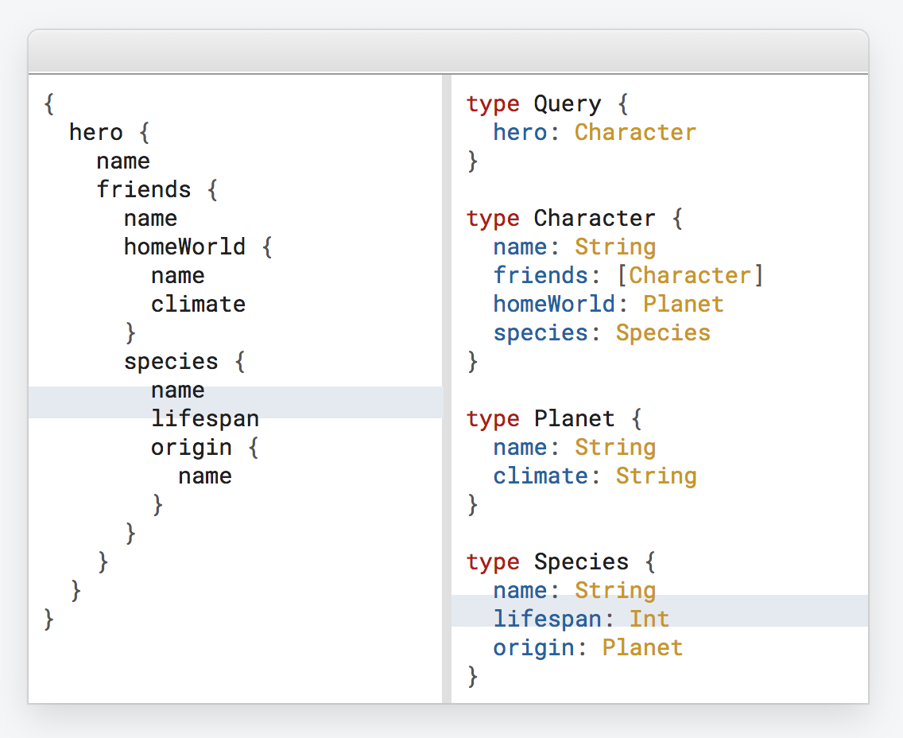
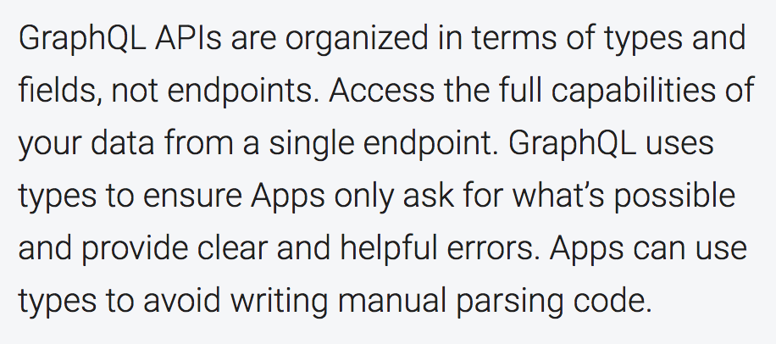
Type System

Slide 20
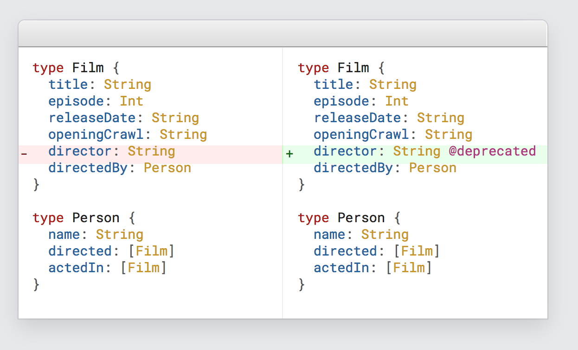
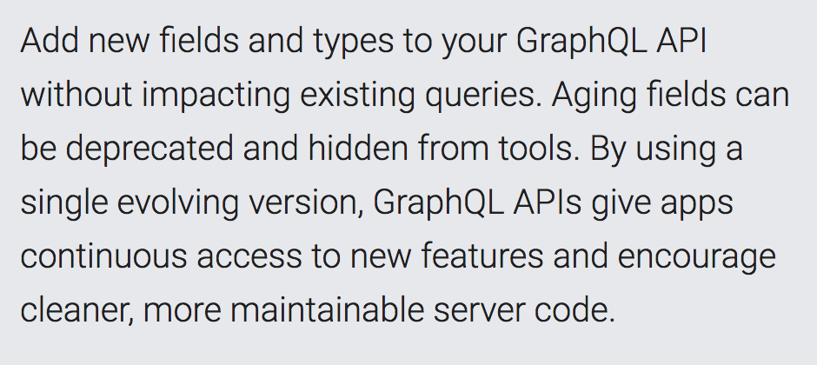
Update and evolve your API without versions

Slide 21
There are some awesome devtools that come with GraphQL right out of the box which will be shown in the demo.

Slide 22
DEMO TIME!
source code available at:
github.com/nafeu-pelmorex/pa-graphql-lnl

Slide 23
Discussion Time:
How can we potentially utilize GraphQL to improve our apps, apis and other technical offerings at Pelmorex?
What are some current bottlenecks on an API level?

