Slide 1
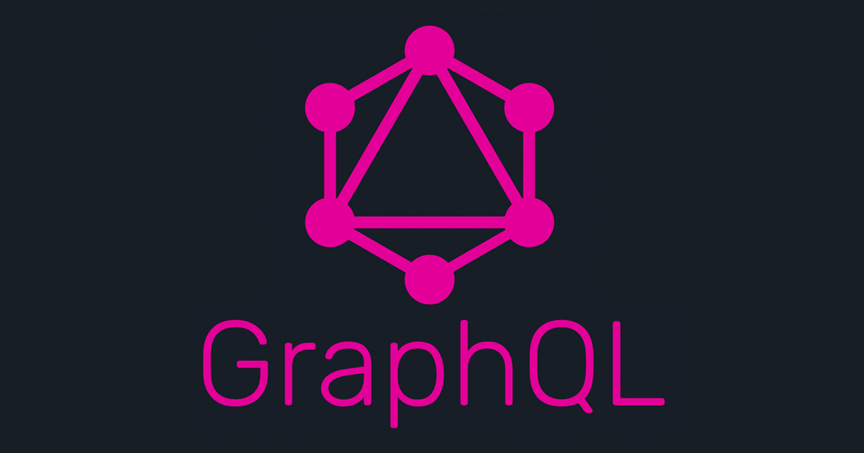
Lunch & Learn
Nafeu Nasir – Full Stack Developer (Console Team)
March 22nd, 2019

Slide 2
What is GraphQL?

Slide 3
First lets get some context:
Graph => thinking of a problem in terms of nodes and edges
QL => query language (a way of asking for data)
GraphQL => a way of asking for data in terms of nodes and edges
Imagine querying an API in terms of nodes and edges instead of endpoints.

Slide 4
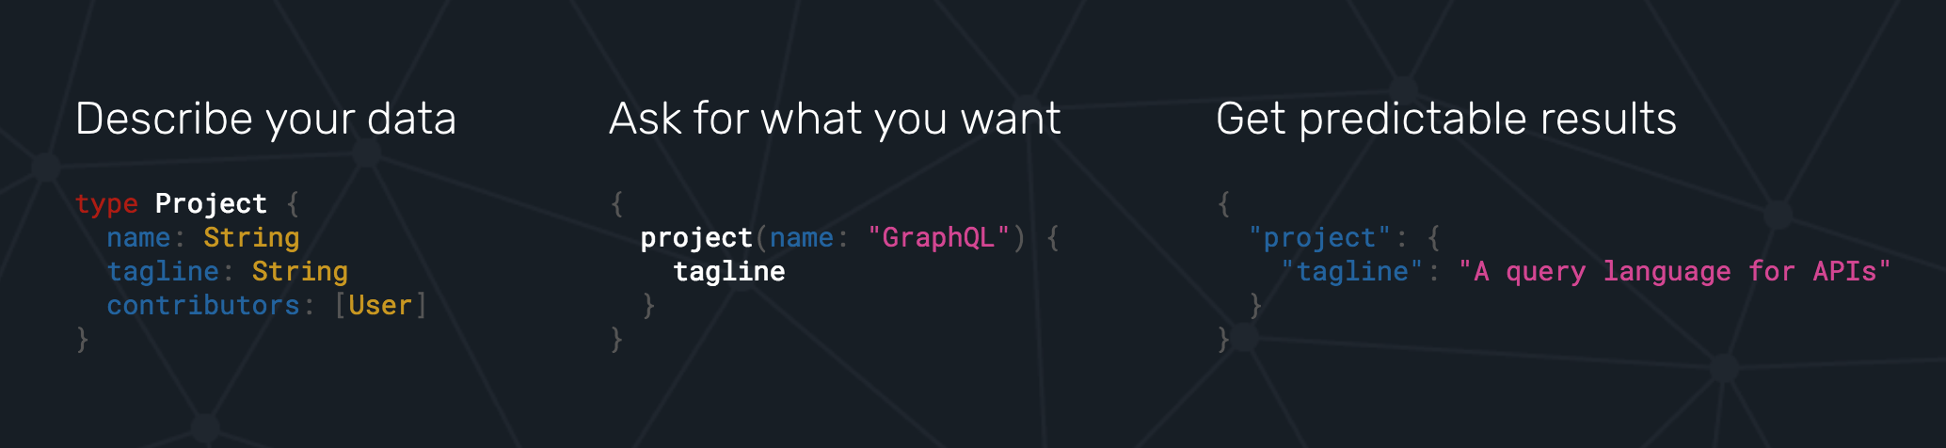

Slide 5
Why should you care?

Slide 6
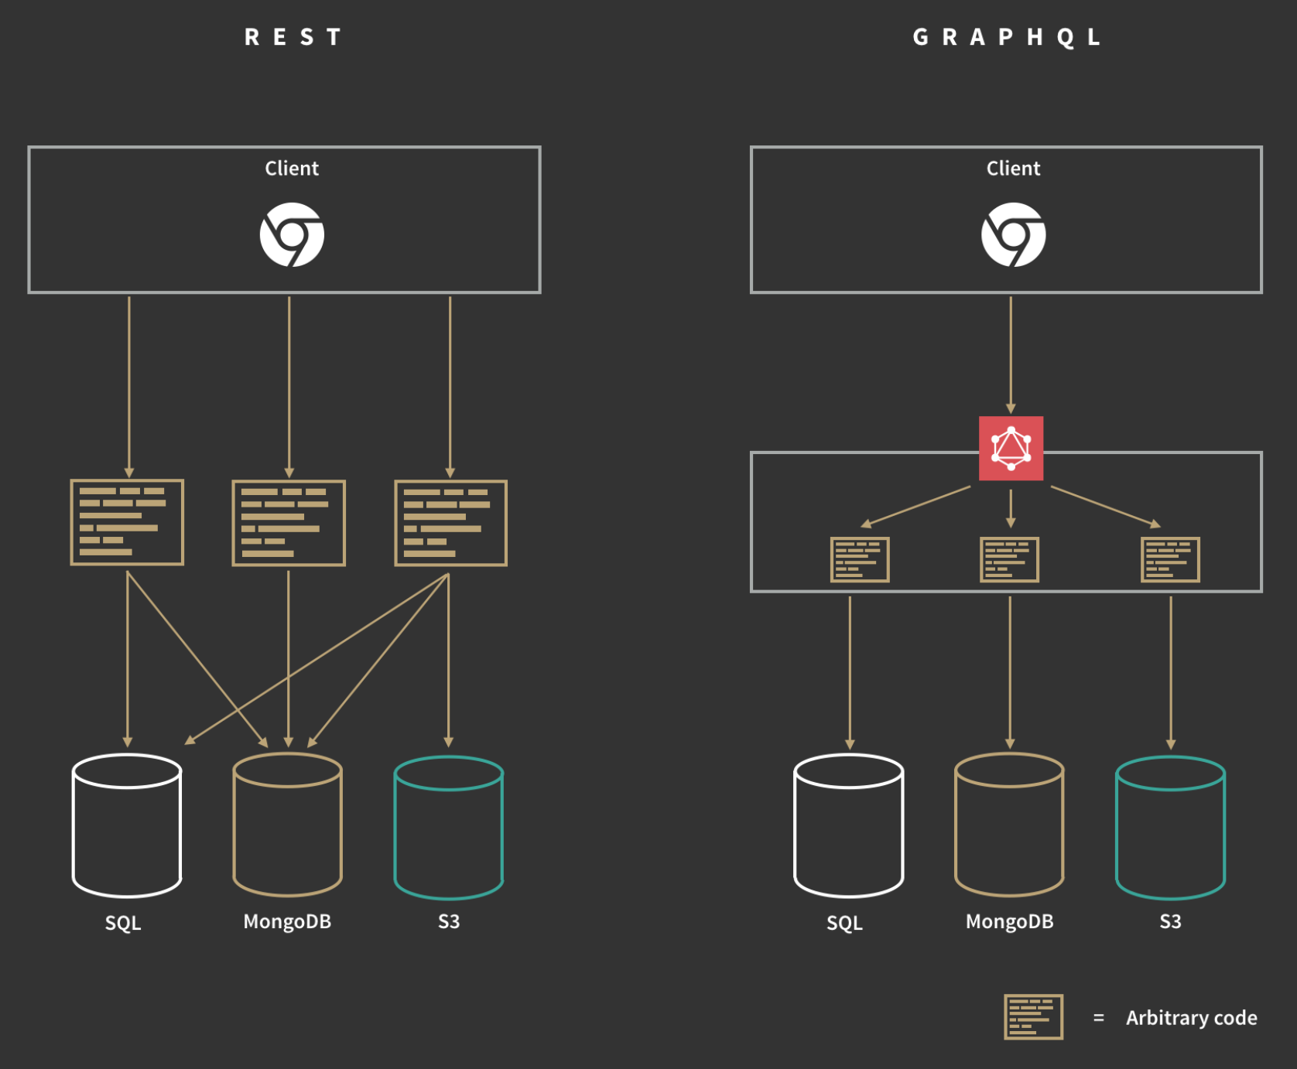
It replaces REST APIs! (or can be used to manage multiple separate REST APIs)
it can be used in conjunction with existing technology
it claims to be highly performant, more maintainable, more scalable and more efficient in place of REST

Slide 7
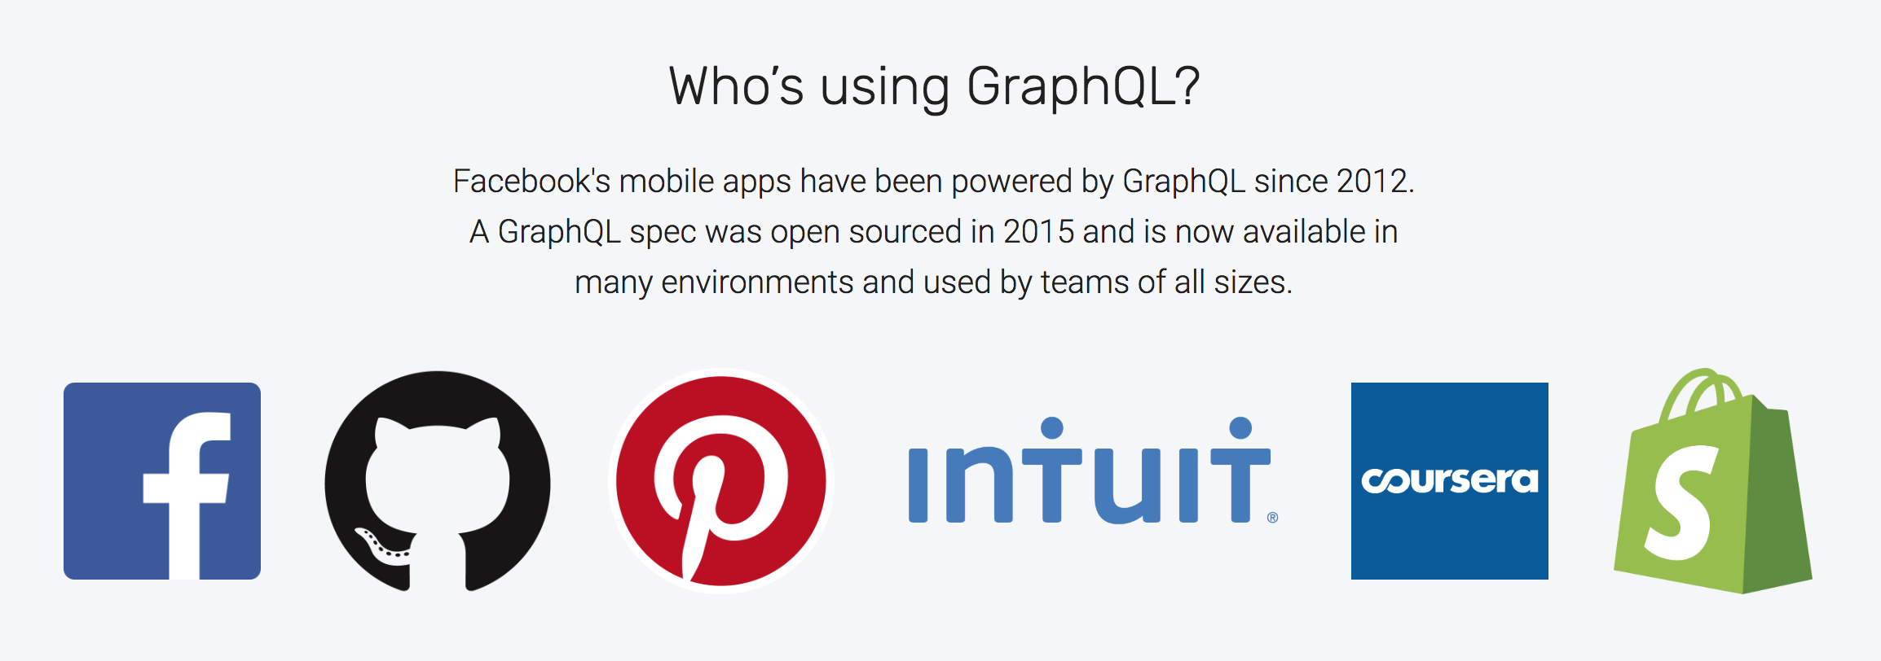

Slide 8
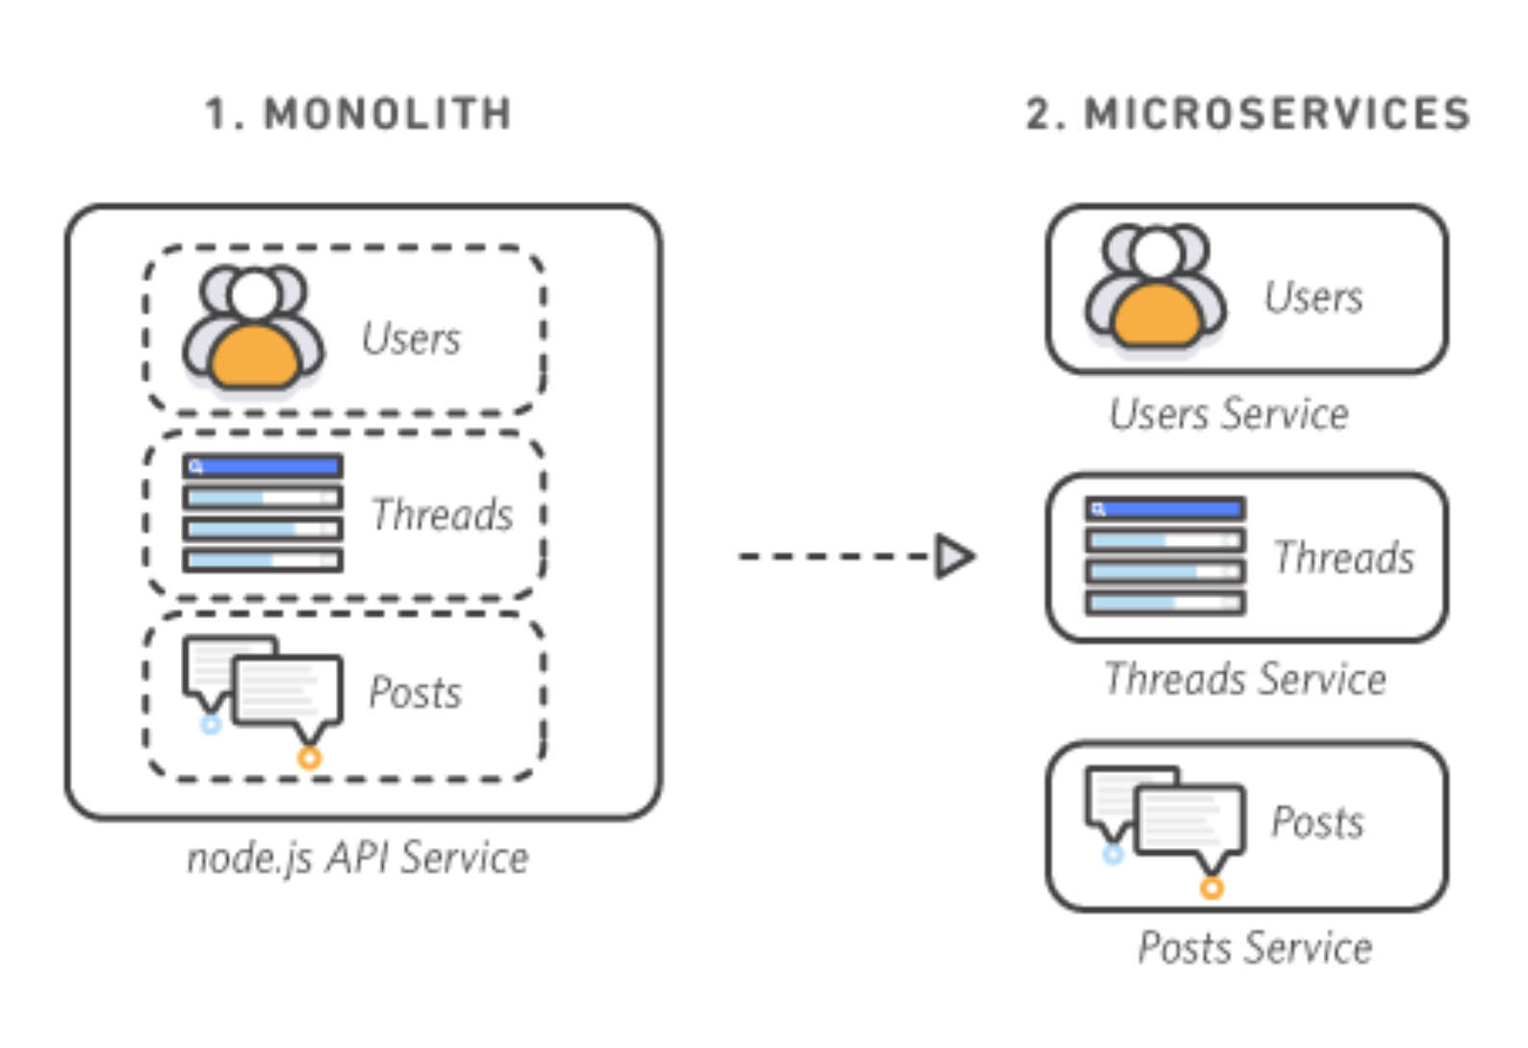
Goodbye Monolith
the industry is moving towards microservice and hexagonal architecture over monolithic architecture (and for good reason)
we have a huge variation in experiences now (mobile, tablet, IOT device, desktop, voice assistant) all querying the same resources
we have Third Party APIs that do certain challenging things really well so that we don't have to anymore
Twilio: handles texting & automated voice calls from your apps
Braintree: handles monetary transactions
Auth0: handles authentication and user account management
Goole/Amazon/IBM/Microsoft Cloud: various AI related APIs

Slide 9
Our problems, in layman's:
Our apps are talking to a lot of things, and then those things are talking to other things. Some of those things are inside a database that we own and some aren’t. Some of those things get searched through multiple times even when its not necessary. Some of those lookups hog more resources than they need to. Sometimes we need to change the types of things we are looking for while simultaneously NOT breaking how we are already looking for things.
Sometimes we do not get all of the things and we don’t know why.

Slide 10
With GraphQL you always ask for exactly what you need

Slide 11
“I want a list of all the users but sometimes I just need a list of their emails, or just their phone numbers”
With REST:
Multiple endpoints? or additional query params?
`api/users/getAll`
`api/users/getAllEmails`
`api/users/getAll?filter=email`
…
With GraphQL:
One endpoint: /graphql?query=‘…’
`{
User {
emails
}
}`

Slide 12
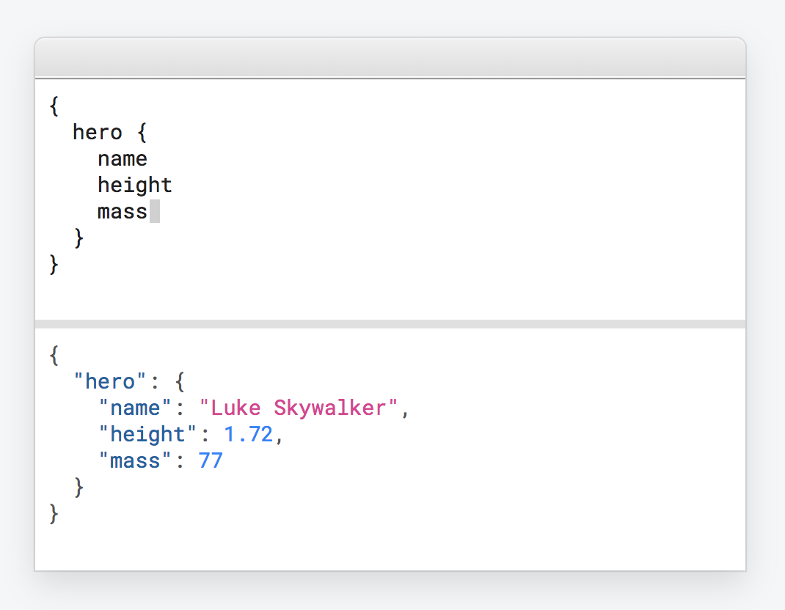
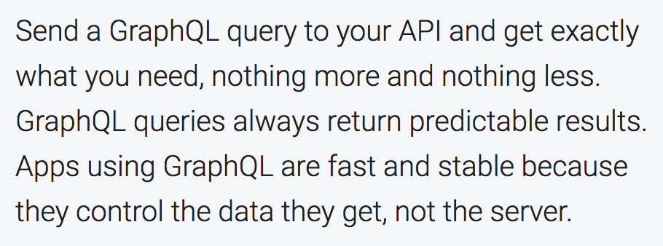

Slide 13
How about maintainability?

Slide 14
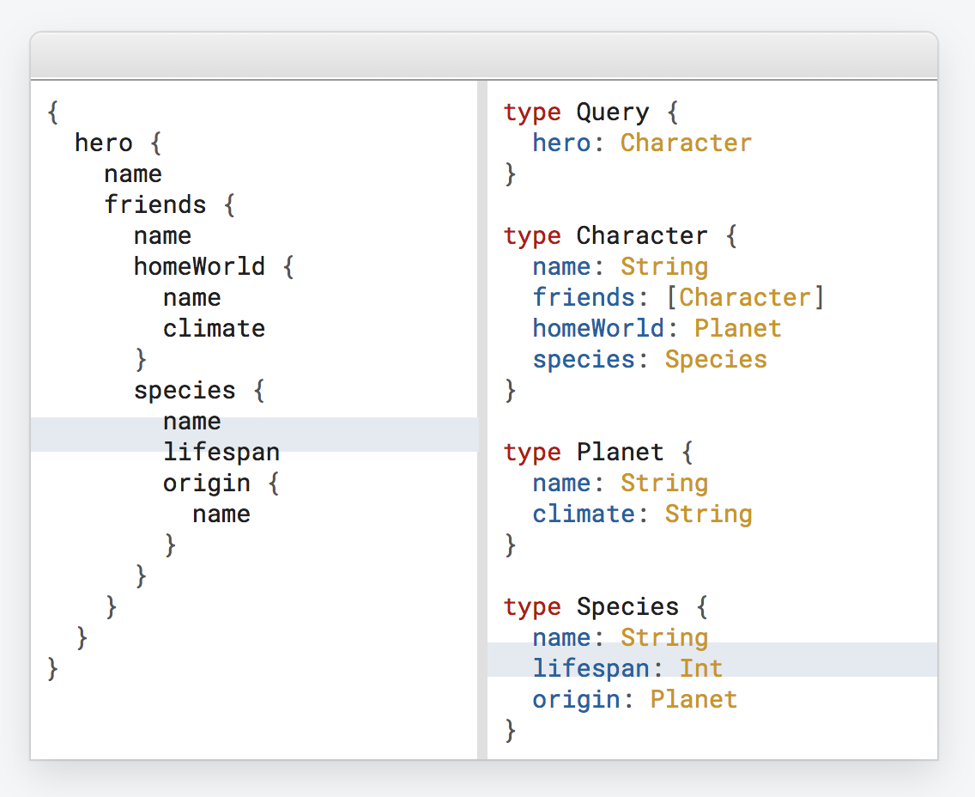
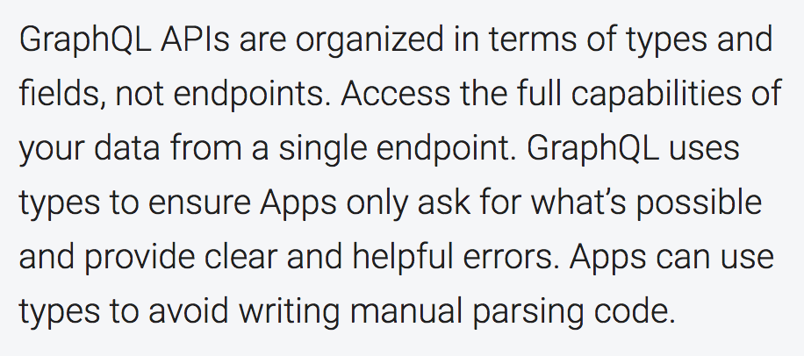
Type System

Slide 15
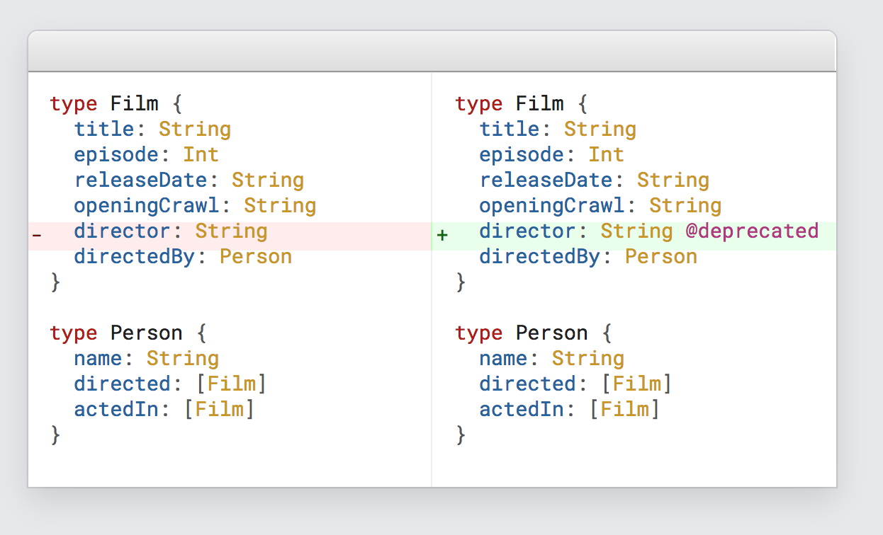
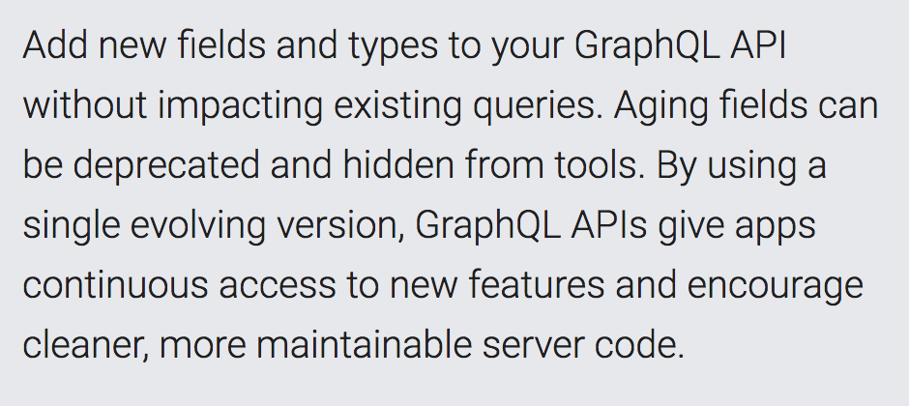
Update and evolve your API without versions

Slide 16
There are some awesome devtools that come with GraphQL right out of the box which will be shown in the demo.

Slide 17
DEMO TIME!

Slide 18
Discussion Time:
How can we potentially utilize GraphQL to improve our apps, apis and other technical offerings at Pelmorex?
What are some current bottlenecks on an API level?

