Slide 1



UN ESCAP REGTECH AI HACKATHON 2026 · RDTII 2.1 · PILLARS 6 & 7
ClauseChain
A reproducible proof for every exported legal row.
TEAM zAI BD — BANGLADESH
Abu Naser Md. Nafew · Team Lead, Full-stack & AI Engineering
Md. Insaful Rahman Tusar · Independent Legal Consultant, Legal Review
Punam Chowdhury · AI Engineer
Md Saniul Basir Saz · AI Engineer
Farhana Borsha · UI/UX Designer

Slide 2
ONE SLIDE
Executive Summary
An autonomous legal-evidence engine that turns official statute portals, gazette PDFs and treaty texts into RDTII 2.1 indicator evidence — every row carrying a byte-exact verbatim snippet, pinpoint citation, archived source and a verification receipt.
WHAT
RDTII evidence collection is manual, slow and fragile: scattered portals, anti-bot walls, scanned gazettes, bilingual statutes, dead links, and citation errors that are expensive for lawyers to catch.
PROBLEM
Format-based extractors (HTML / PDF / EPUB / OCR) → statute-structure RuleUnit graph (SQLite / Neo4j) → hybrid retrieval (exact-phrase + BM25 + dense) → LLM mapping with rubric-as-code → 9 deterministic gates → adversarial refuter → named human review → deterministic replay.
CORE TECH
The rubric is encoded as data (YAML), not code: indicator polarity, 0.5 tiers, the 7.5 court-order test, and 6.5 treaty evidence all flow through one generic pipeline — the same design that scales to the 8 finals economies.
WHY P6 & P7 FIT

Slide 3
WHY THIS IS HARD
Problem Statement
1
Fragmented sources
2
Hostile acquisition
Evidence lives across statute portals, regulator PDFs, gazettes and treaty registers — each with its own markup, structure and access rules.
CloudFront/Akamai anti-bot walls, geo-blocks and TLS fingerprinting; links in official inventories die (we found dead links in the provided inventory itself).
3
Hard documents
4
Legal precision
Scanned gazettes need OCR; consolidated acts exceed 600 pages; Malaysia publishes bilingual text ("Seksyen 12A"); treaties use Article grammar.
A quote that stops mid-clause, a repealed act cited as current, or a wrong pinpoint costs real credibility — lawyers must verify in seconds, not hours.
5
Polarity traps
6
Proving absence
7.1/7.2 score the ABSENCE of frameworks; 7.5 turns on a court-order test; 6.4-vs-6.1 hinges on condition-vs-ban — keyword matching gets these wrong.
"No provision found" is a claim about the whole corpus — it must be backed by a search-coverage manifest, not silence.

Slide 4
WHAT CLAUSECHAIN IS DESIGNED TO ACCOMPLISH
Objective
Autonomous discovery
Crawl official portals and the ESCAP legal inventory; acquire, archive and hash every source; discover provision-level NEW evidence beyond the sample kit — the 20-point lever.
Faithful extraction
Parse statutes into their real structure (Part → section → subsection), never fixed-size chunks; OCR scanned gazettes with CER < 5%; keep original-language verbatim text.
Verified mapping
Map provisions to P6-I1…P7-I5 with rubric-as-code + LLM reasoning, then force every row through 9 deterministic gates before it may exist in the output.
Human-authoritative output
Role-separated named review (citation vs mapping), append-only decision receipts, and a deterministic replay that regenerates the final CSV/JSON from approvals alone.

Slide 5
EVIDENCE FLOW, SOURCE TO SUBMISSION
System Architecture
SOURCES
SSO · lom.agc · legislation.gov.au · gazettes · MITI/ESG treaty registers
ACQUIRE
Seeds pipeline · politeness + Playwright anti-bot fallback · archive + SHA-256 · reconciliation report
EXTRACT
Format-based: anchored HTML · statute PDF · EPUB oracle · OCR VM · grammar profiles (treaty / Malay)
GRAPH
RuleUnit store (SQLite default, Neo4j opt-in) · FTS5 + embeddings · cross-references
MAP & GATE
Hybrid retrieval → LLM screen/map (nano→mini escalation) → gates G1–G9 → NEW/KNOWN diff
VERIFY & SHIP
Adversarial refuter · named human review · zone-3 noise audit · replay → CSV/JSON

Slide 6
STACK, FRAMEWORKS, LICENSING
Technology Solution & Innovative Features
STACK & LICENSING
WHAT MAKES IT DIFFERENT
Engine — Python 3.12 (PSF), httpx/pydantic/numpy (BSD/MIT), pymupdf (AGPL, unmodified library use)
Graph — SQLite + FTS5 (public domain) default · Neo4j Community (GPLv3) optional via GRAPH_BACKEND
Models — profile-swappable via models.yaml: cloud GPT nano/mini tiers (operator key) or local Ollama; BGE-M3 embeddings (MIT); local OCR-VLM
App — Django + DRF (BSD), Next.js/React (MIT), PostgreSQL (PostgreSQL licence)
Ops — systemd + nginx on plain Linux; no proprietary services required; Path A runs fully offline from a clean clone
Proof chain, not just answers — every row: archived bytes + SHA-256 + span-level citation proof + gate results
Rubric-as-code — indicator polarity, 0.5 tiers, exclusions and treaty scoping live in YAML data, never in code
Honest failure — dead links become ACQUISITION_UNRESOLVED facts that BLOCK absence conclusions (network failure is never legal absence)
Processing fingerprints — source sha + extractor version + grammar profile gate every cache reuse; parser changes force re-extraction
Gold-audit tripwire — we detected planted errors in the provided Malaysia gold data and filed corrections with receipts

Slide 7
CHUNKING = STATUTE STRUCTURE, NEVER FIXED WINDOWS
Backend Logic I — Discover, Extract, Structure
Discovery
data/seeds.json (ESCAP inventory + deep-research deltas) drives acquisition. Each build reconciles the manifest: cached-ok is never refetched, new rows are fetched, failures are recorded — and declared expectations (e.g. "Art. 14.11 must parse") fail the build closed if the wrong document came back.
Extraction
Extractors are organized by FILE FORMAT, not country: anchored-HTML (SSO print view, incl. subsidiary legislation), statute-PDF with named grammar profiles (Commonwealth "s. 12(1)", treaty "Art. 14.11", Malay "Seksyen 12A"), EPUB structure oracle aligned to the authorised PDF, OCR for scanned gazettes.
Chunking strategy
The unit of retrieval and citation is the RuleUnit: one provision at subsection depth (id, article path, verbatim text, parent-section context, page/anchor location, modality components). No sliding windows — a citation can always name its exact clause.
Graph
Instrument → Section → Provision nodes with CROSS_REFERENCES / AMENDS edges in a swappable GraphStore (SQLite judged path; Neo4j demo). Every provision carries legal status evidence, eligibility, source-artifact hash and processing fingerprint.

Slide 8
HYBRID RETRIEVAL · RUBRIC-AS-CODE MAPPING · 9 GATES
Backend Logic II — Retrieve, Map, Verify
Hybrid retrieval
Three legs, unioned broad-recall (never top-k): deterministic exact-phrase/defined-term scan, BM25 full-text (FTS5), dense cosine (cached embeddings). Master-known anchors are INJECTED into the candidate set so gold recall never depends on ranking. Source-type allowlists scope evidence classes per indicator (P6-I5 = treaties only) before any cap; every truncation is recorded.
Mapping
LLM screen (bulk tier) → mapping (high tier) with the indicator brief generated from YAML: legal test, polarity rule (absence-scored 7.1/7.2/6.5), exclusions, official scoring criteria. Low-confidence and ban-vs-condition ambiguity escalate to a stronger model; every rationale is stored.
Gates G1–G9
Deterministic, fail-closed, run on the FINAL exported text: G1 snippet is byte-exact in the archived source · G2 location · G3 official-domain authority · G4 currentness/status · G5 whole-rule · G6 rationale support · G7 indicator fit · G8 dangling references · G9 span-closure review flag.
Edge cases
Ambiguity is surfaced, not hidden: adversarial refuter attacks every NEW row; absence rows ship a search-coverage manifest and are blocked while any configured acquisition is unresolved; zone-3 scores get a multi-persona noise audit with Krippendorff’s α and a master-gold tripwire.

Slide 9
MEASURED, LOGGED, REPRODUCIBLE
Evaluation Metrics & Performance
53,969
9
74
148
provisions in the judged corpus (SG 10,494 · MY 3,688 · AU 39,787)
deterministic gates on every row — snippet exactness is enforced by construction, not sampled
provision-level NEW findings discovered beyond the sample kit in the final sweep
automated tests green, incl. builder-level integration and champion-contract suites
HOW WE MEASURE
Citation fidelity — G1 verifies each exported snippet byte-exact against the archived official copy; alignment proofs bind PDF page spans. Zero-tolerance: a row that fails any gate cannot be exported.
Master-gold recall — every master-known anchor is tracked per run; misses are adjudicated into REAL_MISS / GOLD_WRONG / CORRECT_ABSTENTION with receipts (we filed corrections to the provided gold where its own citations were wrong).
OCR quality — scanned-gazette path measured by character error rate (target < 5%), with per-page confidence and citation-token disagreement flags carried into review.
Cost & speed — logs/cost_report.json meters every call; one economy-pillar run ≈ 7–15 min on the accuracy profile; embeddings cached, unchanged documents restamped, LLM spend only on changed evidence.

Slide 10
WHAT THE JUDGES WILL SEE
Demo & Preview
python run.py --economy Singapore --pillar 6 — clean clone, offline Path A, no keys. The same engine the web console triggers.
1 · One command
Admin-gated Runs screen starts a real sweep; Review screen walks findings with source context, gate results and refuter verdicts; decisions are written with named, role-separated reviewers.
2 · Live web console
The ≤10-min recording processes a scanned gazette end-to-end: OCR → RuleUnits → mapped finding with page-anchored citation proof.
3 · Scanned-PDF path
submission_replay.py regenerates the final CSV/JSON purely from approvals; every bundle is content-hashed so the artifact is reproducible on the judges’ machine.
4 · Replay & receipts

Slide 11
THE BUILD STORY · CHAPTER ONE
Six walls.
Six break-throughs.
Everything on the next six slides actually happened during this build — and each fix left a receipt the engine still carries.

Slide 12
WALL 1 OF 6
The portals fight back
THE WALL
THE BREAKTHROUGH
Singapore sits behind CloudFront rate-limiting; Australia’s treaty portal (dfat.gov.au) rejects the TLS handshake of anything that is not a real browser. Official inventories even carry dead links. A crawler that pretends this is fine produces silent gaps.
Politeness + backoff first; a real-browser (Playwright) fallback second. And when a wall would not fall — DFAT stayed geo-blocked — the engine records ACQUISITION_UNRESOLVED instead of concluding “no treaty exists.” Network failure is never legal absence.
RECEIPT Australia P6-I5 ships blocked-by-design, with five unresolved acquisitions listed in its coverage manifest — visible in the app’s review screen.

Slide 13
WALL 2 OF 6
The reference data lied
THE WALL
THE BREAKTHROUGH
Malaysia’s provided reference data contains deliberately planted errors — and Malaysia counts double. One master row cites “clause 4.11” of the Personal Data Protection Act 709. We searched the official text; that clause does not exist.
Every reference anchor is re-verified per run. Misses are adjudicated into REAL_MISS / GOLD_WRONG / CORRECT_ABSTENTION with named human decisions — so an error in the reference data becomes a documented correction, not a copied mistake.
RECEIPT Two GOLD_WRONG adjudications with reviewer receipts in data/review/recall_decisions.json; the audit trail is browsable in the Ledger.

Slide 14
WALL 3 OF 6
Monster documents
THE WALL
THE BREAKTHROUGH
A 666-page consolidated compilation. A telecommunications act published as two PDF volumes. Tables of contents that mimic real sections and poison naive parsers. Fixed-size chunking would shred provisions mid-sentence and cite none of them correctly.
Statute-structure parsing: an EPUB structure oracle aligned span-exact to the authorised PDF, a monotonic section filter that kills list-item false positives, and RuleUnits at subsection depth — the unit of retrieval IS the unit of citation.
RECEIPT 39,787 Australian provisions parsed with page-anchored citations; Corporations Act 2001 alone contributes 14,078 aligned units.

Slide 15
WALL 4 OF 6
The scanner’s ghosts
THE WALL
THE BREAKTHROUGH
Malaysian gazettes arrive as scans. OCR misreads statutory labels — a “12B” becomes “12b” or worse, and a wrong section label means a wrong citation in front of a lawyer. Bilingual acts print “Seksyen 12A” where the gold data says “s. 12A.”
The OCR router measures per-page confidence and carries it into review; a sequence-aware repair restores misread section labels from statutory order; a named Malay grammar profile parses Seksyen/Perkara headings while keeping Commonwealth citations.
RECEIPT Per-page OCR confidence + citation-token disagreement flags are visible on affected findings in the review screen.

Slide 16
WALL 5 OF 6
The polarity trap
THE WALL
THE BREAKTHROUGH
RDTII scores 7.1, 7.2 and 6.5 on the ABSENCE of frameworks. Our first treaty sweep proved how dangerous that is: retrieval surfaced 77 relevant treaty articles for P6-I5 — and the mapper rejected every single one for proving the “wrong” answer to the indicator question.
Polarity is rubric DATA, not prompt folklore: absence-scored indicators carry an evidence rule that tells the mapper the row documents what EXISTS while the score captures absence. One YAML block fixed all 77; a regression test pins the behaviour forever.
RECEIPT The fix is one commit touching only configs/rdtii/pillar_6.yaml; the very next run produced CPTPP Art. 14.11 and DEPA Art. 4.3 as NEW rows.

Slide 17
WALL 6 OF 6
The half-quoted law
THE WALL
THE BREAKTHROUGH
An early export ended a quotation at “…may be issued with an or” — a truncated word. Another stopped at a list-introducing colon, quoting a rule while omitting every one of its conditions. A lawyer reading either would stop trusting everything else.
Snippets are finalized source-exact and structurally closed BEFORE any gate runs: closure follows list children to a genuine sentence stop, legal abbreviations (“s.”, “No.”) never count as endings, and a passage whose closure cannot be proven cannot be exported at all.
RECEIPT The G9 structural-closure gate records closure codes on every row; unclosable spans fail closed and go to human review instead of the output file.

Slide 18
THE BUILD STORY · CHAPTER TWO
Proof, not promises.
A working system anyone can open today — read-only demo access is printed on the login page. These are unedited screenshots.

Slide 19
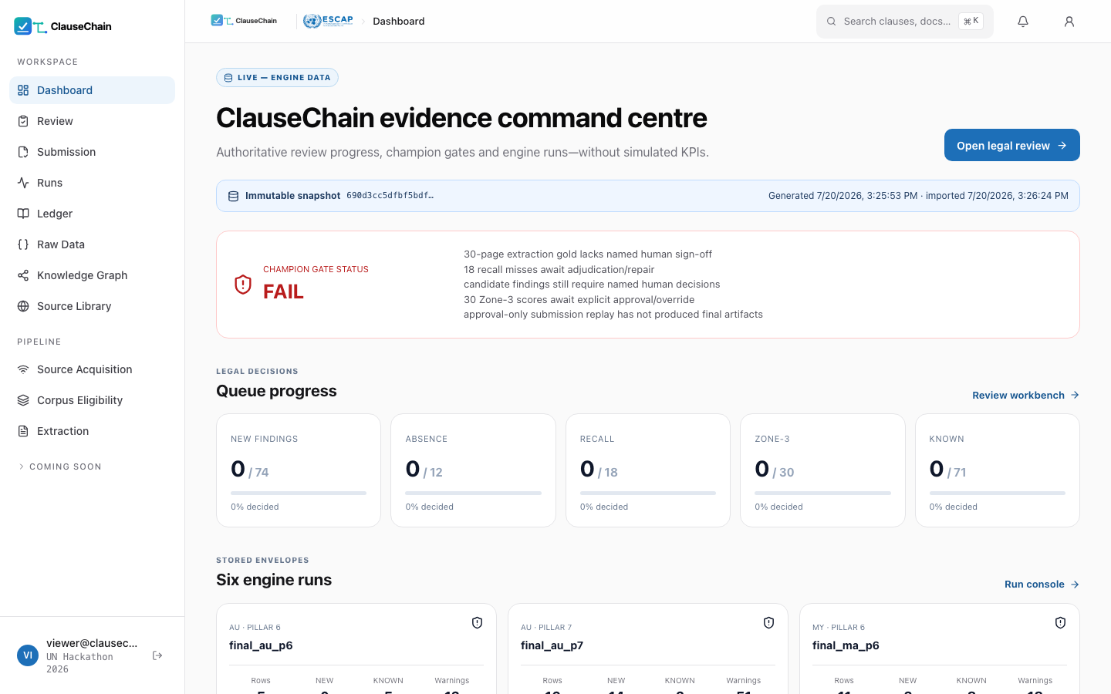
PROOF · COMMAND CENTRE
The system refuses to flatter itself
The dashboard’s champion gate reads FAIL until every human obligation is met.
Immutable snapshot hash on every screen — the app is a mirror of engine artifacts, never its own truth
Live queue progress across NEW / absence / recall / zone-3
No simulated KPIs anywhere — the banner says so

Slide 20
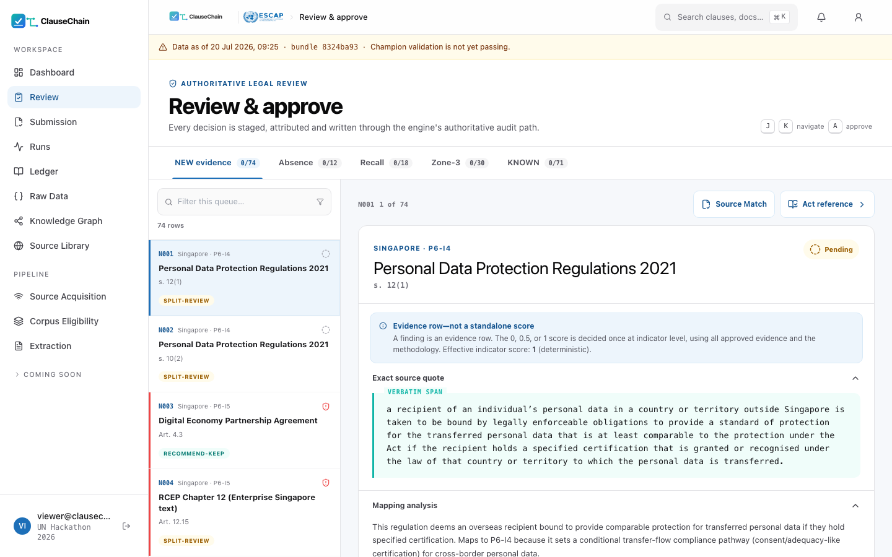
PROOF · REVIEW WORKBENCH
Where a lawyer meets the evidence
Every finding: exact source quote, mapping analysis, refuter verdict, staged sign-off.
Verbatim span highlighted from the archived official copy
Refuter chips (RECOMMEND-KEEP / SPLIT-REVIEW) triage attention
Treaty rows N003/N004 — the first 6.5 evidence — sit in the same queue as everything else

Slide 21
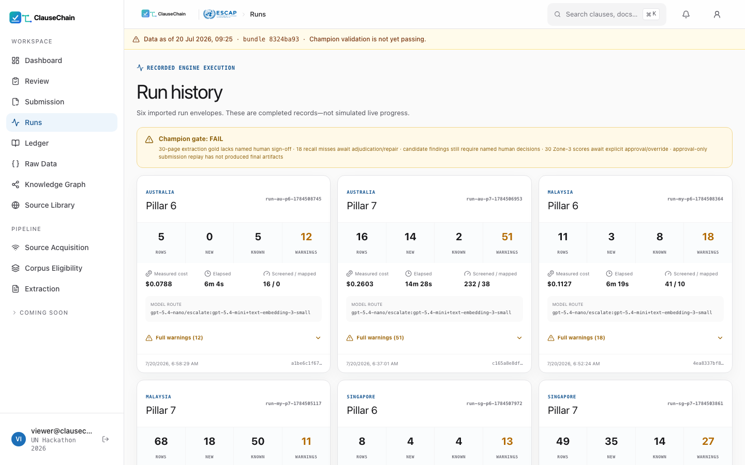
PROOF · RUN HISTORY
Every run is an accountable record
Six envelopes: measured cost, elapsed time, model route, warnings — per run.
$0.08–$0.34 per economy-pillar, printed with the model route that produced it
Warnings are first-class (“Full warnings (51)”), not buried in logs
Content hash on each envelope ties the UI to the artifact

Slide 22
PROOF · PIPELINE
Watching the evidence arrive
Source acquisition with archive hashes, reconciliation and failure honesty.
Each source: official URL, SHA-256, access date, status
Dead links stay visible — they feed the audit, not the void
The same screen a judge would use to trace any citation back

Slide 23
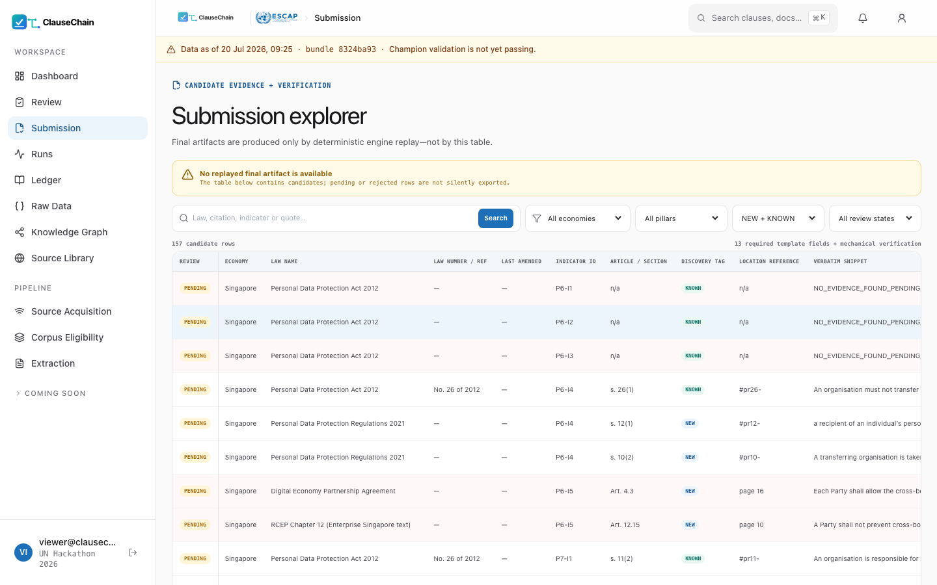
PROOF · SUBMISSION
The output file, with its receipts
The consolidated dataset beside the decision bundles that produced it.
Template-exact columns, one consolidated CSV/JSON
Content-hashed review bundles — append-only history
Replay regenerates identical bytes from approvals alone

Slide 24
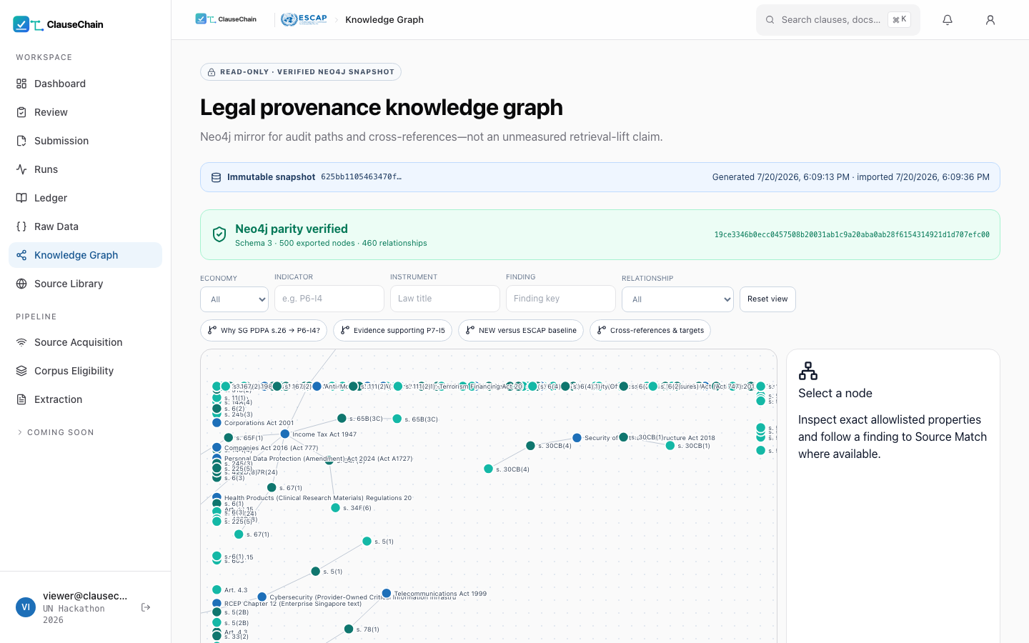
PROOF · KNOWLEDGE GRAPH
The law as a graph, not a pile of text
Instrument → Section → Provision with cross-references — browsable.
CROSS_REFERENCES edges follow “subject to s. 26” chains
SQLite default; Neo4j swap via one env var
Every node carries legal status + eligibility + source hash

Slide 25
WHY THIS WINS ON TRUST
Innovation & Competitive Advantage
Treaty-evidenced 6.5
We audit the gold
P6-I5 rows cite the actual binding commitments (CPTPP Art. 14.11, DEPA Art. 4.3, RCEP Art. 12.15) parsed from official state registers through the same generic pipeline — no hand-curated rows anywhere.
The engine re-verifies the provided master data and caught its planted Malaysia errors — including citations to clauses that do not exist — filing corrections with evidence.
Absence is proven
Uncertainty is modelled
Score-0 claims carry a search-coverage manifest; unresolved acquisitions (e.g. a geo-blocked treaty register) BLOCK the absence conclusion instead of faking it.
Zone-3 scores ship a multi-persona noise audit (Krippendorff’s α) and a master-gold tripwire — a band with receipts, never a bare number.
Human-authoritative by design
Generic to the core
Citation reviewer ≠ mapping reviewer, enforced at write time; append-only receipts; the submission is replayable from decisions alone.
Nothing in code names a statute or a row: targets live in seeds/YAML data. The rerun that added treaties, Malay grammar and subsidiary legislation changed configuration, not engine logic.

Slide 26
THE FINALS QUESTION, ANSWERED CONCRETELY
Adding an Economy Is a Data Change
configs/jurisdictions/th.yaml (all it takes)
WHY IT SCALES
jurisdiction: TH
source_format: pdf
languages: { primary: th, supported: [th, en] }
section_grammars: [thai] # "มาตรา N" — named profile
official_sources:
- { domain: ratchakitcha.soc.go.th,
source_type: official_gazette }
citation_patterns:
section: ["s. {n}", "มาตรา {n}"]
status_assertions:
"PDPA B.E. 2562": { status: in_force, fact_url: "…" }
# + seed rows in data/seeds.json (official URLs)
# + nothing else. No code.
Extractors are format-based (HTML / PDF / EPUB / OCR), never country-based — a new economy reuses them untouched.
Section grammars are named data profiles: treaty and Malay shipped this round; "Pasal", "Статья", "มาตรา" are one dictionary entry each.
Rubric YAML is economy-independent — pillars are added the same way (P8 = one new YAML, zero engine changes).
Cross-lingual retrieval (BGE-M3) + original-language verbatim + English column are already wired.
Proof: this round, treaties + subsidiary legislation + Malay grammar were added mid-sprint as configuration — the engine diff was generic plumbing only.
The government-verified Round-2 gold (CN·IN·ID·LA·MN·RU·TH) is already ingested as the 8-economy eval baseline.

Slide 27
FROM 3 ECONOMIES TO THE REGION
Scalability & Future Development
SCALE PATH
VALUE FOR ESCAP & STAKEHOLDERS
New economy = data, not code: a jurisdiction YAML (portals, citation grammar, status assertions) + seed rows. Extractors are format-based; grammars are named profiles ("Pasal", "Статья", "มาตรา" next).
Finals-ready gold: the government-verified Round-2 database (CN·IN·ID·LA·MN·RU·TH) is already ingested as the evaluation baseline for the 8-economy expansion.
Multilingual by architecture: BGE-M3 cross-lingual retrieval, original-language verbatim + appended English column, per-language section grammars.
Continuous monitoring: incremental fingerprints mean a nightly run re-extracts only changed documents — amendment tracking falls out of the cache design.
ESCAP researchers — RDTII updates in hours instead of months, with every cell traceable to an archived official source.
Governments — see exactly which provision produced each score; corrections become data changes with receipts.
Businesses & trade lawyers — pinpoint, current, verifiable answers on cross-border data rules across jurisdictions.
Expected outcomes — faster policy insight, fewer stale citations, lower compliance-research burden, and a reusable evidence commons for digital-trade regulation.

Slide 28
OUR CASE
Why ClauseChain can be a Good Solution
SUBSTANTIVE ACCURACY
TECHNICAL RESILIENCE
ARCHITECTURE
74 provision-level NEW findings beyond the sample kit — the 20-point lever, systematically harvested
First treaty-evidenced P6-I5 rows (CPTPP 14.11, DEPA 4.3, RCEP 12.15) from official registers
Byte-exact citations a lawyer verifies in seconds; polarity traps encoded as rubric data
We audited the gold itself and caught the planted Malaysia errors — with receipts
Live portals with anti-bot walls beaten (backoff + real-browser fallback); failures recorded, never faked
Scanned gazettes: OCR with per-page confidence + statutory glyph repair; bilingual Malay grammar
End-to-end with zero manual steps — and a web console that triggers the same engine
Incremental fingerprints: nightly re-runs re-extract only changed law
Swap LLM / OCR / graph by config — two shipped profiles, incl. a fully key-free local path
Audit trail beyond the ask: verbatim snippet + archived source + SHA-256 + gate results + named review + replay
Measured cost: US$1.16 for the entire 3-economy sweep (≈ $0.01 per document)
Adding an economy or pillar = one YAML + seed rows; finals gold already ingested
Trust is the product: every row the judges check will check out.

Slide 29
REFERENCES
Sources, models & libraries
LEGAL DATA SOURCES
MODELS & METHODS
OPEN-SOURCE LIBRARIES
RDTII 2.1 Guide, methodology sheet & Round-1/Round-2 databases (UN ESCAP)
Singapore Statutes Online — sso.agc.gov.sg (Acts + subsidiary legislation print view)
Laws of Malaysia (AGC), Federal Gazette, PDP Department, NACSA, MITI FTA portal
Federal Register of Legislation — legislation.gov.au (authorised PDF + EPUB)
Official treaty texts: CPTPP, RCEP, DEPA, SADEA, KSDPA (state registers)
GPT nano/mini tiers via API (operator key) · local Ollama fallback profile
BGE-M3 multilingual embeddings (MIT)
Noise-audit uncertainty design after Qian Xiao (Maynooth), 12 Jun workshop
Direct corpus interaction / broad-recall motivation: Li et al., arXiv:2605.05242
GraphRAG legal schema after Chawuthai (KMITL), 12 Jun workshop
Python · httpx · pydantic · numpy · pymupdf · pytest
SQLite/FTS5 · Neo4j Community (optional)
Django · DRF · Next.js · React · PostgreSQL
Playwright (anti-bot fallback) · systemd/nginx deployment
Full licence inventory in the repository README
ClauseChain · Team zAI BD · UN ESCAP RegTech AI Hackathon 2026

