Slide 1

🍳
MealMate.
End-term defense — practical results from Weeks 6–9:
Database Systems · Cybersecurity · Multimedia Technologies
https://mealmate-29tt.onrender.com
CS-2618 · Samarin · Kaniyazov · Sadybek · Temirtas
Notes:
Live app is deployed and reachable — open the URL any time during the defense. Everything shown today runs on this deployment.

Slide 2
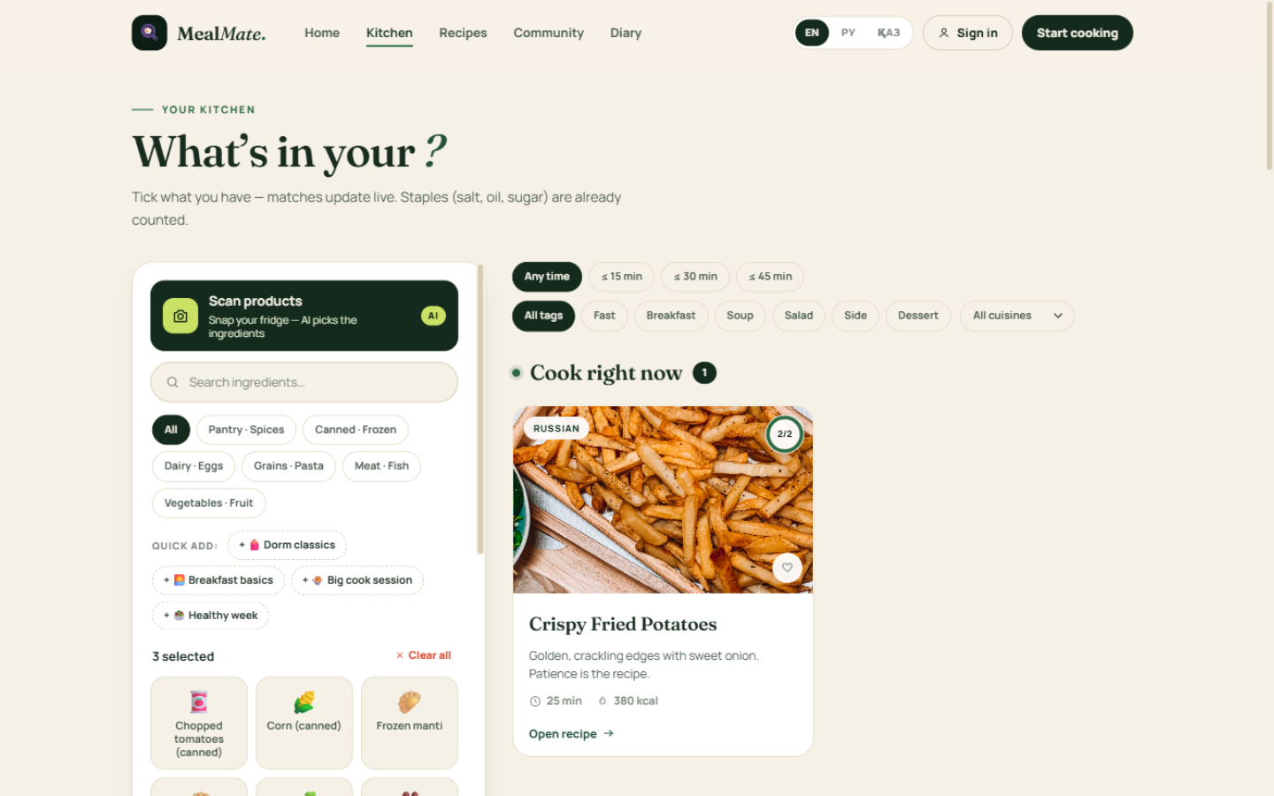
THE PROJECT IN ONE MINUTE
A web app that matches recipes to the food you already own.
68
recipes across 5 cuisines — 14 Kazakh
51
picker ingredients, every one covered by a recipe
3
languages: EN / RU / KK — UI, content and cooking steps
Stack: React 18 → Express (Node 24) → SQLite. Deployed on Render, source on GitHub.
Live: the ingredient picker with an instant match list

Slide 3
A · DATABASE SYSTEMS — ER DIAGRAM (1 OF 2)
7 core entities, PK/FK on every table, verbs on relationships.
users
ingredients
recipes
photo_diary
PK user_id
name · email UQ
password_hash · is_guest
PK ingredient_id
name · name_ru/kk
category · is_staple
1 : M
PK recipe_id
КБЖУ · time · cuisine
tags · image · title_ru/kk
1 : M
PK photo_id
FK user_id, recipe_id
photo · note · uploaded_at
recipe contains ingredient (M:N via junctions)
1 : M
1 : M
recipe splits into steps (1 : M)
keeps
needs
user ticks ingredient
recipe lists ingredient
user_ingredients
recipe_ingredients
instruction_blocks
reset_tokens + app_meta
PK user_id + ingredient_id
FK → users, ingredients
PK recipe_id + ingredient_id
quantity · unit · optional
PK instruction_id
FK recipe_id
step_number UQ · descr ×3 lang
PK token id · FK user_id
SHA-256 hash · 30 min TTL
user uploads photo (1 : M)
M:N resolved with junction tables; editable source: docs/er-diagram.dbml → paste at dbdiagram.io during the defense.
Business rules: unique e-mail · step numbers unique within a recipe · FK ON DELETE CASCADE.

Slide 4
A · DATABASE SYSTEMS — DESIGN DECISIONS
Ready for the live challenge: change one thing, explain everything.
is_staple flag
salt, oil, sugar are assumed available — the matcher never counts them as missing. Change during defense: flip it and «Almost there» grows by hundreds of rows.
i18n columns
title_ru/kk, description_ru/kk on recipes; name_ru/kk on ingredients; localized steps. The API picks the column with ?lang= and falls back to English.
Junction extras
recipe_ingredients carries quantity, unit, optional — so the UI shows «600 g» and skips optional items when matching.
Indexes & integrity
FK ON DELETE CASCADE everywhere; indexes on junctions and diary(user_id); UNIQUE email and (recipe_id, step_number).
Matching query runs in SQL (two CTEs): missing = total − have per recipe, have ≥ 1 guarantees relevance — verified against the live deployment.

Slide 5
B · CYBERSECURITY — SECURITY RISK TABLE
Five realistic risks — each closed by a measure that is actually in the code.
Risk | Consequence for users / data | Protection (implemented)
Brute-force password attacks on /login | Account takeover; personal diary exposed | Per-IP rate limit 40 req/10 min on auth; scrypt hashing makes offline cracking slow
SQL injection via search and filters | Full database dump or destruction | Parameterized queries only (node:sqlite) — zero string concatenation in SQL
XSS through diary notes and names | Script runs in other users' browsers, sessions stolen | React auto-escaping + strict server-side validation (type, length, MIME whitelist)
Session hijacking / cookie theft | Attacker acts as the victim | httpOnly + SameSite cookie, HMAC-SHA256 signature — unreadable and unforgable in JS
Oversized image uploads (DoS) | Disk and memory exhausted, service down | 6 MB body limit, browser-side canvas compression to JPEG ≤ ~3 MB, MIME check
Also: security headers (helmet), one-time hashed password-reset tokens (30 min TTL), guest diary writes rejected with 401 at API level.

Slide 6
B · CYBERSECURITY — SAFE SCENARIO (CONTROLLED SIMULATION)
Threat: an attacker brute-forces the login. Watch the protection respond.
1
2
3
4
Attacker script
MealMate API
Rate limiter trips
Account stays safe
→
→
→
sends POST /api/auth/login
tried passwords: qwerty, 123456, …
verifyPassword fails →
every attempt is counted per IP
41st request within 10 min
→ HTTP 429 Too Many Requests
scrypt hash never leaves;
session cookie never issued
Live demo path: send 45 rapid wrong logins from the demo script → the 41st receives 429 and the rate bucket resets after 10 minutes. The same limiter protects diary uploads (20 / 10 min).
Why this scenario is safe: it runs against our own local deployment with a test account — no real third-party systems are touched.
Bonus hardening: scrypt makes each guess cost ~100 ms of CPU — brute-forcing a 8-char password becomes computationally absurd even offline.

Slide 7
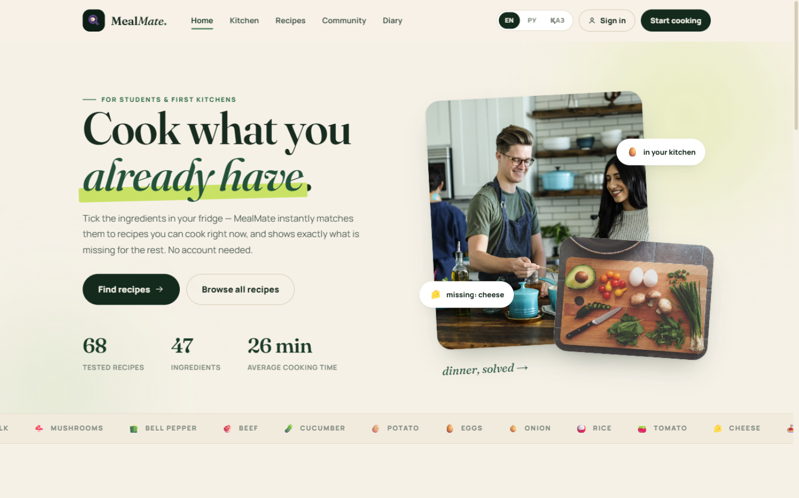
C · MULTIMEDIA TECHNOLOGIES — PRODUCT PROMO
A 60-second promo, built by the team from real product footage.
3+ MULTIMEDIA ELEMENTS
Animation
Ken Burns zooms, fade-ups, animated underline — rendered frame by frame (1440 frames)
▶ MealMate-promo.mp4
60 s · 1280×720 · MP4 (H.264 + AAC)
Text & graphics
kinetic titles, brand palette, stat captions, accent shapes
Images
real screen captures of the deployed product (home, matching, recipe, community)
Audio
original synthesized chord pad — composed in code, no stock audio
Frame from the promo — animated title over a live home-screen capture
Play: docs/MealMate-promo.mp4 (also at github.com/nafiks/mealmate → docs). Formats: H.264 video + AAC audio in MP4 — plays everywhere; PNG frames; WAV intermediate audio. Original elements: screen recordings and the synthesized soundtrack are team-created.

Slide 8
INDIVIDUAL DEFENSE MAP
Every member owns a layer — ask us anything.
Artur — Lead
problem → solution reasoning, user research, feature priorities
Arsen — Frontend
design system, picker & matching UI, i18n, rendering pipeline, this deck
Adilet — Database
ER model, SQL matching CTEs, integrity, coverage audit
Sanzhar — Backend
Express API, auth & security, seed content, deployment
Live app https://mealmate-29tt.onrender.com Source github.com/nafiks/mealmate
AI disclosure: AI assisted code generation and deck design; every mechanism shown is deployed, verified and explained by the team.

