Slide 1
Canary Results
RPI-CDPHP

Slide 2
Survival Curves for Random
Diabetes
Acute Care

Slide 3
Cox Regression Coefficients for Random
Diabetes
Acute Care

Slide 4
Survival Curves for Only Propensity (Selected)
Diabetes
Acute Care

Slide 5
Cox Regression Coefficients for Only Propensity (Selected)
Diabetes
Acute Care

Slide 6
Means for Propensity Matching (Selected)

Slide 7
Survival Curves for Only Propensity (All)
Diabetes
Acute Care

Slide 8
Cox Regression Coefficients for Only Propensity (All)
Diabetes
Acute Care

Slide 9
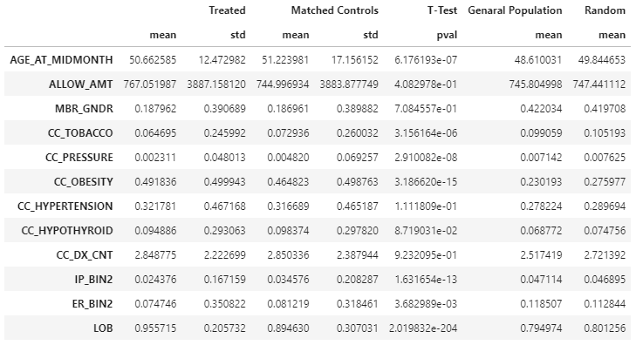
Means for Propensity Matching (All)

