Slide 1
Canary
RPI-CDPHP

Slide 2
Data Preparation
Load PMPM, Canary, and pregnancy data from S3
Do necessary pre-processing
Log the costs
Filter out duplicate values
Necessary type-castings
Medicaid and Pregnancy filters
etc.
Define IP/ER visits from IP/ER cost data

Slide 3
Data Preparation (Cont.)
Get all the canary patients who have their CC_DIABETES flag equals 0 on their registered date.
Pick a matching algorithm (Nearest neighbor matching, Propensity score matching, Hybrid matching etc.)
Create the matched population
For each canary patient let their registration month be i
Find N(for example 50) control patients to match this canary patient from the pmpm patients on month i who have CC_DIABETES = 0 on month i. For example the N patients should have the same age and then be the nearest neighbors according to other features(log costs, cc codes etc).
Set the index date for these pmpm controls patients to be month i.
This forms a matched set of roughly 30 times the number of canary patients and each control has an index date.

Slide 4
Approach: Manual Feature Selection with Hybrid Matching

Slide 5
Hybrid Matching
Find treated/control patient pairs that “look similar” based on their health profile.
Hybrid Matching: A combination of exact matching, coarsened exact matching and K nearest neighbors matching.
Other possible methods: Propensity Score Matching, Subspace Matching.

Slide 6
Hybrid Matching
We observe that after the matching the difference in means between the treated and the control patients are small
(p-value > 0.05 means the feature means are almost identical).

Slide 7
Hybrid Matching

Slide 8
Hybrid Matching

Slide 9
Survival Analysis
Acute Care: Time to inpatient or emergency visits(not related to pregnancies)

Slide 10
Survival Analysis
Inpatient Visits(left), Emergency Visits(Right)

Slide 11
Survival Analysis
Time to Diabetes Diagnosis

Slide 12
Survival Analysis
Hypothesis Testing-Restricted Mean Survival Time

Slide 13
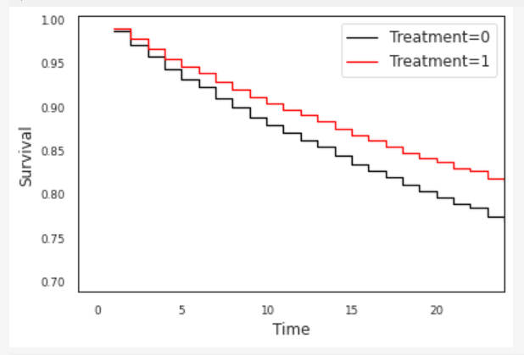
Survival Analysis
Cox regression models associate covariates with survival risk
Upper left: Acute Care
Upper right: Inpatient visits
Bottom left: Emergency Visits
Bottom Right: Time to Diabetes

Slide 14
Survival Analysis
Cox regression weights(Acute care)

Slide 15
Survival Analysis
Cox regression weights(Diabetes)

Slide 16
Latent Subspace Matching
Instead of using domain knowledge to pick “good” features for matching, using techniques involving neural networks(autoencoders, multitasking neural networks), we could automatically find suitable features in lower dimensions.

Slide 17
Approach: Automated Feature Selection and Matching in Latent Space using Deep Autoencoders

Slide 18
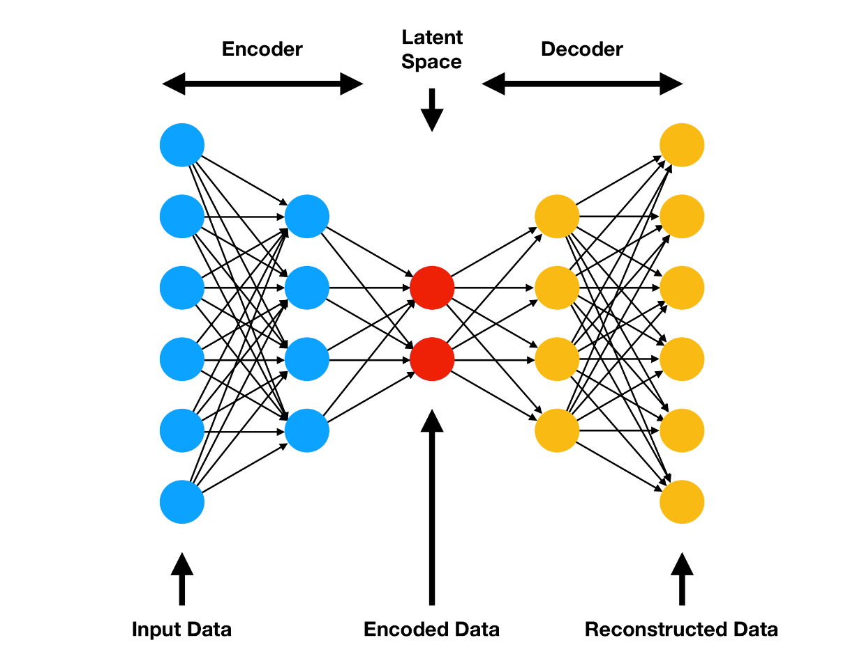
Methodology (Step 1): Network Train
Train a Deep Neural Network
Features are from PMPM dataset containing patients’ demographic and claims data
Goal: predict health states/features of patients at least one year in the future using earlier data
After training, the intermediate layer or “Latent Space” contains enough relevant information about patient’s health trajectory and overall health state
This network is then used as a feature transformer
Save Model in Amazon S3
All features
Generic Objective
Fig Source: https://www.compthree.com/blog/autoencoder/

Slide 19
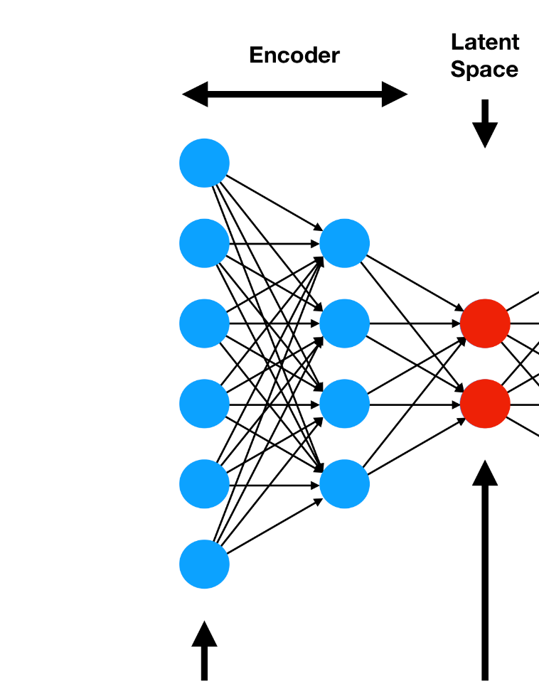
Methodology (Step 2): Feature Transformation
Generate the treated and control population with all the original features
We will use the pre-trained network to transform the original features into latent low-dimensional features
Transformed Latent Features
Fig Source: https://www.compthree.com/blog/autoencoder/

Slide 20
Methodology (Step 3)
For each patient in treated group, find a matched patient from control group
Nearest Neighbor Matching
Latent Features
Matching
Treated and Matched Controls (Latent and Corresponding Original)
Save all data in S3
Propensity Score Matching

Slide 21
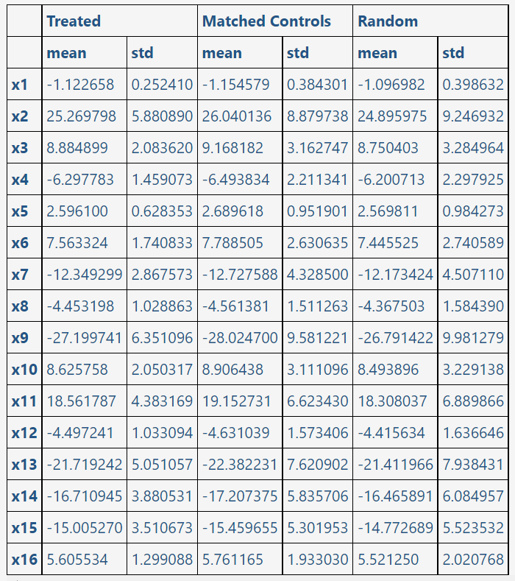
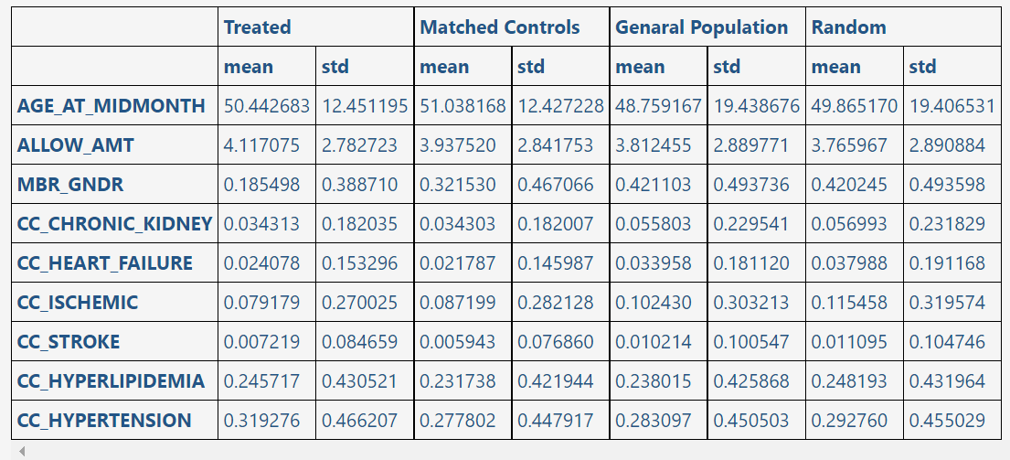
Distributions of Features in Latent Space and Selected features in Corresponding original space

Slide 22
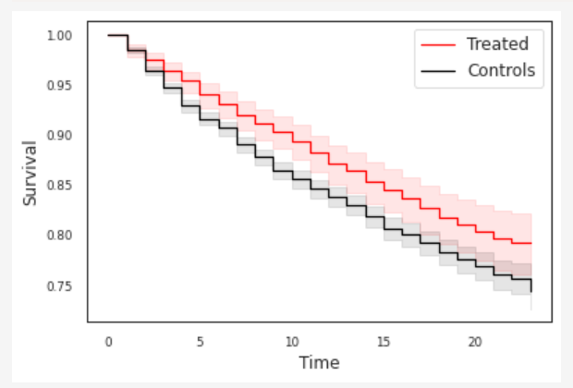
Survival Analysis
Acute Care: Time to inpatient or emergency visits(not related to pregnancies)
P=0.002351

Slide 23
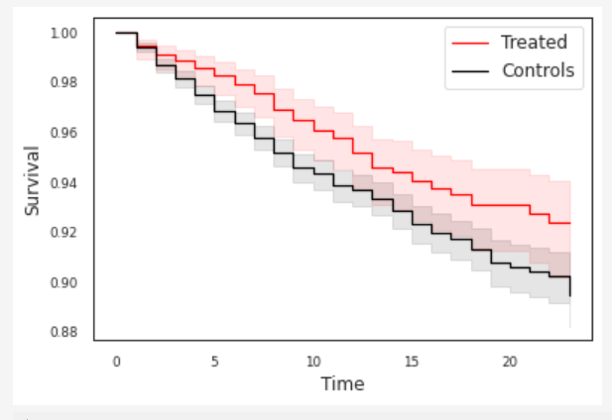
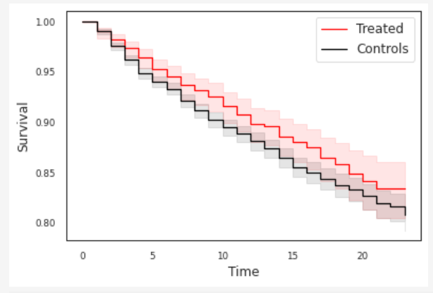
Survival Analysis
Inpatient Visits(left), Emergency Visits(Right)
P = 0.019223
P = 0.041262

Slide 24
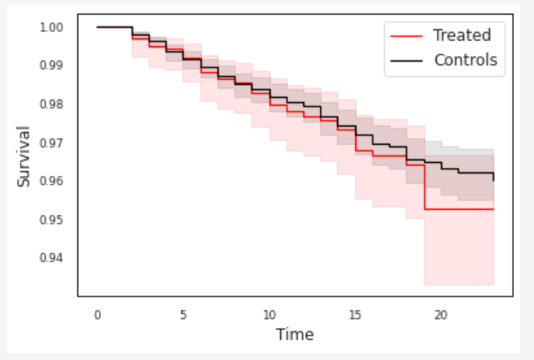
Survival Analysis
Time to Diabetes Diagnosis
P = 0.507

Slide 25
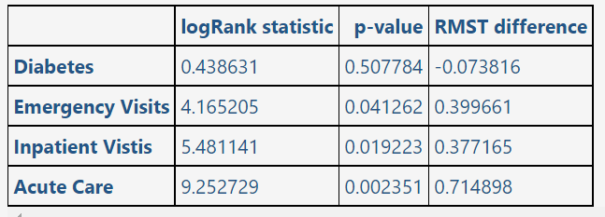
Survival Analysis
Hypothesis Testing-Restricted Mean Survival Time

Slide 26
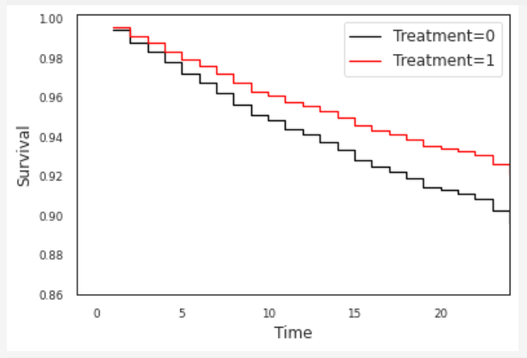
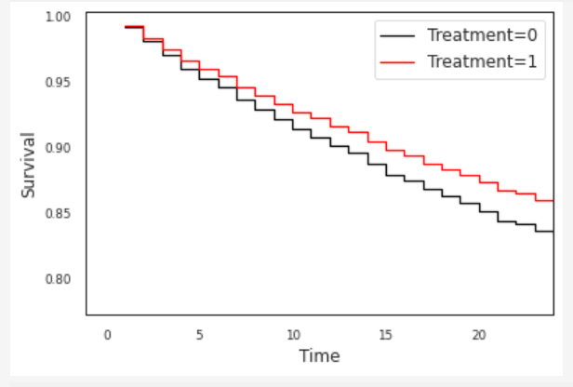
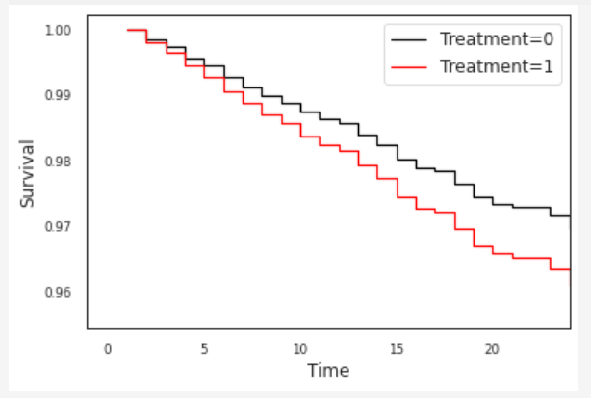
Survival Analysis
Cox regression models associate covariates with survival risk
Upper left: Acute Care
Upper right: Inpatient visits
Bottom left: Emergency Visits
Bottom Right: Time to Diabetes

Slide 27
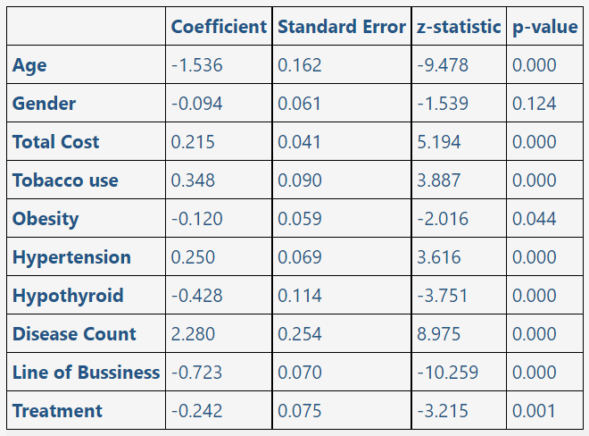
Survival Analysis
Cox regression weights(Acute care)

Slide 28
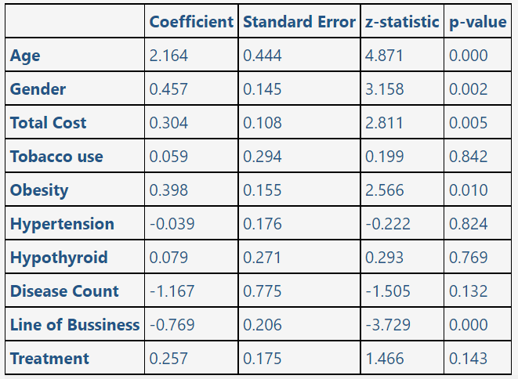
Survival Analysis
Cox regression weights(Diabetes)

