Slide 1
Canary Evaluation
Causal Inference and Survival Analysis

Slide 2
Hybrid Matching
Find treated/control patient pairs that “look similar” based on their health profile.
Hybrid Matching: A combination of exact matching, coarsened exact matching and K nearest neighbors matching.
Other possible methods: Propensity Score Matching, Subspace Matching.

Slide 3
Hybrid Matching
We observe that after the matching the difference in means between the treated and the control patients are small
(p-value > 0.05 means the feature means are almost identical).

Slide 4
Hybrid Matching

Slide 5
Hybrid Matching

Slide 6
Survival Analysis
Acute Care: Time to inpatient or emergency visits(not related to pregnancies)

Slide 7
Survival Analysis
Inpatient Visits(left), Emergency Visits(Right)

Slide 8
Survival Analysis
Time to Diabetes Diagnosis

Slide 9
Survival Analysis
Hypothesis Testing-Restricted Mean Survival Time

Slide 10
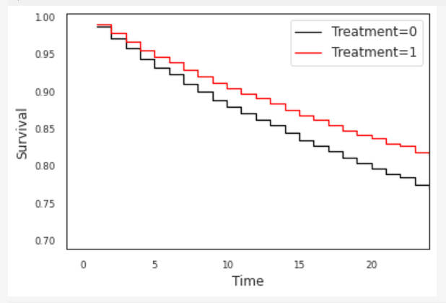
Survival Analysis
Cox regression models associate covariates with survival risk
Upper left: Acute Care
Upper right: Inpatient visits
Bottom left: Emergency Visits
Bottom Right: Time to Diabetes

Slide 11
Survival Analysis
Cox regression weights(Acute care)

Slide 12
Survival Analysis
Cox regression weights(Diabetes)

Slide 13
Subspace Matching
Instead of using domain knowledge to pick “good” features for matching, using techniques involving neural networks(autoencoders, multitasking neural networks), we could automatically find suitable features in lower dimensions.

