Slide 1
Deep Learning Approach

Slide 2
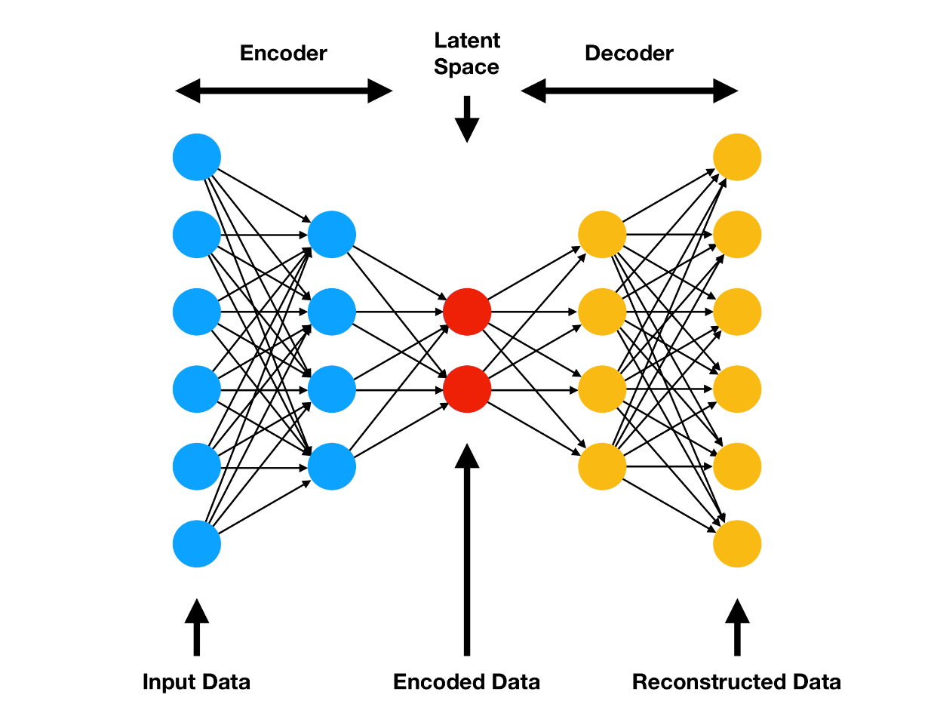
Methodology (Step 1): Network Train
Train a Deep Neural Network
Features are from PMPM dataset containing patients’ demographic and claims data
Goal: predict health states/features of patients at least one year in the future using earlier data
After training, the intermediate layer or “Latent Space” contains enough relevant information about patient’s health trajectory and overall health state
This network is then used as a feature transformer
Save Model in Amazon S3
All features
Generic Objective
Fig Source: https://www.compthree.com/blog/autoencoder/

Slide 3
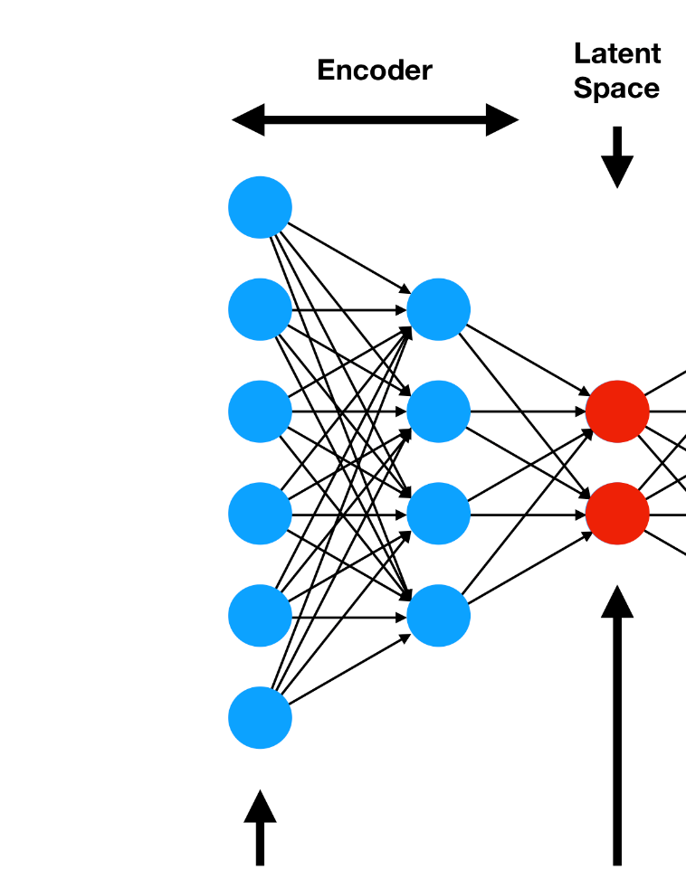
Methodology (Step 2): Feature Transformation
Generate the treated and control population with all the original features
We will use the pre-trained network to transform the original features into latent low-dimensional features
Transformed Latent Features
Fig Source: https://www.compthree.com/blog/autoencoder/

Slide 4
Methodology (Step 3)
For each patient in treated group, find a matched patient from control group
Nearest Neighbor Matching
Latent Features
Matching
Treated and Matched Controls (Latent and Corresponding Original)
Save all data in S3
Propensity Score Matching

Slide 5
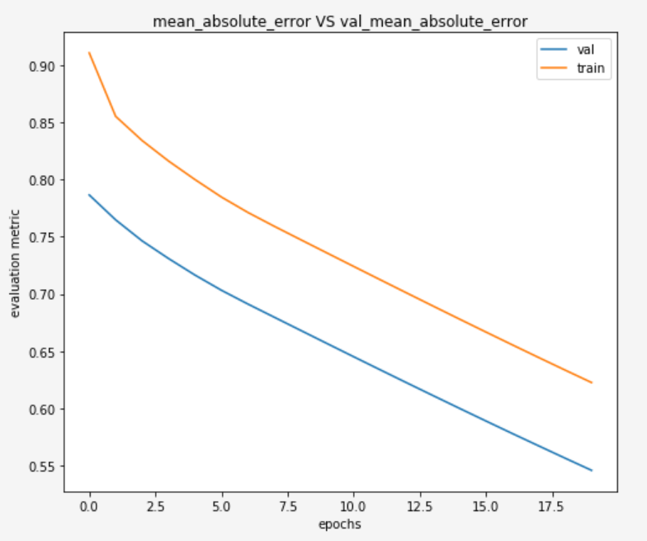
Neural Network Evaluation
2017 Data as training features -> 2019 January Data as training labels
2018 Data as test features -> 2020 January Data as test labels
20 Epochs, Model M6
Train on 112764 samples, validate on 12530 samples (10%)
Test Data: 137176 samples
MAE of Training Data: 0.6100
MAE on Test Data: 0.6012

Slide 6
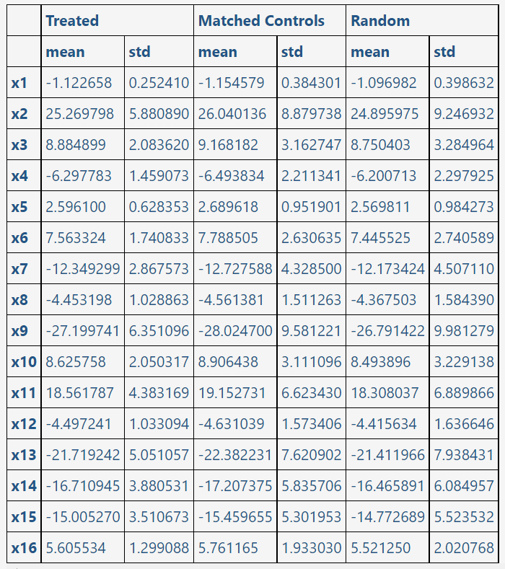
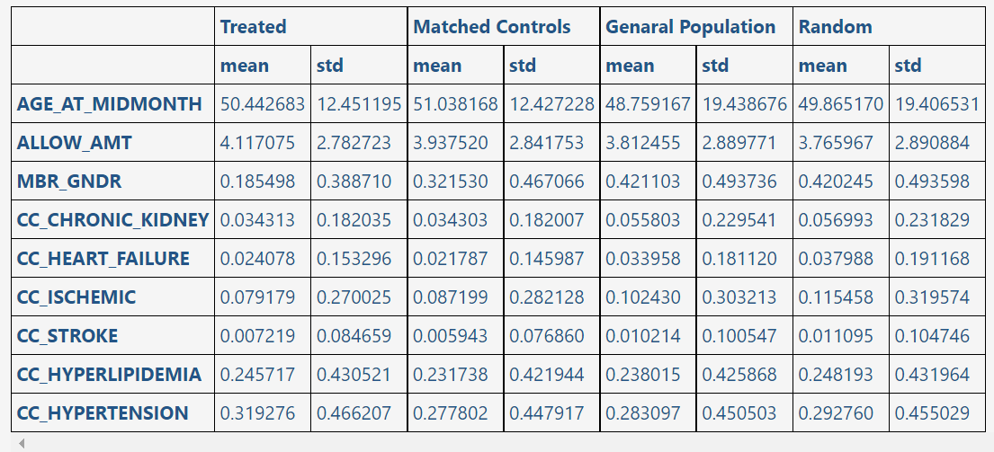
Distributions of Features in Latent Space and Selected features in Corresponding original space

Slide 7
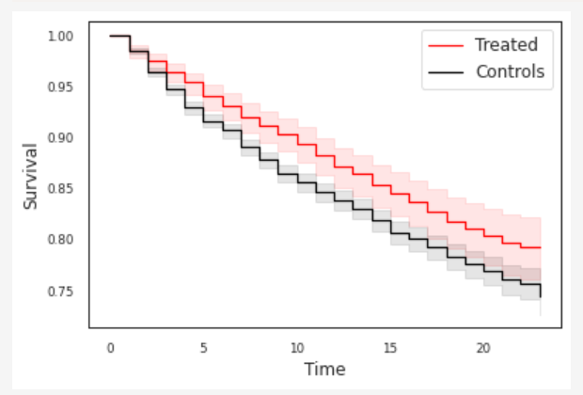
Survival Analysis
Acute Care: Time to inpatient or emergency visits(not related to pregnancies)
P=0.002351

Slide 8
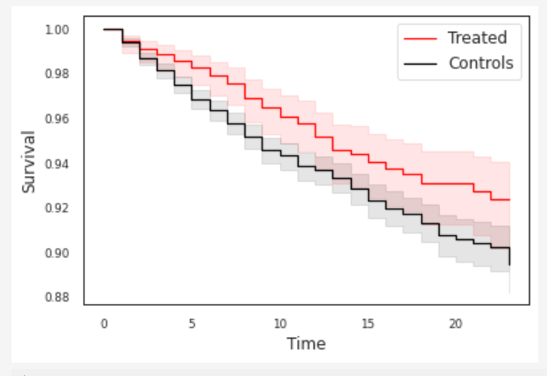
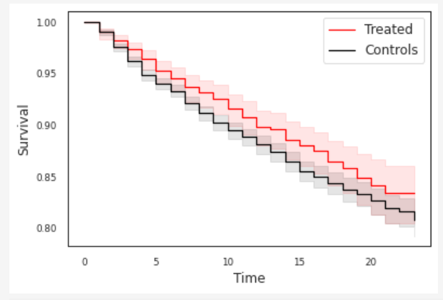
Survival Analysis
Inpatient Visits(left), Emergency Visits(Right)
P = 0.019223
P = 0.041262

Slide 9
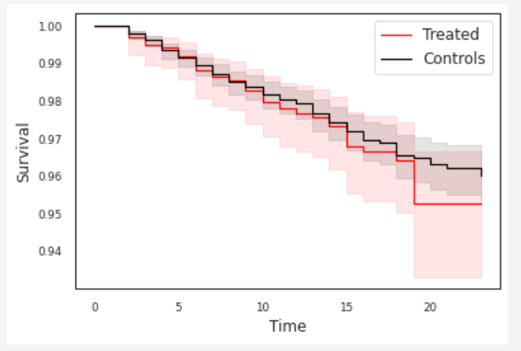
Survival Analysis
Time to Diabetes Diagnosis
P = 0.507

Slide 10
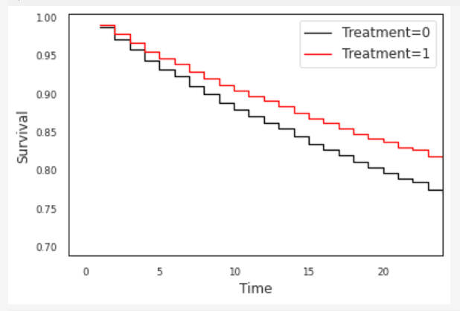
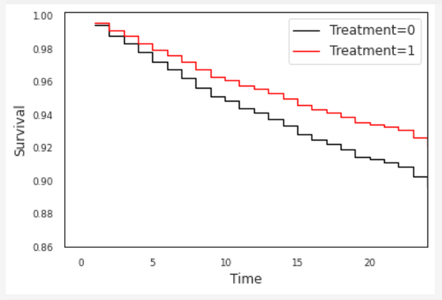
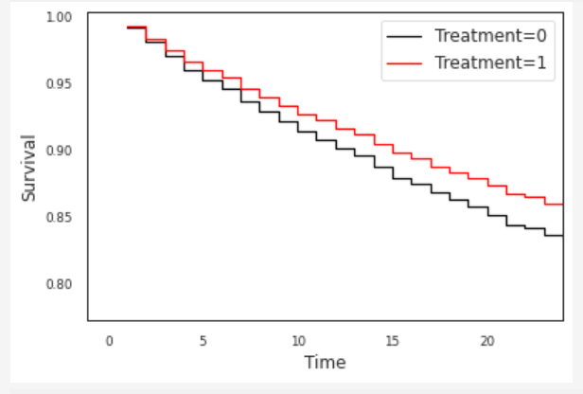
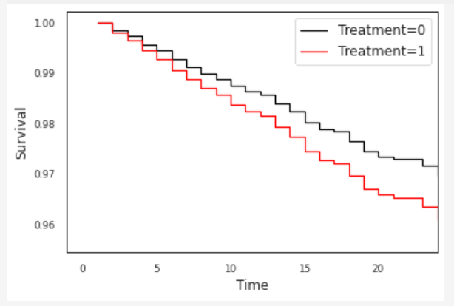
Survival Analysis
Cox regression models associate covariates with survival risk
Upper left: Acute Care
Upper right: Inpatient visits
Bottom left: Emergency Visits
Bottom Right: Time to Diabetes

Slide 11
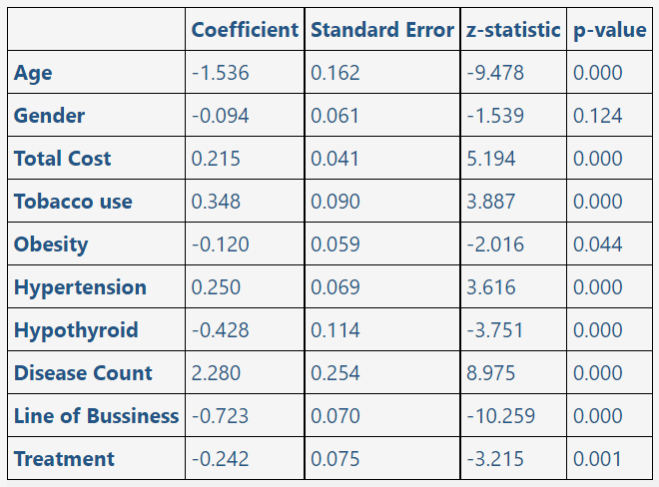
Survival Analysis
Cox regression weights(Acute care)

Slide 12
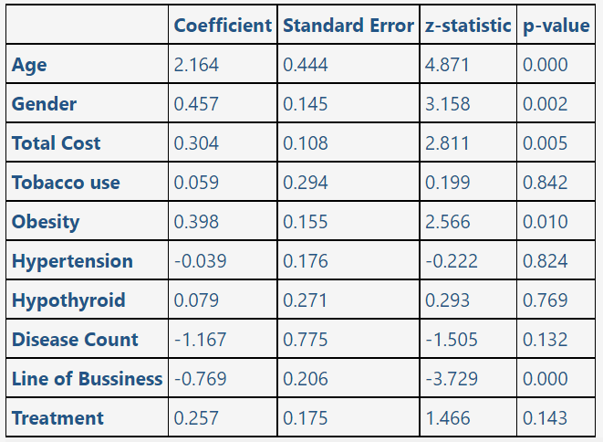
Survival Analysis
Cox regression weights(Diabetes)

