Slide 1

Hand Gesture Home Automation System Using Respberry pi pico and MQTT Protocol
By:
Sambit Kumar Rout(121CS0216)
MD Nafis AL Safayet (121CS0217)
Amit Kumar Sah(121CS0218)
Priyanka Kumari Sah(121CS0219)
Adya Ranjan Sahoo (121CS0220)
Subject : IOT Lab
Date : 8/11/2024
Supervisor: Prof.(Ms.) Suchismita Chinara
T.A. : Vipulsingh Negi

Slide 2
Introduction
Overview of Home Automation
In recent years, the Internet of Things (IoT) has transformed traditional home automation, allowing devices to communicate seamlessly.
This system enables users to control LED lights through hand gestures, detected via a mobile or laptop camera. By leveraging IoT and gesture recognition, the project showcases a more intuitive and user-friendly approach to controlling home appliances.
Objective of the Project
To design a hand gesture-based system to control home appliances using laptop or mobile.
To utilize the Respberry pi pico microcontroller as the central controller for automation.
To integrate MQTT protocol for secure and reliable communication between devices.
To explore the potential of gesture recognition technology in smart homes
Components and Tools Used
Respberry pi pico: A low-cost microcontroller with built-in WiFi.
LED Lights: Used to demonstrate the appliance control functionality.
Mobile/Laptop: Equipped with a camera to capture and recognize hand gestures.
MQTT Protocol: A lightweight messaging protocol used for reliable IoT communication.
Gesture Recognition Software: Python libraries like OpenCV and MediaPipe (for gesture detection).

Slide 3
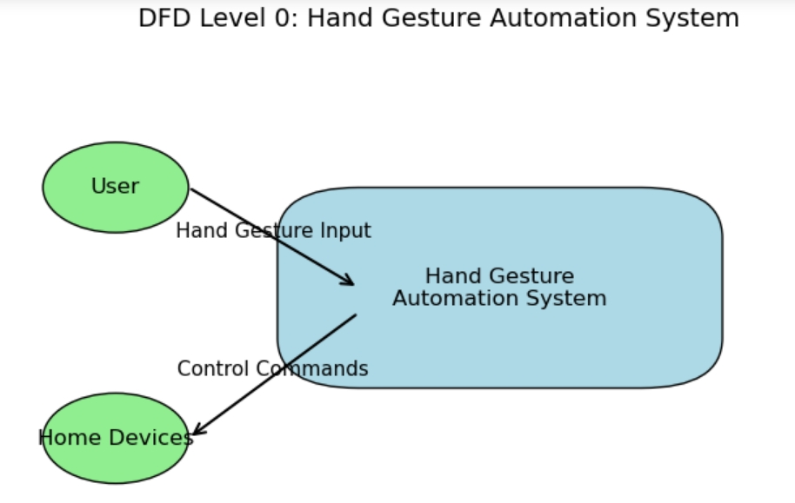

Slide 4
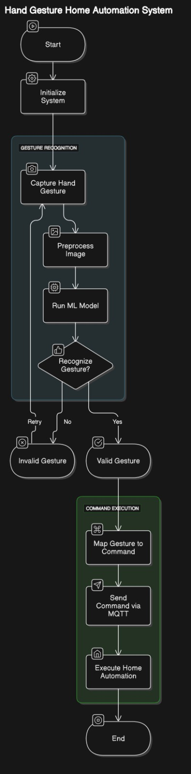

Slide 5
METHODOLOGY
Gesture Recognition
1. Image Capture: The mobile/laptop camera captures live video
2. Hand Gesture Detection: Using Python libraries (e.g., OpenCV and MediaPipe), the software identifies specific hand gestures.
3. Gesture Interpretation: Each recognized gesture is mapped to a unique control command (e.g., open hand = "LED ON", closed fist = "LED OFF").
4. Message Publishing: The command is then published to an MQTT topic, which the Respberry pi pico
subscribes to.
Communication via MQTT
1. Broker Setup: An MQTT broker (such as Mosquitto) is set up to manage message routing.
2. Topic Structure: A topic (e.g., "home/automation/LED") is created, and the gesture recognition software publishes messages on this topic.
3. Message Transmission: The Respberry pi pico, subscribed to the topic, receives the messages in real-time.
Respberry pi pico Control
1. Message Reception: The Respberry pi pico receives messages through the MQTT protocol.
2. Action Execution: Based on the command received, the Respberry pi pico controls the LED. For example, "LED ON" turns the LED on, and "LED OFF" turns it off.
3. Feedback Mechanism: The Respberry pi pico can publish a response message to confirm the action has been successfully performed

Slide 6
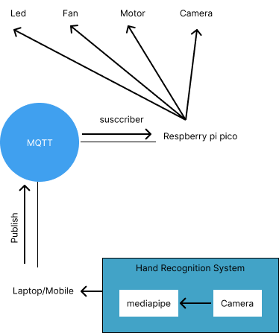

Slide 7
Challenges and Solutions
Gesture Detection Accuracy: Inconsistent lighting affected accuracy.
Solution: Use image preprocessing techniques to standardize lighting.
Communication Latency: Network issues led to occasional delays.
Solution: Optimized MQTT broker configuration for improved reliability.
Limited Gesture Set: Complex gestures caused recognition errors.
Solution: Limited the system to simple gestures for reliable performance.
Future Scope
This project demonstrates the potential of hand gesture-based control for home automation.
Future enhancements may include:
Integration with voice commands for multimodal control.
Addition of more gestures to control multiple appliances.
Enhanced security measures for safer MQTT communication.

Slide 8
References:
OpenCV Documentation: https://docs.opencv.org/
MediaPipe by Google: https://google.github.io/mediapipe/
MQTT Protocol Documentation: https://mqtt.org/

Slide 9
Conclusion:
The Hand Gesture Home Automation System effectively demonstrates how IoT and gesture recognition can simplify home automation.
Using Respberry pi pico, MQTT, and gesture recognition, this project provides an accessible, responsive, and user-friendly approach to smart home control, illustrating the potential of gesture-based interfaces in everyday applications.
Thank You

