Slide 1

DNS Threat Classification
Implementing an LSTM Neural Network from Scratch in C++ to Detect Malicious DNS Queries
Nafisa Usrat
Roll: 245451 | Phone: 01751996940
Supervisor: Dr. Rezvi Shahariar
Institute of Information Technology (IIT), University of Dhaka
1
SPL-1 | 2026
Notes:
1

Slide 2
Problem Statement
✓
⚠
🎣
⇄
⚡
Benign
DGA
(Domain Generation Algorithms)
Phishing
Tunneling
C2
Normal traffic
Malware domains
Brand spoofing
Data exfiltration
Command & Control
DNS (Domain Name System) queries carry rich threat signals — but classifying them requires understanding sequential character patterns.
~39,000 labeled DNS samples across 5 threat categories
Standard libraries have not been used, all math implemented from scratch in C++
Goal: build and validate a working LSTM(Long Short-Term Memory) classifier end-to-end
2
Notes:
2

Slide 3
System Architecture
Raw DNS
Domain
Preprocess
& Encode
Pad/Truncate
to 100 chars
Custom
LSTM
Dense +
Softmax
Threat
Label
Input
cleanDns() → charToIndex()
kMaxLength = 100
hiddenSize=32, C++
5-class output
Prediction
Key Design Decisions
No <cmath> or <algorithm>
BPTT with truncK=15
All math custom-implemented (squareRoot, logarithm, power via Taylor series)
Truncated backprop to avoid vanishing gradients over long sequences
Gradient clipping = 1.0
LR decay 0.95/epoch
Prevents explosion; weight clamping removed as it conflicted with clipping
initialLR=0.001, patience=8 early stopping, dropout=0.3
3
Notes:
3

Slide 4
Training Journey
01
Baseline: ~48%
Initial training — NaN explosion around epoch 11
02
Math Bugs Fixed
squareRoot() & logarithm() Taylor series had poor initial guesses and insufficient iterations
03
Gradient Issues
Added zero-division guards, correct 1/k gradient averaging before norm clipping
04
State Accumulation
Hidden states grew each epoch — training loop structure fixed
05
Final: 87.8%
Removed weight clamping, added state clipping, stable training confirmed
4
Notes:
4

Slide 5
Classification Results
87.8%
Benign
91.4%
DGA
89.9%
Overall Accuracy
14,137 test samples
Phishing
78.1%
Tunneling
95.2%
C2
95.3%
⚠ Phishing (78.1%) is the weakest class — confused with Benign and DGA due to overlapping domain patterns. All other classes exceed 90%.
5
Notes:
5

Slide 6
C++ vs PyTorch LSTM
Custom C++
PyTorch
Benign
91.4%
89.9%
-1.6%
DGA
89.9%
80.5%
-9.5%
Phishing
78.1%
77.0%
-1.1%
Tunneling
95.2%
94.5%
-0.8%
C2
95.3%
95.3%
0.0%
OVERALL
87.8%
82.4%
-5.5%
6
Notes:
6

Slide 7
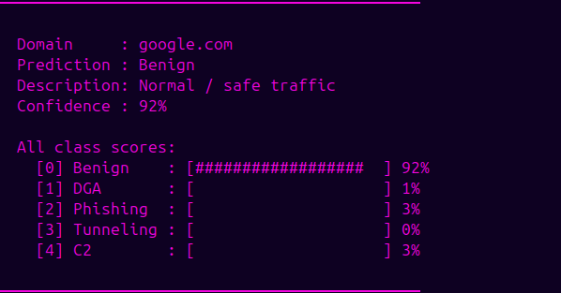
CLI — DNS Threat Detector
CLI Features
Interactive Mode
Live domain input with confidence scores
Single Query
./dga_classifier -q domain.com
7
Notes:
7

Slide 8
Conclusion
Full C++ LSTM from scratch
All gates, activations, BPTT and optimiser implemented manually — no ML library used.
End-to-end preprocessing pipeline
CSV loading, DNS cleaning, character encoding, label mapping — all in C++.
5-class DNS threat classification
Detects Benign, DGA, Phishing, DNS Tunneling, and C2 traffic.
PyTorch benchmark comparison
Mirror architecture built in Python to validate C++ implementation results.
CLI tool deployment
Runnable classifier accepting domain strings from command line.
8
Notes:
9

Slide 9
Thank You
GitHub Repo: https://github.com/nafisa1602/SPL-1
9

