Slide 1

Blockchain Application for Education
Masters Thesis Proposal
Nafisa Jassani, University of Houston

Slide 2
Problem Statement
Students add false skills, false courses and false experience certificates in their resumes when applying for jobs. They also present false degrees and false experience certificates.
Background check costs a lot to the companies to verify the students’ qualifications.
Recruiters may have to spend a lot of time verifying the skills (by asking for projects and then verifying them)

Slide 3
Proposed Solution
Educational Institutions (Physical / Course sites like Coursera) can write transactions recording the completion of a course by a student.
Recruiters can verify the courses completed by an applicant (by knowing his/her public key).
Recruiters can write transactions recording the experience attained by an employee.
Students can send requests to peers to endorse their skills.
Students can endorse the peers who have send endorse requests.

Slide 4
Why Blockchain?
Student qualification record cannot be forged, since blockchain provides integrity of transactions.
Blockchain has a fixed timestamp which cannot be changed and thus the sequential qualification record of a student can be accessible.
Blockchain is decentralized, thus enabling Institutions, Recruiters and Students from around the globe can participate and at no (or least) costs.
Blockchain records can be accessed by any participant satisfying the Access Control Rules.

Slide 5

Project Phases Phase 1: Educational Institution registers the course completion to qualification of student, Recruiter verifies the Students qualifications, Recruiter issues Experience Certificate for qualification of Employee Phase2: Student can send connect request to other students(Peers), Student can approve requests send by other students(Peers).

Slide 6
Solution Architecture: Overview
Assets: Assets are tangible or intangible goods, services, or property, and are stored in registries.
Participants: Participants are members of a business network. They may own assets and submit transactions.
Transactions: Transactions are the mechanism by which participants interact with assets.
Access Control: Access control rules allow fine-grained control over what participants have access to what assets in the business network and under what conditions.
Identities and ID cards: ID cards simplify the process of connecting to a business network, and extend the concept of an identity outside the business network.

Slide 7
Participants
Admin Users |  | Non-Admin User
Educational Institution | Recruiter/ Employer | Student/ Applicant/ Employee
Properties: Email (Primary Key) Name Address | Properties: Email (Primary Key) Name Address | Email (Primary Key) Name Student Qualification Peers Pending Requests Applied To
Functions: Record Specialization for Student | Functions: Verify Applicant’s qualifications Record Experience Certificate for Employee | Functions: Send Connect Request To Peers Approve Request to Connect Skills (in progress)

Slide 8
Assets
Student Qualification | Skills
Courses Experience Certificate | (Phase 3)

Slide 9
Transactions
Record Specialization for Student
Course Title
Mode of Instruction – ONLINE / FACE TO FACE
Course Level – Graduate / Undergraduate
Provider Educational Institution
Student completed the course
Verify Applicant’s qualifications
Candidate (Employee/Student)
Applied to (Self Id of the Recruiter)
Record Experience Certificate for Employee
Certificate ID
Number of Years
Description
Candidate (Employee/Student)
Applied to (Self Id of the Recruiter)

Slide 10
Transactions (continued..)
Send Connect Request To Peers
Connect To (Student except self) (Peer ID)
Self ID of Student
Message of Connect Request
Approve Requests
Peer ID (from who the connection request was sent - Student except self)
Self ID of Student
Record Skills
(Phase 3)

Slide 11
Demo of the Project so far

Slide 12
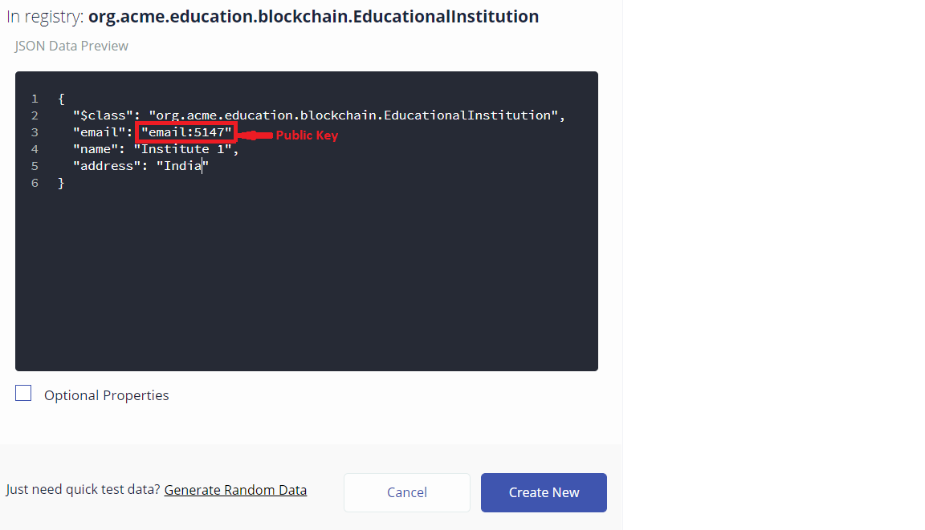
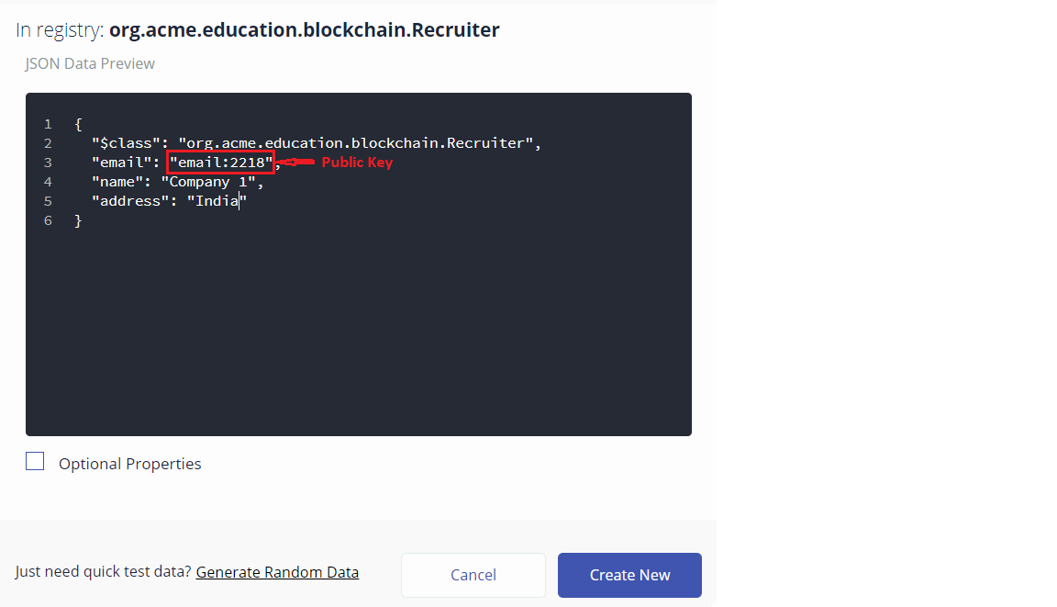
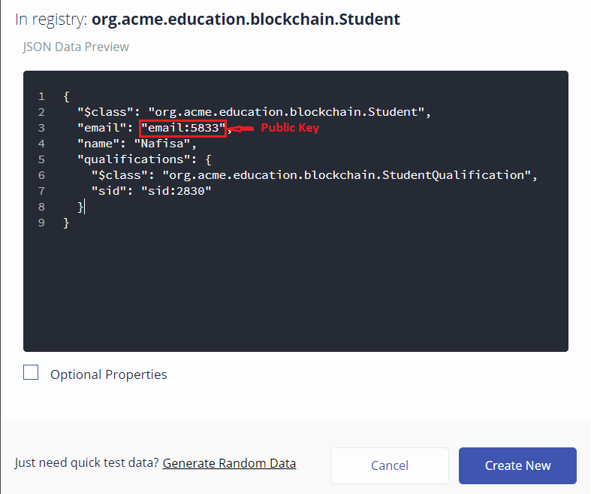
Create Participants

Slide 13
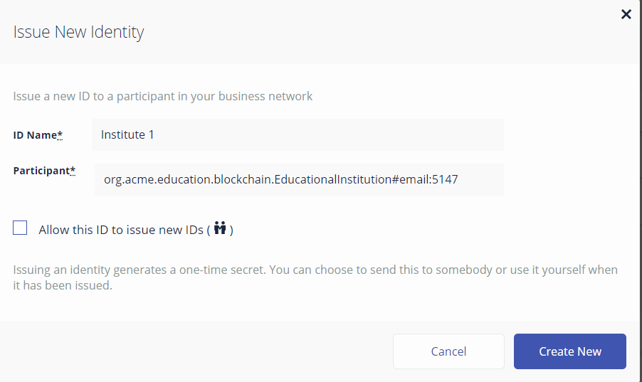
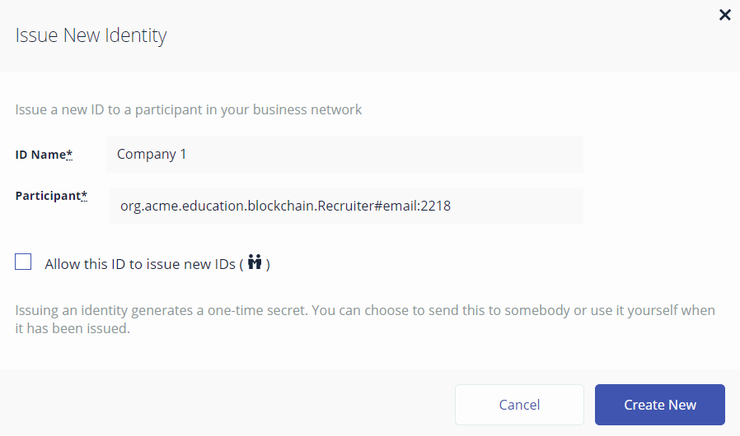
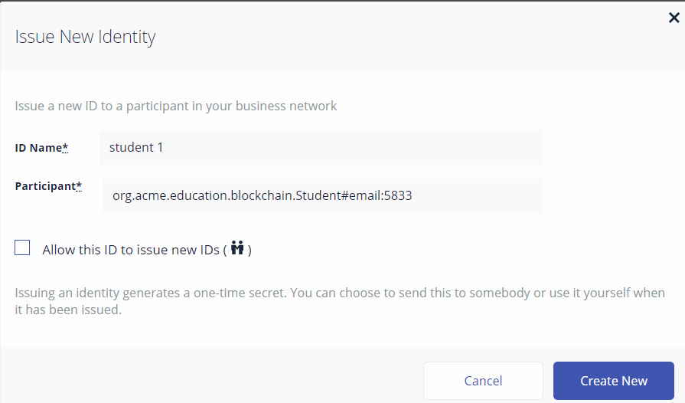
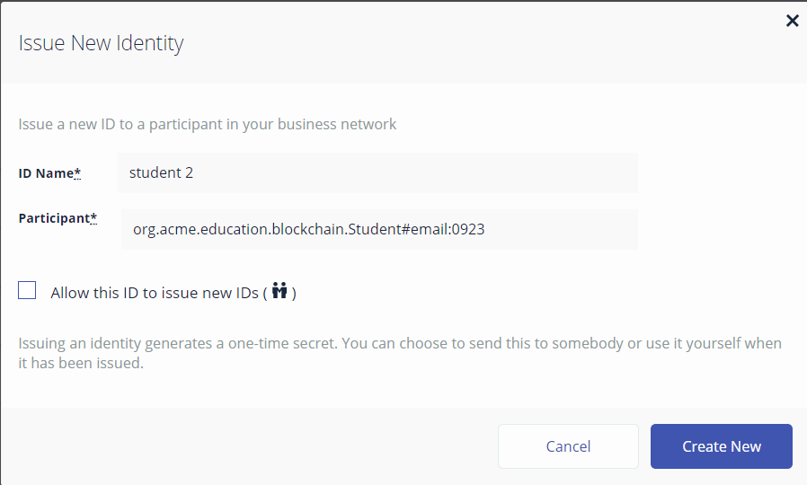
Issue IDs for Participants

Slide 14
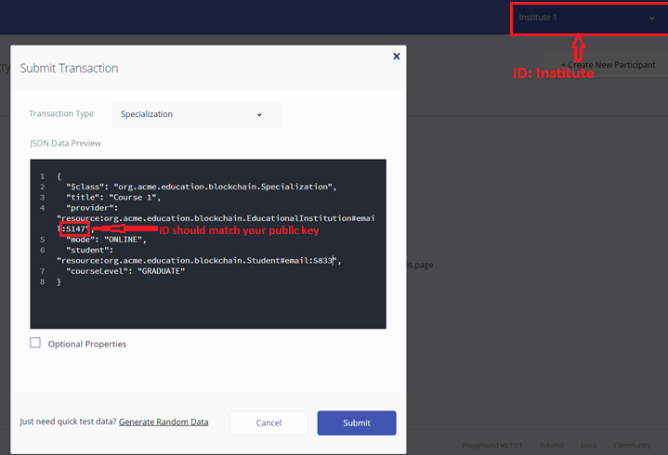
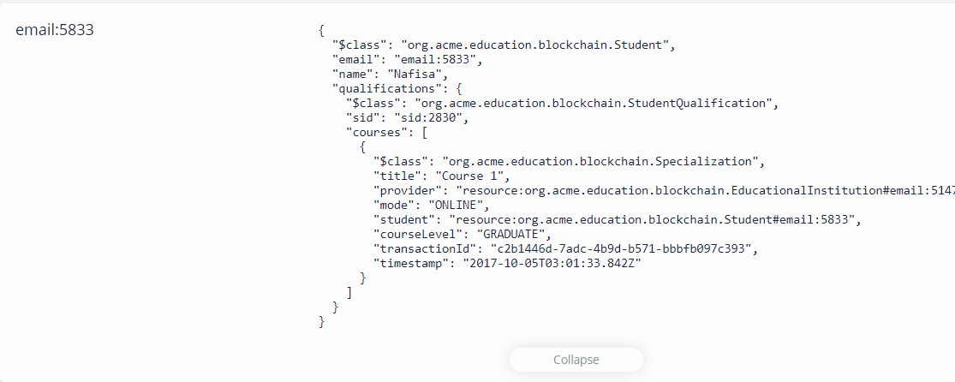
Transaction: Institute can Add Specialization for Student

Slide 15
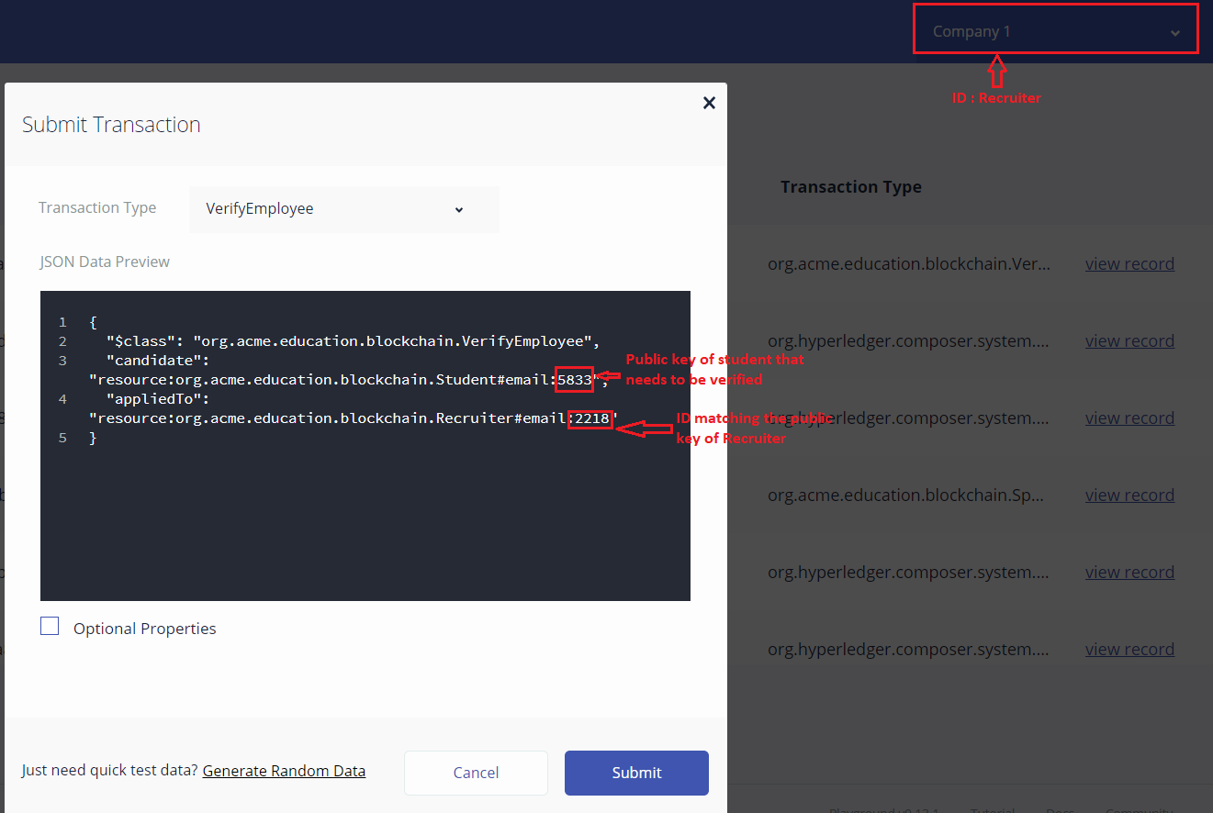

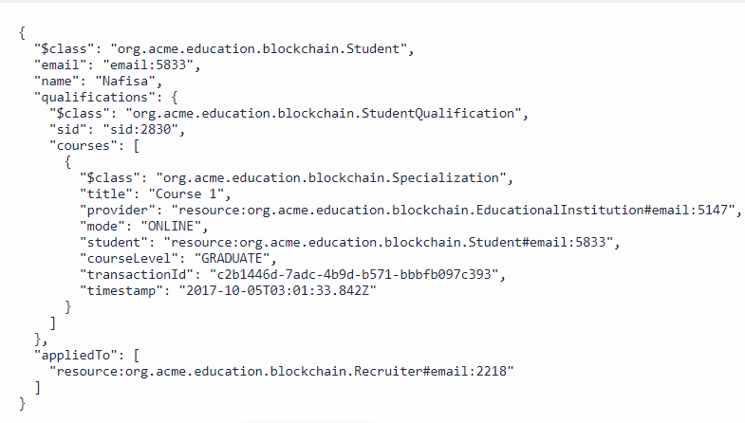
Transaction: Recruiter can verify an applicant and adds transaction that the student has applied to the Recruiter

Slide 16
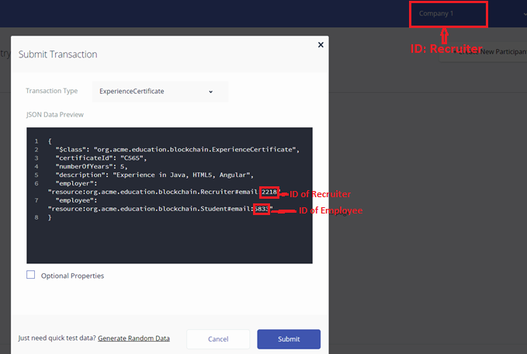
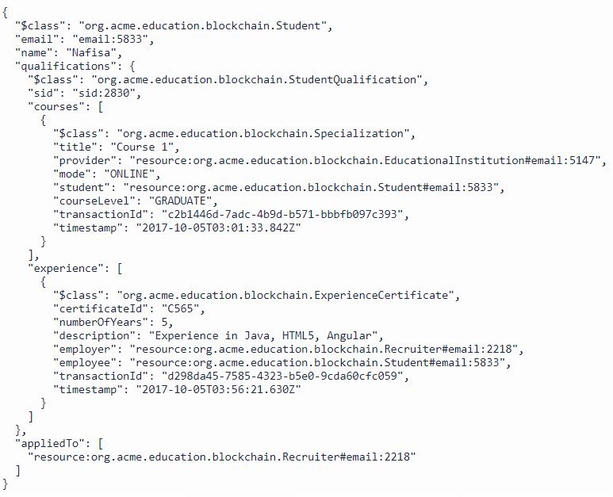
Transaction: Recruiter can register experience certificate for an employee

Slide 17
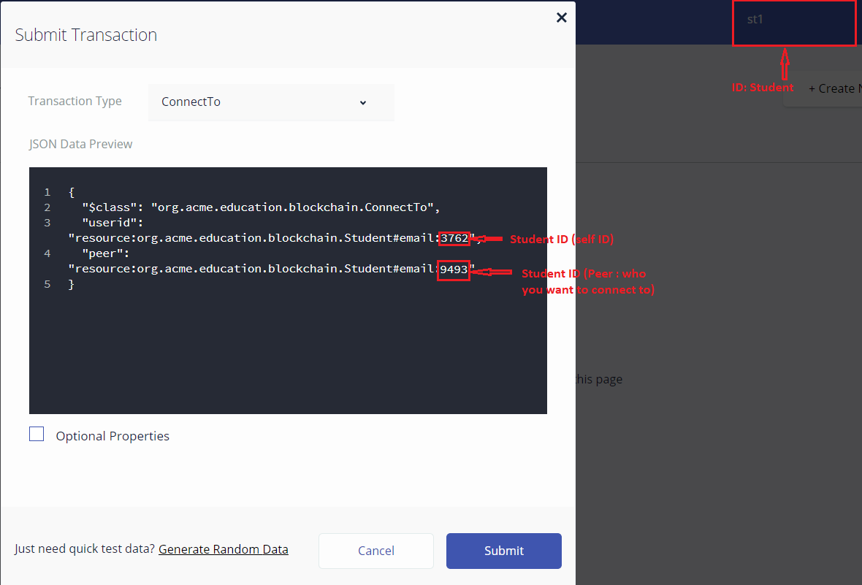
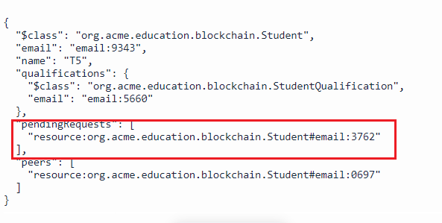
Transaction: Student can send connect request to another Student

Slide 18
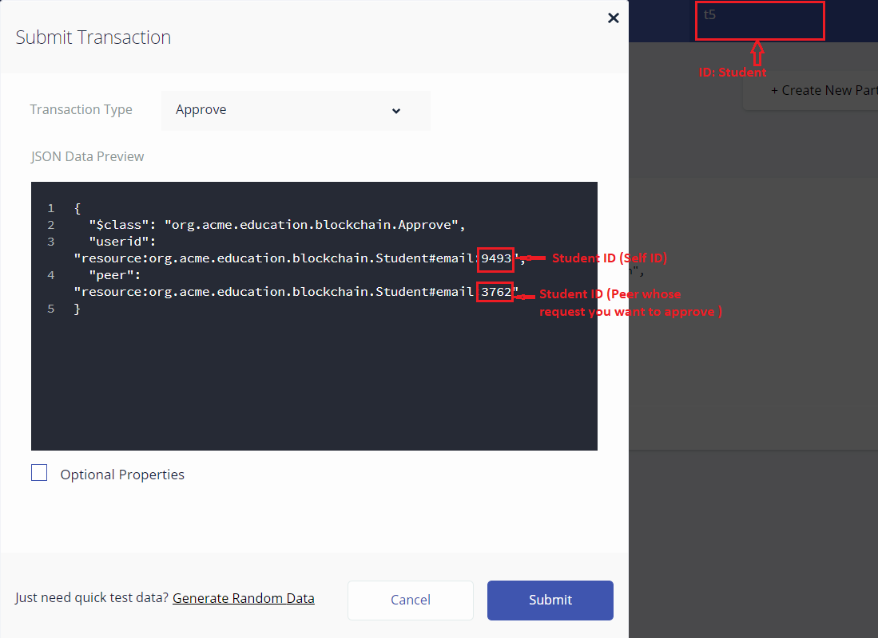
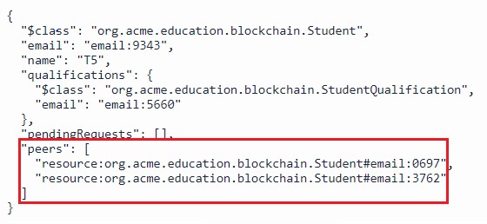

Transaction: Student can Approve the request sent by another Student

Slide 19
Plan for Phase 3
Students can add skills and proof of work (link to github, hosted project, etc.) to their profile
Students can request their peers to endorse their skills
Students can endorse skills of their peers
Recruiter can view full profile of the student who has applied to their company.

