Slide 1

Blockchain Application for Education
Masters Thesis Proposal
Nafisa Jassani, University of Houston

Slide 2

Project Phases Previous Completed Phase 1: Educational Institution registers the course completion to qualification of student, Recruiter verifies the Students qualifications, Recruiter issues Experience Certificate for qualification of Employee Phase2: Student can send connect request to other students(Peers), Student can approve requests send by other students(Peers).

Slide 3
Project Phases Current Phase 3: Students can add skills and proof of work (link to github, hosted project, etc.) to their profile Students can request their peers to endorse their skills Students can endorse skills of their peers Recruiter can view full profile of the student who has applied to their company.

Slide 4
Participants
Admin Users |  | Non-Admin User
Educational Institution | Recruiter/ Employer | Student/ Applicant/ Employee
Properties: Email (Primary Key) Name Address | Properties: Email (Primary Key) Name Address | Email (Primary Key) Name Student Qualification Peers Pending Requests Applied To Skills Endorsement Requests
Functions: Record Specialization for Student | Functions: Verify Applicant’s qualifications Record Experience Certificate for Employee | Functions: Send Connect Request To Peers Approve Request to Connect Add Skills to profile Request Endorsements from Skills Endorse Skills of Peers
Functionality added for this Phase

Slide 5
Assets
Student Qualification | Skills
Courses Experience Certificate | Skill Name Number Of Years Of Experience url For Proof Of Work Endorsements

Slide 6
Transactions
Add Skills
skill
Student
Request Endorsement
Skill
User Id (Self User ID)
Request Endorsement From (ID of Peer from who you are requesting endorsement)
Approve Endorsement
Skill
User Id (Self User ID)
Approve Endorsement Of (ID of Peer from who you are endorsing)
Comments

Slide 7
Demo of the Phase 3

Slide 8
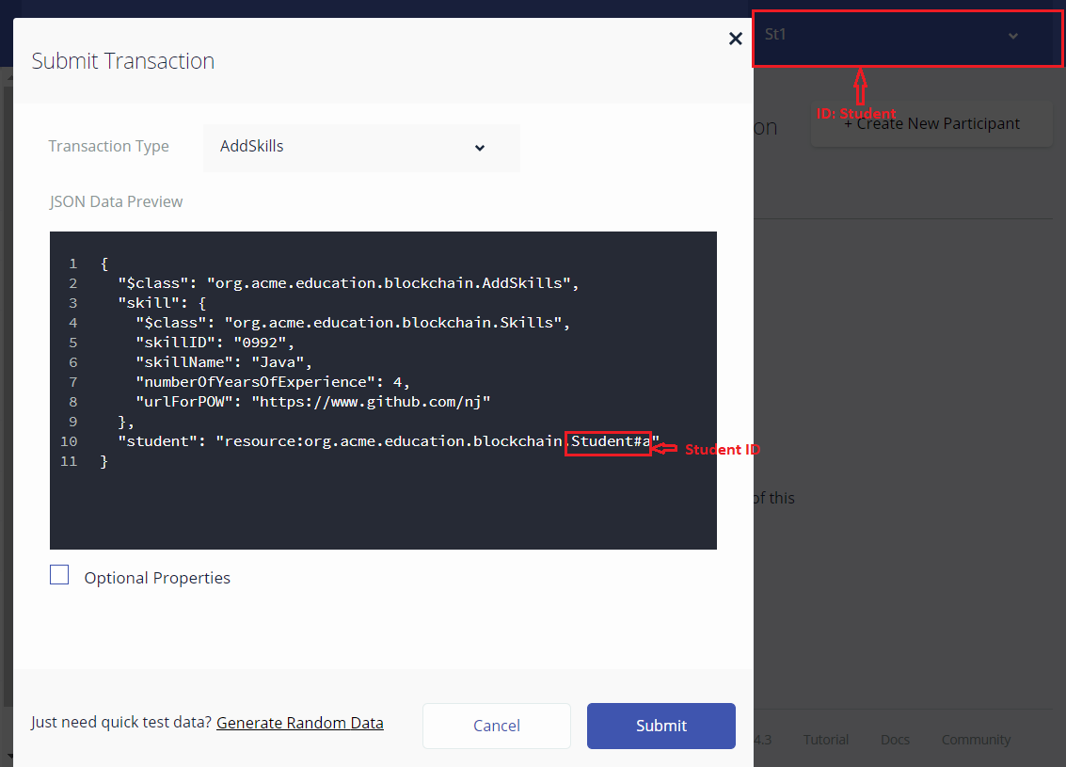
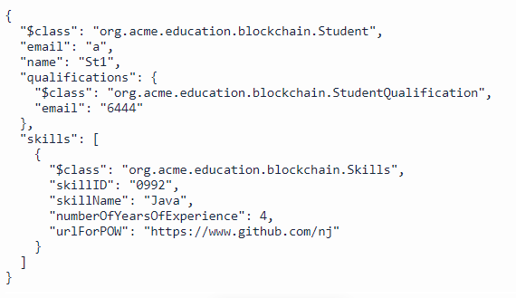
Transaction: Student can add Skills to his/her profile

Slide 9
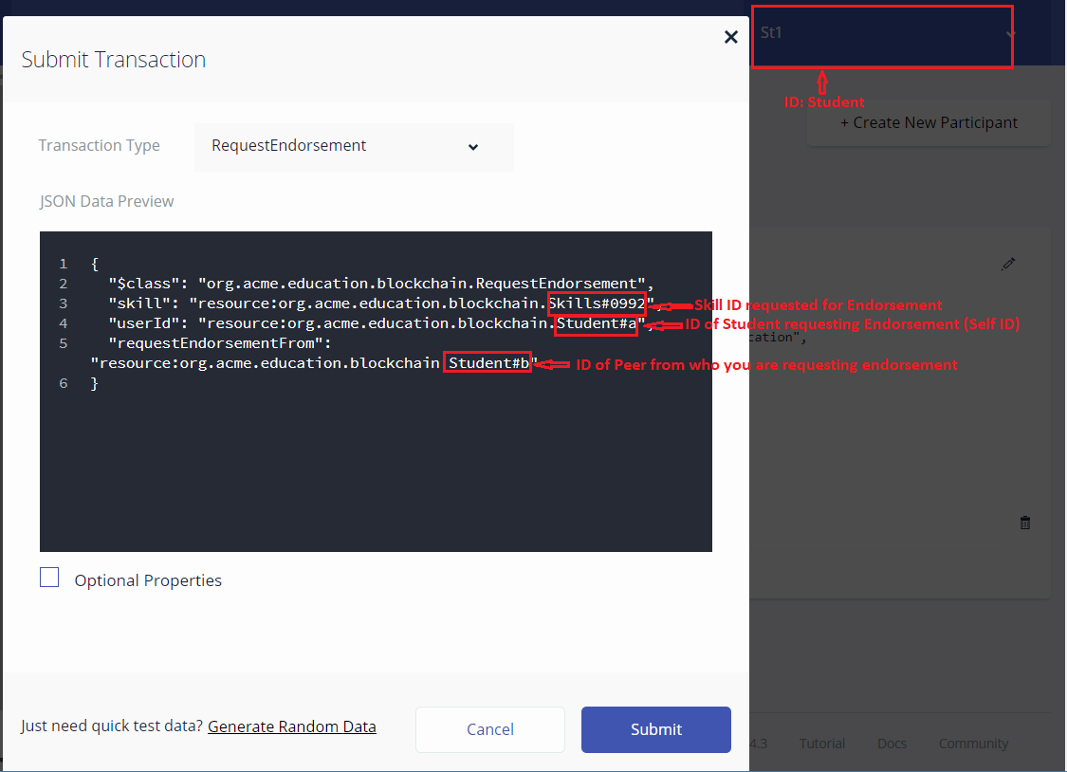
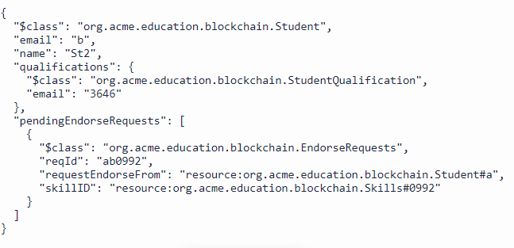
Transaction: Student can Request Peers to Endorse their Skills

Slide 10
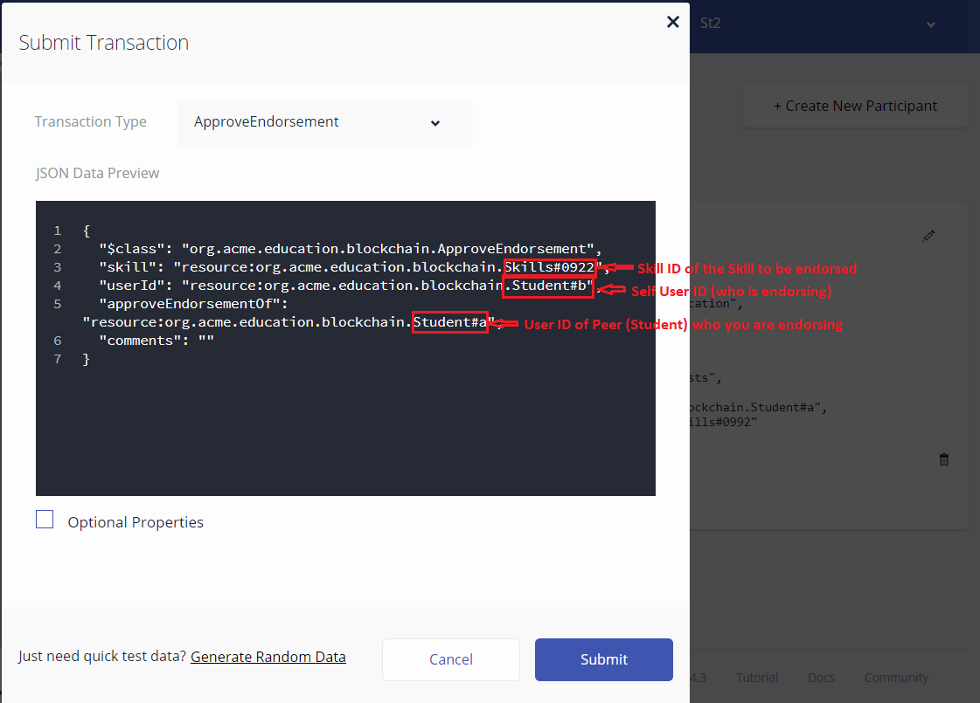
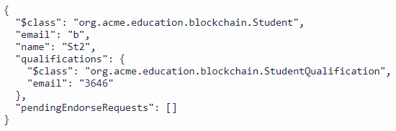
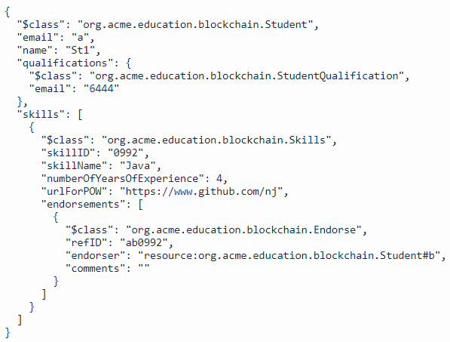
Transaction: Student can Endorse Skills of their Peers

Slide 11
Plan for Phase 4
What are the various APIs available for developing blockchain applications?
Research on Why Hyperledger Composer is fit for this project?

