Slide 1
CUSTOMER ANALYTICS
SCA TDD3 Power BI Capstone Project
Prepared By Nafisat Muazu Ejile (Group 3C)
Understanding customer segments, regions, contribution and concentration

Slide 2
1. Business Problem
The business needs to understand who contributes most to revenue and profit.
The analysis focuses on four questions:
• Which customer segments contribute most?
• Which customer regions contribute most?
• How concentrated is revenue among customers and segments?
• How does customer contribution change over time?

Slide 3
2. Data & Preparation
Five business tables were used: Sales, Customers, Products, Branches and Targets.
40,003 raw sales records were reviewed and 40,000 clean transactions were retained.
408 blank DiscountPct values were treated as 0 based on the project assumption.
Power Query was used for cleaning, data types, duplicate checks and preparation.
A star-schema model and dedicated Date table were created in Power BI.

Slide 4
3. Executive Overview
₦4.21B
Total Revenue
₦890.38M
Total Profit
21.16%
Profit Margin
4,000
Customers
The overview page gives management a quick view of overall business performance and customer reach.
The trend visuals show how revenue and profit change over time, while regional analysis shows where customer revenue comes from.

Slide 5
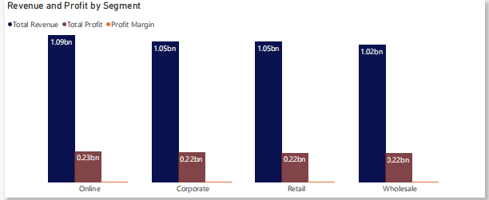
4. Customer Segment Analysis
Online is the largest revenue-generating segment at approximately ₦1.095B.
Online also records the highest profit at approximately ₦231.4M.
Wholesale has the highest preliminary profit margin at approximately 21.29%, even though it has the lowest revenue.
Key lesson: the biggest seller is not always the most profitable segment.

Slide 6
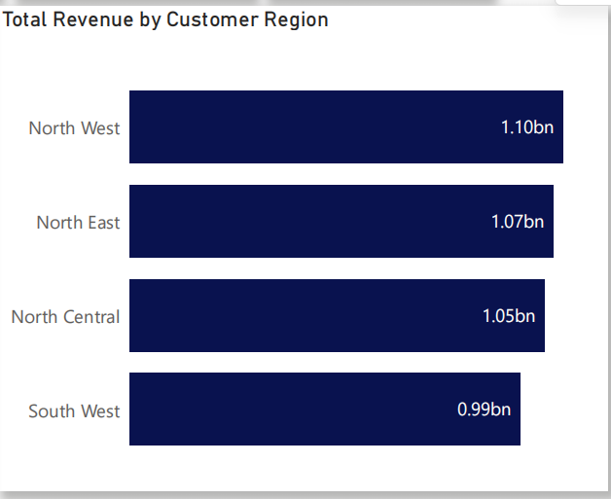
5. Customer Region Analysis
North West has the highest customer revenue at approximately ₦1.097B.
South West has the lowest customer revenue among the regions, but its preliminary profit margin is strong at approximately 21.54%.
This shows why management should compare revenue and profit together when evaluating regions.

Slide 7
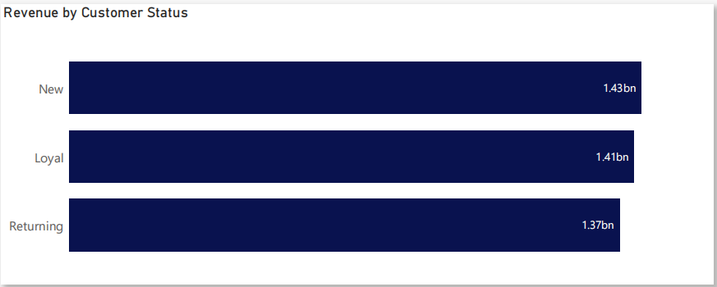
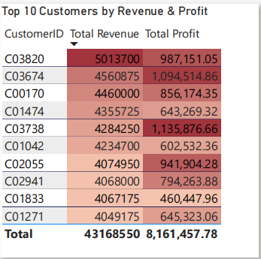
6. Customer Status & Top Customers
New, Loyal and Returning customers contribute at similar levels.
The business therefore does not depend mainly on one customer-status group.
The Top 10 customers generate approximately ₦43.17M in revenue.
Their contribution is only about 1.03% of total revenue, showing that revenue is spread across many customers.

Slide 8
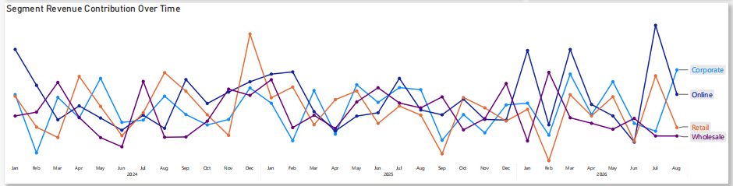
7. Contribution vs Concentration
Contribution asks: “How much does this customer or segment contribute to the total?”
Concentration asks: “How dependent is the business on a small number of customers?”
The low Top 10 revenue share indicates low customer concentration.
This reduces the risk of losing a large share of revenue from the loss of only a few customers.

Slide 9
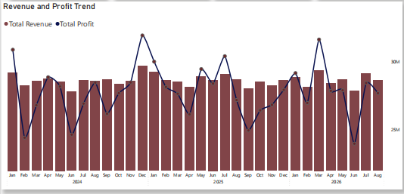
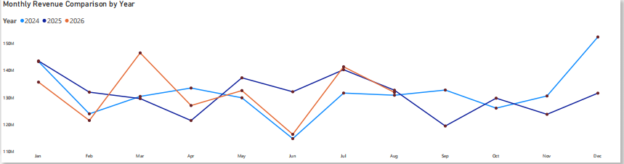
8. Customer Trends
The time analysis compares customer and segment performance across months and years.
Year-over-year and monthly views help identify periods of growth, decline and changes in customer contribution.
The Date table makes these comparisons consistent and supports Power BI time-intelligence measures.

Slide 10
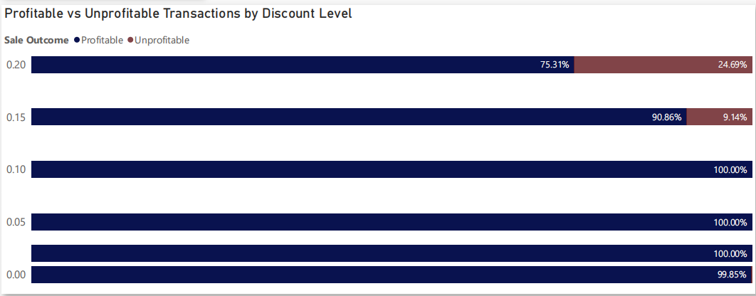
9. Additional Insight: Discount & Profitability
The additional analysis compares profitable and unprofitable transactions across discount levels.
This is not one of the four core 3C questions, but it adds useful context about customer transactions and discount behaviour.
The visual should be used to identify discount levels that deserve further investigation, not to claim that discount alone causes profit or loss.

Slide 11
10. Key Insights
1. Revenue is broadly spread across customer segments.
2. Online leads both revenue and profit.
3. Some regions have lower revenue but stronger margins.
4. Top 10 customers account for only about 1.03% of total revenue.
5. Customer-status groups contribute at similar levels.
6. Revenue and profit trends should be monitored over time.

Slide 12
11. Recommendations
• Keep valuable customers coming back through retention activities.
• Use different strategies for different customer segments.
• Investigate why regional performance differs and learn from stronger regions.
• Monitor monthly and yearly customer trends.
• Keep tracking customer concentration so dependence on a small customer group does not increase.

Slide 13
CONCLUSION
The business has a broad customer base and low customer concentration.
The strongest opportunity is to use customer, segment and regional insights together to improve retention, targeting and decision-making.
Thank you

