Slide 1
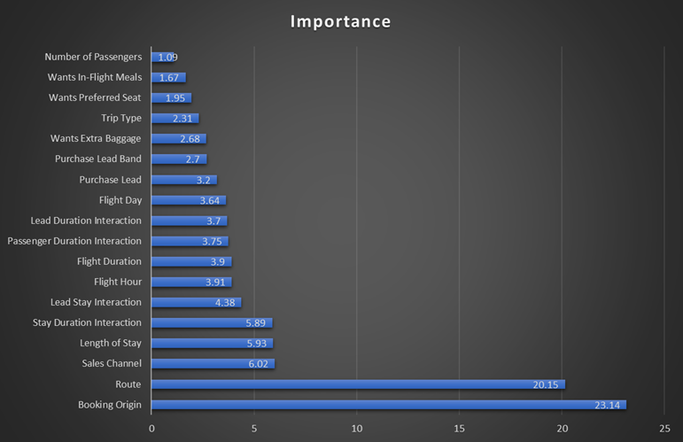
Customer Booking Prediction — Model Findings
CatBoost classifier | 5-fold stratified cross-validation | Class weighting: 1:5
ROC-AUC
0.799 ± 0.003
Useful predictive discrimination
Recall
72.8% ± 0.9%
Catches ~3 in 4 actual bookers
Precision
32.0% ± 0.4%
Trade-off from prioritising recall
F1
0.444 ± 0.004
Precision/recall balance
Key findings
Top drivers
Booking origin and route dominate predictive power, together accounting for ~45% of feature importance.
Customer behaviour
Length of stay and flight duration are the strongest numerical predictors.
Business objective
1:5 class weighting prioritises completed bookings and reduces costly false negatives.
Model stability
Very small CV standard deviations indicate consistent performance across folds.
Recommendation: target likely bookers proactively, accepting some false positives to avoid missed sales opportunities.

