Slide 1
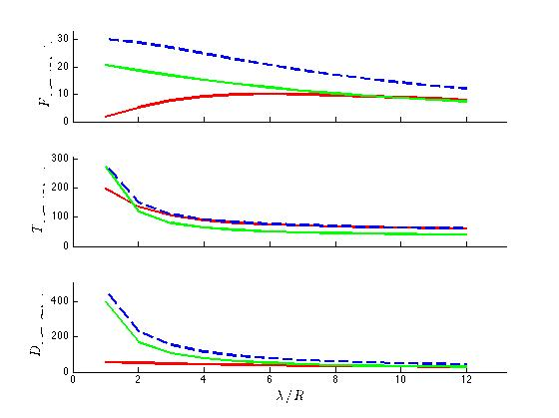
Nafiseh
Microrobot simulation results with three numerical methods
In this graph the variable is the helical pitch (x-axis). Thrust, Torque and Drag (y-axis) are measured.
Next step… using Nanoscribe facilities to print microrobots

