Slide 1
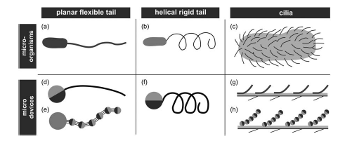
Nafiseh
Designing more microrobots with solidwork
Studying mathematical models for flagellum swimming motion
Analysing effective parameters to improve efficiency of microrobots
Using Matlab to simulate microrobots
Writing the thesis

