Slide 1
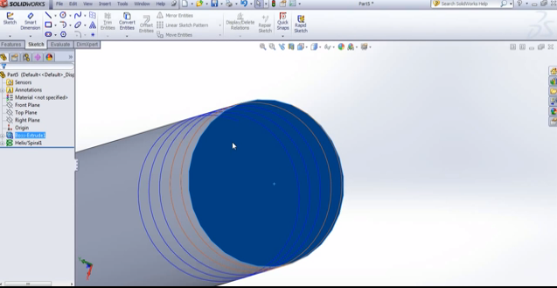
Nafiseh
Learning Solid work
Reading about Nanoscribe
Designing helical microbots

