Slide 1
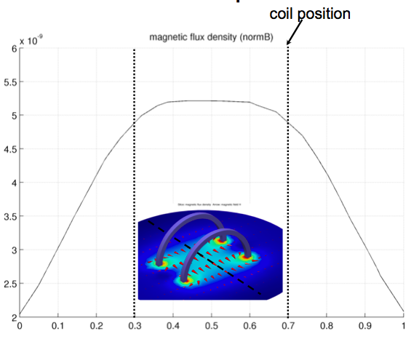
Nafiseh
  Simulating the microrobot with 2 degree of freedom (1D model) _x0013_
  Next step: microrobot with 6 degree of freedom

