Slide 1
Clive
Ultrasonic Link
In negotiations with transducer suppliers. Added one more to make three in total.
Derived appropriate model of transducer for sims
Investigated UMC process documentation – inadequate
Cadence simulations indicate series inductor is best for mitigating effect of transducer plate capacitor since:
Creates external resonant circuit including load resistor and plate cap
Series (transducer) circuit serves to replace losses in resonant circuit
Maximises power delivered to a matched load

Slide 2
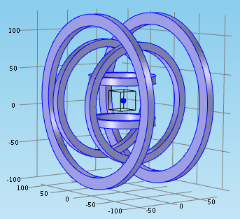
Nafiseh
Microrobot Simulation
Finished modeling
Start implementing

