Slide 1
Clive
Sally
Ultrasonic Link
In negotiations with transducer suppliers. Added one more to make three in total.
Derived appropriate model of transducer for sims
Investigated UMC process documentation – inadequate
Cadence simulations indicate series inductor is best for mitigating effect of transducer plate capacitor since:
Creates external resonant circuit including load resistor and plate cap
Series (transducer) circuit serves to replace losses in resonant circuit
Maximises power delivered to a matched load
Carried out first microdialysis cycling monitoring experiment
Comparing levels in tissue, sweat and blood levels before, during and after recovery
Ran microdialysis samples back through analysis system offline to get levels with temporal resolution
Working on optimising sensor system and designing new chip for online experiments

Slide 2
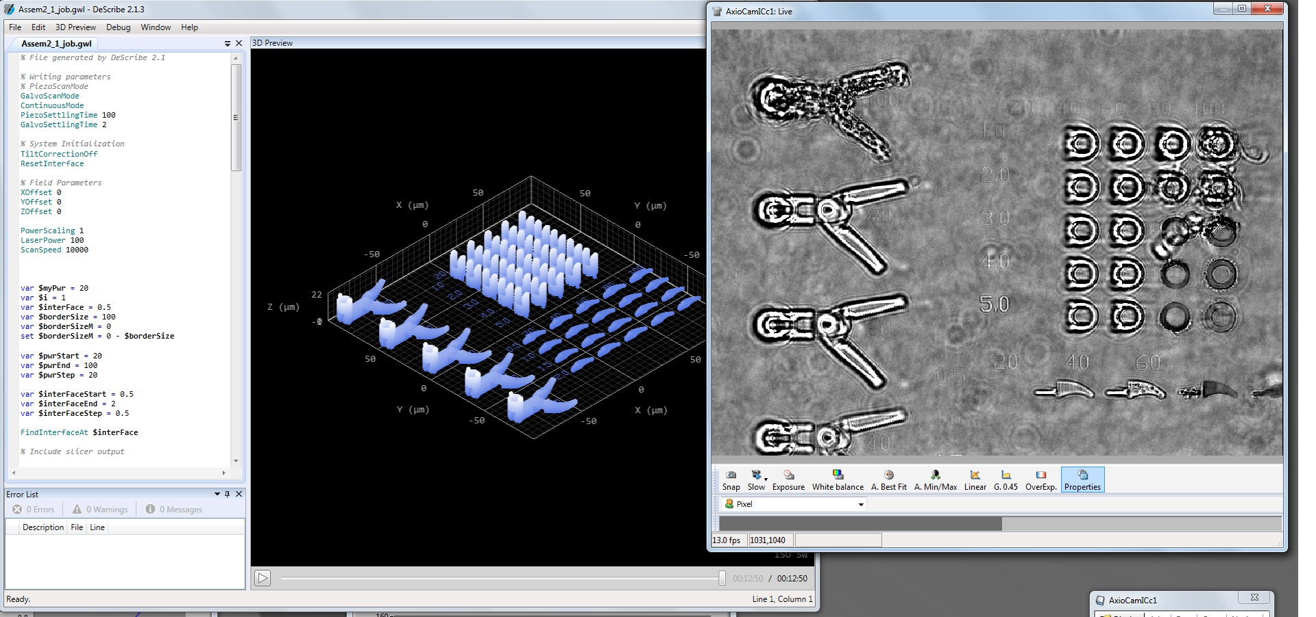
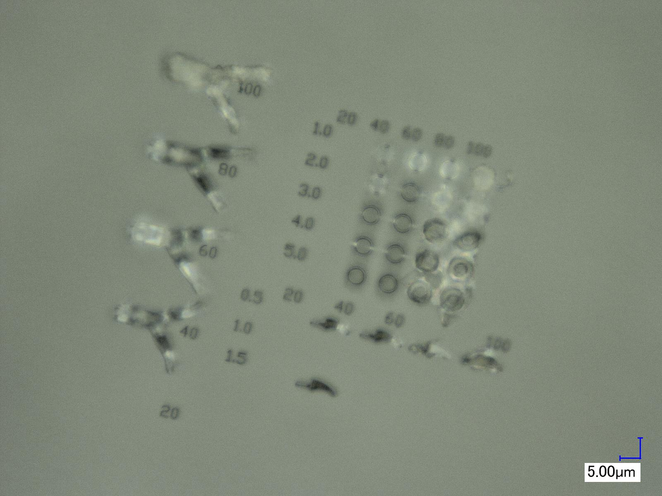
Vincenzo
Henry
Lactate biosensor – optimization of the outer membrane layer.
Installation of Nanoscribe and Keyence VHX-2000 (workshop B525)
Nanoscribe installation
cleanroom preparation
operation and maintenance training
test structure writing
test script to automate parameter sweeps
requires optimisation on focal point finding and laser power

Slide 3
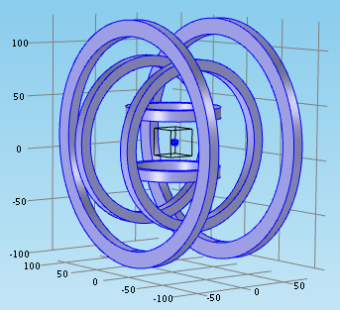
Nafiseh
Nanoscribe training and workshop
Microrobot simulation
Finished modelling
Starting implementation

