Slide 1
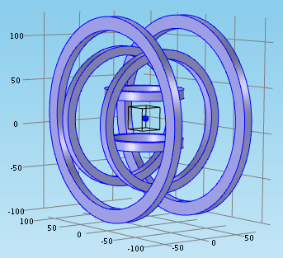
Nafiseh
Microrobot Simulation
Finished modeling
Start implementing

