Slide 1
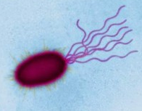
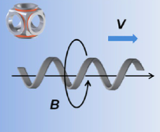
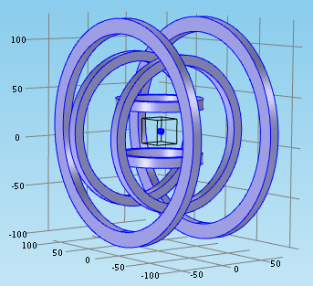
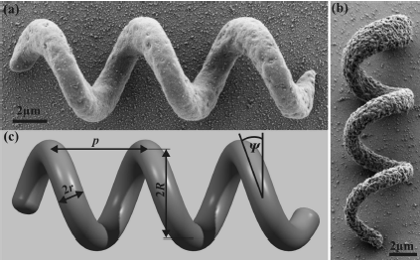
Platform for Microrobot Navigation
Nafiseh Vahabi

Slide 2
Microrobot and Applications

Slide 3
Microrobot Application
Targeted Therapy
Manipulation
Sensing and marking

Slide 4
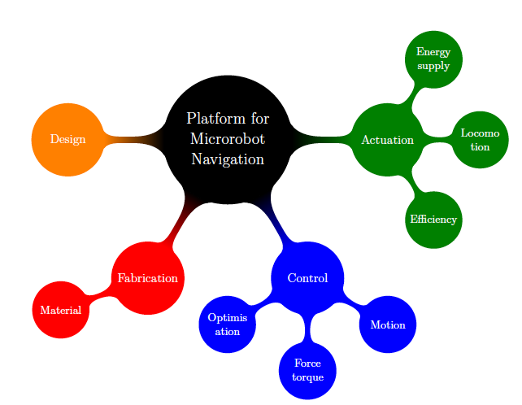
Microrobot platform requirement

Slide 5
Table summerise all the microrobots

Slide 6
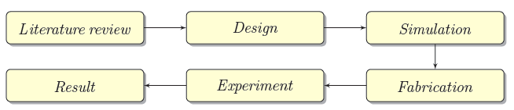
Overview Diagram of the project

Slide 7
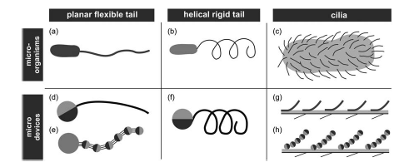
Design
Microorganism

Slide 8
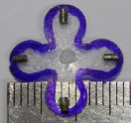

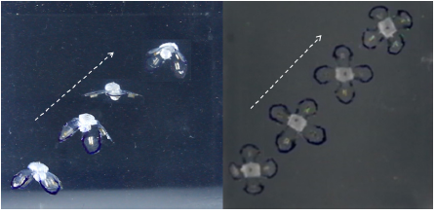
Design

Slide 9
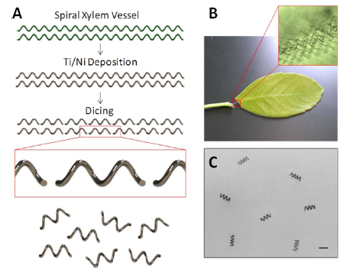
Design

Slide 10
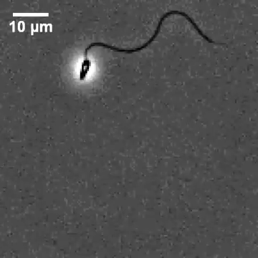
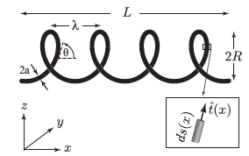

Helical Shape Microrobot

Slide 11

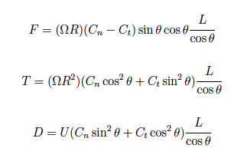

Propulsion Modeling
High viscous fluid

Slide 12
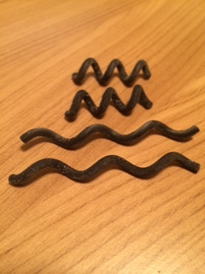
Helical Parameter
Simple Helix
Helix with sphere head
Helix with square head
Optimizing helical parameter

Slide 13
Simulation

Slide 14
Numerical Simulation
Resistive Force Theory (RFT)
Body Slender Theory (BST)
Regularized Stokes methods (RSM)

Slide 15
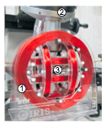
Simulation

Slide 16
Simulation Result

Slide 17
Fabrication
Lithography
Training with nanoscribe

Slide 18
Any Question?

