Slide 1
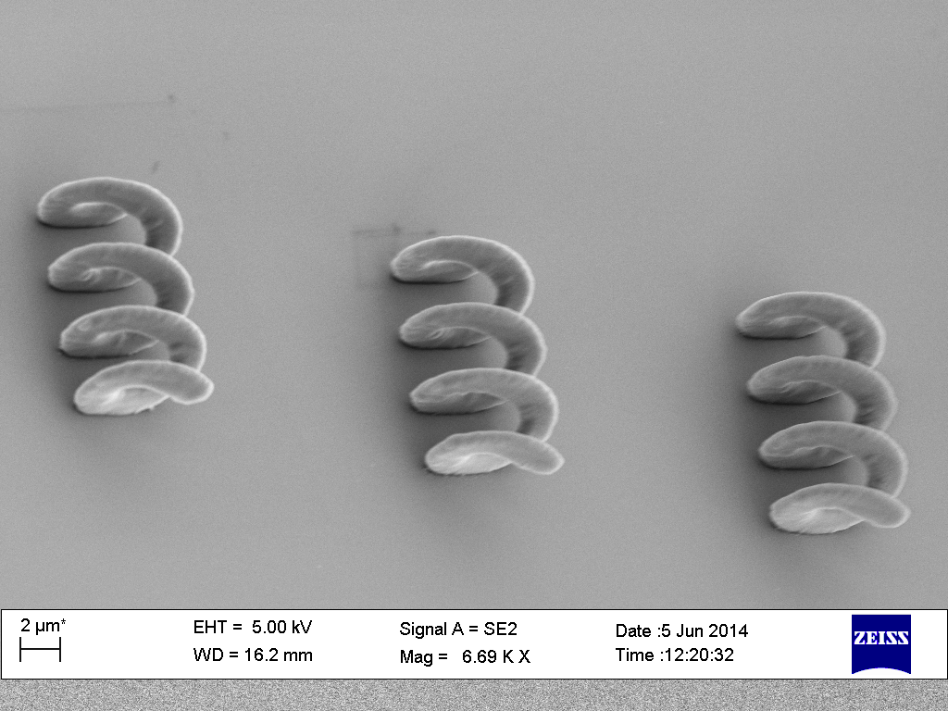
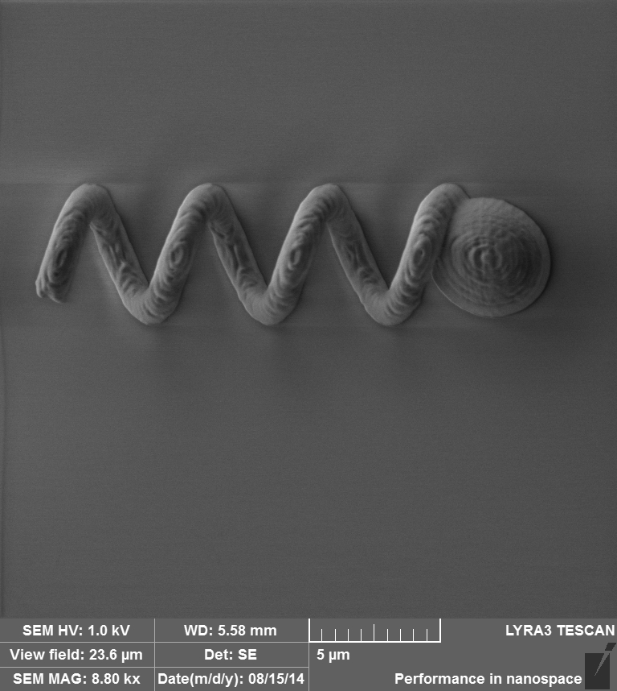
Nafiseh
  Optimising design of the microrobot for fabrication process
  Analysing structures with Ebu using SEM
  Writing up thesis

