Slide 1
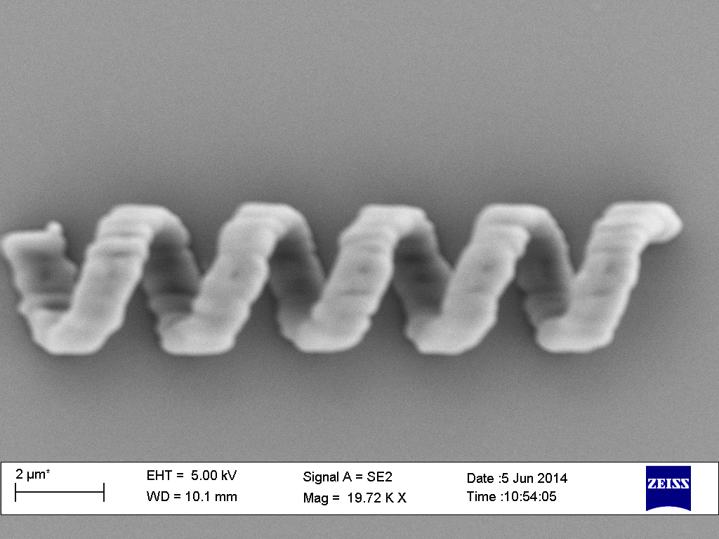
Nafiseh
Carrying on the microrobot simulation
Microrobot fabrication
  Printing microrobots
  Analysing and optimising design of the microrobot by looking at their SEM pictures

