Slide 1
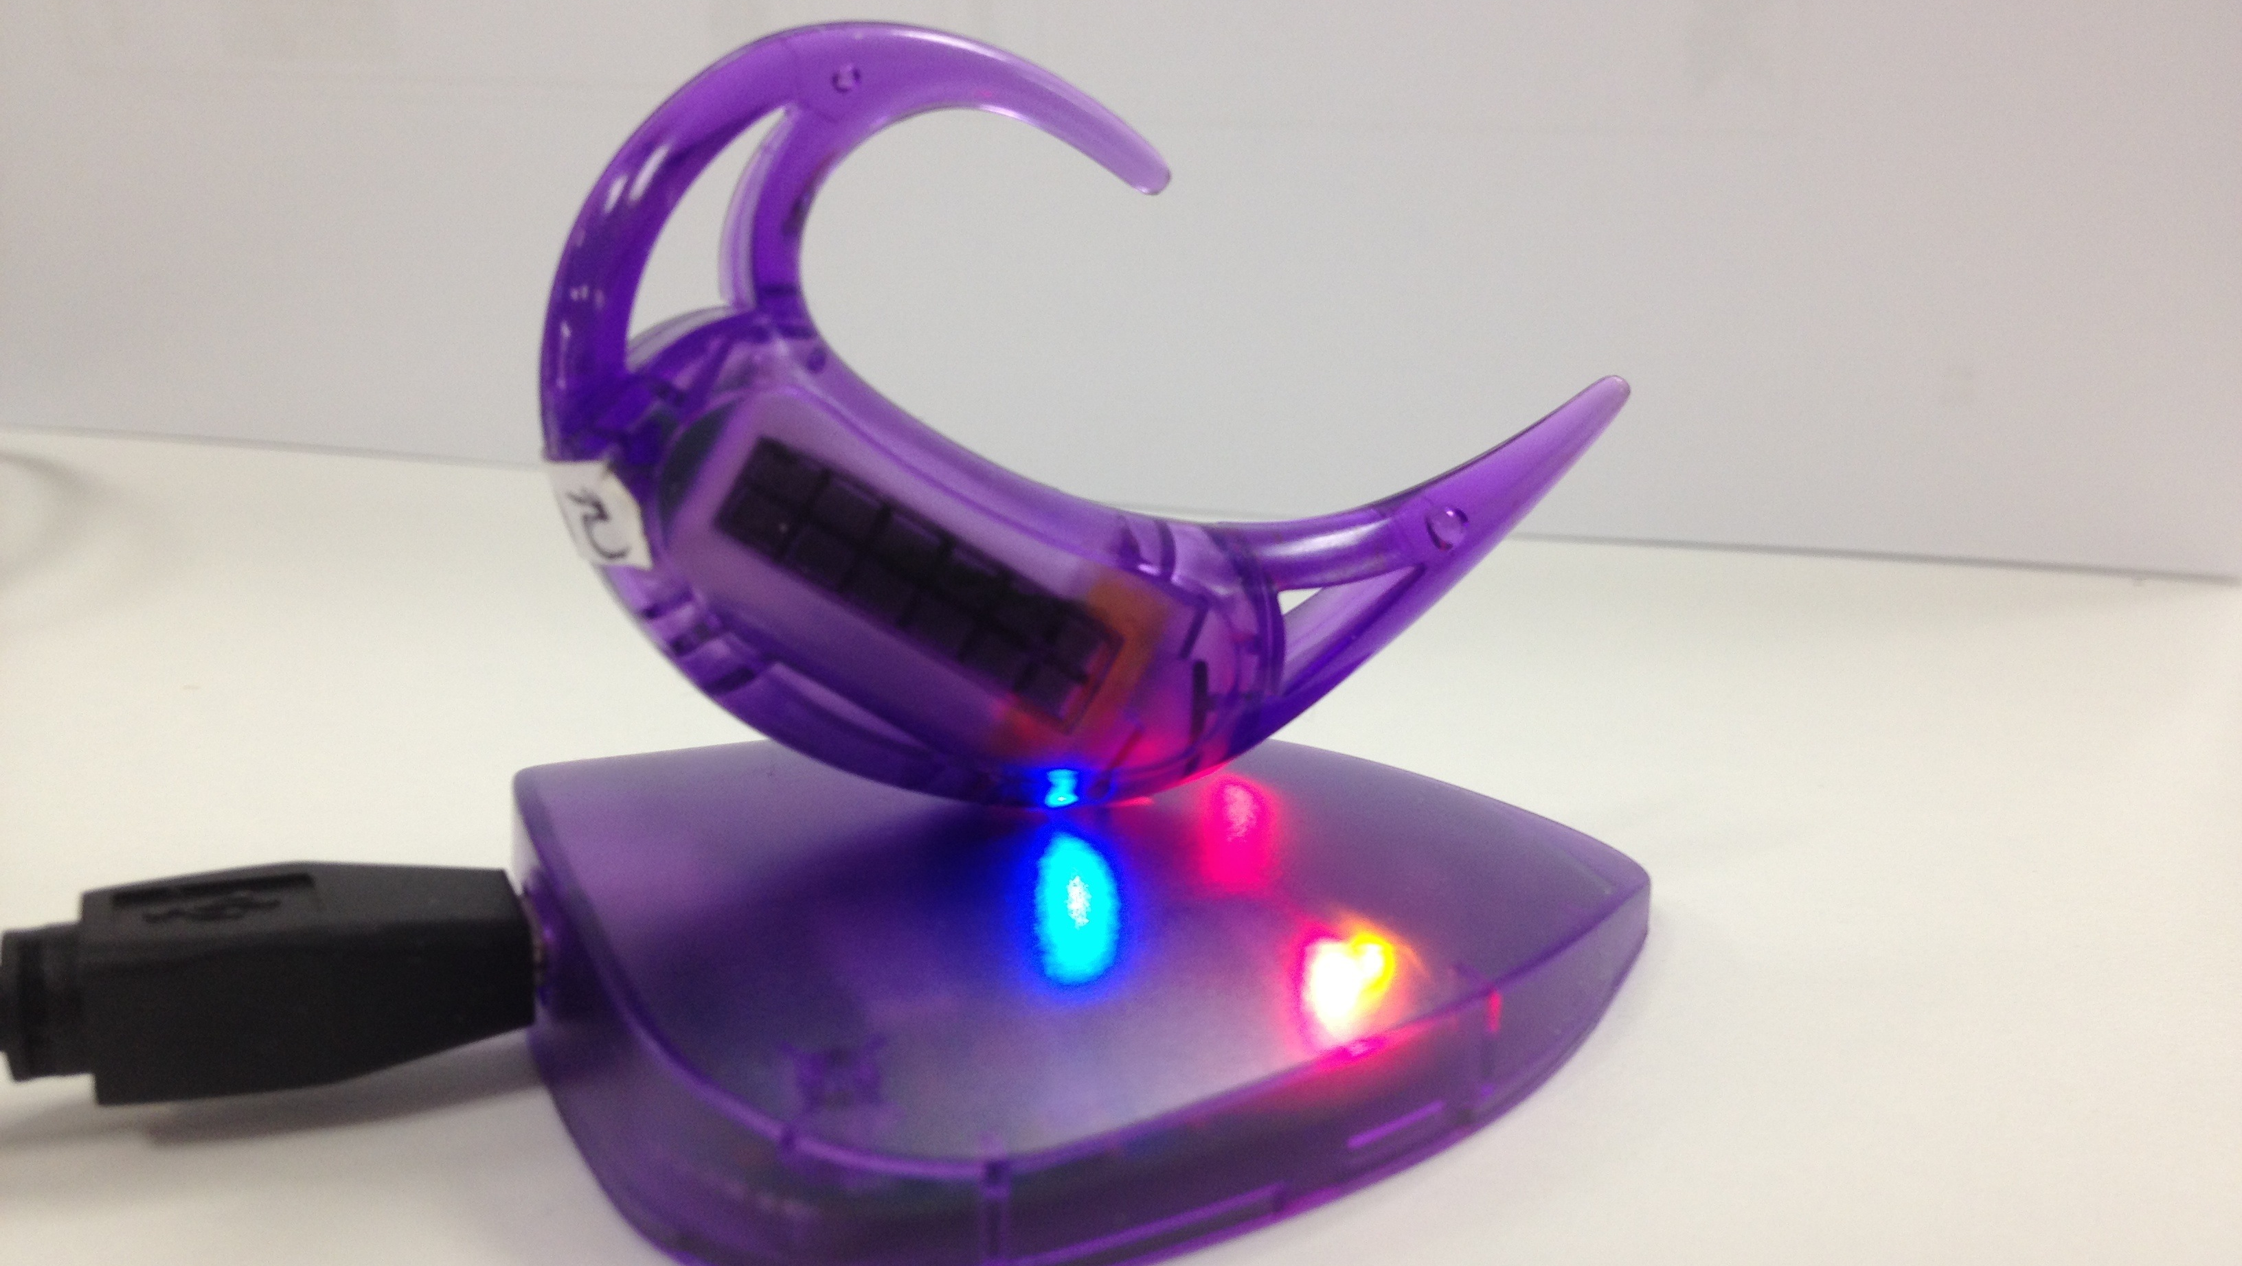
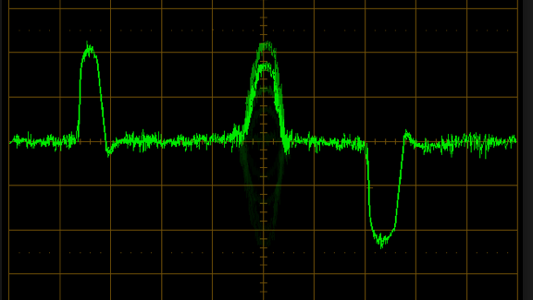
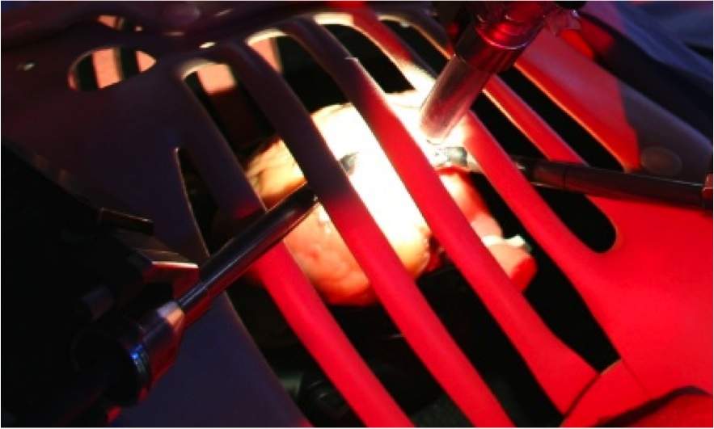
Platform for Microrobot Navigation
Nafiseh Vahabi

Slide 2
History of Microrobot
Video
Shapes
Application

Slide 3
Recent Microrobots

Slide 4
Table summerise all the microrobots

Slide 5
Overview Diagram of the project

Slide 6
Challenge of the project
High viscous fluid
Microsize
Actuation mechanisn

Slide 7
Design
Helix
Twist

Slide 8
Parameter Optimisation
Reynold number
High viscous
Standard equations

Slide 9
The table of different angle and helical parameters

Slide 10
Potential novel design
jellyfish

Slide 11
Simulation
Numerical simulation
Fluid hydrodynamic
Problem - solusion

Slide 12
Simulation methods

Slide 13
Implementing in matlab, Comsol workshop

Slide 14
Fabrication
Lithography
Training with nanoscribe

Slide 15
Scanning Electron Microscope

Slide 16
Any Question

