Slide 1
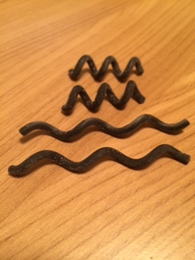
Nafiseh
Microrobots’s design
Optimising microrobots’s parameters
3D printing of two microrobots’s designs
Simulation
Research on numerical methods to implement a simulator.

