Slide 1
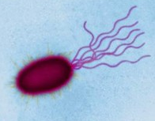
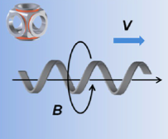
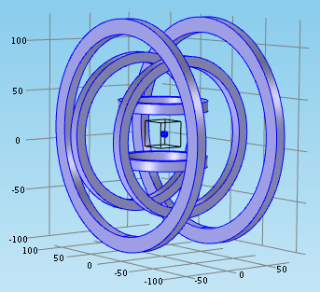
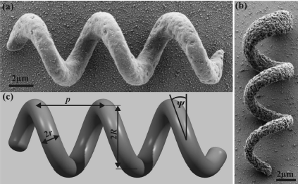
Platform for Microrobot Navigation
Nafiseh Vahabi
MRes

Slide 2

History of Swimming Microrobot
At 1930 first swimming mechanism at micro scale reported
‘Life at Low Reynolds Number’’ by Purcell

Slide 3
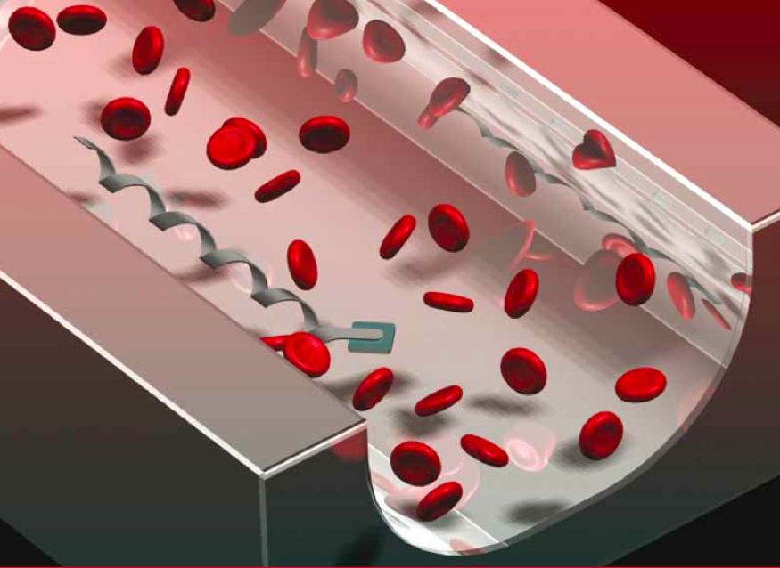
Microrobot and Applications
Biology
Biomedicine
Lab-on-a-chip
Robotics
…

Slide 4
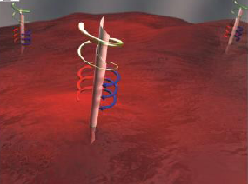
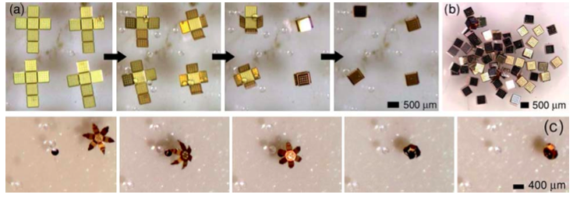
Medical Application
Targeted drug delivery
Cell manipulations

Slide 5
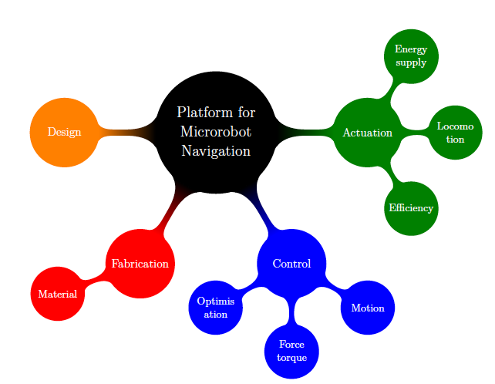
Microrobot platform requirement

Slide 6
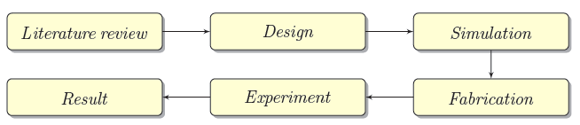
Overview Diagram of the project

Slide 7
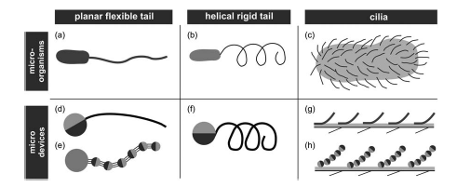
Design
Microorganism

Slide 8
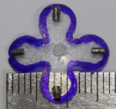

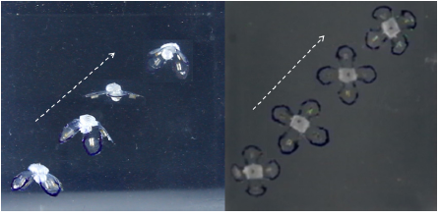
Design
17 mm long and 0.5 mm thick

Slide 9
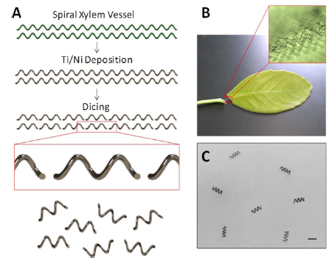
Design

Slide 10
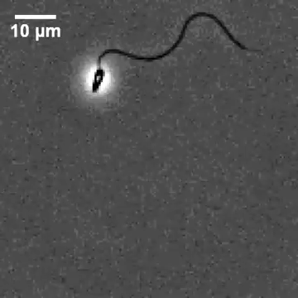
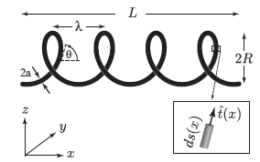

Helical Shape Microrobot

Slide 11

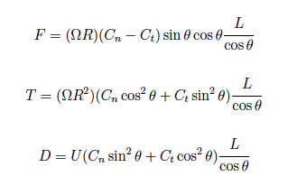

Propulsion Modeling
High viscous fluid

Slide 12
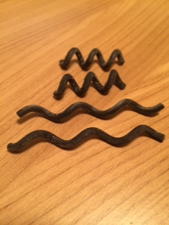
Helical Parameter
Simple Helix
Helix with sphere head
Helix with square head
Optimizing helical parameter

Slide 13
Simulation

Slide 14
Simulation Methods
Resistive Force Theory (RFT)
Body Slender Theory (BST)
Regularized Stokes methods (RSM)

Slide 15
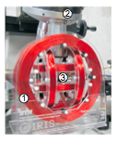
Simulation

Slide 16
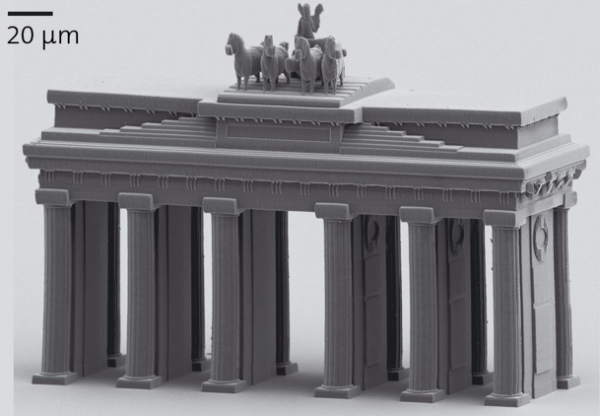
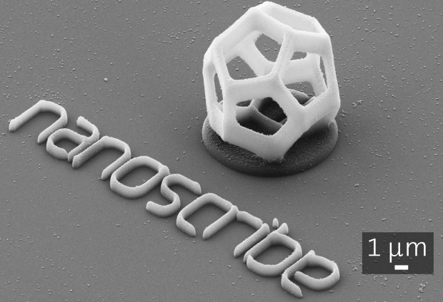
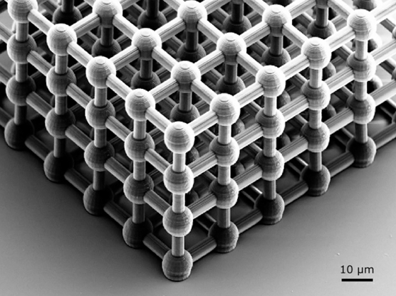
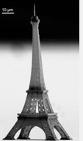
Fabrication
Nanoscribe technology

Slide 17
Any Question?

