Slide 1
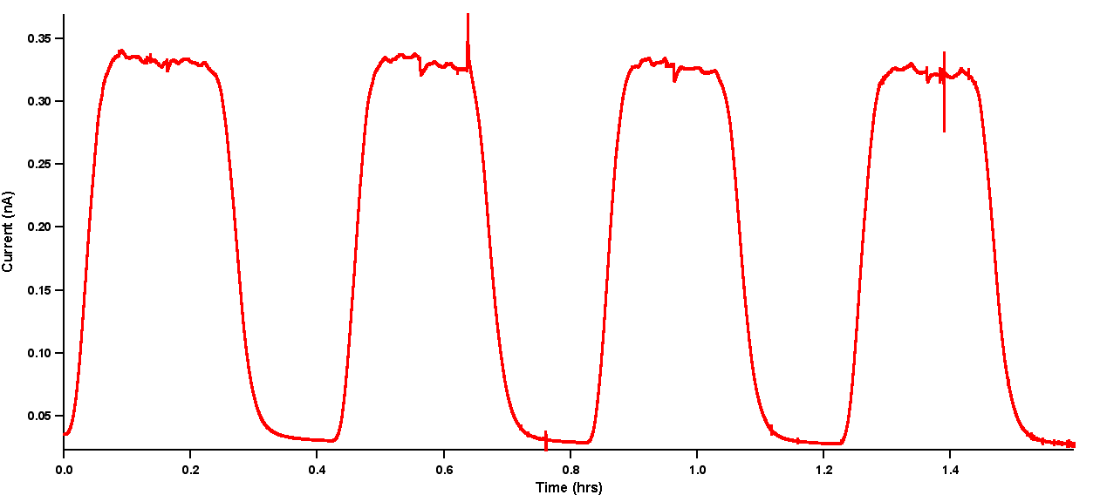
Clive
Sally
Ultrasonic Link
Data and Power transfer
Sims indicate that simuiltaneous data and power transfer is feasible using BFSK.
Demonstrator
All orders have been placed and components are arriving
Miscellaneous
More detailed analysis of novel regulator circuit confirmed that circuit is stable under high impedance load conditions. This is due to a synthesized inductor in the negative feedback control loop. Voltage regulators typically suffer from instability under high impedance load conditions.
Working on optimising the reproducibility of lactate biosensors for online measurements during cycling.
Further testing of 3D-printed microfluidic device with needle biosensors in electrode holders- estimating delay of system.

Slide 2
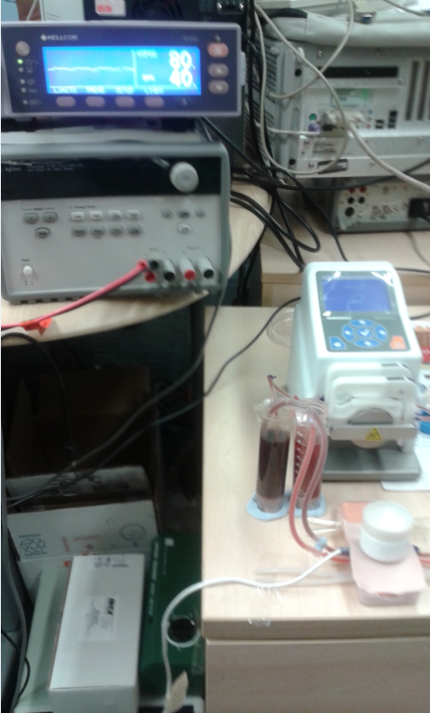
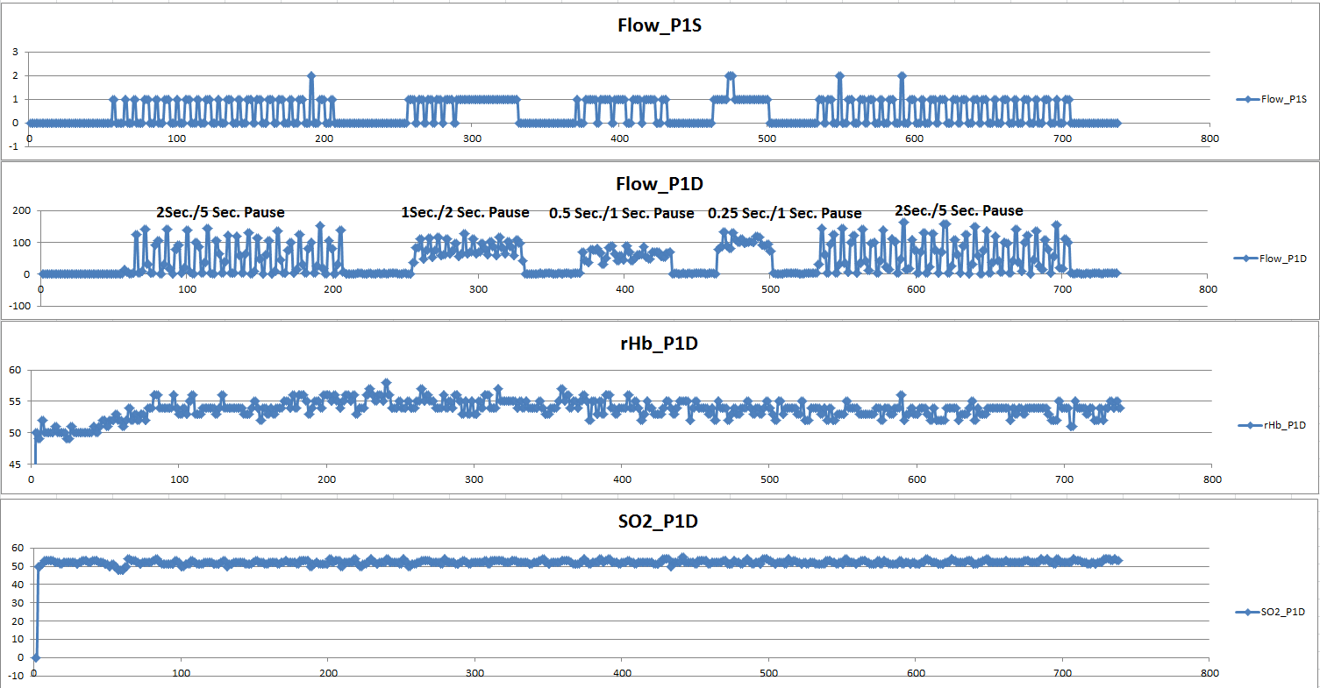
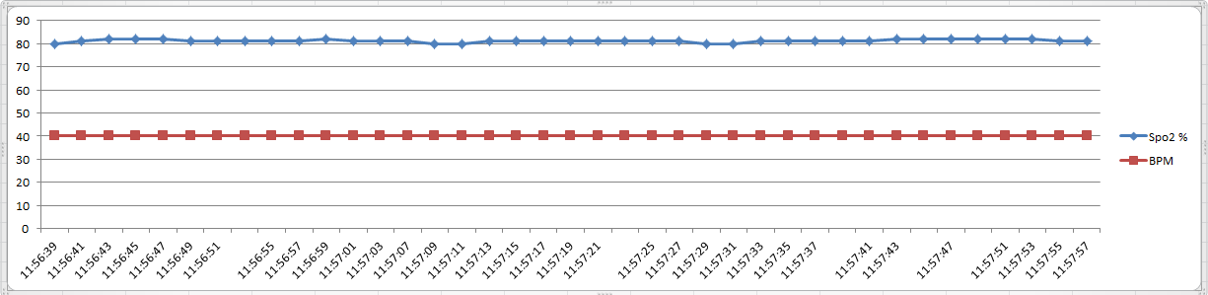
Ching-Mei
Writing StO2 journal paper (new data from phantom and some data from Richard’s chapter)
Working on BSN ASIC 3rd Tape-out
SpO2 Reading from Nellcor and new phantom:
Flow rate : 0.5 sec/ 1 sec pause →40 BPM
StO2 reading from O2C machine and new Phantom
Notes:
iss

Slide 3
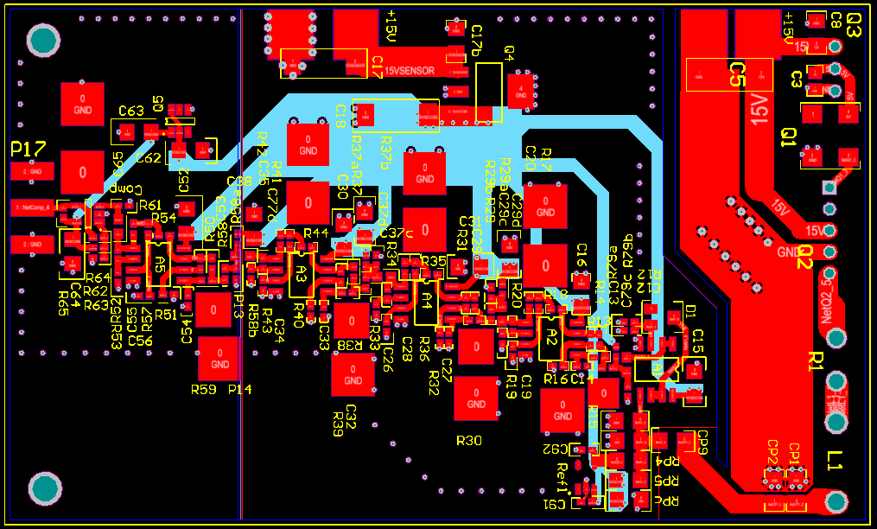
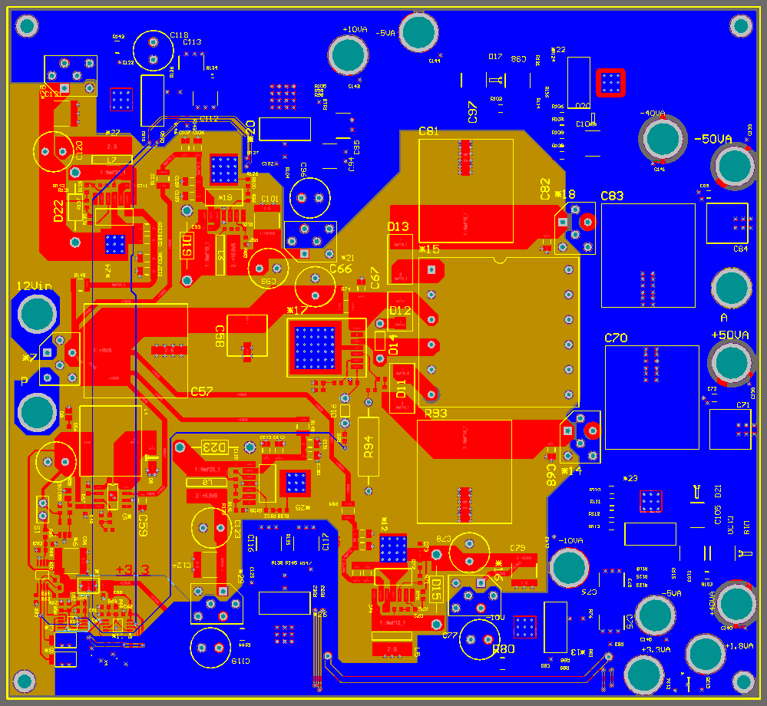
Vincenzo
Henry
Medtronic – sample is too big
Nanoscribe – development and release of printed microstructures
New design of the microdialysis wearable biosensor
Testing microfluidic platform for lactate sweat sensor
Ultrasonic power board
Layout completed and submitted
Inductive link base station
Modifying layout to include new DC detector circuit for improving data detection

Slide 4
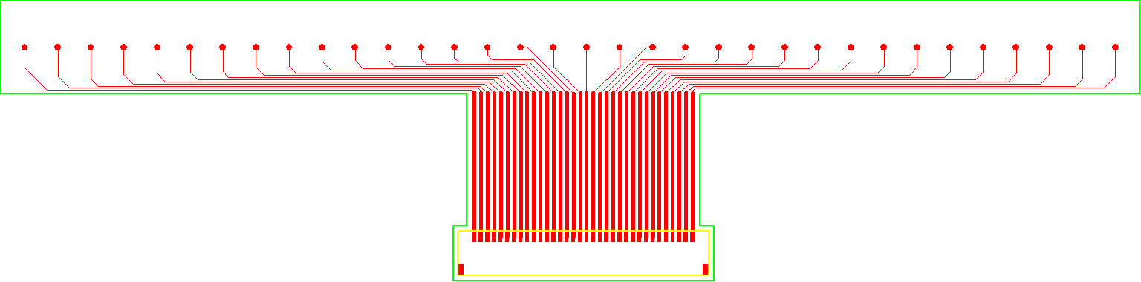
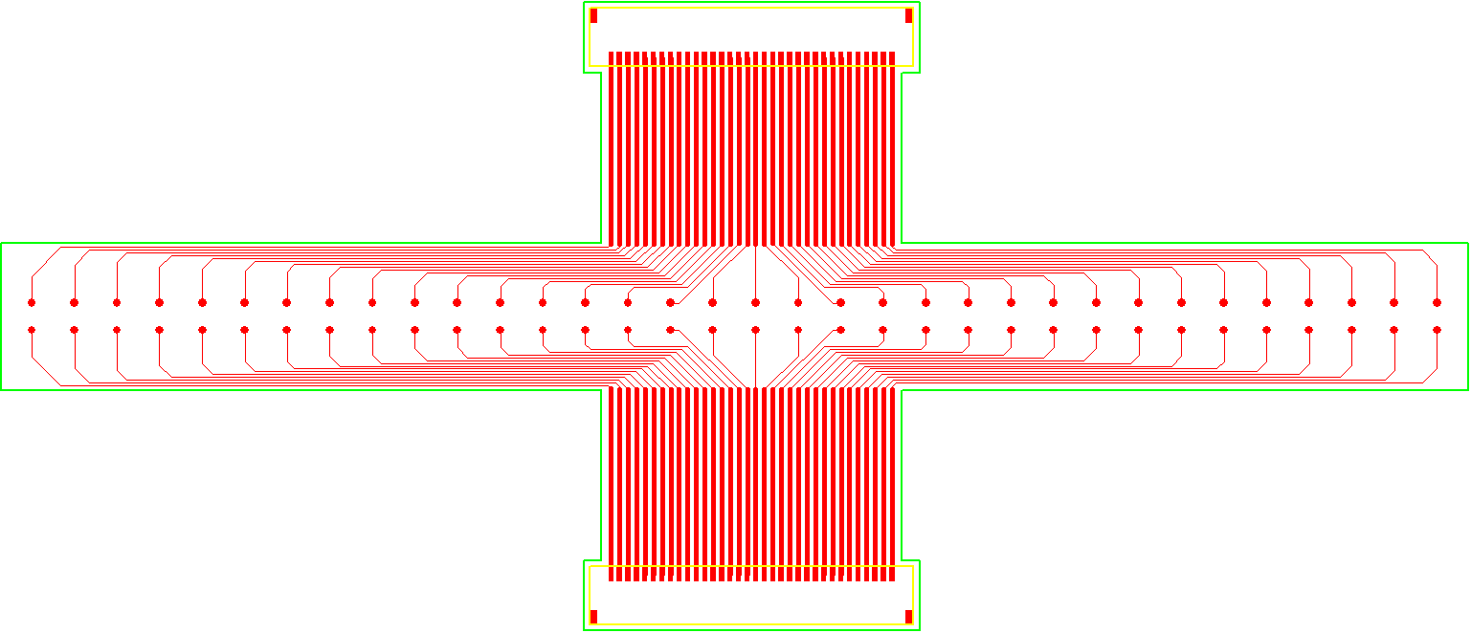
Panagiotis
Nafiseh
Finished the design of 6 versions of flexible sensor arrays for ionic sensing (pH, K⁺, Na⁺).
Finished ionic sensing readout PCB (2 channels, one with a 32:1 multiplexer).
Working of Finite Element simulations for impedance sensor and 2nd impedance PCB.
Preparing for the final presentation.
Finishing the last chapter of thesis
  Result and discussion
Sent the thesis to Vincenzo and Henry for feedback.
Flexible Ionic Sensing Array

