Slide 1
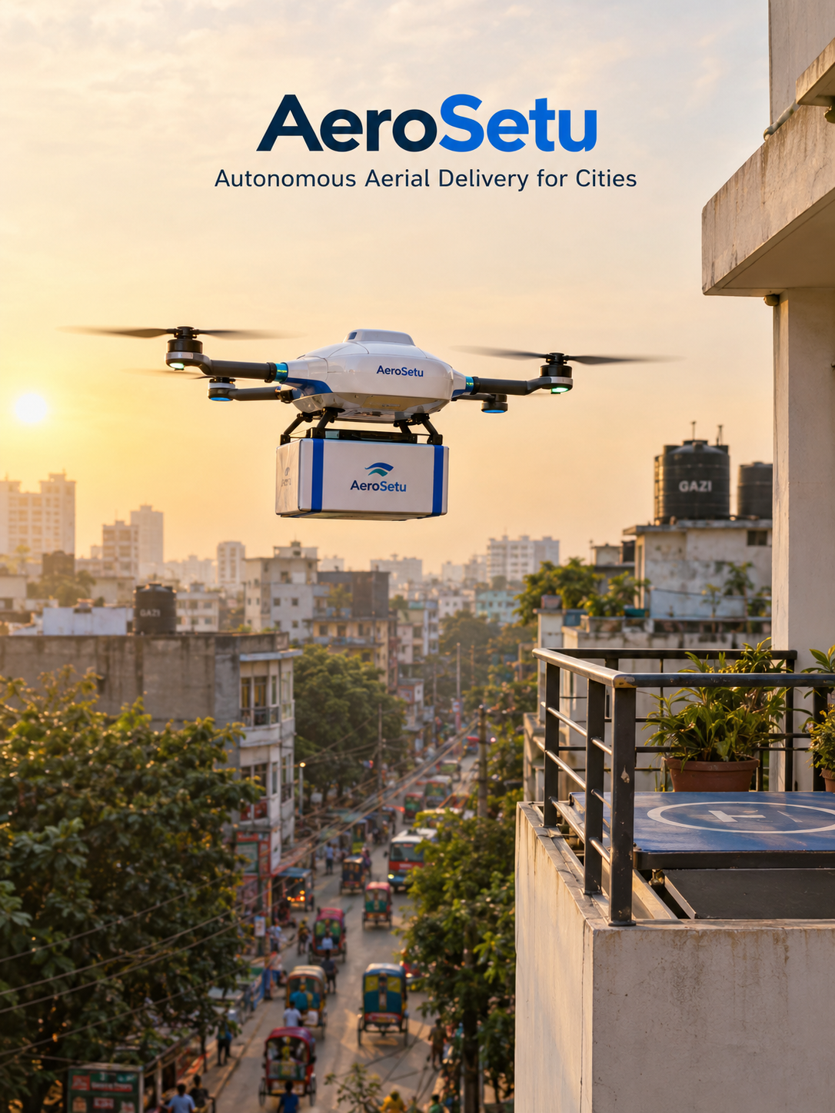
AeroSetu
Vision and AI powered drone food delivery
SECTIONS AND PRESENTERS
1, 2
MD Masfie Amin Srijon
3, 4
Nafis Islam Kabbo
5, 6
MRM Mubashshirul Haque
7
Refayet Hossain Ananda
8
MD. Nafis Sadot
9
Neloy Nandi
10, 11
Anindo Chama
12
MD Jebon Sheikh
Vision and AI powered drone food delivery
1/51

Slide 2
Overview
Presentation outline
1
The problem and the market
2
Value proposition
Problem Solution Fit
Value Proposition Canvas
3
Technology: vision, Jev and GLM
4
Business model and revenue
Architecture and model selection
Business Model Canvas
5
Unit economics and break even
6
Internal strengths and weaknesses
Cost and contribution analysis
SWOT internal
7
External opportunities and threats
8
External business environment
SWOT external
PESTEL
9
Competition and industry analysis
10
Operations and the people system
Porter's Five Forces
Operations process design
11
Risk analysis
12
Social impact and future strategy
Risk register and mitigation
Triple Bottom Line, Ethics, Future Strategy
Vision and AI powered drone food delivery
2/51

Slide 3
1
The problem and the market
Problem Solution Fit
The market is already paying, in lost time, every single day.
Vision and AI powered drone food delivery
3/51

Slide 4
1. The problem and the market
SkyBhat flies a corridor, not a route
How one order travels, end to end
1
2
3
4
5
Order and pad
Launch
Corridor flight
Landing
Return
App matches a kitchen to a landing pad
Aircraft is loaded at the hub
Vision follows the corridor to the pad
Pad occupancy and descent are checked
Aircraft returns to the hub for recharge
The product is a promise
What the customer gets
Fifteen minutes, not sixty
The price of a fixed corridor
A pad the customer already trusts
Predictable arrival time
No rider traffic exposure
Food that arrives hot
We are not competing with Pathao on convenience. We are competing on a promise they cannot make: a delivery time.
SkyBhat uses vision to fly the corridor. A reasoning model is called only when a decision is hard, which is what makes the promise affordable.
Vision and AI powered drone food delivery
4/51

Slide 5
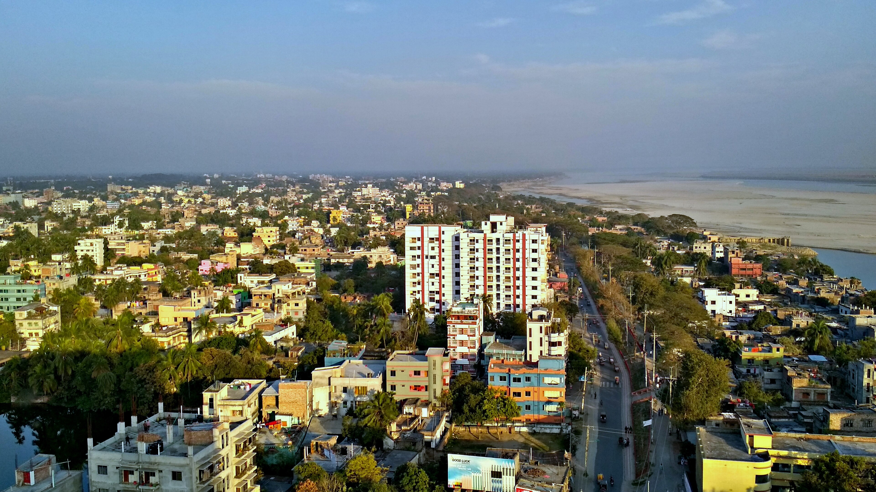
1. The problem and the market
Rajshahi first, on purpose
We are not avoiding Dhaka. We are sequencing it.
The honest weakness, and why we still start here
Less dense than Dhaka, so corridors run longer against our 6 km range
That needs a higher density of pad sites per corridor, which is capital we spend early
RCC will ask hard questions about airspace over the university area
Rajshahi city skyline. CC BY-SA 4.0, Wikimedia Commons
553,288
Tk 490 cr
162
33%
People in the city at the 2022 census
Four flyovers started 2023, all unfinished
Air quality index, worst in Bangladesh that day
Urbanisation rate, growing about 8 percent a year
Roads cannot keep up. A smaller regulator is a smaller bet. Dhaka is the prize, not the starting line.
Sources: BBS 2022 census, IQAir 16 March 2025, The Daily Star and Rajshahi City Corporation reporting on the Tk 490 crore flyover projects, September 2026
Vision and AI powered drone food delivery
5/51

Slide 6
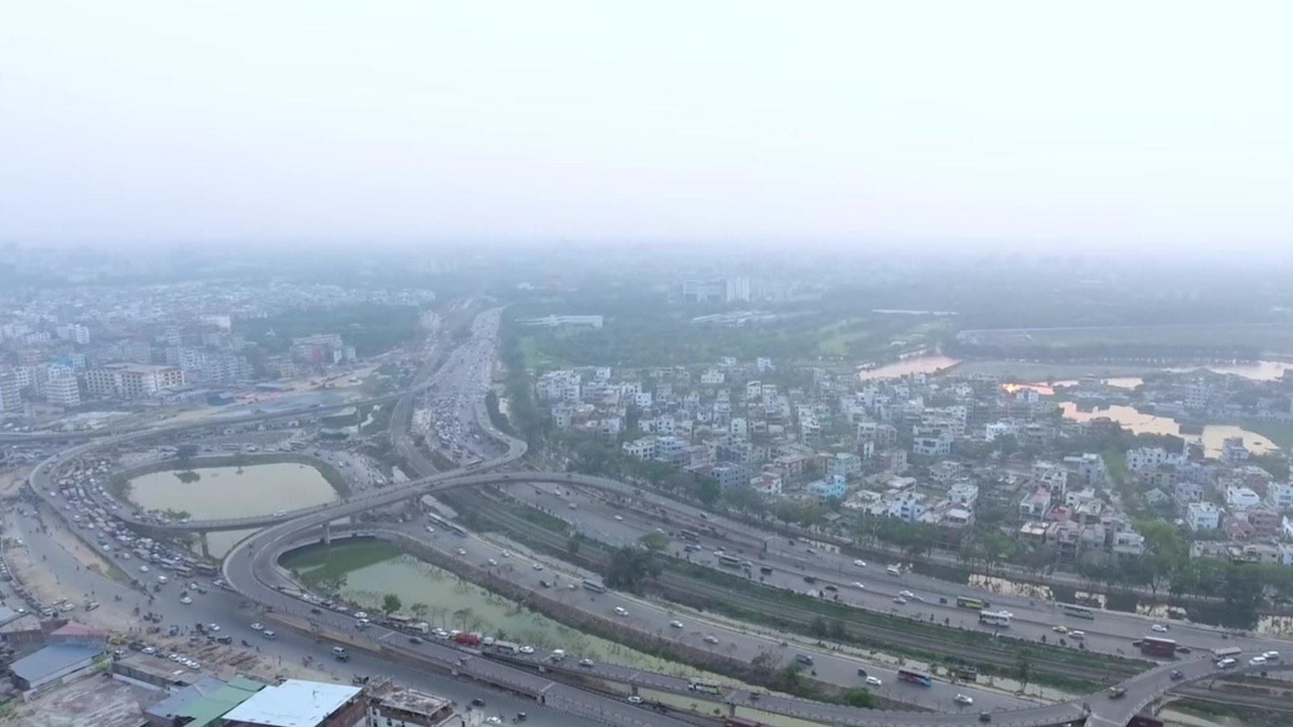

1. The problem and the market
The road tax Dhaka already pays
This is the market, and it is not a forecast
74 min
1.4 M
Average Dhaka road journey for a trip a drone flies in six
Trips a day, and roughly a fifth of them now take over an hour
4 hours
0.6%
Average time a Dhaka commuter loses each day
Rise in mean trip time since 2016, because the corridor space is taken
This is not a market we have to create. It is a market that already exists, priced every day, in lost time.
And Rajshahi pays the same tax in a smaller city: four unfinished flyovers, about 63 percent of traffic commercial, and motorised traffic growing roughly 8.5 percent a year.
Sources: Dhaka Metropolitan Development Planning Committee area study, General Motors Bangladesh Study 2017, TomTom and Uber Movement indices, The Business Standard on the 2024 corridor and cabling works
Vision and AI powered drone food delivery
6/51

Slide 7
2
Value proposition
Value Proposition Canvas
One claim has to survive contact with a competitor: the fixed window.
Vision and AI powered drone food delivery
7/51

Slide 8
2. Value proposition
Value Proposition Canvas
Nine blocks, one claim
Customer jobs
Products
Pain relievers
Get hot food fast
A corridor delivery
Vision flying
Order arrives by a known time, without sitting in traffic
Flight from hub to pad, and the landing pad itself
A corridor is not a road, so congestion is irrelevant
Pain
Services
Gain creators
Traffic and uncertainty
A promise, tracked
Predictable windows
Jams, a rider who may not show up, no arrival time
Live order state, a fixed window, a named fallback
A rider cannot beat a fixed window, and does not try
Gain
Competitors
Time back in the day
Pathao, foodpanda
A predictable window instead of an open guess
Strong on demand, weak on a guaranteed arrival time
The claim we must defend: a rider can be fast, but a rider cannot be fifteen minutes, every time, in rain, without a road.
Vision and AI powered drone food delivery
8/51

Slide 9
2. Value proposition
Problem Solution Fit is real, and it is not yet proven
The customer problem is solved. The operating context is not.
Dimension
What we found
Verdict
The problem
Dhaka road journeys average about 74 minutes for trips a drone covers in 6
Real and measured
Our solution
Vision guided corridor flight with pad landing and a fixed delivery window
Technically demonstrated elsewhere
The customer
Urban households ordering three or more times a week
Matches existing behaviour
The channel
Kitchen apps, and a pad network we install ourselves
The pads are the barrier
Revenue
Delivery fee, subscription and kitchen contracts
Comparable economics
The context
Airspace permission, monsoon season, and a regulator with no precedent
Unproven in Bangladesh
Customer problem solved: yes. Operating context solved: not yet. That is the honest answer, and it is why we start in Rajshahi.
Vision and AI powered drone food delivery
9/51

Slide 10
3
Technology: vision, Jev and GLM
Architecture and model selection
Vision does the flying. The models are called only when a decision is hard.
Vision and AI powered drone food delivery
10/51

Slide 11
3. Technology: vision, Jev and GLM
The escalation chain: vision, then Jev, then GLM
Vision does the flying. The models are called only when a decision is hard.
Vision
Jev
GLM-5.3-Flash
On the aircraft, always
Hub, fast bounded decisions
Hub, rare escalation
Navigation and obstacle detection
Corridor following and landing
Runs with no network at all
Reads structured flight state
Returns a typed action
Below a confidence floor it abstains
Multimodal reasoning
Ambiguous and unusual situations
Never touches the flight path
Runs on every flight
Called on most decisions
Called on a small minority
Always local and deterministic, with no network and no model
Hard safety rules, state estimation, path planning and flight control never leave the aircraft. If the link drops mid flight, the drone finishes vision only and lands. A network outage is a slower delivery, never an unsafe one.
Vision and AI powered drone food delivery
11/51

Slide 12
3. Technology: vision, Jev and GLM
Four architectures, and why we chose one
This is a procurement decision with a margin attached
Architecture
Latency
Cost per task
Verdict
Vision only
Lowest
Lowest
Leaves the hard case unsolved, but nothing else works without it
Vision and GLM
High
Low
Misses the fast decision niche, spends reasoning tokens on easy calls
Vision and Jev
Low
Lowest
Right shape, but no fallback when the case is genuinely ambiguous
Vision, Jev and GLM
Low
Low
Escalation only, so the reasoning model runs on a small minority of flights
We build Vision, Jev and GLM. Every tier is an escalation, so the expensive model is the exception rather than the rule.
Vision and AI powered drone food delivery
12/51

Slide 13
3. Technology: vision, Jev and GLM
GLM-5.3-Flash and Jev, chosen for business reasons
Licence, cost and dependency, not benchmark scores
GLM-5.3-Flash, Z.ai
Jev, TypeSafe AI
Licence and access
Licence and access
MIT licence, weights ungated on Hugging Face, commercial use permitted
Proprietary and hosted. No public weights, so no self hosting
Cost to us
Cost to us
About $0.075 per million input and $0.25 per million output tokens
About $0.0029 per thousand decisions on the vendor's own estimate
Why this model
Why this model
Intelligence index 57, against a median near 27 for open weight peers
Returns a typed action with a probability, so a flight path can act on it
Control we keep
Dependency we accept
Reasoning effort is capped, so a hard flight cannot bill without limit
Vendor lock in on the fastest tier. A licence change would force a rebuild
The decision in one line
One vendor we own, because we can host and fork GLM. One vendor we rent, because Jev is fast and cheap but closed. Escalation means we pay for intelligence only when a flight is genuinely hard.
Sources: Z.ai model documentation and release announcement, Hugging Face model card, TypeSafe AI Jev documentation, Artificial Analysis, JevBench. Release dates and prices as at October 2026
Vision and AI powered drone food delivery
13/51

Slide 14
3. Technology: vision, Jev and GLM
Who decides when the AI is involved
The escalation rule, as an operating procedure
Tier
Trigger
Action
Frequency
Vision only
Obstacle is clear of the corridor, pad is free, weather is inside limits
Continue, entirely on board
Always
Vision to Jev
Pad occupied, approach is degraded, confidence is below the floor
Continue, reposition, abort landing, or return home
Most decisions
Jev to GLM
Case is ambiguous or unlike anything seen in training
Higher level recommendation to the flight supervisor
Rare
Safety path
Any hard limit is crossed, or the link is lost
Deterministic return, land and disarm
Never escalated
Escalation is a cost control and a safety control at the same time. Fewer calls mean a lower bill, and a lower tier means a faster, more predictable answer.
Vision and AI powered drone food delivery
14/51

Slide 15
4
Business model and revenue
Business Model Canvas
The bottom row of the canvas decides whether this business exists.
Vision and AI powered drone food delivery
15/51

Slide 16
4. Business model and revenue
Business Model Canvas
Nine blocks, and the two that decide everything
Key partners
Key activities
Key resources
RCC and CAAB, pad hosts, kitchen partners, battery suppliers, insurers
Corridor design, pad operation, fleet maintenance, AI supervision
Airframe fleet, landing pads, hub sites, flight data, CAAB approval
Value propositions
Customer relationships
Channels
A fixed delivery window, hot food, no rider exposure, live tracking
In app self service, with a subscription for frequent buyers
Kitchen apps and our own app, both linked to the pad network
Customer segments
Cost structure
Revenue streams
Urban households in Rajshahi first, then Dhaka, ordering three or more times a week
Airframes, hubs, pads, staff, insurance, connectivity, AI inference
Delivery fee, subscription, kitchen contract, corporate and NGO contracts
The bottom row is where this business lives or dies: who orders, what it costs us, and what we earn per flight.
Vision and AI powered drone food delivery
16/51

Slide 17
4. Business model and revenue
Six revenue streams, in the order they switch on
Only the first two are needed to reach break even
Stream
Price
Switches on
Why it matters
Delivery fee
Tk 90 per flight
Day one
Immediate, per flight, no contract needed
Subscription
Tk 499 a month
Month 6
Lifts frequency and cuts acquisition cost
Kitchen contract
6 to 10 percent
Month 9
Predictable volume from a named partner
Pad hosting
Tk 400 a month
Month 9
Pays for the pad on the customer's roof
Corporate and NGO
Tk 60,000 a month
Year 2
Emergency, medical and blood runs
Data and mapping
Tk 200,000 a month
Year 3
Corridor data sold to logistics and planners
Why delivery fee alone is not enough
Why subscription changes the maths
A single flight has to cover airframe life, not just fuel
Five flights a month turns a cost into a habit
Model assumptions from Pathao and foodpanda commission rates, and BSRTC concession fees per ride
Vision and AI powered drone food delivery
17/51

Slide 18
5
Unit economics and break even
Cost and contribution analysis
Tk 43 per flight before hub costs. Everything else is a consequence of that number.
Vision and AI powered drone food delivery
18/51

Slide 19
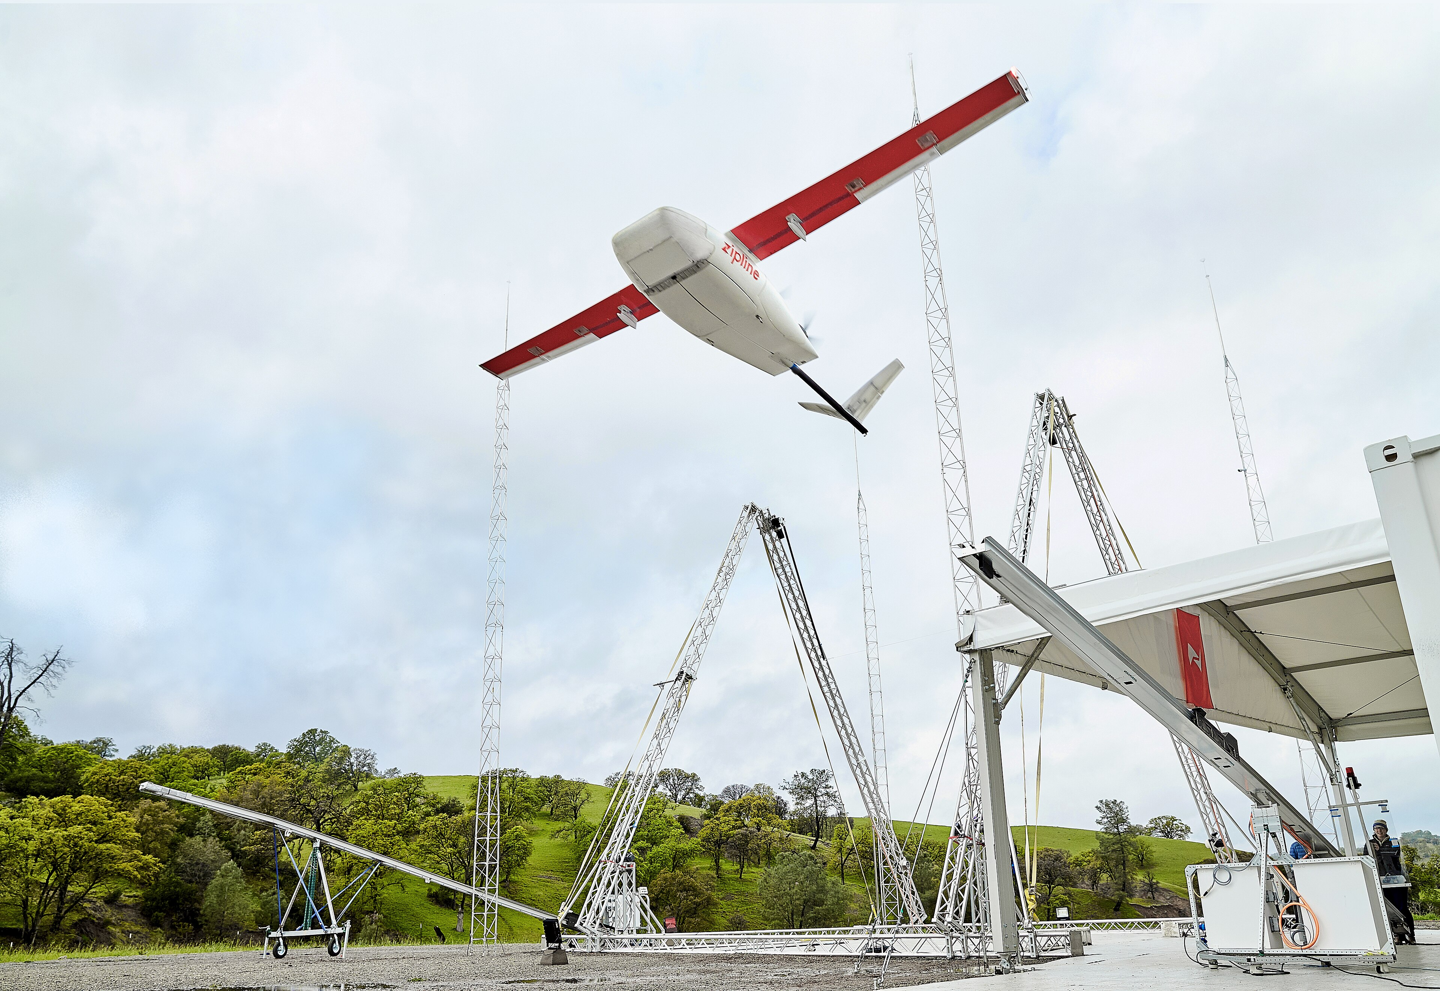
5. Unit economics and break even
One hub, one month, itemised
This is the number that decides whether the business exists
Monthly cost line
Amount
Airframe lease, 6 aircraft
Tk 180,000
Hub rent and utilities
Tk 120,000
Salaries, 9 staff
Tk 270,000
Battery replacement
Tk 60,000
Connectivity and cloud
Tk 25,000
AI inference, at launch volume
Tk 18,000
Zipline drone on its launch rail. CC BY-SA 4.0, Wikimedia Commons
Insurance and maintenance
Tk 40,000
What this number is not
Pad build, 40 pads at Tk 4,000
Tk 160,000
It is one hub, not the company
It excludes growth capex and founders pay
Total monthly fixed cost per hub
Tk 873,000
Model assumption. Airframe and hub costs benchmarked against Pathao vehicle lease costs, Dhaka rents and Bangladeshi aviation fuel prices
Vision and AI powered drone food delivery
19/51

Slide 20
5. Unit economics and break even
Unit economics decide whether this works
Per delivery, in Rajshahi, at launch volumes
Line
Amount
Note
Delivery fee collected
Tk 90
The only certain line in the model
Pad hosting, after month 9
Tk 20
Net of what the host pays us
Variable cost, per flight
Tk 46
Electricity, wear, connectivity, support time
AI inference, per flight
Tk 1
Escalation only, so it stays under a taka
Contribution per flight
Tk 43
Before any hub fixed cost
Tk 43 per flight before hub costs. That is the whole question, and the next slide answers it.
Tk 20,290
471
16
3
Monthly fixed cost per hub, from the previous slide
Flights a hub needs each month to cover it
Flights a day, across all six aircraft
Flights per aircraft per day, with margin for weather
Model assumption. Range shown because every input is an estimate at this stage
Vision and AI powered drone food delivery
20/51

Slide 21
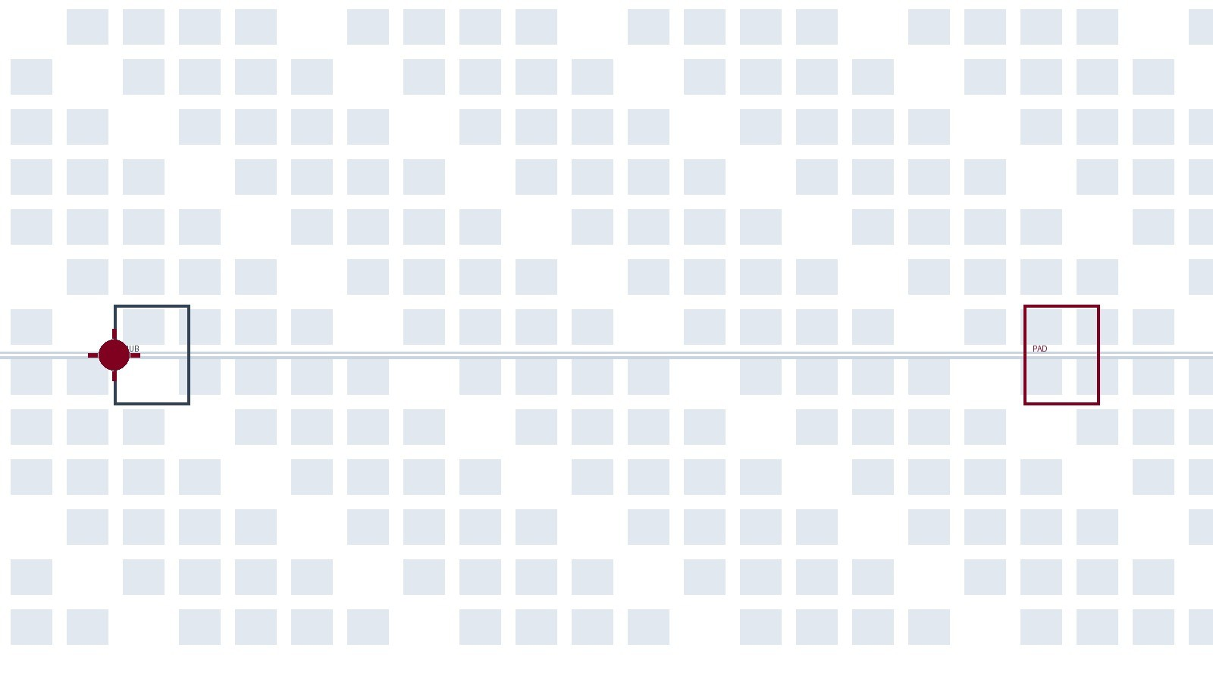
5. Unit economics and break even
Break even is a density problem
Rajshahi has the units, Dhaka has the density
At break even
Rajshahi
Dhaka
Flights a day, all hubs
16
34
Flights per aircraft
3
6
Contribution per flight
Tk 43
Tk 43
Contribution per month
Tk 20,600
Tk 44,000
Fixed cost per hub
Tk 20,290
Tk 20,290
Operating result
Tk 310
Tk 23,700
Rajshahi reaches break even on a thin margin. Dhaka reaches it with room to survive a bad month. We launch in the hard city to learn cheaply, and we scale in the dense one to earn.
The honest limit: if a hub runs under twelve flights a day, it loses money. Density is the constraint, not demand.
Vision and AI powered drone food delivery
21/51

Slide 22
6
Internal strengths and weaknesses
SWOT internal
Knowing our own limits is the cheapest advantage we can buy.
Vision and AI powered drone food delivery
22/51

Slide 23
6. Internal strengths and weaknesses
Internal strengths
Resources and capabilities we genuinely control
Vision first architecture
Escalation design
The safety path never needs a network, so a link drop is a slower delivery, not an unsafe one
Vision, then Jev, then GLM, so the costly reasoning model runs on a minority of flights
Corridor, not a road
Pad based landing
A corridor ignores congestion, so the promise does not depend on traffic
Delivery ends at a pad we install and maintain, not on a balcony we do not control
Local cost base
Founder operator access
Rajshahi rents and salaries are materially below Dhaka, which lowers the cost of learning
A team that can design corridors, negotiate pads and hold an engineering conversation with vendors
Vision and AI powered drone food delivery
23/51

Slide 24
6. Internal strengths and weaknesses
Internal weaknesses, and the plan against each
Stated plainly, because a SWOT that flatters itself is useless
Weakness
What it really means
Our response
No operating history
No CAAB approval, no live corridor, no proven unit economics
Single hub pilot in Rajshahi before any expansion
No regulatory approval
Bangladeshi airspace is closed to this use and no precedent exists
Pre-application meeting with CAAB, before hardware is ordered
Capital hungry
Pads, hubs and airframes are paid for long before revenue arrives
Start with two corridors and one hub, not a city wide plan
Weather exposure
Monsoon and low visibility stop flights outright
Design corridors for the worst month, not the average one
Model dependency
Jev is hosted and closed, so the fastest tier is not ours
Keep a deterministic rule set that reproduces its decisions
Team of eight
No dedicated safety engineer, no legal counsel, no regulator relations
Named owners for every risk, reviewed monthly
Vision and AI powered drone food delivery
24/51

Slide 25
6. Internal strengths and weaknesses
Every strength has a limit
Which is why the SWOT is one argument, not four lists
Strength
Why it helps
Its limit
How we hold it
Vision first architecture
Independent of the network
Needs a fallback that is provably safe
Fallback is local and deterministic
Escalation design
Low AI cost per flight
Depends on two models behaving as tested
Hub can fall back to Jev alone, or to rules
Corridor, not a road
Predictable arrival time
Needs pads, and pads need permission
Pilot corridor sized to the pad budget
Pad based landing
Delivery lands where we control
Pad owner can withdraw consent
Contracts hold a minimum term and a removal clause
Local cost base
Lower fixed cost in Rajshahi
Thinner margin if volume is low
Break even shown at three flights per aircraft
Founder operator access
Fast decisions on corridor and pad design
Key person risk across eight founders
Every critical process has a written owner
A strength without a limit is optimism. Every one of ours has a named condition attached.
Vision and AI powered drone food delivery
25/51

Slide 26
7
External opportunities and threats
SWOT external
The regulator is the largest single factor in this business.
Vision and AI powered drone food delivery
26/51

Slide 27
7. External opportunities and threats
External opportunities
Demand and conditions already moving in our favour
A measured road problem
Delivery demand compounding
74 minutes for a trip a drone flies in six, across 1.4 million daily journeys
Platform orders grew sharply through 2024 and 2025, and the ceiling is not in sight
Bangladesh is ready for drone policy
Unreliable last mile
The National Drone Policy 2026 framework exists, so the conversation can start
Low rider availability in peripheral areas leaves demand that roads cannot serve
Pad and rooftop space
Corporate and NGO demand
Terraced housing in both cities suits a pad model better than a tower block city
Medical and blood runs already travel by road at high cost and low speed
Vision and AI powered drone food delivery
27/51

Slide 28
7. External opportunities and threats
External threats
Two of these can end the business on their own
CAAB refuses permission
Platform price response
No approval means no flights, and a hardware business with no revenue
Pathao and foodpanda can subsidise delivery below our cost
Airspace conflict
Monsoon shutdown
Military, police and utility corridors constrain where a corridor can go
The worst month for air is also the worst month for road demand
Public safety incident
Liability exposure
One accident ends the conversation with the regulator
Damage on a third party roof is a legal question we have not settled
Vision and AI powered drone food delivery
28/51

Slide 29
7. External opportunities and threats
Every threat has an owner and a trigger
A threat without both is a worry, not a risk
Threat
Severity
Owner
Trigger we watch
CAAB refusal
Severe
Founder and CAAB liaison
Written refusal, or silence past 90 days
Price response
High
Head of partnerships
Platform fee cut below Tk 40 on our corridor
Airspace conflict
High
Corridor lead
Proposed corridor crosses a restricted zone
Monsoon shutdown
Medium
Operations lead
More than four consecutive no-fly days
Safety incident
Severe
Safety lead
Any ground contact not on a pad
Liability dispute
High
Legal adviser, retainer
First claim from a pad owner
Pad owner withdraws
Medium
Hub manager
Five pads withdrawn in a month
Vendor price change
Medium
Head of AI and data
Jev or GLM price more than doubles
Eight named threats, eight owners, and a trigger for each one. That is the difference between a SWOT and a plan.
Vision and AI powered drone food delivery
29/51

Slide 30
8
External business environment
PESTEL
Six environments. One of them is a gate, not a factor.
Vision and AI powered drone food delivery
30/51

Slide 31
8. External business environment
PESTEL, in one view
Six environments, and where SkyBhat sits in each
Political
Economic
Social
Airspace control sits with CAAB, and no precedent exists
A weak taka raises airframe and fuel costs in dollar terms
Balcony delivery is a comfort question before it is a technology question
Gate
Pressure
Favourable
Technological
Environmental
Legal
Vision models and cheap compute are finally good enough
Zero tailpipe emissions, but the noise argument has to be won locally
No drone delivery rules exist, so the framework is ours to draft
Favourable
Mixed
Unresolved
Political is a gate and legal is unresolved. The other four only change the price of getting through.
Vision and AI powered drone food delivery
31/51

Slide 32
5. Unit economics and break even
Political and legal: the gate, and the four unanswered questions
We cannot price this business until these four are answered
Who authorises delivery flight?
Over what height, and over whose land?
CAAB holds airspace, but no delivery corridor licence class exists today
No published ceiling and no consent rule for flying over private property
Who issues an operator certificate?
What is the liability position?
We are not pilots, so the rule that applies to us is not written yet
Damage to a pad, a roof or a person has no defined allocation of risk
The only responsible answer today
We have not been granted permission and we do not assume we will be. The first milestone is a written pre-application meeting with CAAB. Until that document exists, our financial plan is a hypothesis and every slide in this deck says so.
Sources: CAAB notices and drone related press reporting, National Drone Policy 2026 framework reporting, BTRC spectrum allocation, The Daily Star on unlicensed drones
Vision and AI powered drone food delivery
32/51

Slide 33
5. Unit economics and break even
Economic, social and technological: three favourable, one hard
The environment helps the product and hurts the balance sheet
Economic
Social
Technological
Environmental
A weak taka raises imported airframe cost
Delivery fees cannot rise as fast as fuel
Margins thin before volume
Balcony workers already accept rooftop deliveries
Less rider exposure is a safety argument
Willingness to pay exists, trust comes later
Vision models are finally accurate enough
Cheap edge compute fits on the aircraft
Open weights remove a vendor lock in
No tailpipe emissions on the corridor
Rotor noise is a real local complaint
Rain and humidity reduce usable days
Three of four environments help. The one that hurts is money, and it is the reason the delivery fee cannot fall below Tk 90.
Rajshahi is where social acceptance is highest and fixed costs are lowest, which is exactly why we start there.
Sources: Bangladesh Bank reporting on inflation and remittances, BRAC BIGD and NBER work on Dhaka gig work, CAAB and BTRC connectivity data
Vision and AI powered drone food delivery
33/51

Slide 34
8. External business environment
Two factors decide the outcome
Everything else is manageable
1. CAAB permission
2. Corridor density
A written pre-application response before any hardware purchase
Pad density per corridor, and flights per aircraft per day, tracked weekly
How we measure it
How we measure it
Everything else in PESTEL is a variable cost of doing business
Currency, noise, weather and trust change the price and the timetable
None of them can close the company on their own
If permission arrives and density holds, this business works. If either one fails, no amount of engineering saves it.
Vision and AI powered drone food delivery
34/51

Slide 35
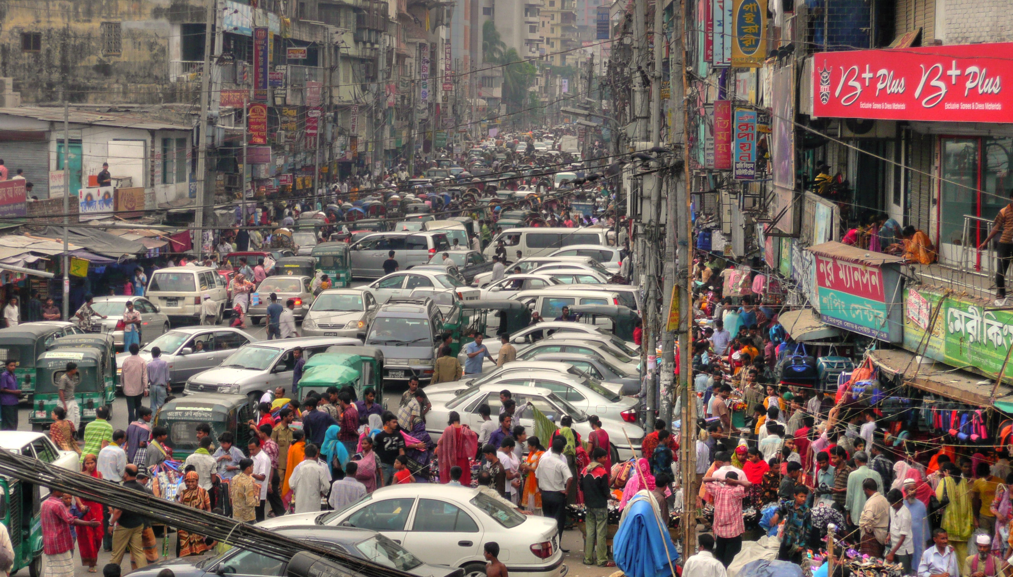
6. Internal strengths and weaknesses
Internal strengths and weaknesses
06
Presented by
MRM Mubashshirul Haque
2303127 | Framework: Porter's Five Forces
We are not competing with riders. We are competing with a road.
Traffic jam at New Market, Dhaka. CC BY-SA 2.0, Wikimedia Commons
Vision and AI powered drone food delivery
31/51

Slide 36
6. Internal strengths and weaknesses
Porter's Five Forces, one at a time
The forces decide the margin, not the technology
Rivalry
New entrants
Substitutes
Supplier power
Buyer power
High
Medium
High
Low
High
Pathao and foodpanda both fight for orders
They can subsidise below our cost
We compete on a promise, not a discount
Hardware can be bought
Pads and corridors cannot be bought
One corridor at a time is a moat
A rickshaw is a substitute
Walking and a car are substitutes
Only the fixed window is unsubstitutable
Airframes from a small number of vendors
Batteries are replaceable
Open weights reduce supplier power
The customer holds one tap and no contract
We must earn the window every flight
Pubs give us the density we need
Three of five forces are high. That is why the model is not a discount business.
Rivalry, substitutes and buyer power are all set by the customer, not by us. Our only lever is the pad network and the fixed window it makes possible. Everything else is a price we have to survive.
Vision and AI powered drone food delivery
32/51

Slide 37
6. Internal strengths and weaknesses
The pad network is the moat
What an entrant would have to copy first
1
2
3
4
Sign pad hosts
Get permission
Design the corridor
Prove the window
Months of negotiation, one roof at a time
CAAB approval, which no competitor has
Needs flight data and airspace clearance
Hundreds of deliveries to earn a fifteen minute promise
Barrier
Speed to copy
Why
Strength
Airframe
Buyable
Six months and capital
Low
Software
Buyable
Open weights are free
Low
Pad network
Slow
One host at a time, on a roof
High
CAAB approval
Slow
A pre-application, then a licence
High
Proven corridor data
Very slow
Hundreds of flights to collect
High
Vision and AI powered drone food delivery
33/51

Slide 38
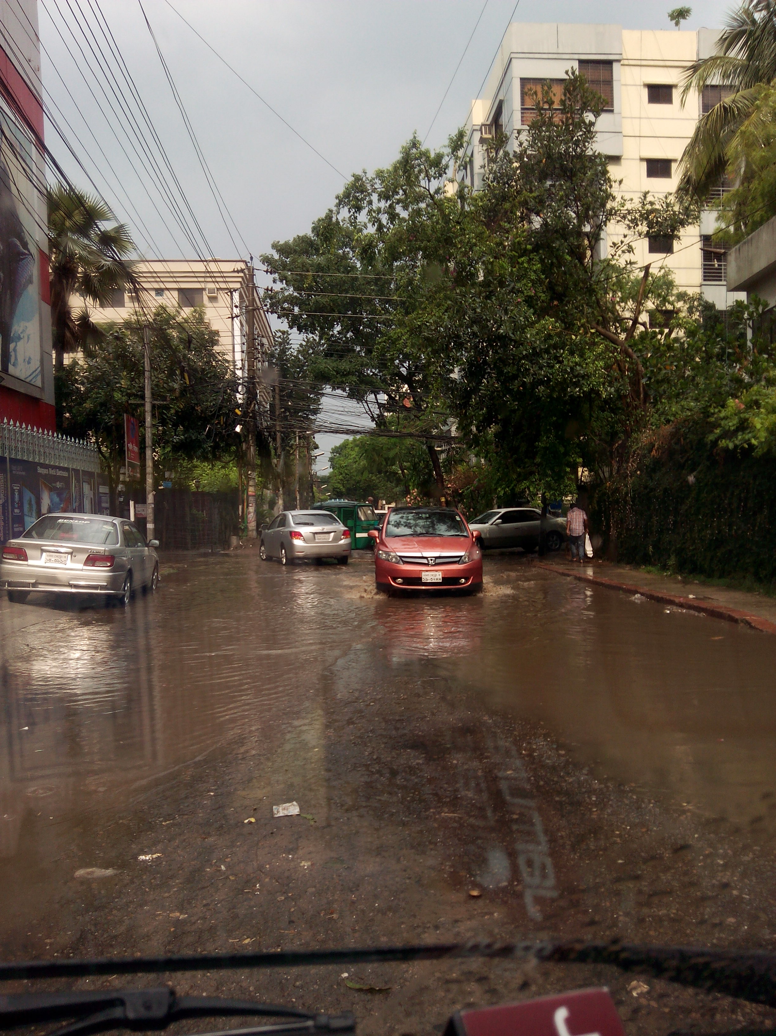
7. External opportunities and threats
External opportunities and threats
07
Presented by
Refayet Hossain Ananda
2303148 | Framework: Operations and Risk Analysis
One order, eight handovers, and nine ways it fails.
Rain water covering a Dhaka road. CC BY-SA 3.0, Wikimedia Commons
Vision and AI powered drone food delivery
34/51

Slide 39
7. External opportunities and threats
How one order actually moves
Eight handovers, each with a named owner
1. Order placed
2. Kicked off
3. Loaded
4. Launched
App receives order, pad and kitchen matched
Kitchen accepts, clock starts, customer notified
Drone loaded at the hub and pre-flight checks run
Airframe launches and enters the corridor
5. Corridor flight
6. Approach
7. Landing
8. Returned
Vision follows the corridor, Jev watches for bounded calls
Pad occupancy and descent are verified on board
Touchdown on the pad, package released, pad confirmed empty
Drone returns, recharges, and the flight is logged for review
The rule that governs every handover
The aircraft decides its own safety, and may refuse a landing at any step
A refused landing means return home, a rebooked order, then a refund
No operator, customer or model can override the safety path on board
Vision and AI powered drone food delivery
35/51

Slide 40
7. External opportunities and threats
The people the system needs
Nine roles in the pilot hub, and what each one owns
Role
Count
What this person owns
Hub manager
1
Pad network, host relationships, corridor design input
Flight operations lead
1
Launch and recovery schedule, weather calls, no fly decisions
Safety lead
1
Safety path ownership, incident review, regulator liaison
Corridor engineer
1
Corridor geometry, pad placement, airspace compliance
AI and data lead
1
Vision and model evaluation, escalation thresholds, drift
Line mechanics
2
Airframe checks, battery swaps, pad maintenance
Kitchen coordinator
1
Partner kitchens, packaging that survives a landing
Customer support
1
Failed delivery recovery, refunds, pad host complaints
Regulatory affairs
1
CAAB applications, permits, insurance liaison
Nine roles, of which three are new to a delivery business: safety lead, AI and data lead, and regulatory affairs. None of the three are optional in Bangladesh.
Vision and AI powered drone food delivery
36/51

Slide 41
7. External opportunities and threats
Who decides when the AI is involved
The escalation rule, as an operating procedure
Tier
Trigger
Action
Frequency
Vision only
Obstacle is clear of the corridor, pad is free, weather is inside limits
Continue, entirely on board
Always
Vision to Jev
Pad occupied, approach is degraded, confidence is below the floor
Continue, reposition, abort landing, or return home
Most decisions
Jev to GLM
Case is ambiguous or unlike anything seen in training
Higher level recommendation to the flight supervisor
Rare
Safety path
Any hard limit is crossed, or the link is lost
Deterministic return, land and disarm
Never escalated
Escalation is a cost control and a safety control at the same time. Fewer calls mean a lower bill, and a lower tier means a faster, more predictable answer.
Vision and AI powered drone food delivery
37/51

Slide 42
7. External opportunities and threats
Risk register, risks 1 to 5
Probability, impact and a mitigation we can actually run
#
Risk
Probability
Impact
Mitigation
1
CAAB refuses permission
Medium
Severe
Pre-application meeting first. No hardware ordered before a written response
2
Corridor crosses restricted airspace
Medium
Severe
Altitude capped below the restricted volume, corridor re-routed, verified on map before launch
3
Aircraft lands outside a pad
Low
Severe
Pad recognition on board, geofence enforced locally, damage reporting to the pad owner
4
Liability dispute over a roof
Medium
High
Insurance with a named third party, host contracts with a liability clause, legal retainer
5
Vision fails in heavy rain
High
High
Weather thresholds stop launches outright, corridor designed for the worst month, not the average
Risks 1 and 2 are the same risk seen from two sides: whether we are allowed to fly at all.
Vision and AI powered drone food delivery
38/51

Slide 43
7. External opportunities and threats
Risk register, risks 6 to 9
Operating and commercial risks
#
Risk
Probability
Impact
Mitigation
6
Battery degrades faster than budgeted
Medium
Medium
Second battery set per airframe, monthly cycle counts, replacement booked into monthly cost
7
Jev is withdrawn or repriced
Medium
Medium
Deterministic rule set reproduces its decisions, GLM fallback, contract reviewed before launch
8
Pad host withdraws consent
Medium
High
Minimum term in every contract, a removal clause, and never one pad on a critical corner
9
Rider or customer refuses a pad
Medium
Low
Pad count per corridor held above the minimum density, doorstep fallback for the corner case
Risk 7 is the one people forget
We chose a closed model for the fastest tier, and we accept that
The mitigation is not a contract, it is a rule set that works without Jev
Vision and AI powered drone food delivery
39/51

Slide 44
7. External opportunities and threats
Three risks we will not take
Stated as prohibitions, not ambitions
No flight over a crowd
No flight without a recoverable pad
No model on the safety path
Corridors are sized so a corridor never crosses a school, a hospital or a stadium. No exception, no launch.
If the pad is not recognised on board, the aircraft does not descend. It holds, then returns home.
Safety rules, state estimation, planning and control stay local. No network call can unlock a flight.
These three are not negotiable and they are not on the roadmap for improvement. They are the reason a regulator might listen at all.
Everything in Section 7 comes back to one line: the aircraft is always allowed to refuse, and no model or manager can tell it to continue.
Vision and AI powered drone food delivery
40/51

Slide 45

8. External business environment
External business environment
08
Presented by
MD. Nafis Sadot
2303174 | Framework: Triple Bottom Line, Ethics, Future Strategy
A business that only answers to its balance sheet is not a business we want to run.
Terraced rooftops, Mugda, Dhaka. CC BY-SA 4.0, Wikimedia Commons
Vision and AI powered drone food delivery
41/51

Slide 46
8. External business environment
Triple bottom line: what helps and what hurts
People, planet and profit, in that order of how we will judge it
People
Planet
Profit
Riders lose the worst trips on the network
A pad income for households that own a roof
Fewer injuries, because fewer road kilometres
No tailpipe emissions on the corridor
Less fuel burned across the network
Rotor noise is a cost we pay in goodwill
A fixed window the platforms cannot match
Contribution that scales with corridors
A regulator who can say no to us at any time
The trade we accept
Riders lose the highest paying, worst paying, most dangerous trips if we take the easy ones first. We will take them deliberately and slowly, and publish what it costs the rider who loses one.
People first is only credible if it names who pays for it. The riders pay, so the riders are in scope.
Vision and AI powered drone food delivery
42/51

Slide 47
8. External business environment
Ethics: five commitments we would publish
Written before launch, not after criticism
1. No flight over a crowd
Schools, hospitals and stadiums are excluded from every corridor
2. The aircraft may refuse
No operator or model can force a landing the safety path rejects
3. Pad consent is renewable
Any host can end hosting with thirty days notice, and we remove the pad
4. Riders keep their income floor
Corridor assignment never drops a rider below their current daily average
5. Every incident is disclosed
Reported to the customer, the pad owner and the regulator, in that order
Five commitments, each one a promise a customer or a rider can hold us to.
Vision and AI powered drone food delivery
43/51

Slide 48
8. External business environment
Ethics of the AI, specifically
Five limits we will not cross, whichever model is in the loop
No model commands a flight
Models recommend. State estimation, planning and control stay local and deterministic
No training on customer data
No images, addresses or order history leave our infrastructure for training
Every decision is logged
Vision output, Jev action and GLM recommendation are recorded for review
Confidence is respected
Below the floor the system abstains and asks a human. It never guesses a landing
Human escalation has authority
A supervisor can stop any flight, and the aircraft will not argue
Rule zero: the drone must be safe to fly with no network, no model and no data. Anything we cannot guarantee that, we do not launch.
Vision and AI powered drone food delivery
44/51

Slide 49
8. External business environment
Three horizons, and what each one must prove
A roadmap that a regulator and an investor can both read
Horizon 1
Horizon 2
Horizon 3
Months 0 to 6
Months 6 to 18
Years 2 to 3
CAAB pre-application answered
One hub, two corridors, forty pads
Vision only, with Jev behind a flag
Written permission in hand
Jev and GLM live on escalated flights
Break even on one hub
Dhaka corridors, three more hubs
Medical and blood contracts
Corridor data sold as a product
Permission gates Horizon 2, and break even gates Horizon 3. Neither can be bought ahead of the other.
Rajshahi is Horizon 1 and 2. Dhaka is Horizon 3. We would rather be early in a small city than late in a large one.
Vision and AI powered drone food delivery
45/51

Slide 50
8. External business environment
Six conditions, and the verdict
What has to be true, stated as testable conditions
#
Condition
Threshold
Status
1
CAAB grants corridor permission
Binary
Not yet
2
A hub flies 16 deliveries a day
12 needed
Not yet
3
Contribution holds above Tk 40
Tk 43 modelled
Not yet
4
Landing on a pad, not a rooftop
Demonstrated elsewhere
Not yet
5
Escalation keeps AI cost under Tk 1 a flight
Tk 1 modelled
Not yet
6
Monsoon does not close the network
Open
Not yet
The verdict
Six of six conditions are untested. That is the honest position of any first year. The plan is not to prove the market, which is already proven, but to prove permission and density, in Rajshahi, before any capital is committed to Dhaka.
Vision and AI powered drone food delivery
46/51

Slide 51
Thank You
Open Discussions
We welcome questions from the professor and audience.
1
If CAAB approves a single corridor, does that change the order of our plan?
2
How much of the fifteen minute promise survives a week of monsoon rain?
3
Would you rather we started in Dhaka, and what would it cost us?
SkyBhat | Vision and AI powered drone food delivery | As the crow flies.
/ 51
47

