Slide 1
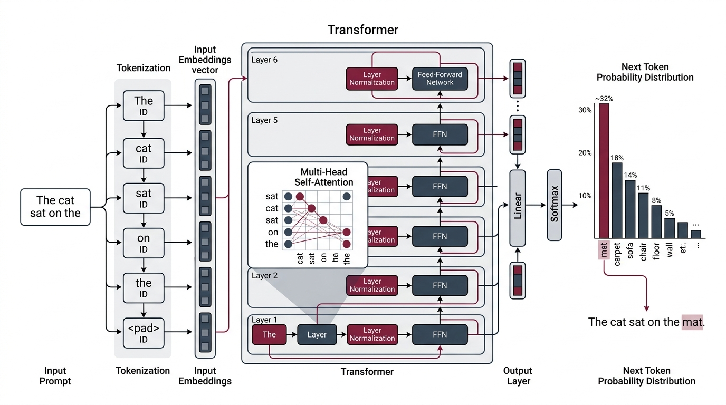
1. INTRODUCTION & FOUNDATIONS
What is a Large Language Model?
A probabilistic next-token predictor
01 | AUTOREGRESSIVE
TRANSFORMER PIPELINE
Next-Token Prediction
Predicts the next token, one at a time.
02 | FROZEN WEIGHTS
No Live Truth
Billions of fixed weights. No external check.
03 | FRAGILE REASONING
Errors Cascade
One small error corrupts all later steps.
Prompt -> Tokenization -> Self-Attention -> Softmax -> Next Token
Core Principle: An LLM predicts tokens. It cannot verify its own reasoning.
Large Language Models Cannot Self-Correct Reasoning Yet | ICLR 2024
01/01
Notes:
To understand why self-correction fails, we first need to look at what a Large Language Model actually is. As shown on the left, three properties define an LLM. First, generation is autoregressive and sequential, one token at a time. Second, during inference the billions of neural weights are completely frozen, with no external ground truth. Third, multi-step reasoning is fragile, any small mistake in early steps gets baked into the context. On the right, the architecture diagram visualizes this pipeline. A prompt is tokenized, passes through layers of multi-head self-attention and feed-forward networks, and produces a probability distribution over the vocabulary to sample the next token. Because the weights are frozen and no internal oracle exists, asking the model to check its own reasoning cannot magically create new verification signals.

