Slide 1
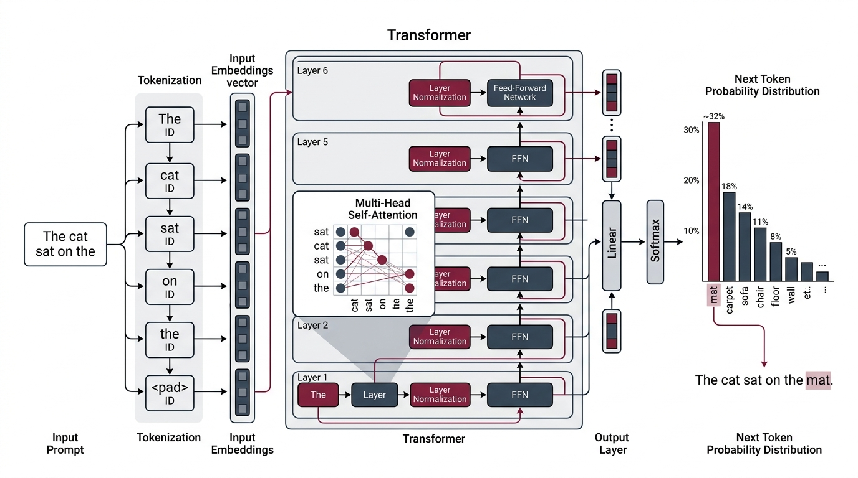
1. INTRODUCTION & FOUNDATIONS
What is a Large Language Model?
Autoregressive token predictor with frozen neural parameters
TRANSFORMER PIPELINE
01 | NEXT-TOKEN PREDICTION
Autoregressive Sampling
• Predicts probability distribution P(wt | w<t)
• Generates strictly left to right, token by token
02 | FROZEN INFERENCE
Static Neural Parameters
• Weights remain fixed during runtime
• Zero dynamic ground truth without external tools
03 | REASONING CASCADE
Sequential Vulnerability
• A step-two logic slip corrupts all downstream tokens
• No native backtracking or internal verification
Core Principle: LLMs predict probable tokens with frozen weights. They cannot independently verify their own reasoning.
Large Language Models Cannot Self-Correct Reasoning Yet | ICLR 2024
01/01
Notes:
To understand why self-correction fails, look at the architecture on the left. An LLM tokenizes input text, routes it through multi-head self-attention layers, and samples the next token from a probability distribution. Notice the three pillars on the right: generation is autoregressive, parameters are completely frozen at runtime, and multi-step reasoning is strictly sequential. When a model makes a mistake in an intermediate step, it has no native backtracking mechanism. Asking a frozen model to verify itself cannot produce new truth signals.

